Slide 1
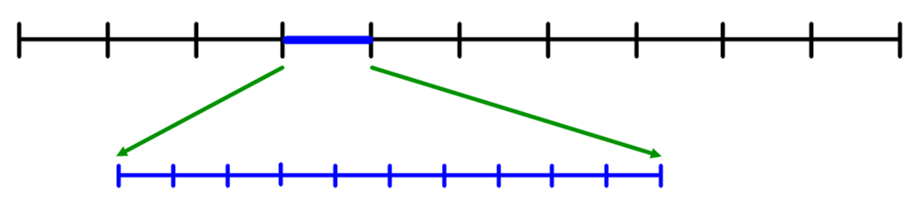
If the two arrows represent the integers 2 and 3…

Slide 3
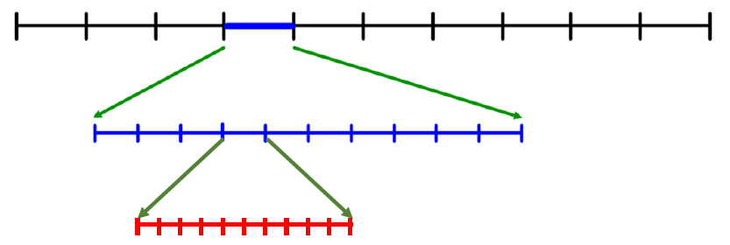
If the two arrows represent the integers 120 and 130…

Slide 5
Practise each question on your templates with your chosen numbers.
Check with your partner that you are correct.
Are you sure?
How do you know?
Only write answers on your worksheet when you are certain you are correct.

Slide 6
What do you think 0.7 < 0.76 < 0.8 means?
Show that 0.7 < 0.76 < 0.8 on your template.

Slide 7
What do you think 0.7 < 0.76 < 0.8 means?
Write a similar inequality for different end points.

Slide 8
Show that 0.7 < 0.76 < 0.764 on your template
Write a similar inequality for different end points.

