Slide 1
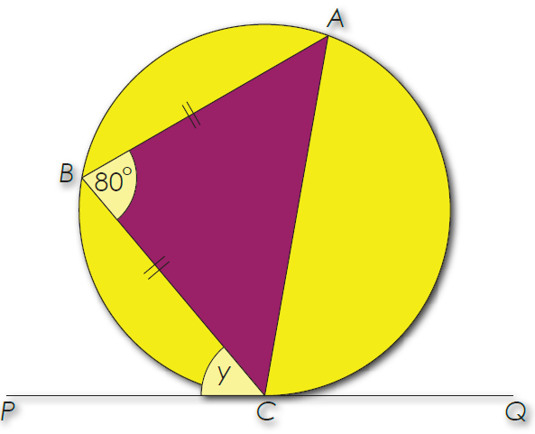




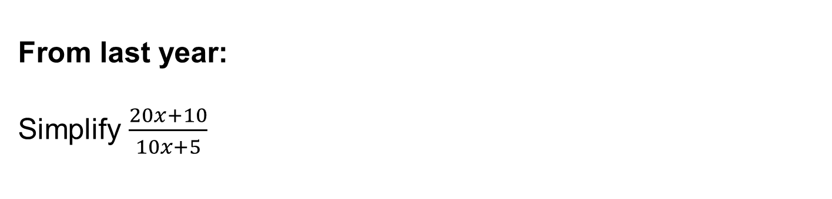

From Spring 1
Convert $16m^{2}$ to ${cm}^{2}$
$$3$$
$$2$$
$$1$$
From last term:
Work out angle $y$ and give reasons.
From last year:
Simplify $\frac{20x+10}{10x+5}$
Notes:
Timed spaced retrieval – non calculator

Slide 2
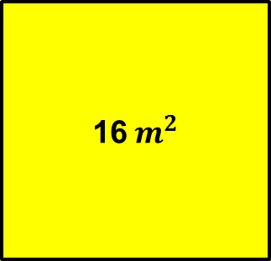


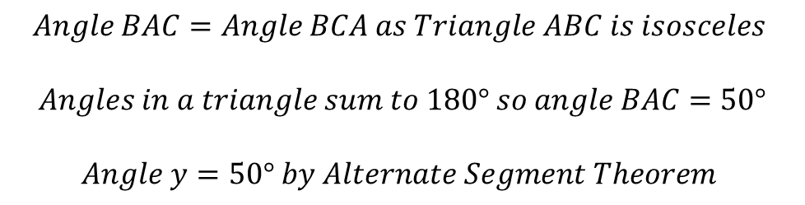



Mark your work
16${ m}^{2}$
$$4 m$$
$$16 m^{2}=400×400=160000 {cm}^{2}$$
$$400 cm$$
$$4 m$$
$$×{100}^{2}$$
$$400 cm$$
$$Angle BAC=Angle BCA as Triangle ABC is isosceles$$
$$Angles in a triangle sum to 180° so angle BAC=50°$$
$$Angle y=50° by Alternate Segment Theorem$$

Slide 3

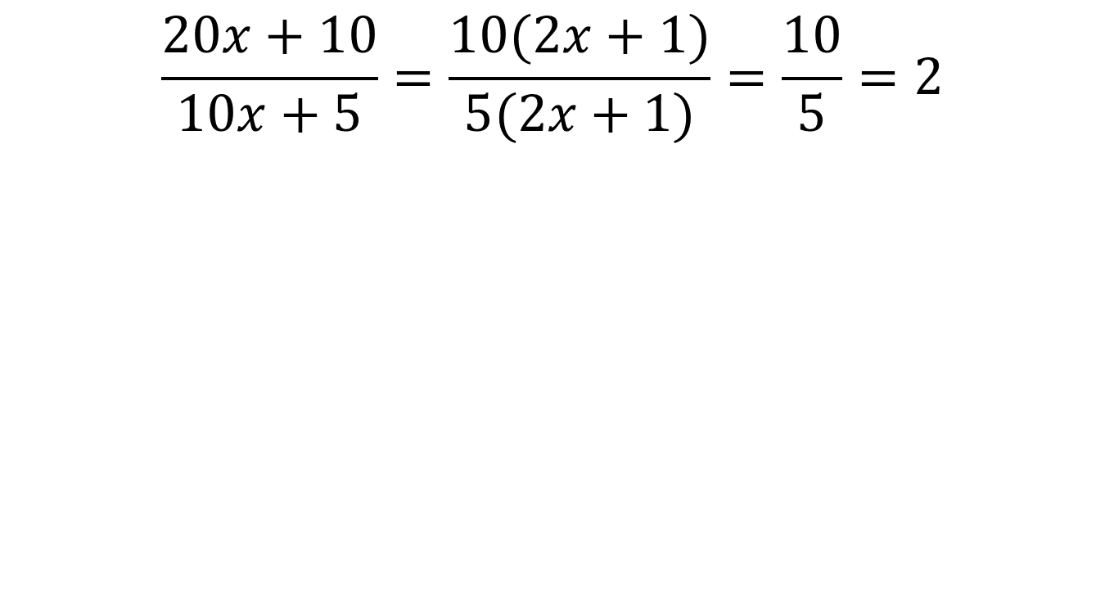
Mark your work
$$\frac{20x+10}{10x+5}=\frac{10(2x+1)}{5(2x+1)}=\frac{10}{5}=2$$
$$Factorise$$

Slide 4
The height of a person
The weight of a dog
The number of students in a class
The result of rolling a dice
Time taken to run 5K
The temperature
The number of apples in an orchard
The pressure exerted by an elephant
The circumference of a circle
The amount of money in a savings account
Shoe size
The number of viewers of a TV show
These cards represent two different types of data.
In pairs put these cards into two groups.
Notes:
Don’t mention discrete/continuous straight away
Discuss students ideas

Slide 5
The height of a person
The weight of a dog
The number of students in a class
The result of rolling a dice
Time taken to run 5K
The temperature
The number of apples in an orchard
The pressure exerted by an elephant
The circumference of a circle
The amount of money in a savings account
Shoe size
The number of viewers of a TV show
Discrete data can only take certain values.
Continuous data can take any value (within a range).
Which data is discrete? Which data is continuous?
Notes:
Don’t mention discrete/continuous straight away
Discuss students ideas

Slide 6
The height of a person
Continuous
The weight of a dog
Continuous
The number of students in a class
Discrete
The result of rolling a dice
Discrete
Time taken to run 5K
Continuous
The temperature
Continuous
The number of apples in an orchard
Discrete
The pressure exerted by an elephant
Continuous
The circumference of a circle
Continuous
The amount of money in a savings account
Discrete
Shoe size
Discrete
The number of viewers of a TV show
Discrete
Discrete data can only take certain values.
Continuous data can take any value (within a range).
Notes:
Shoe size is discrete but actual foot length is continuous

Slide 7

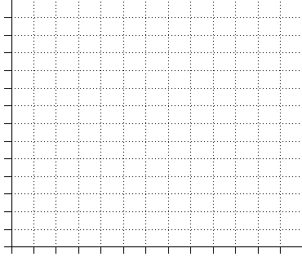









The hours of sunshine each month in the UK is shown in the table:
Jan | Feb | Mar | Apr | May | Jun | Jul | Aug | Sep | Oct | Nov | Dec
19 | 24 | 37 | 55 | 59 | 62 | 68 | 70 | 59 | 48 | 35 | 26
$$70$$
$$60$$
A line graph can be drawn to show how the number of hours sunshine changes as a year passes.
$$50$$
$$40$$
$$Hours$$
$$30$$
$$20$$
$$10$$
Jan
Feb
Mar
Apr
May
Jun
Jul
Aug
Sep
Oct
Nov
Dec
$$Month$$

Slide 8
The hours of sunshine each month in the UK is shown in the table:
Jan | Feb | Mar | Apr | May | Jun | Jul | Aug | Sep | Oct | Nov | Dec
19 | 24 | 37 | 55 | 59 | 62 | 68 | 70 | 59 | 48 | 35 | 26
$$70$$
$$60$$
This line graph is an example of a
time series graph.
It can be drawn for discrete or continuous data and shows how data changes over time.
$$50$$
$$40$$
$$Hours$$
$$30$$
$$20$$
$$10$$
Jan
Feb
Mar
Apr
May
Jun
Jul
Aug
Sep
Oct
Nov
Dec
$$Month$$

Slide 9
Decide which of the following descriptions you would draw a time series graph for.
The annual average temperature in the UK from 2008 to 2018.
The number of sweets in 5000 bags produced by Haribo
The quarterly sales profit for a clothes shop for the year 2018
The heights of children in particular school.
The daily food consumption of a family over a week
The birth rate in Scotland from 1900 to 2000.

Slide 10

Decide which of the following descriptions you would draw a time series graph for.
The annual average temperature in the UK from 2008 to 2018.
The number of sweets in 5000 bags produced by Haribo
The quarterly sales profit for a clothes shop for the year 2018
The heights of children in particular school.
The daily food consumption of a family over a week
The birth rate in Scotland from 1900 to 2000.

Slide 11
Title: Time Series Graphs
A time series graph can show trends in the data as well as each individual values of the data.
In your books:
Ben’s quarterly gas bills over a period of two years are shown in the table
Plot the data on a graph and comment on any pattern in the data.
 | Jan-Mar | Apr-Jun | Jul-Sep | Oct-Dec
2017 | £65 | £38 | £24 | £60
2018 | £68 | £42 | £30 | £68

Slide 12
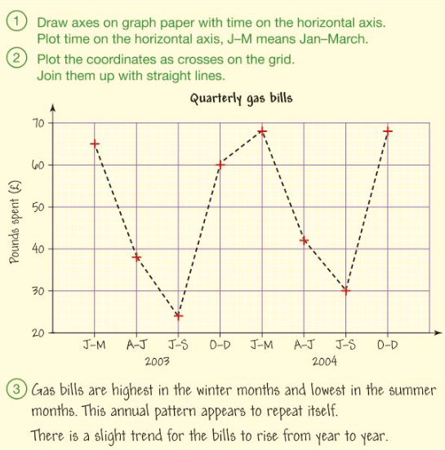
Mark your work

Slide 13
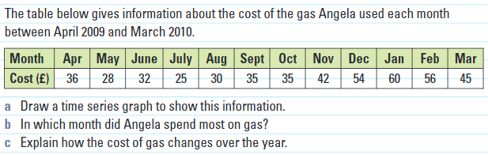
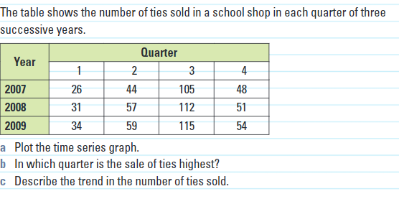


Consolidation
$$1.$$
$$2.$$

Slide 14
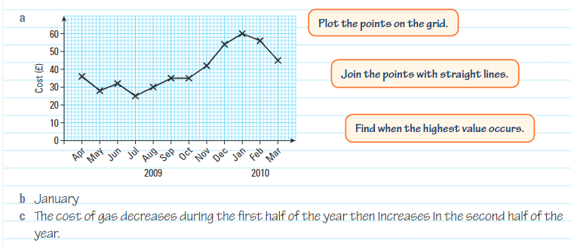
Mark your work

Slide 15
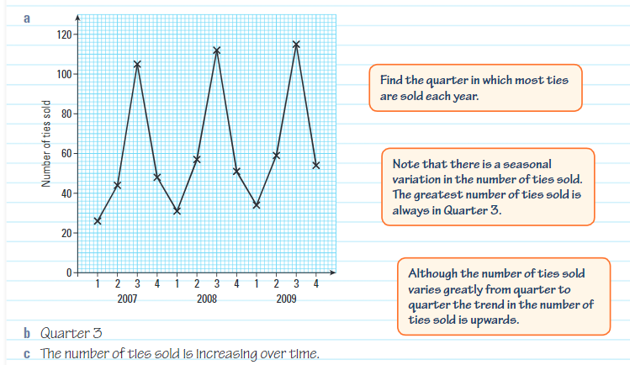
Mark your work

