Slide 1
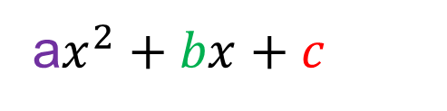
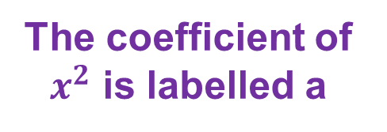
Here is a quadratic expression:
a$x^{2}+bx+c$
The coefficient of $x^{2}$ is labelled a
The constant value is labelled c
The coefficient of x is
labelled b

Slide 2






Discuss: Which of these expressions are quadratic expressions?
How do you know?
$$x^{2}+7$$
$$\sqrt{x}+7x$$
$$4x^{2}−1>0$$
$${3x}^{2}+7x^{3}+x$$
$$x^{2}+7x−9=0$$
$${3x}^{2}+7x+1$$

Slide 3
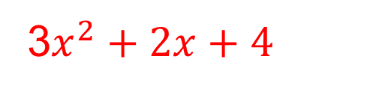
What is the value of c in this expression?
3$x^{2}+2x+4$
3
2
4

Slide 4
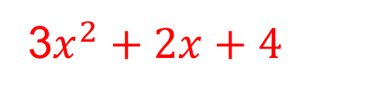
What is the value of b in this expression?
3$x^{2}+2x+4$
3
2
4

Slide 5
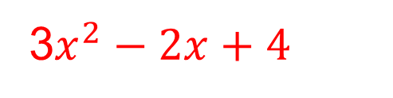
What is the value of b in this expression?
3$x^{2}−2x+4$
2
-2
3

Slide 6
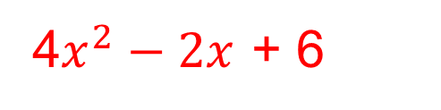
What is the value of a in this expression?
4$x^{2}−2x$ + 6
6
-2
4

Slide 7
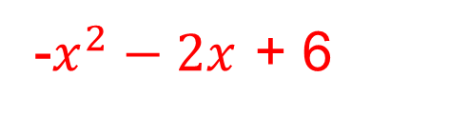
What is the value of a in this expression?
-$x^{2}−2x$ + 6
-1
0
1

Slide 8

What is the value of b in this expression?
$$2x −3x^{2}+ 6$$
-3
2
3

Slide 9
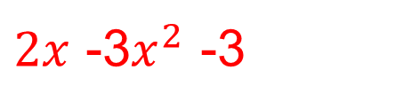
What is the value of c in this expression?
$2x$ -3$x^{2}$ -3
-3
2
3

Slide 10
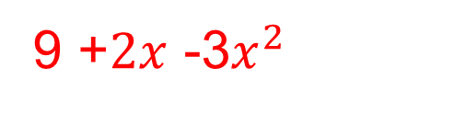
What is the value of a in this expression?
9 +$2x$ -3$x^{2}$
-3
2
3

Slide 11

Which of these expressions are quadratic equation?
$$x^{2}+7$$
$$\sqrt{x}+7x$$
$$4x^{2}−1>0$$
$${3x}^{2}+7x^{3}+x$$
$$x^{2}+7x−9=0$$
$${3x}^{2}+7x+1$$

Slide 12
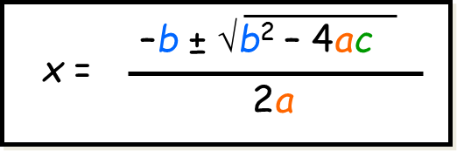
This is the Quadratic Formula:
It solves equations in the form ${ax}^{2}+bx+c=0$

Slide 13
Memory Game
You will have 10 seconds to look at the quadratic equation
You have to try and recreate as much of it as possible after this time has passed.

Slide 14
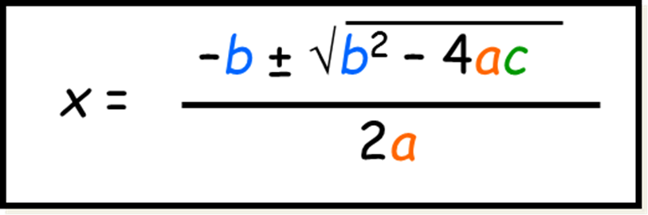
The Quadratic Formula

Slide 15
Example: Use the quadratic formula to solve $2x2 + 5x – 1 = 0$
2x² + 5x – 1 = 0
–b ± √b² – 4ac
x =
2a
–5 ± √5² – (4 × 2 × –1)
SUBSTITUTE
x =
2 × 2
SIMPLIFY
–5 ± √25 + 8
x =
4
–5 + √33
–5 – √33
SPLIT
x =
or
x =
4
4
SOLVE
x = 0.186
x = –2.686 (to 3 d.p.)

Slide 16
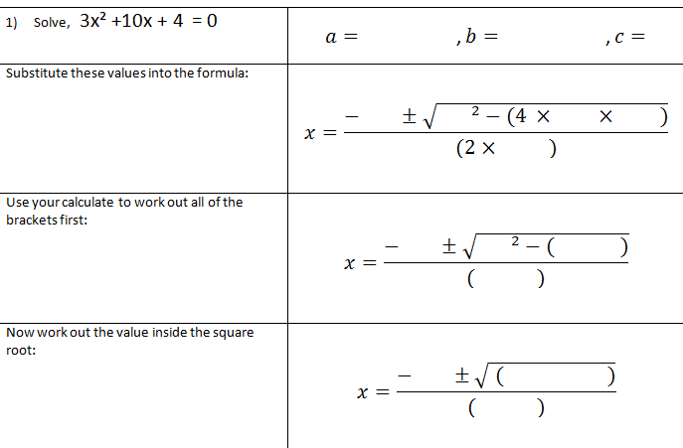
Your turn: Fill in the blanks

Slide 17
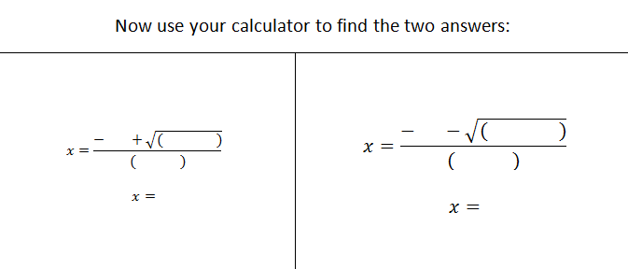
Notes:
Acknowledgements:
Openmiddle.com
M Booth
UEA

Slide 18
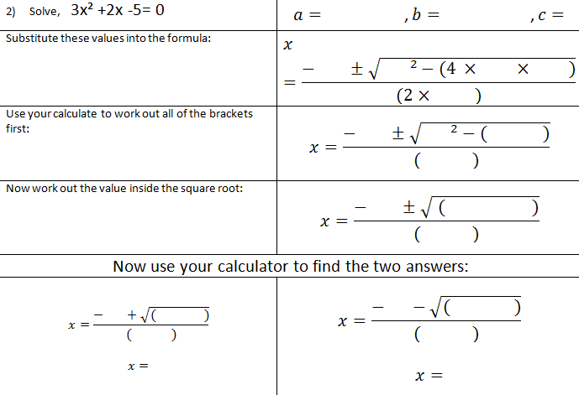

Slide 19
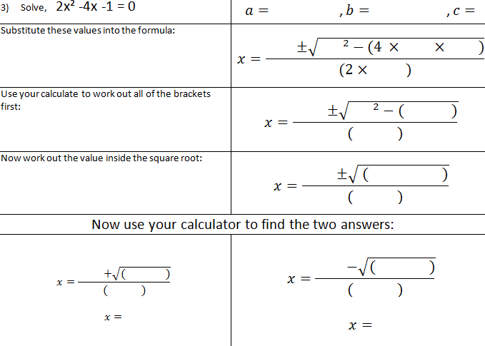

Slide 20
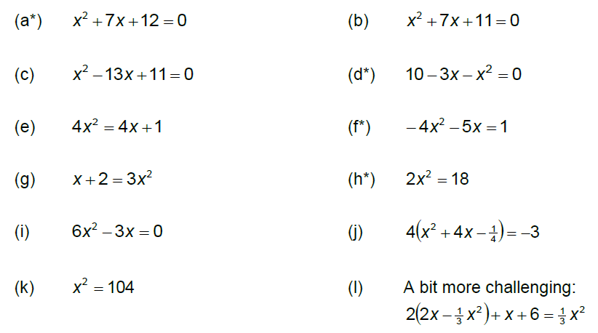
In your books: Solve the following to 2 decimal places.
* Questions can also be solved by factorising

Slide 21
Mark your work
x = -3 and -4
x = -2.38 and -4.62
x = 12.09 and 0.91
x = -5 and 2
x = -0.21 and 1.21
x = -0.25 and -1
x = 1 and -0.67
x = 3 and -3
x = 0.50 and x = 0
x = -3.87 and -0.13
x = -10.20 and 10.20
x = 2 and 3

Slide 22
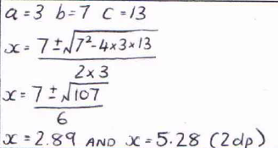
Can you spot the common mistake?

Slide 23
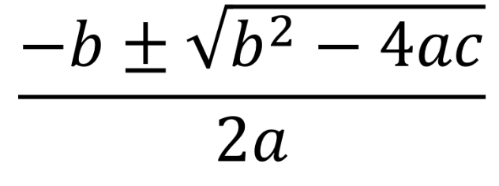
Challenge
Using the digits 1 to 9, at most once each for a, b and c, find the results with the greatest and least value
Notes:
Assuming the solution can be negative, the greatest value would occur when a=2, b=9, and c=1 (solution = -0.11). The least value, found by Robert Hays, would occur when a=1, b=9, c=2 (solution = -8.77)

