Slide 1


$$B:G=1:4$$
Write down an equivalent ratio
and another…
and another…
Notes:
From http://educatingmrmattock.blogspot.co.uk/2015/12/ratios-fractions-and-linear-functions.html
Fraction of whole

Slide 2



$$B:G=1:4$$
$$B:G=2:8$$
$$B:G=3:12$$

Slide 3
$$B:G=1:4$$
Write down a fraction equivalent to $\frac{B}{G}$
and another…
and another…
Notes:
From http://educatingmrmattock.blogspot.co.uk/2015/12/ratios-fractions-and-linear-functions.html
Fraction of whole

Slide 4


$$B:G=2:3$$
Write down an equivalent ratio
And another…
And another…
Notes:
Emphasis that B only equals 2 when G equals 3

Slide 5

$$B:G=2:3$$
$$Write down a fraction equivalent to \frac{B}{G}$$
And another…
And another…
Notes:
Emphasis that B only equals 2 when G equals 3

Slide 6
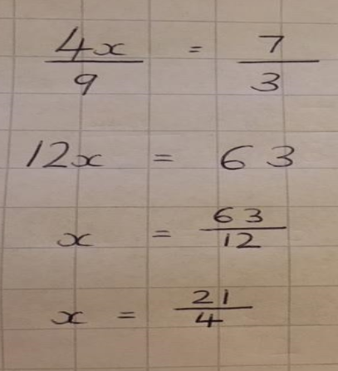
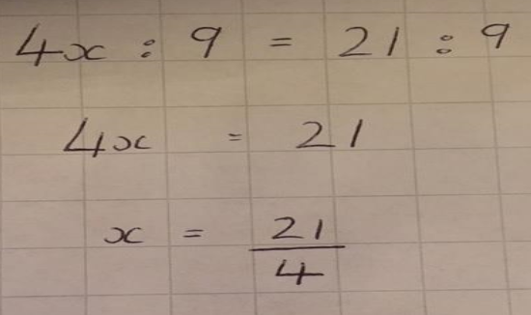
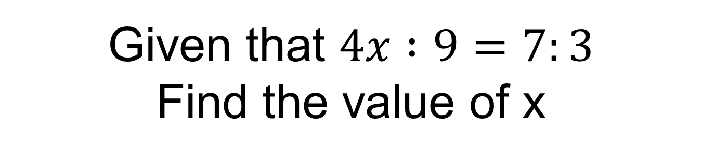
Given that $4x :9=7:3$
Find the value of x
METHOD 1
METHOD 2
In pairs describe how to go from one line of working to the next.
Notes:
Emphasise that 4x does not equal 7

Slide 7
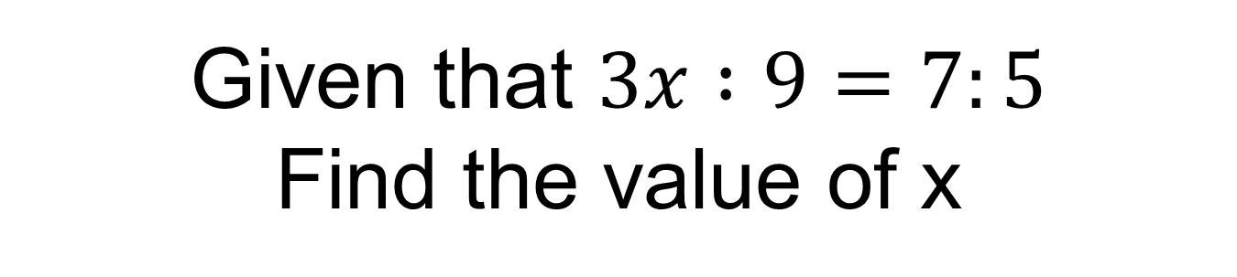
Given that $3x :9=7:5$
Find the value of x
Notes:
On mini whiteboards
X = 21/5

Slide 8

Given that $x :9=4:x$
Find the positive value of x
Notes:
X = 6

Slide 9
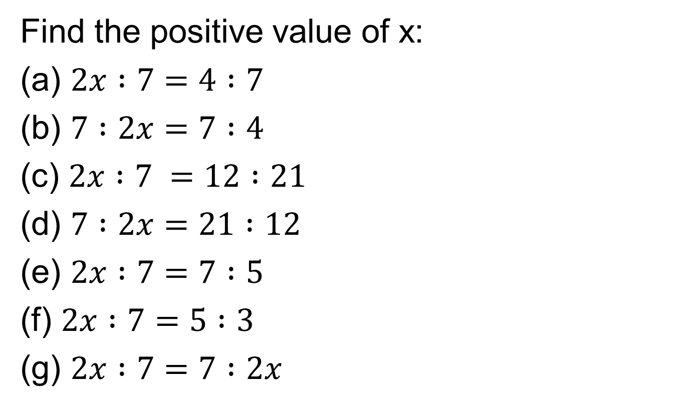
In your books…
Find the positive value of x:
(a) $2x :7=4 :7$
(b) $7 :2x=7 :4$
(c) $2x :7 =12 :21$
(d) $7 :2x=21 :12$
(e) $2x :7=7 :5$
(f) $2x :7=5 :3$
(g) $2x :7=7 :2x$

Slide 10
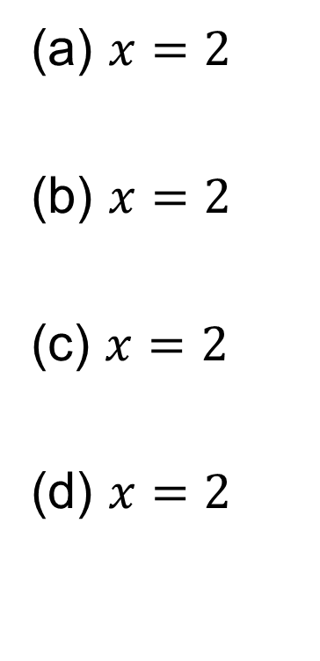
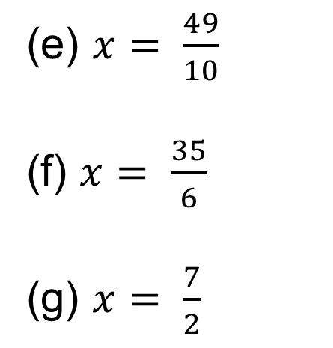
Mark your work
(a) $x=2$
(b) $x=2$
(c) $x=2$
(d) $x=2$
(e) $x= \frac{49}{10}$
(f) $x= \frac{35}{6}$
(g) $x= \frac{7}{2}$

Slide 11
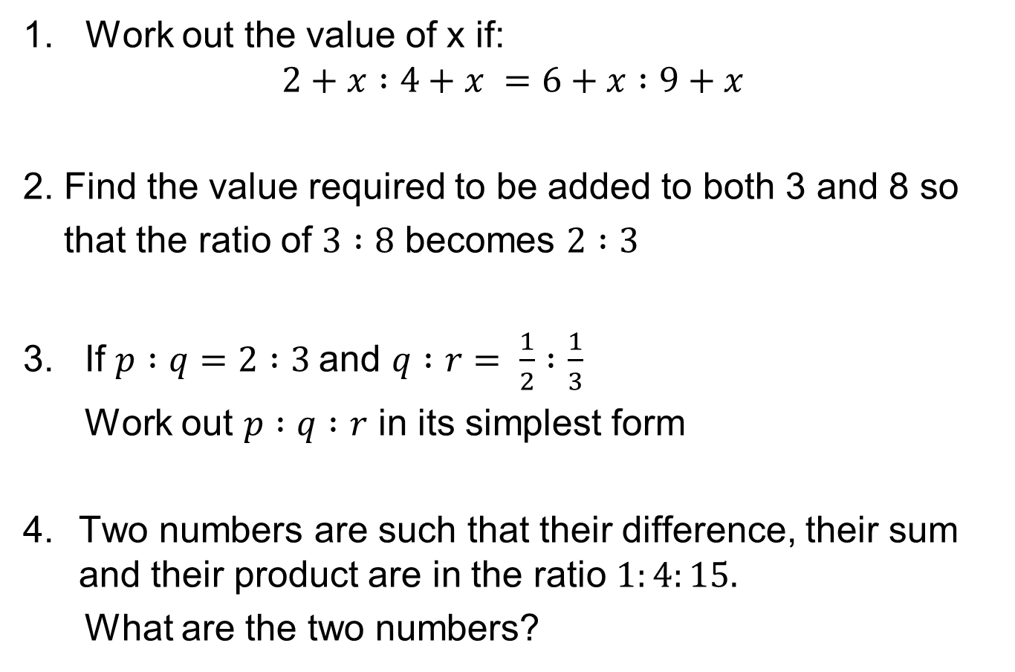
Challenge
Work out the value of x if:
$$2+x :4+x =6+x :9+x$$
2. Find the value required to be added to both 3 and 8 so
that the ratio of $3 :8$ becomes $2 :3$
3. If $p :q=2 :3$and $q :r= \frac{1}{2} :\frac{1}{3}$
Work out $p :q :r$ in its simplest form
Two numbers are such that their difference, their sum and their product are in the ratio $1:4:15.$
What are the two numbers?
Notes:
7

Slide 12
Challenge Answers
6
7
2:3:2
6 and 10

