Slide 1

Linear Sequences Revision
3
6
9
12
15
8
11
14
17
20
+3
+3
+3
+3
These are called the first differences
This sequence is the three times table add five
3n
+ 5

Slide 2
On your whiteboards
What is the n^{th} term?
2
4
6
8
10
8
10
12
14
16
+2
+2
+2
+2
2n
+ 6

Slide 3
On your whiteboards
What is the n^{th} term?
10
20
30
40
50
8
18
28
38
48
+10
+10
+10
+10
10n
- 2

Slide 4
On your whiteboards
What is the n^{th} term?
-10
-20
-30
-40
-50
8
-2
-12
-22
-32
-10
-10
-10
-10
-10n
+ 18

Slide 5
On your whiteboards
What is the same?
What is different?
What is the n^{th} term?
1
4
9
16
25
These are called the first differences
+3
+5
+7
+9
These are called the second differences
+2
+2
+2

Slide 6
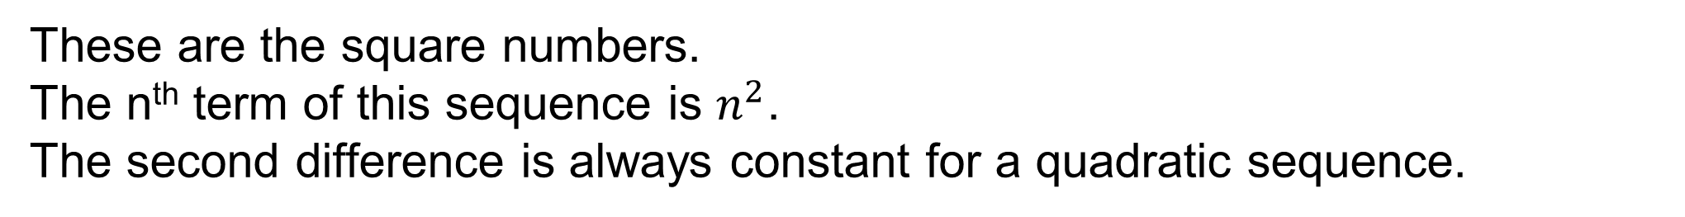
On your whiteboards
These are the square numbers.
The n^{th} term of this sequence is $n^{2}$.
The second difference is always constant for a quadratic sequence.
1
4
9
16
25
+3
+5
+7
+9
+2
+2
+2

Slide 7
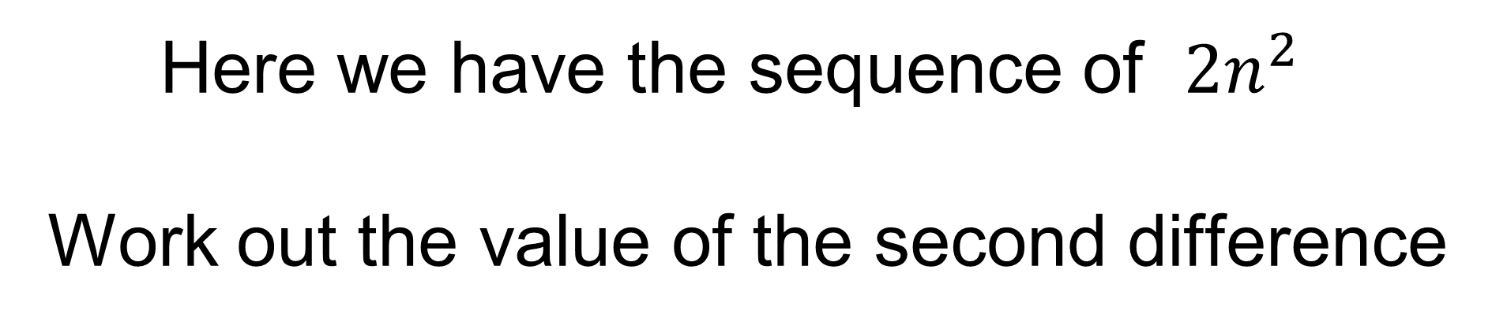
On your whiteboards
Here we have the sequence of ${2n}^{2}$
Work out the value of the second difference
2
8
18
32
50
+6
+10
+14
+18
+4
+4
+4

Slide 8
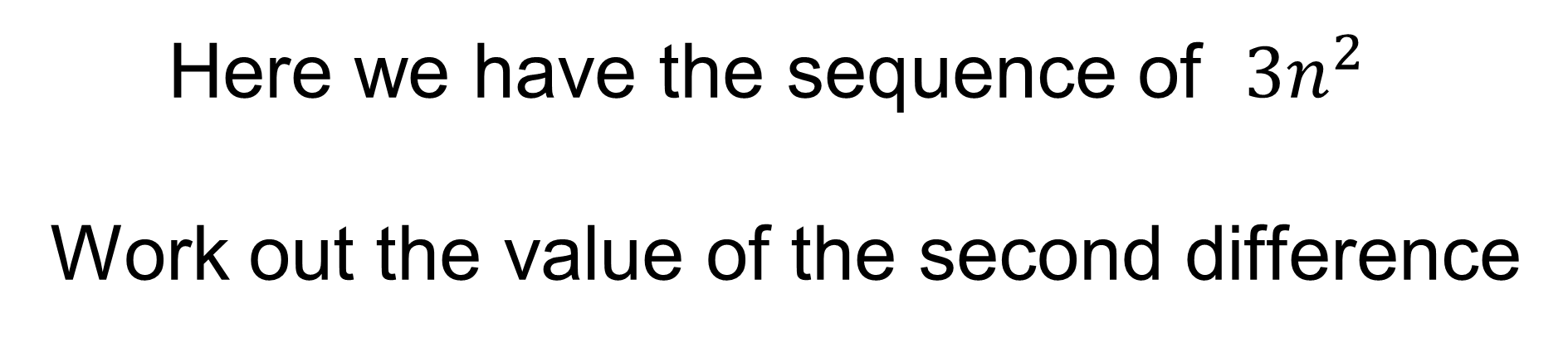
On your whiteboards
Here we have the sequence of ${3n}^{2}$
Work out the value of the second difference
3
12
27
48
75
+9
+15
+21
+27
+6
+6
+6

Slide 9
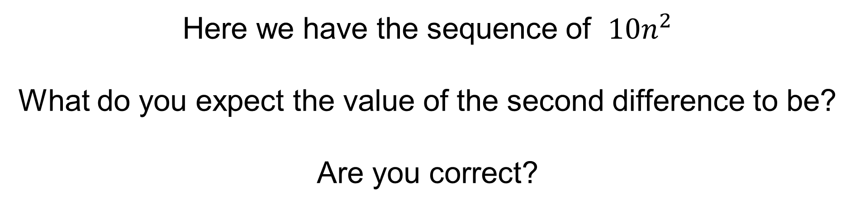
On your whiteboards
Here we have the sequence of ${10n}^{2}$
What do you expect the value of the second difference to be?
Are you correct?
10
40
90
160
250
+30
+50
+70
+90
+20
+20
+20

Slide 10
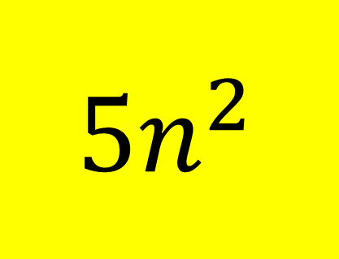
On your whiteboards
$${ 5n}^{2}$$
What is the nth term?
5
20
45
80
125
+15
+25
+35
+45
+10
+10
+10

Slide 11
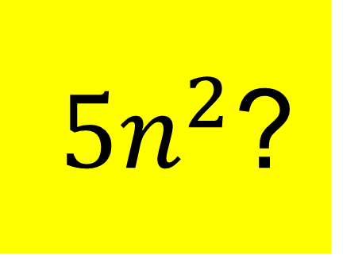
On your whiteboards
${ 5n}^{2}$?
What is the nth term?
7
22
47
82
127
+15
+25
+35
+45
+10
+10
+10

Slide 12
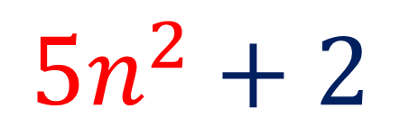
On your whiteboards
What is the nth term?
5
20
45
80
125
7
22
47
82
127
$${5n}^{2}+2$$

Slide 13
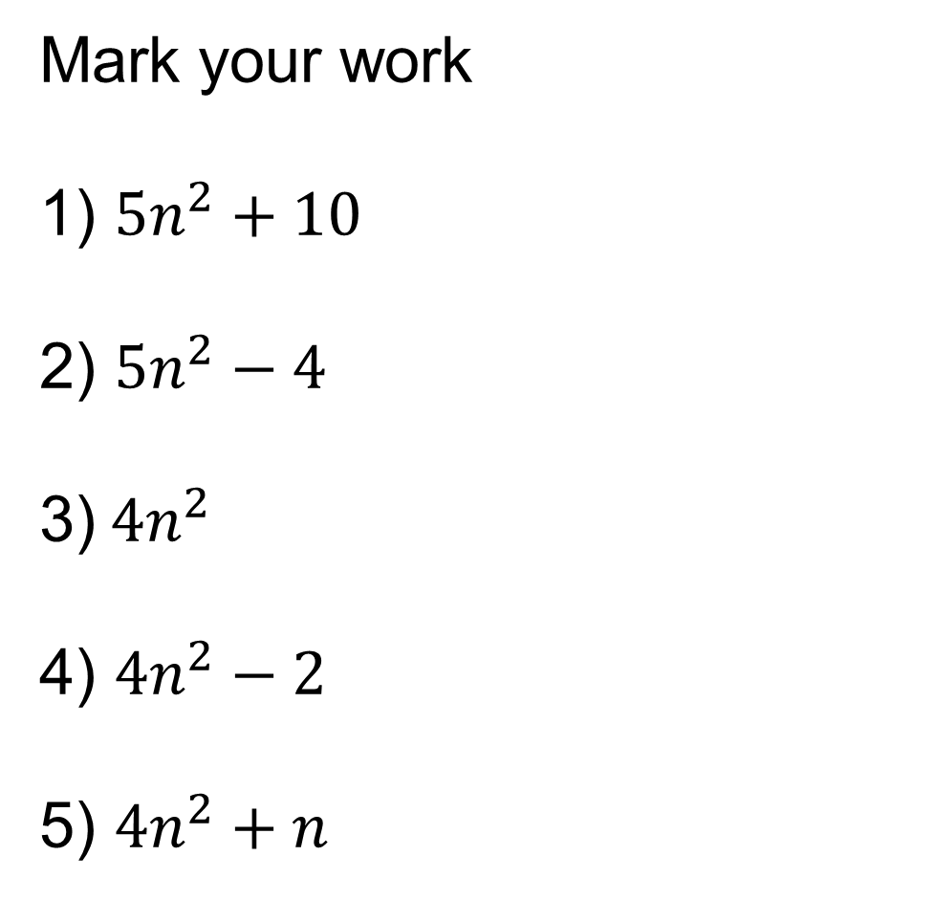
Finding the nth term of a quadratic sequence
Mark your work
1) ${5n}^{2}+10$
2) ${5n}^{2}−4$
3)${ 4n}^{2}$
4) ${4n}^{2}−2$
5) ${4n}^{2}+n$
In your books:
15, 30, 55, 90, 135…
1, 16, 41, 76, 121…
3) 4, 16, 36, 64, 100…
4) 2, 14, 34, 62, 98…
5) 5, 18, 39, 68, 105…

Slide 14
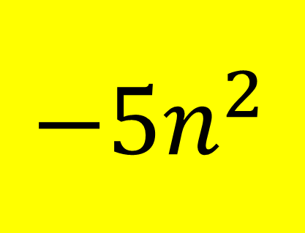
On your whiteboards
$${ −5n}^{2}$$
What is the nth term?
-5
-20
-45
-80
-125
-15
-25
-35
-45
-10
-10
-10

Slide 15
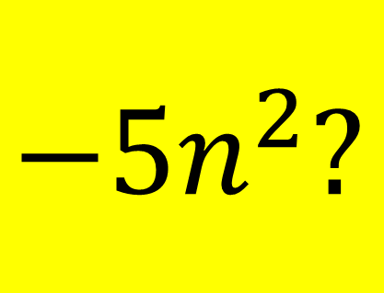
On your whiteboards
$${ −5n}^{2}?$$
What is the nth term?
0
-15
-40
-75
-120
-15
-25
-35
-45
-10
-10
-10

Slide 16
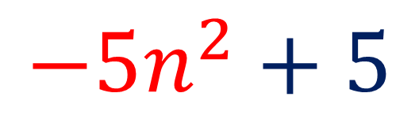
On your whiteboards
What is the nth term?
-5
-20
-45
-80
-125
0
-15
-40
-75
-120
$${−5n}^{2}+5$$

Slide 17
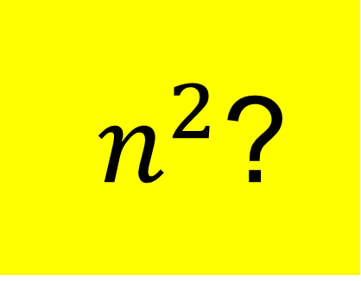
On your whiteboards
${ n}^{2}$?
What is the nth term?
3
7
13
21
31
+4
+6
+8
+10
+2
+2
+2

Slide 18
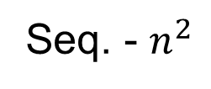
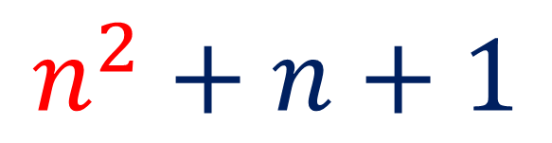
On your whiteboards
What is the nth term?
1
4
9
16
25
3
7
13
21
31
Seq. - $n^{2}$
2
3
4
5
6
$$n^{2}+n+1$$

Slide 19
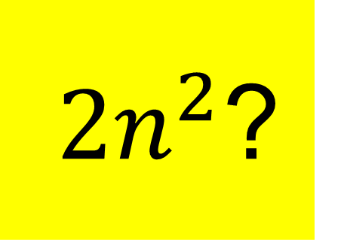
On your whiteboards
${ 2n}^{2}$?
What is the nth term?
3
10
21
36
55
+7
+11
+15
+19
+4
+4
+4

Slide 20
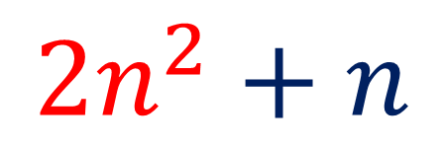
On your whiteboards
What is the nth term?
2
8
18
32
50
3
10
21
36
55
Seq. - $n^{2}$
1
2
3
4
5
$${2n}^{2}+n$$

Slide 21
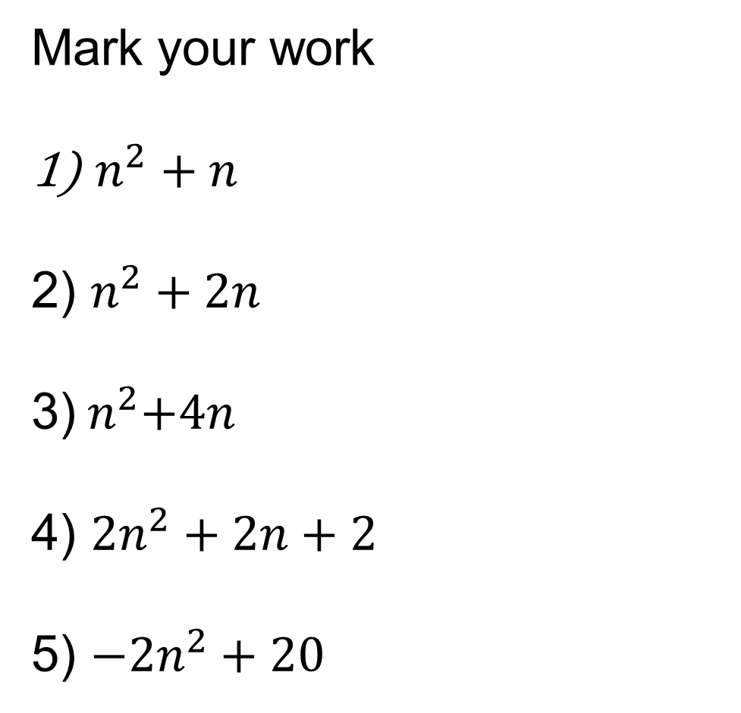
Finding the nth term of a quadratic sequence
Mark your work
$n^{2}+n$
2) $n^{2}+2n$
3)${ n}^{2}+4n$
4) ${2n}^{2}+2n+2$
5) ${−2n}^{2}+20$
In your books:
2, 6, 12, 20…
3, 8, 15, 24…
3) 5, 12, 21, 32…
4) 6, 14, 26, 42…
5) 18, 12, 2, -12…

Slide 22

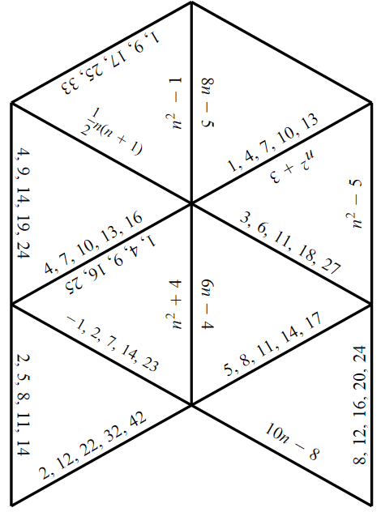
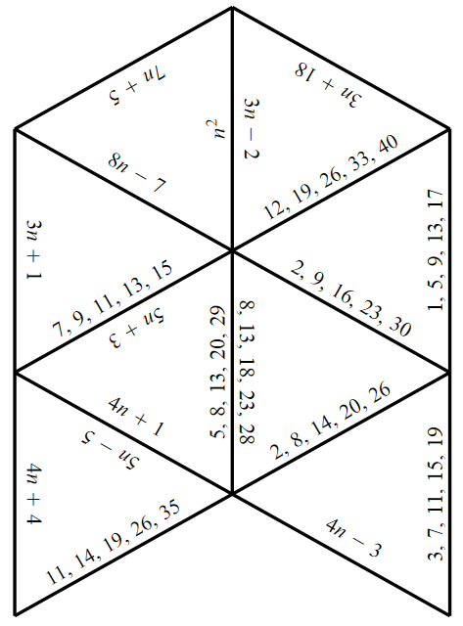
Quadratic Sequences - Extension

Slide 23
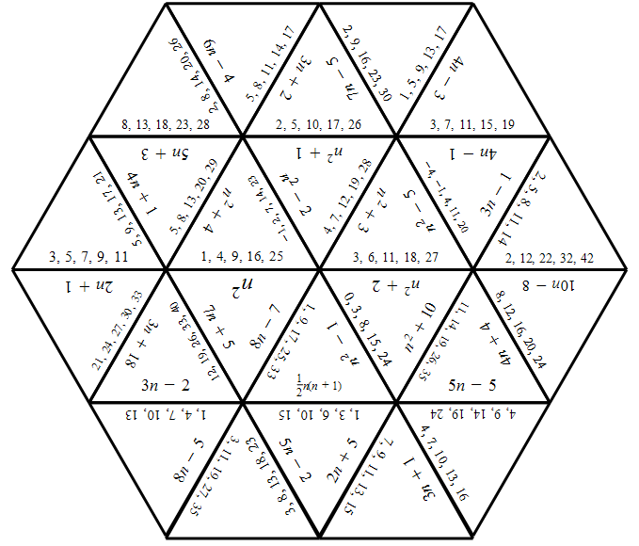
Quadratic Sequences - Solution

