Slide 1
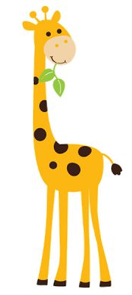
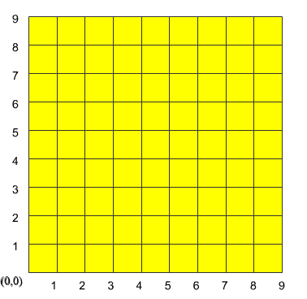
Can you locate the lost giraffe?
The Giraffe is lost in a modern city, where the roads are all at right angles and equally spaced.
Imagine the grid lines represent roads. The giraffe is at a crossroads and needs to be rescued.
Click here to try.

Slide 2
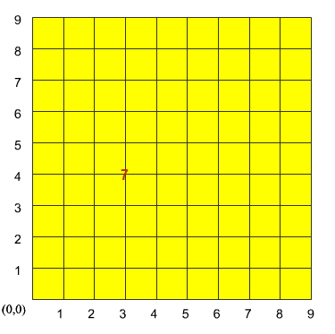
Can you locate the lost giraffe?
This time you have guessed that the giraffe is at (3,4).
This is a distance of 7 away from the giraffe.
Where are all the possible positions of the giraffe?

Slide 3
Can you locate the lost giraffe?
In pairs using your grids:
Take it in turns to choose where the giraffe is and give the distances.
Keep score of the number of guesses your partner needed to find the giraffe.
The one with the lowest total wins.

Slide 4
Can you locate the lost giraffe?
What strategies did you use to locate the giraffe in the lowest number of moves?

Slide 5
Can you locate the lost giraffe?
Have one more game to try and minimise your moves using the strategies discussed.

Slide 6
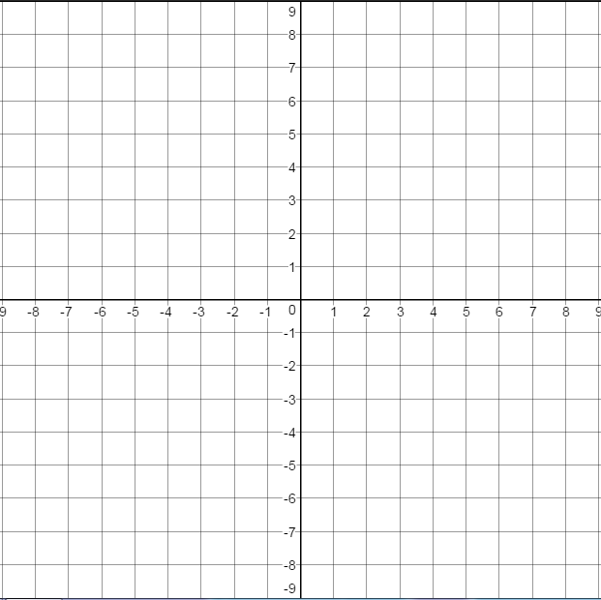
Challenge
Player 1:
Choose a coordinate for the giraffe outside the red box.
Player 2:
You can only guess inside the red box. You are allowed one guess outside the box. If you are incorrect you lose.

Slide 7
