Slide 1
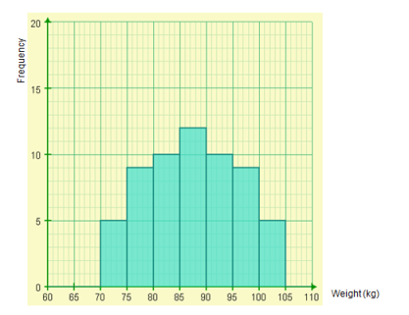
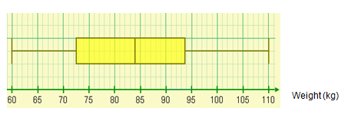
The diagrams represent groups of competitors from 6 different sports.
In pairs, group the cards into the different sports.
Three of the cards are deliberately blank, these will need to be completed by looking at the other cards.
Notes:
Acknowledgements : NCETM, Adam Briggs

Slide 2
The sports represented are:
Weightlifting
Shooting
Sprinting
Gymnastics
Synchronised Swimming
Boxing
Which graph set belongs to which sport?
Notes:
5 mins

Slide 3
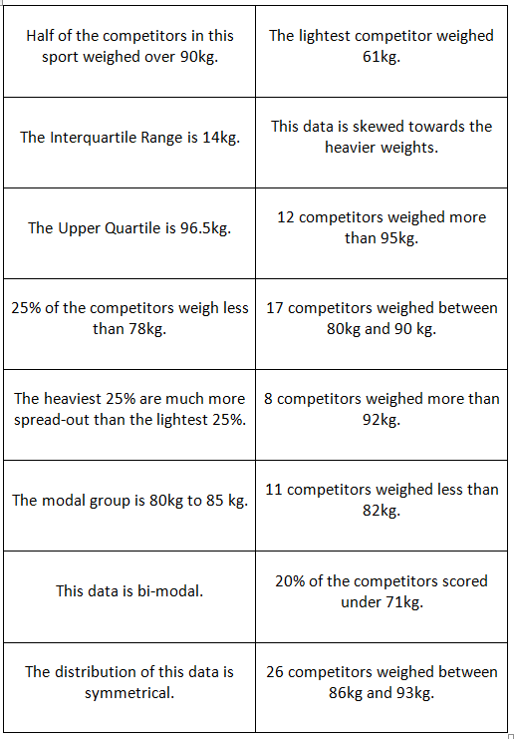
Match each statement to a Sport.
Ensure you fully justify your answer

