Slide 1
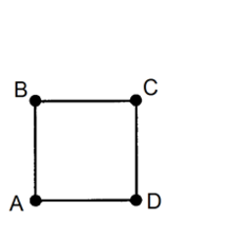
On your grids:
Draw a square (any size).
Label its coordinates like this:
Write down your coordinates
A =
B =
C =
D =

Slide 2
What do you notice about the coordinates we have shared on the board?
What do they all have in common?
Write down four coordinates that make a square using the rules you have found.
Check that it works by drawing on your grid.
If it doesn’t work, what have you done wrong? Have you missed something?

Slide 3
Which set of coordinates don’t make a square?
How do you know? Find the mistake and correct it.
A = (2, 2)
B = (2, 4)
C = (4, 4)
D = (4, 2)
A = (2, 2)
B = (2, 5)
C = (5, 5)
D = (5, 2)
A = (1, 2)
B = (1, 4)
C = (4, 4)
D = (4, 2)
A = (1, 5)
B = (1, 6)
C = (2, 6)
D = (2, 5)

Slide 4
Here are someone’s coordinates.
A = (2, 3)
B = (2, 5)
C = (4, 5)
D = (4, 3)
What is the length of each side of their square?
How do you know?

Slide 5
Here are someone else’s coordinates.
A = (2, 0)
B = (2, 3)
C = (5, 3)
They forgot to write down the coordinate of D.
What is it?
How do you know?

Slide 6
Turn over your plastic wallets so that you have the 4 quadrant grid:
Draw a square (any size). At least two of the vertices must be in different quadrants.
Label its coordinates like this:
Write down your coordinates
A =
B =
C =
D =

Slide 7
Do the coordinates follow the same rules as before?

Slide 8
Do these coordinates make squares?
If they don’t, explain how you know.
A = (-2, 0)
B = (-2, 3)
C = (1, 3)
D = (1, 0)
A = (-2, 2)
B = (-2, 5)
C = (5, 5)
D = (5, 2)
A = (-1, 3)
B = (-1, 4)
C = (4, 4)
D = (4, 3)
A = (1, -3)
B = (1, -2)
C = (2, -2)
D = (2, -4)

Slide 9
Write down 4 coordinates that appear on the 4 quadrant grid that make a square with an area of 9 squares.
What did you have to think about?
A different square has an area of 16 squares.
What could its coordinates be?

Slide 10
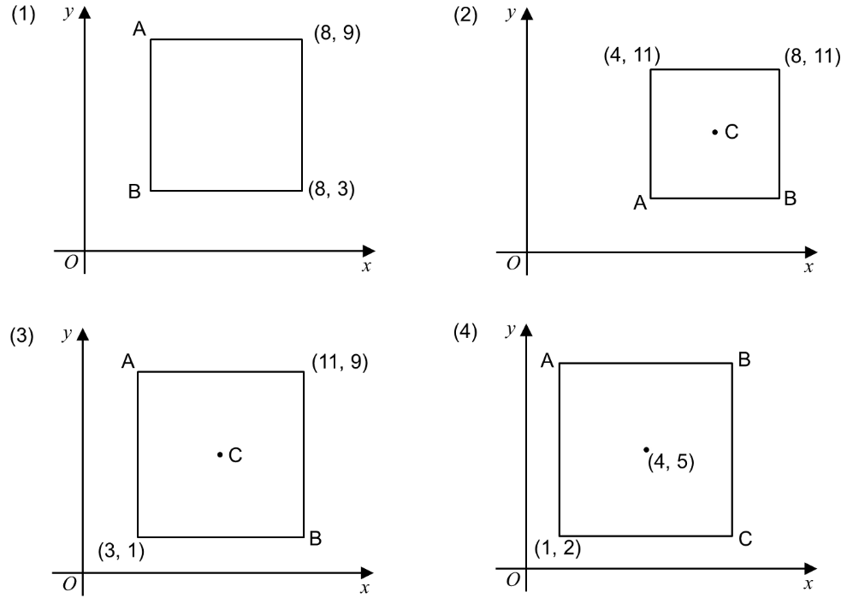
Challenge: Find the missing coordinates for these squares.

Slide 11
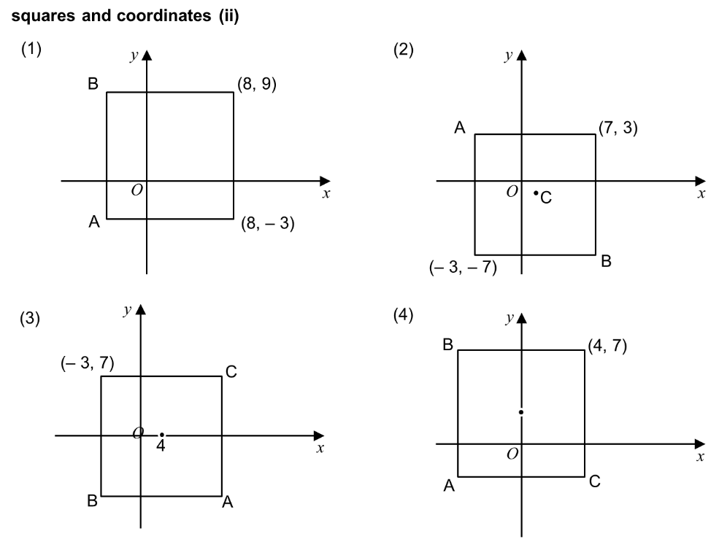
Challenge 2: Find the missing coordinates for these squares.

