Slide 1
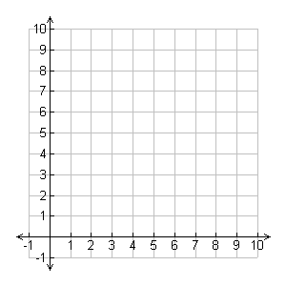
Plot the coordinates and join them up.
(1 , 1)
(1 , 3)
(3 , 3)
(3 , 1)
You should have a square.
What is its area?

Slide 2
Now multiply all the coordinates by 2
(1 , 1)
(1 , 3)
(3 , 3)
(3 , 1)
What can you say about the new shape?

Slide 3
The square has been enlarged by scale factor 2
What do you understand by the term scale factor?

Slide 4
The square has been enlarged by scale factor 2
What is the area of the new shape?
How does this relate to the area of the original shape?

Slide 5
We can show that the area is four times as big because the original shape fits inside four times.

Slide 6
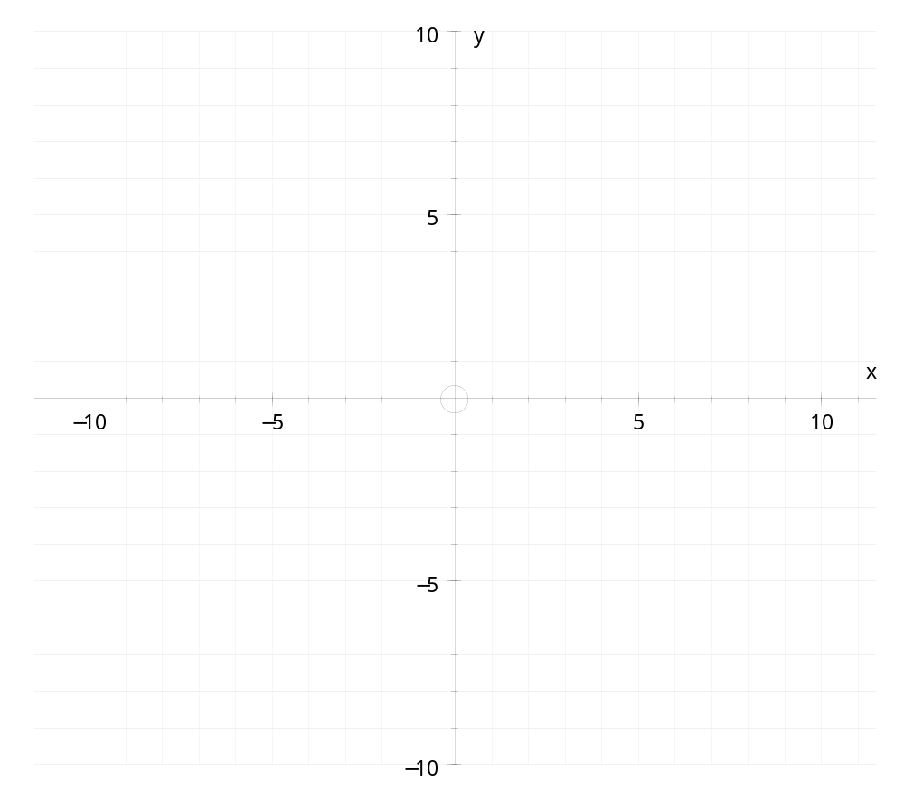
Draw a parallelogram in the second quadrant
(don’t make it too big)
Write down the coordinates.
What is the area of your parallelogram?

Slide 7
Multiply the coordinates by 2 and plot the new shape.
Describe what has happened to the shape.
What is the area of the new parallelogram?
How does it relate to the area of the original parallelogram?
Can you draw your original shape inside your new shape exactly 4 times?

Slide 8
Draw a trapezium in the third quadrant
(again, keep it quite small so you can enlarge it)
Write down the coordinates.
What is the area of your trapezium?

Slide 9
Multiply the coordinates by 3 and plot the new shape.
Describe what has happened to the shape.
What is the area of the new trapezium?
How does it relate to the area of the original trapezium?
Can you draw your original shape inside your new shape exactly 9 times?

Slide 10
Draw an L shape in the fourth quadrant
(again, keep it quite small so you can enlarge it)
Write down the coordinates.
What is the area of your L shape?
Explain how you found the area.
Could you find it in a different way?
And another?

Slide 11
Multiply the coordinates by 3 and plot the new shape.
Describe what has happened to the shape.
What is the area of the new L shape?
How does it relate to the area of the original L shape?
Can you draw your original shape inside your new shape exactly 9 times?

Slide 12

Worksheet
Choose an enlargement that we have just discussed and write it up in your book.
You must explain how you found the area of the original shape and the
new shape.
Explain what happened to the shape after multiplying the coordinates.
Copy and fill in the gaps:
When the length scale factor is 2, the area scale factor is ______
When the length scale factor is 3, the area scale factor is ______
Predict what the area scale factor will be when the length scale factor is 4
Check by drawing a shape, enlarging it and finding the area.

Slide 13
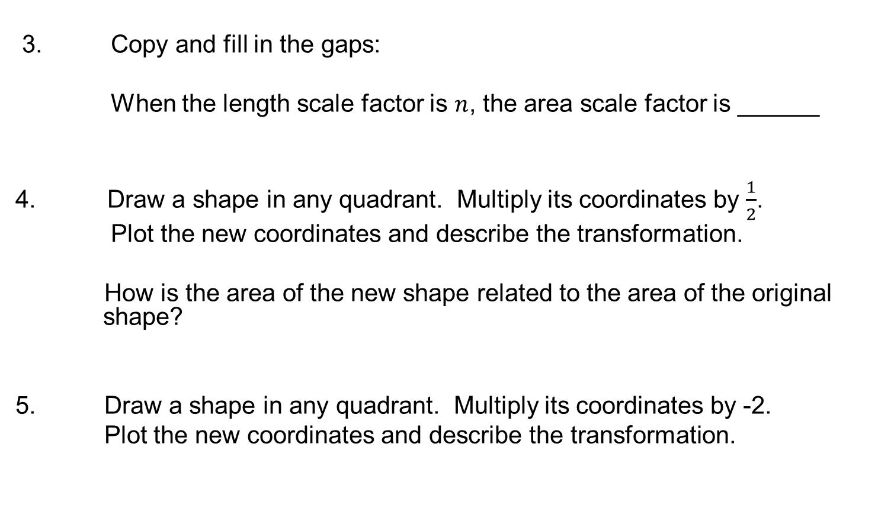
Challenge
3. Copy and fill in the gaps:
When the length scale factor is $n$, the area scale factor is ______
Draw a shape in any quadrant. Multiply its coordinates by $\frac{1}{2}$.
Plot the new coordinates and describe the transformation.
How is the area of the new shape related to the area of the original shape?
5. Draw a shape in any quadrant. Multiply its coordinates by -2.
Plot the new coordinates and describe the transformation.

