Slide 1
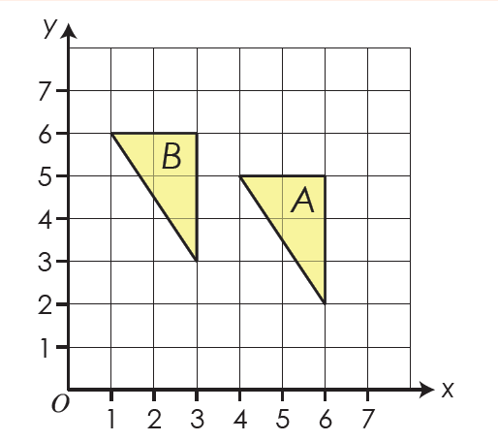

On your whiteboards:
Describe fully the single transformation that maps triangle A onto triangle B
Translation
$$\left(\begin{matrix}−3 \\ 1\end{matrix}\right)$$

Slide 2

On your whiteboards:
Describe fully the single transformation that maps triangle B onto triangle A
Translation
$$\left(\begin{matrix}3 \\ −1\end{matrix}\right)$$

Slide 3
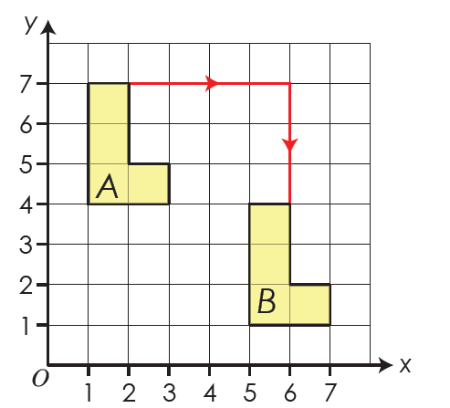
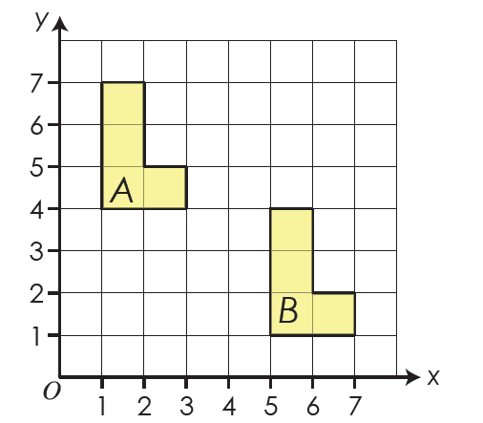

On your whiteboards:
Describe fully the single transformation that maps hexagon A onto hexagon B
Translation
$$\left(\begin{matrix}4 \\ −3\end{matrix}\right)$$

Slide 4

On your whiteboards:
Describe fully the single transformation that maps hexagon B onto hexagon A
Translation
$$\left(\begin{matrix}−4 \\ 3\end{matrix}\right)$$

Slide 5
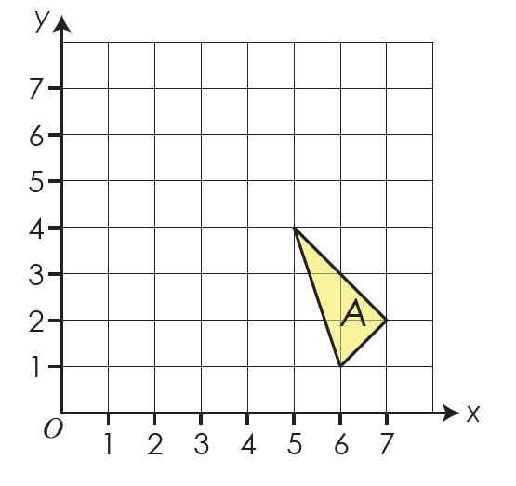




On your whiteboards:
This triangle A is translated $\left(\begin{matrix}−4 \\ 3\end{matrix}\right)$
What are the coordinates of the vertices of triangle A’?
$$(1,7)$$
$$(2,4)$$
$$(3,5)$$

Slide 6
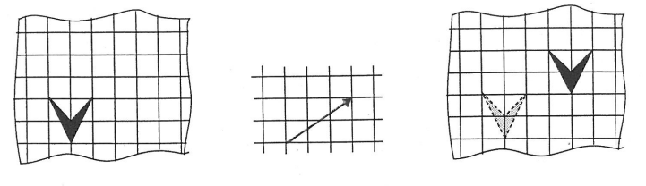

Worked Example
$$\left(\begin{matrix}3 \\ 2\end{matrix}\right)$$
Draw this shape using the squares of your book
Translate the shape using this vector and record the vector as a column vector
Draw the shape in its new position

Slide 7
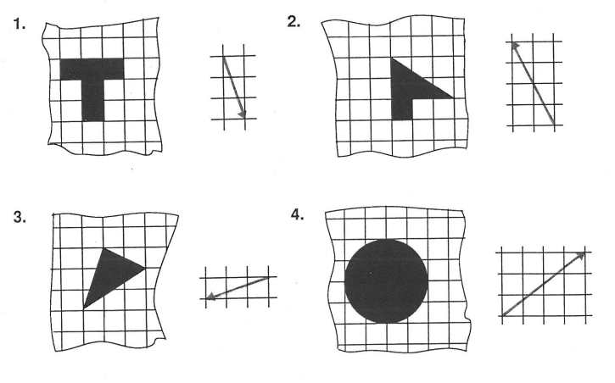
In your books:
Draw each shape as shown and translate it as shown by the vector.
Write the column vector by each translation.
Notes:
Acknowledgements: SMILE

Slide 8
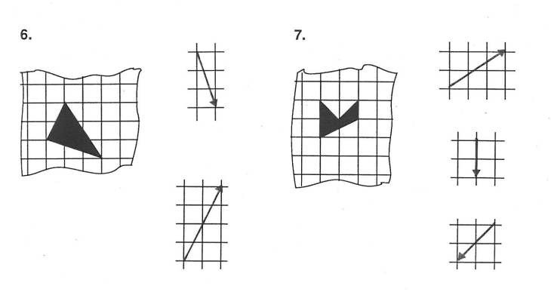
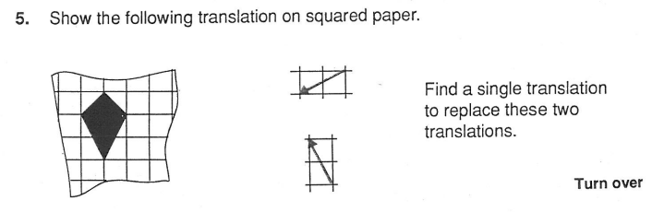
In your books:
Draw each shape as shown and translate it as shown by the vector.
Find a single column vector to describe the overall translation.
5.
6.
Notes:
Acknowledgements: SMILE

Slide 9
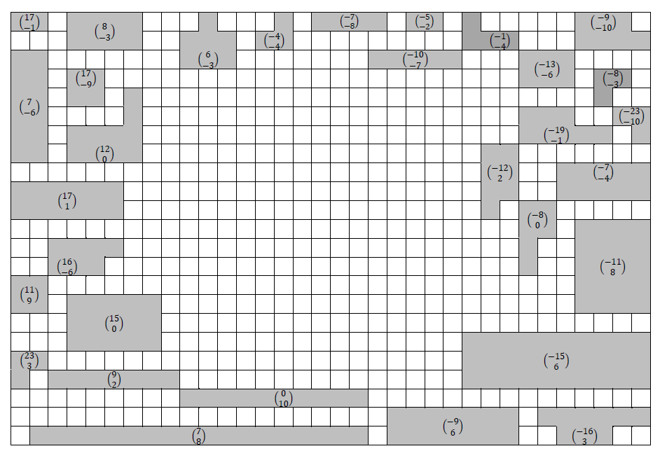
Challenge
Notes:
Acknowledgements: Alice Creswick

