Slide 1
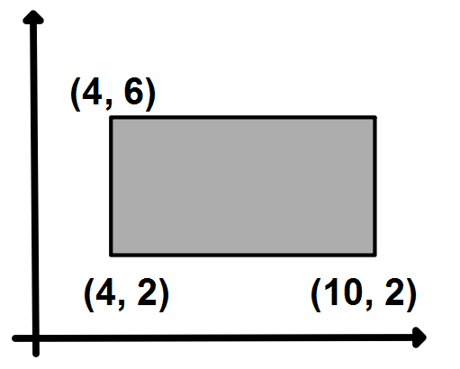
This shape is a rectangle.
What is the missing coordinate?
How do you know?
What is the perimeter of the rectangle?

Slide 2
Draw another rectangle with the same dimensions somewhere else on your grid.
What are its coordinates?
Draw one in each quadrant and write down the coordinates of the vertices.
Compare yours with your neighbour’s.

Slide 3
Challenge:
Can you write down the coordinates of a another rectangle with the same dimensions that isn’t on your grid?
How do you know it’s correct?

Slide 4
Challenge 2:
If another rectangle with the same dimensions has coordinate A (a , b) what are the other coordinates?
What if the rectangle had coordinate D (c, d)?

Slide 5
If I translate this rectangle two squares down, what will the coordinates of the vertices be now?
How have they changed?

Slide 6
If I translate the rectangle one square to the right, what will the coordinates of the vertices be now?
How have they changed?

Slide 7
If I translate the rectangle five squares to the left, what will the coordinates of the vertices be now?
How have they changed?

Slide 8
If I translate the rectangle 4 squares to the left, and 3 square up what will the coordinates of the vertices be now?

Slide 9
If I translate the rectangle a squares to the left, and b square up what will the coordinates of the vertices be now?

Slide 10
Discuss with your partner what you think the missing words are and why.
In general:
When a shape is translated right the x-coordinates increase.
When a shape is translated left the x-coordinates decrease.
When a shape is translated up the y-coordinates increase.
When a shape is translated down the y-coordinates decrease.

Slide 11
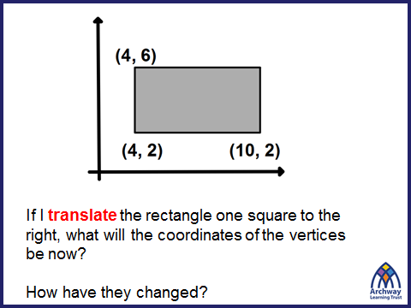
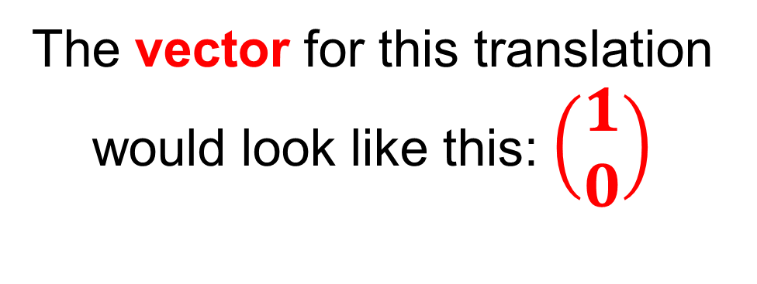
This instruction can also be communicated using a vector.
The vector for this translation would look like this: $\left(\begin{matrix}1 \\ 0\end{matrix}\right)$

Slide 12
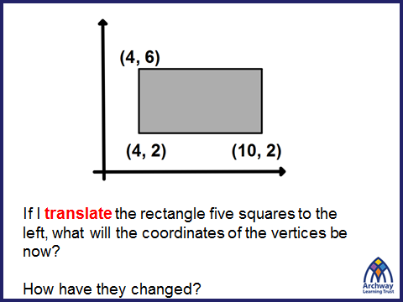
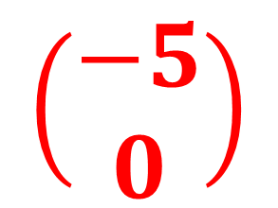
$$\left(\begin{matrix}−5 \\ 0\end{matrix}\right)$$
What do you think the vector for this translation will be?

Slide 13
$$\left(\begin{matrix}−5 \\ 0\end{matrix}\right)$$
The x-coordinates decrease by 5

Slide 14
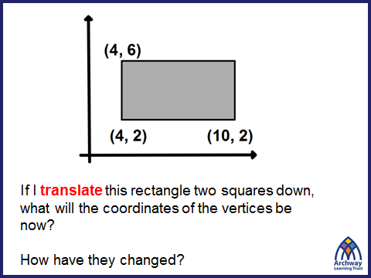
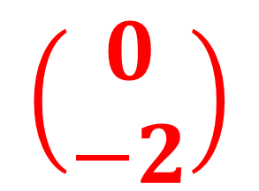
$$\left(\begin{matrix}0 \\ −2\end{matrix}\right)$$
What do you think the vector for this translation will be?

Slide 15
$$\left(\begin{matrix}0 \\ −2\end{matrix}\right)$$
The y-coordinates decrease by 2

Slide 16
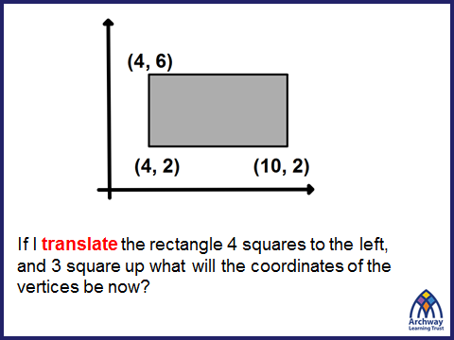
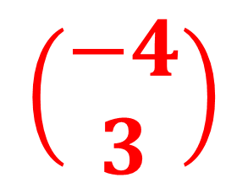
$$\left(\begin{matrix}−4 \\ 3\end{matrix}\right)$$
What do you think the vector for this translation will be?

Slide 17
$$\left(\begin{matrix}−4 \\ 3\end{matrix}\right)$$
The x-coordinates decrease by 4
The y-coordinates increase by 3

Slide 18
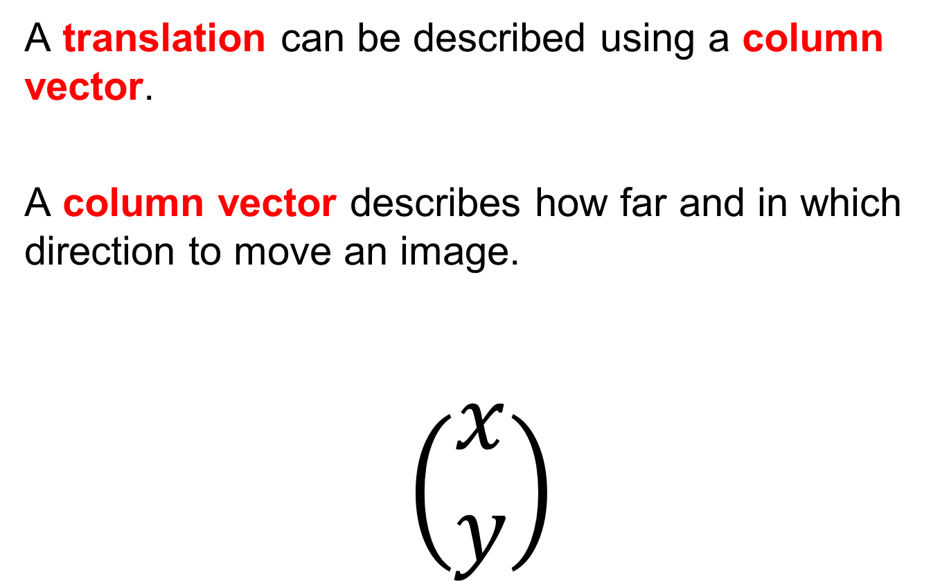
Title: Translation Vectors
A translation can be described using a column vector.
A column vector describes how far and in which direction to move an image.
$$\left(\begin{matrix}x \\ y\end{matrix}\right)$$
The top value tells us how far and it which direction the x coordinates move
The bottom value tells us how far and it which direction the y coordinates move

Slide 19
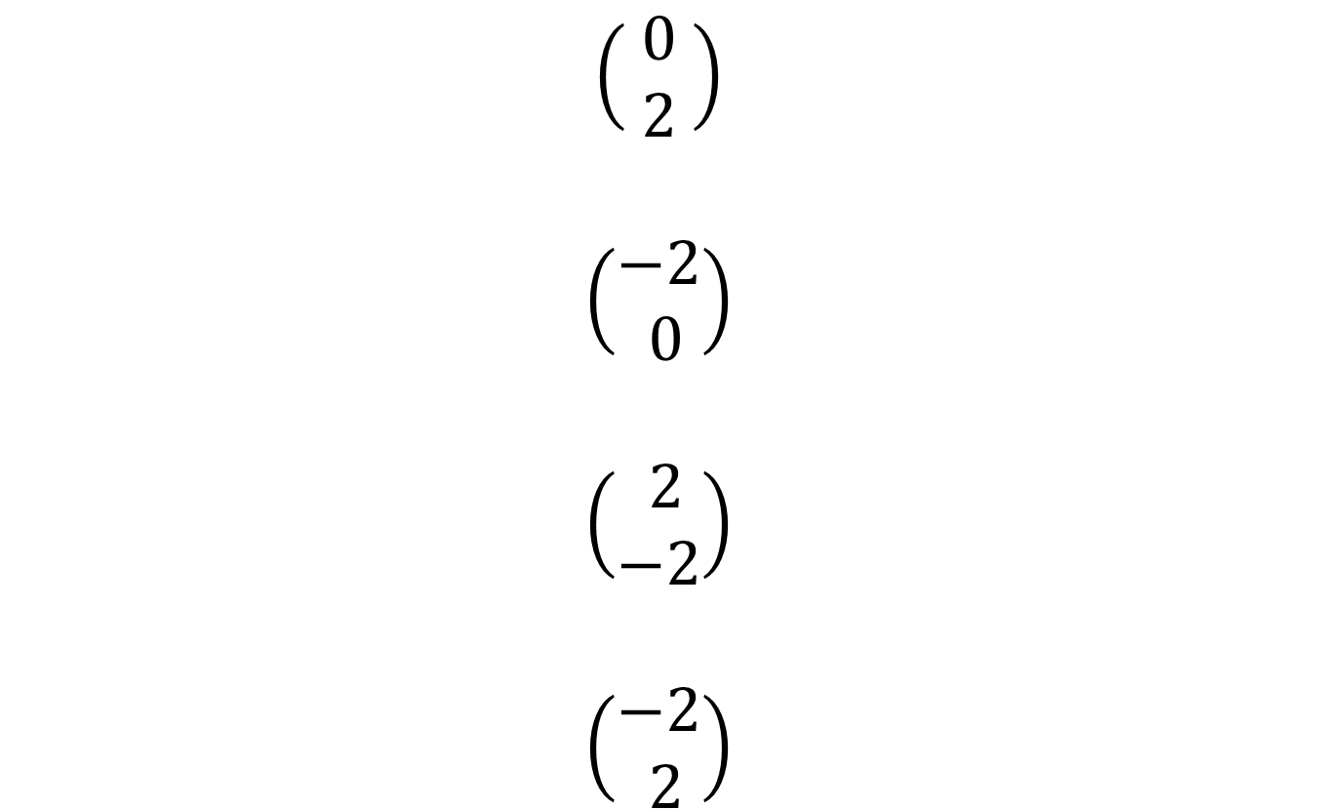
In your books:
Describe, in words, the translations these vectors represent.
$$\left(\begin{matrix} 0 \\ 2 \end{matrix}\right)$$
$$\left(\begin{matrix}−2 \\ 0\end{matrix}\right)$$
$$\left(\begin{matrix} 2 \\ −2\end{matrix}\right)$$
$$\left(\begin{matrix}−2 \\ 2\end{matrix}\right)$$

Slide 20
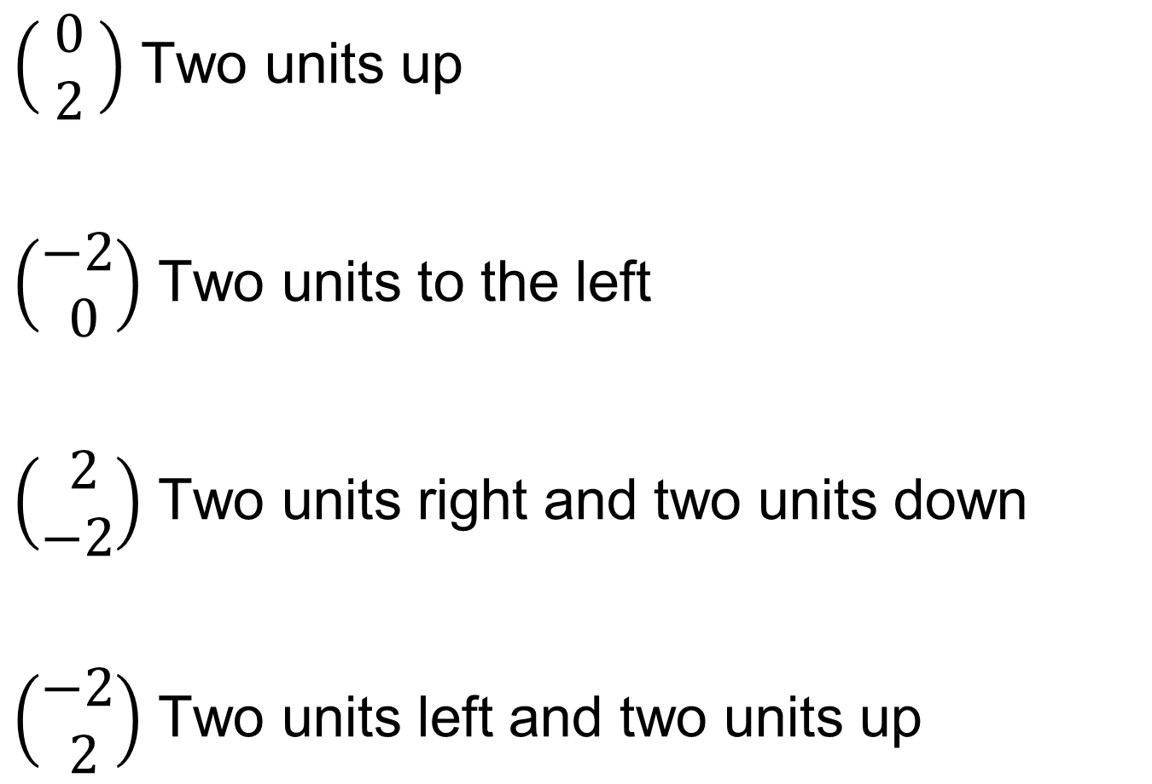
Mark your work:
$\left(\begin{matrix} 0 \\ 2 \end{matrix}\right)$ Two units up
$\left(\begin{matrix}−2 \\ 0\end{matrix}\right)$ Two units to the left
$\left(\begin{matrix} 2 \\ −2\end{matrix}\right)$ Two units right and two units down
$\left(\begin{matrix}−2 \\ 2\end{matrix}\right)$ Two units left and two units up

Slide 21

Vector
nakes and
L
A
D
D
E
R
S
Notes:
Acknowledgements: Craig Barton

Slide 22
Rules for the game.
Roll the dice and move your counter the number of squares shown on the dice.
If you land on a blank numbered square, that ends your go.
If you land on a vector, follow it.
Then it is the end of your go.
The winner is the first person to get to the finish in the exact number of moves.

Slide 23
( )
( )
( )
100 FINISH | 99 | 98 | 97 | 96 | 95 | 94 | 93 | 92 | 91
81 | 82 | 83 | 84 | 85 | 86 | 87 | 88 | 89 | 90
80 | 79 | 78 | 77 | 76 | 75 | 74 | 73 | 72 | 71
61 | 62 | 63 | 64 | 65 | 66 | 67 | 68 | 69 | 70
60 | 59 | 58 | 57 | 56 | 55 | 54 | 53 | 52 | 51
41 | 42 | 43 | 44 | 45 | 46 | 47 | 48 | 49 | 50
40 | 39 | 38 | 37 | 36 | 35 | 34 | 33 | 32 | 31
21 | 22 | 23 | 24 | 25 | 26 | 27 | 28 | 29 | 30
20 | 19 | 18 | 17 | 16 | 15 | 14 | 13 | 12 | 11
1 START | 2 | 3 | 4 | 5 | 6 | 7 | 8 | 9 | 10
2
2
-2
-4
-1
0
( )
( )
( )
3
-2
1
-1
-1
-6
( )
( )
( )
3
0
1
1
-2
-1
( )
( )
( )
2
-1
-1
2
-2
( )
( )
2
-6
2
-1
( )
( )
( )
1
3
-1
3
-1
-2
( )
( )
( )
( )
-1
-2
-4
0
-1
1
-1
2
( )
( )
-1
1
-2
5
( )
( )
( )
0
1
5
3
2
-1
( )
( )
( )
-1
2
-4
2
2
1

