Slide 1
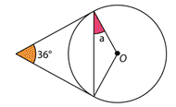

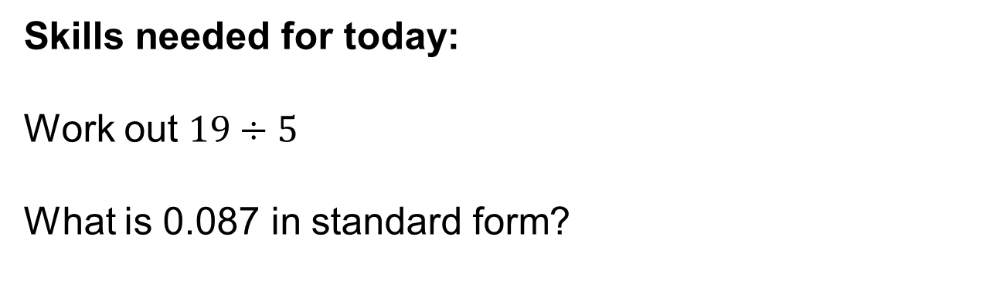
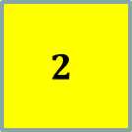

Skills needed for today:
Work out $19÷5$
What is 0.087 in standard form?
$$3$$
$$2$$
$$1$$
From last term:
What is the missing angle?
From last year:
What is the volume of a cylinder that has a radius of 5cm and a height of 10cm? Give your answer in terms of pi.
Notes:
Timed spaced retrieval – non calculator

Slide 2
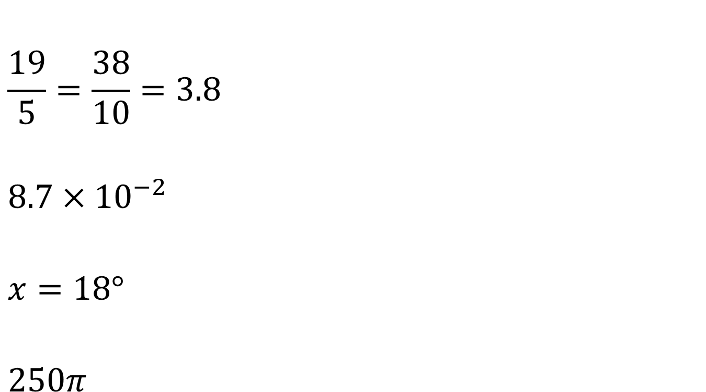
Mark your work
$$\frac{19}{5}=\frac{38}{10}=3.8$$
$$8.7×{10}^{−2}$$
$$x=18°$$
$$250π$$

Slide 3
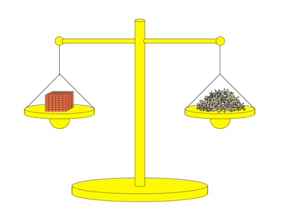
Which weighs more?
A tonne of bricks or a tonne of feathers?

Slide 4
A tonne of bricks and a tonne of feathers have the same mass; they both weigh 100 kg.
The volume of a tonne of bricks is less than the volume of a tonne of feathers as bricks are more dense than feathers.

Slide 5
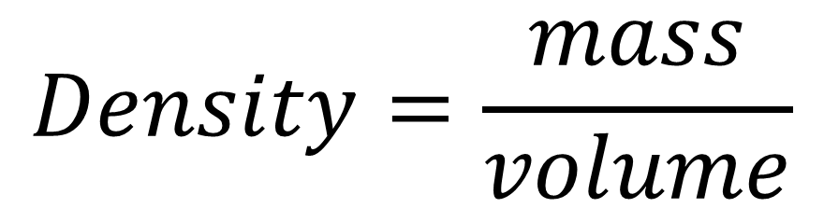
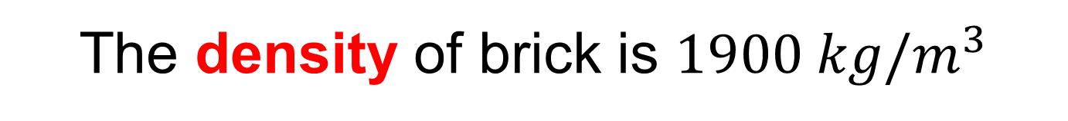
The density of brick is $1900 kg/m^{3}$
Notice the units used,
what is the formula for density?
kg
$$Density=\frac{mass}{volume}$$
m³

Slide 6
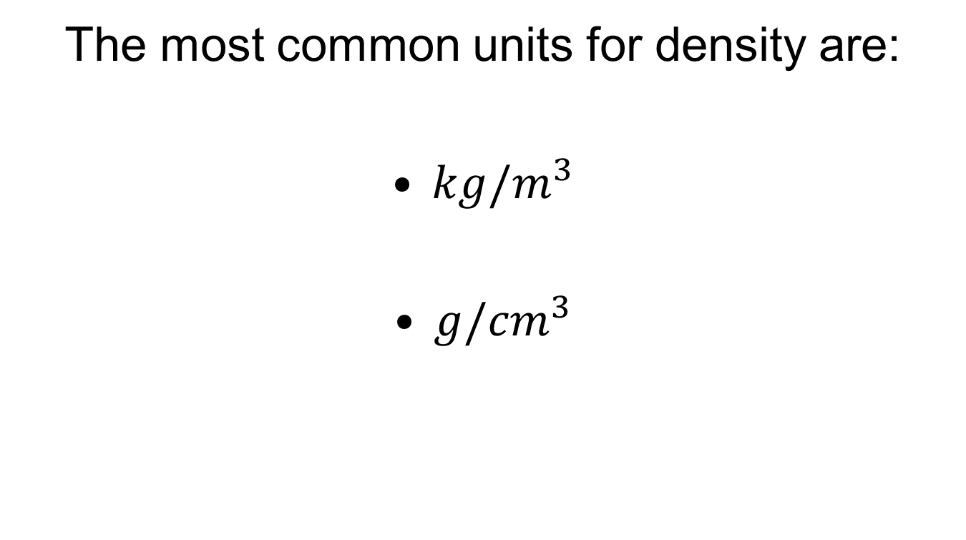
The most common units for density are:
$kg/m^{3}$
$g/{cm}^{3}$

Slide 7
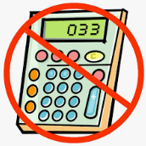
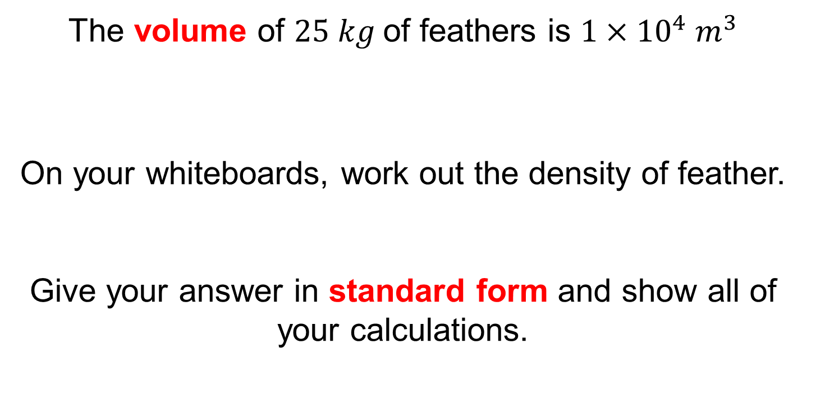
The volume of $25 kg$of feathers is $1×{10}^{4} m^{3}$
On your whiteboards, work out the density of feather.
Give your answer in standard form and show all of your calculations.
Notes:
Share and compare different methods on student whiteboards

Slide 8
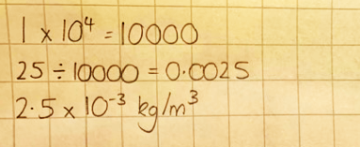
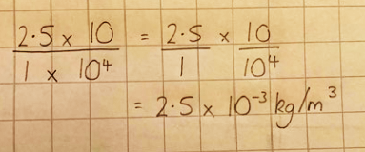
Describe both of these methods with your partner.
Method 1
Method 2
Which method do you prefer for this question? Why?

Slide 9
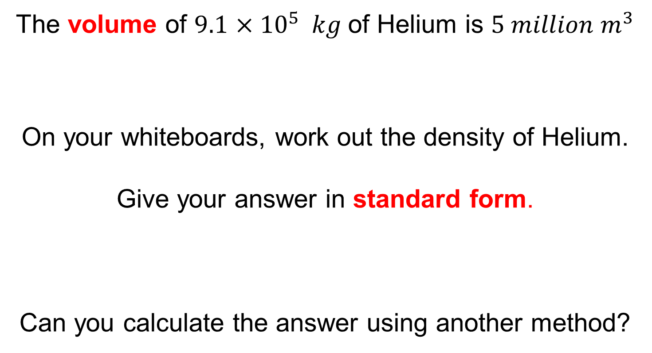
The volume of $9.1$ $×{10}^{5} kg$of Helium is $5 million m^{3}$
On your whiteboards, work out the density of Helium.
Give your answer in standard form.
Can you calculate the answer using another method?
Notes:
Share and compare different methods on student whiteboards

Slide 10
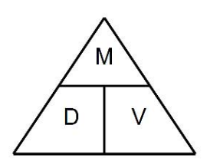
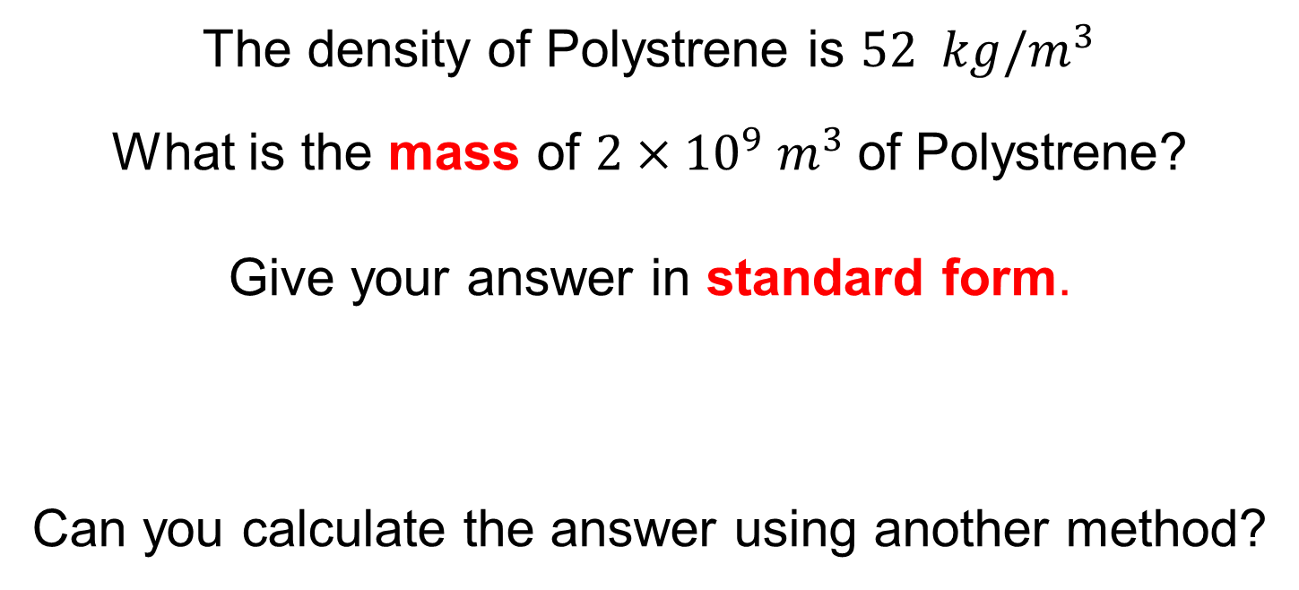
The density of Polystrene is $52 kg/m^{3}$
What is the mass of $2×{10}^{9}{ m}^{3}$of Polystrene?
Give your answer in standard form.
Can you calculate the answer using another method?
Notes:
Share and compare different methods on student whiteboards

Slide 11
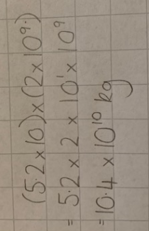
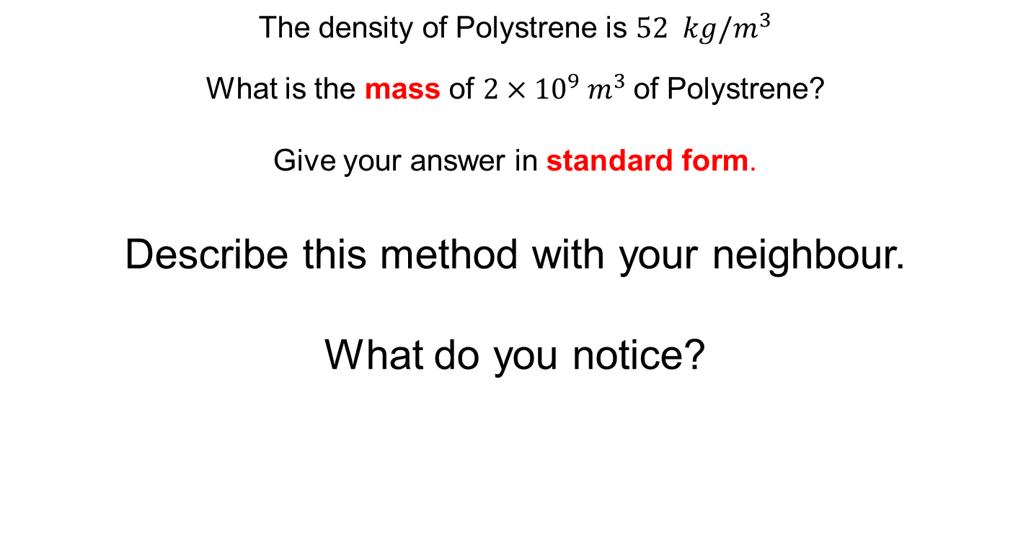
The density of Polystrene is $52 kg/m^{3}$
What is the mass of $2×{10}^{9}{ m}^{3}$of Polystrene?
Give your answer in standard form.
Describe this method with your neighbour.
What do you notice?
Notes:
Share and compare different methods on student whiteboards

Slide 12
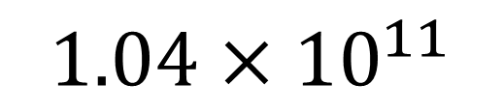


$$÷10$$
$$×10$$
$$1.04×{10}^{11}$$
Notes:
Share and compare different methods on student whiteboards

Slide 13
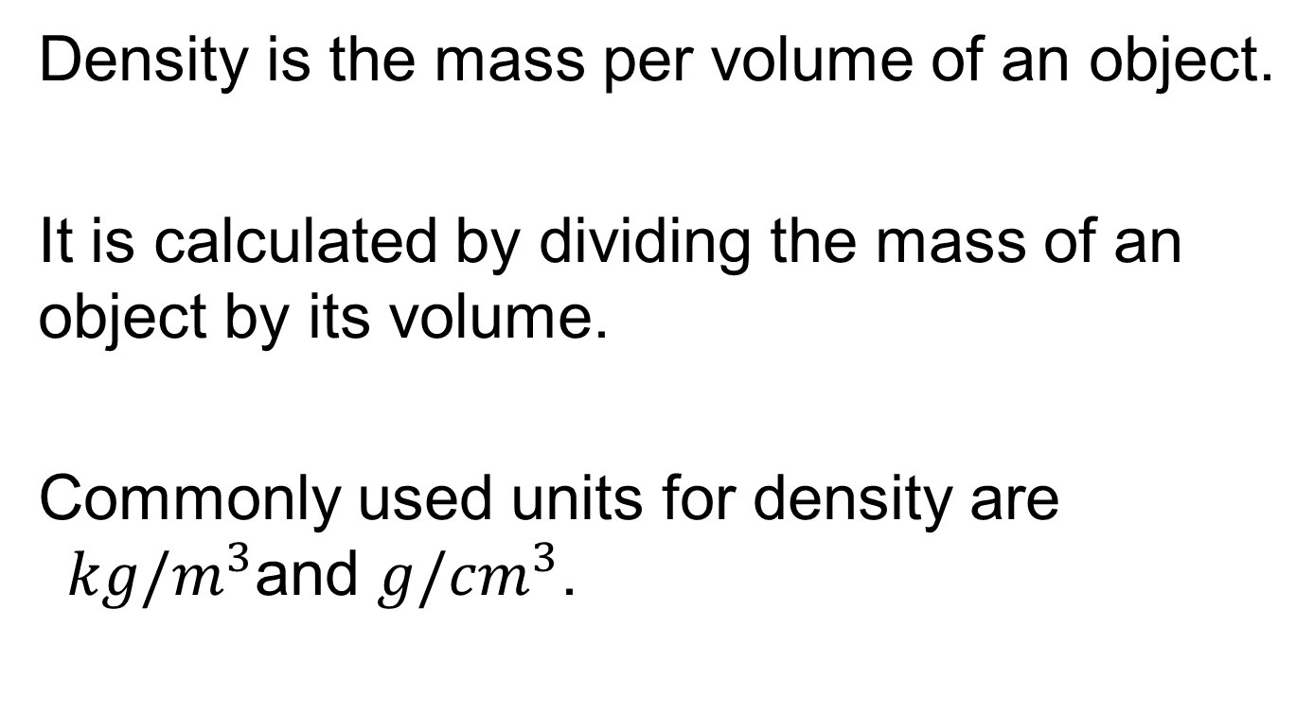
Title: Calculations involving Density
Density is the mass per volume of an object.
It is calculated by dividing the mass of an object by its volume.
Commonly used units for density are $kg/m^{3}$and $g/{cm}^{3}$.

Slide 14
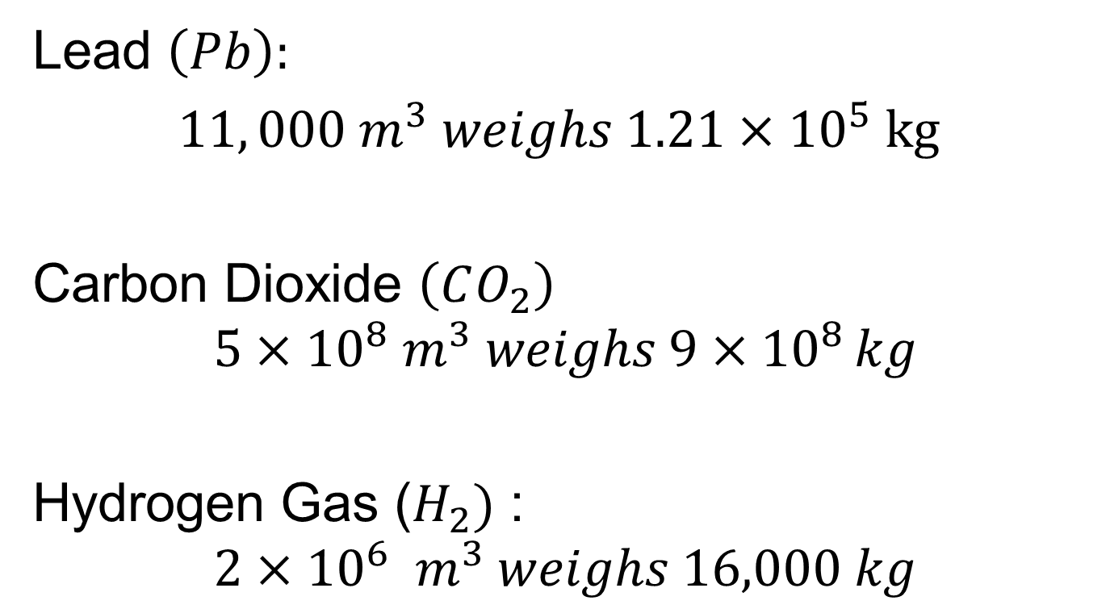
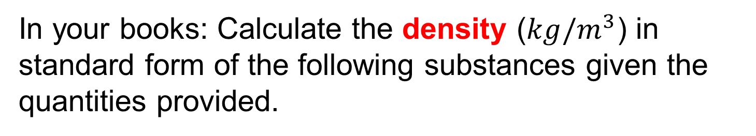
In your books: Calculate the density ($kg/m^{3}$) in standard form of the following substances given the quantities provided.
Lead $\left(Pb\right):$
$11, 000 m^{3} weighs 1.21×{10}^{5} kg$
Carbon Dioxide $\left(CO_{2}\right)$
$$5×{10}^{8} m^{3} weighs 9×{10}^{8 }kg$$
Hydrogen Gas ($H_{2})$ :
$$2×{10}^{6}{ m}^{3} weighs 16,000 kg$$

Slide 15
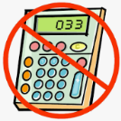
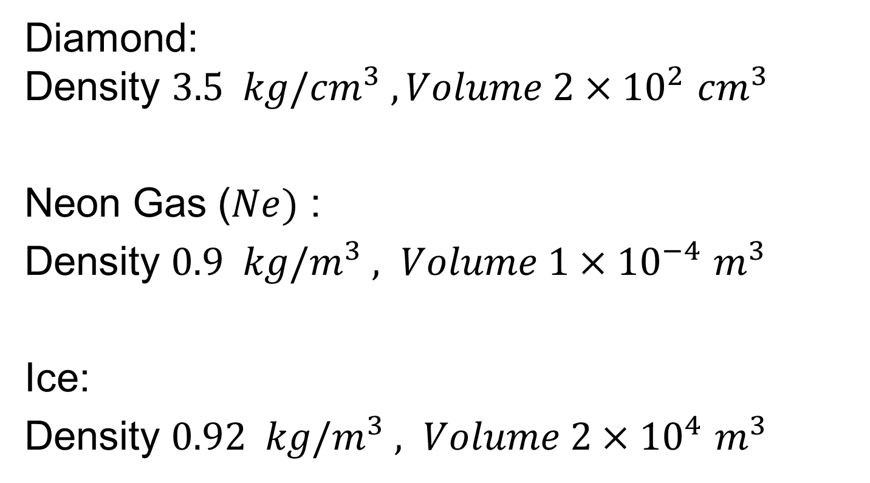
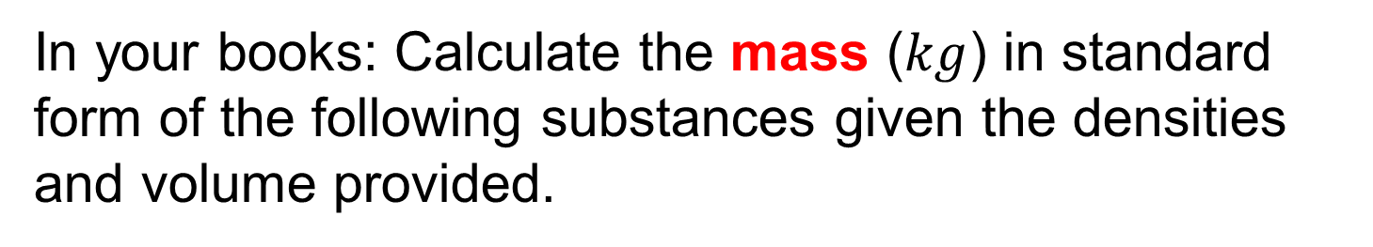
In your books: Calculate the mass ($kg$) in standard form of the following substances given the densities and volume provided.
Diamond:
$$\text{Density} 3.5{ kg/cm}^{3} , Volume 2×{10}^{2} {cm}^{3}$$
Neon Gas ($Ne)$ :
Density $0.9{ kg/m}^{3} , Volume 1×{10}^{−4}$ $m^{3}$
Ice:
Density $0.92{ kg/m}^{3} , Volume 2×{10}^{4}$ $m^{3}$

Slide 16
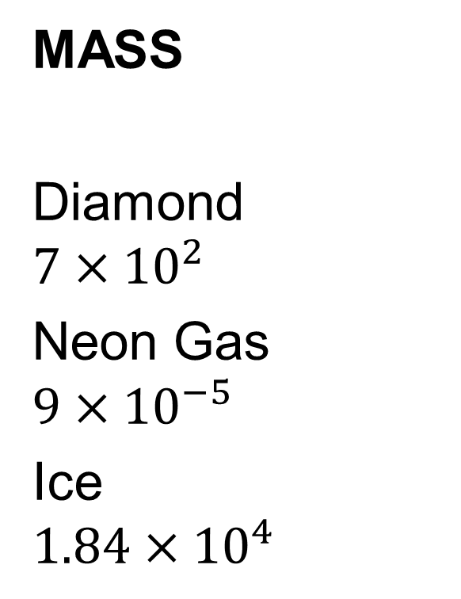
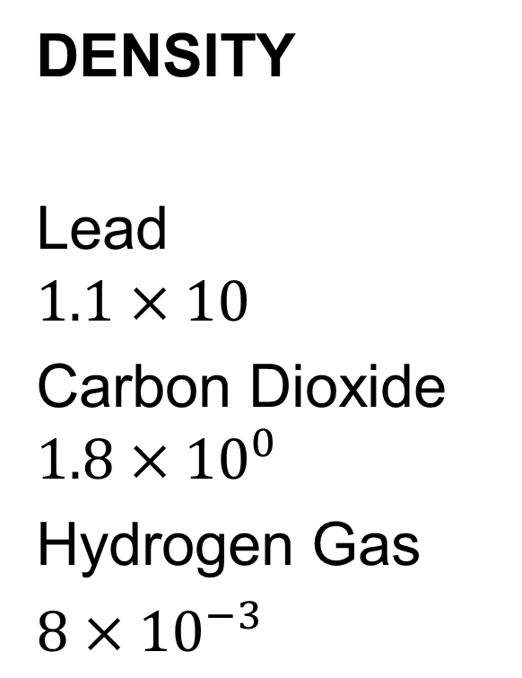
Mark your work
DENSITY
Lead
$$1.1×10$$
Carbon Dioxide
$$1.8×{10}^{0}$$
Hydrogen Gas
$8×{10}^{−3}$
MASS
Diamond
$$7×{10}^{2}$$
Neon Gas
$$9×{10}^{−5}$$
Ice
$$1.84×{10}^{4}$$

