Slide 1
A survey of 20 people asked how they preferred their tea to be made.
The results were as follows:
4 liked milk and sugar
8 liked only milk
6 liked only sugar
2 liked neither milk or sugar
Represent this information in a Venn Diagram

Slide 2
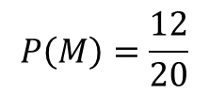






$$M$$
$$S$$
A survey of 20 people asked how they preferred their tea to be made.
The results were as follows:
4 liked milk and sugar
8 liked only milk
6 liked only sugar
2 liked neither milk or sugar
$$8$$
$$4$$
$$6$$
$$2$$
One of the 20 people was asked at random how they preferred their tea.
What is the probability that the chosen person preferred milk?
$$P\left(M\right)=\frac{12}{20}$$

Slide 3
$$M$$
$$S$$
A survey of 20 people asked how they preferred their tea to be made.
The results were as follows:
4 liked milk and sugar
8 liked only milk
6 liked only sugar
2 liked neither milk or sugar
$$8$$
$$4$$
$$6$$
$$2$$
One of the 20 people was asked at random how they preferred their tea.
What is the probability that the chosen person preferred milk?
$$P\left(M\right)=\frac{12}{20}$$

Slide 4
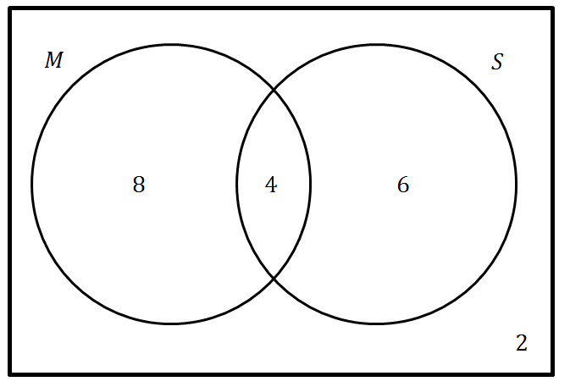
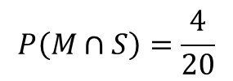
A survey of 20 people asked how they preferred their tea to be made.
The results were as follows:
4 liked milk and sugar
8 liked only milk
6 liked only sugar
2 liked neither milk or sugar
One of the 20 people was asked at random how they preferred their tea.
What is the probability that the chosen person preferred sugar and milk?
$$P\left(M∩S\right)=\frac{4}{20}$$

Slide 5
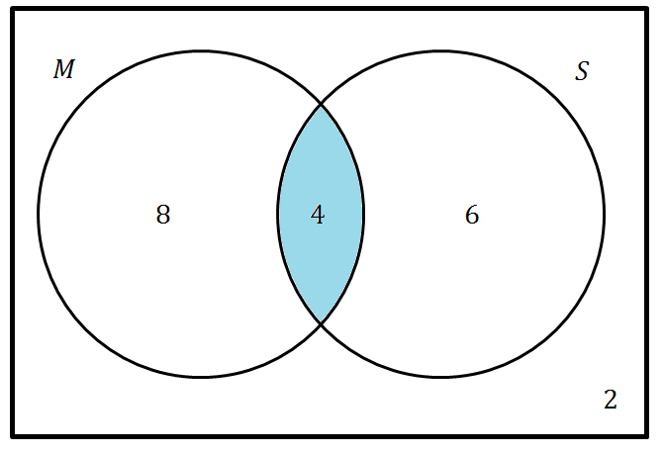
A survey of 20 people asked how they preferred their tea to be made.
The results were as follows:
4 liked milk and sugar
8 liked only milk
6 liked only sugar
2 liked neither milk or sugar
One of the 20 people was asked at random how they preferred their tea.
What is the probability that the chosen person preferred sugar and milk?
$$P\left(M∩S\right)=\frac{4}{20}$$

Slide 6
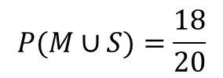
$$M$$
$$S$$
A survey of 20 people asked how they preferred their tea to be made.
The results were as follows:
4 liked milk and sugar
8 liked only milk
6 liked only sugar
2 liked neither milk or sugar
$$8$$
$$4$$
$$6$$
$$2$$
One of the 20 people was asked at random how they preferred their tea.
What is the probability that the chosen person preferred sugar or milk or both?
$$P(M∪S)=\frac{18}{20}$$

Slide 7
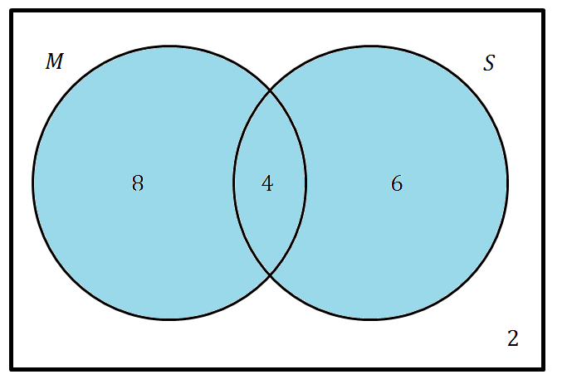
A survey of 20 people asked how they preferred their tea to be made.
The results were as follows:
4 liked milk and sugar
8 liked only milk
6 liked only sugar
2 liked neither milk or sugar
One of the 20 people was asked at random how they preferred their tea.
What is the probability that the chosen person preferred sugar or milk or both?
$$P(M∪S)=\frac{18}{20}$$

Slide 8
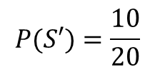
$$M$$
$$S$$
A survey of 20 people asked how they preferred their tea to be made.
The results were as follows:
4 liked milk and sugar
8 liked only milk
6 liked only sugar
2 liked neither milk or sugar
$$8$$
$$4$$
$$6$$
$$2$$
One of the 20 people was asked at random how they preferred their tea.
What is the probability that the chosen person preferred no sugar?
$$P(S′)=\frac{10}{20}$$

Slide 9
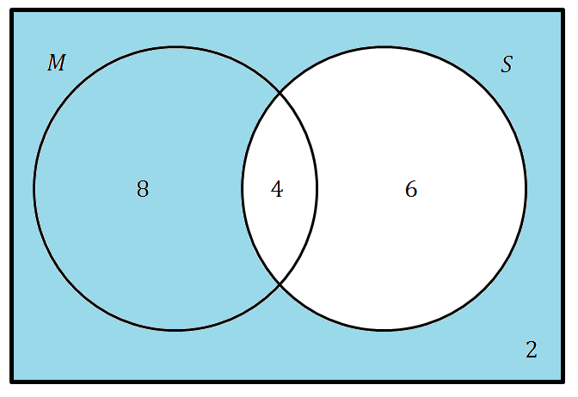
$$M$$
$$S$$
A survey of 20 people asked how they preferred their tea to be made.
The results were as follows:
4 liked milk and sugar
8 liked only milk
6 liked only sugar
2 liked neither milk or sugar
$$8$$
$$4$$
$$6$$
$$2$$
One of the 20 people was asked at random how they preferred their tea.
What is the probability that the chosen person preferred no sugar?
$$P(S′)=\frac{10}{20}$$

Slide 10
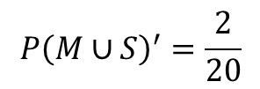
$$M$$
$$S$$
A survey of 20 people asked how they preferred their tea to be made.
The results were as follows:
4 liked milk and sugar
8 liked only milk
6 liked only sugar
2 liked neither milk or sugar
$$8$$
$$4$$
$$6$$
$$2$$
One of the 20 people was asked at random how they preferred their tea.
What is the probability that the chosen person preferred no milk or sugar?
$$P{\left(M∪S\right)}^{′}=\frac{2}{20}$$

Slide 11
$$M$$
$$S$$
A survey of 20 people asked how they preferred their tea to be made.
The results were as follows:
4 liked milk and sugar
8 liked only milk
6 liked only sugar
2 liked neither milk or sugar
$$8$$
$$4$$
$$6$$
$$2$$
One of the 20 people was asked at random how they preferred their tea.
What is the probability that the chosen person preferred no milk or sugar?
$$P{\left(M∪S\right)}^{′}=\frac{2}{20}$$

Slide 12
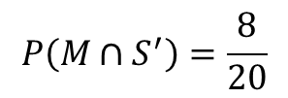
$$M$$
$$S$$
A survey of 20 people asked how they preferred their tea to be made.
The results were as follows:
4 liked milk and sugar
8 liked only milk
6 liked only sugar
2 liked neither milk or sugar
$$8$$
$$4$$
$$6$$
$$2$$
One of the 20 people was asked at random how they preferred their tea.
What is the probability that the chosen person preferred only milk?
$$P\left(M∩S^{′}\right)=\frac{8}{20}$$

Slide 13
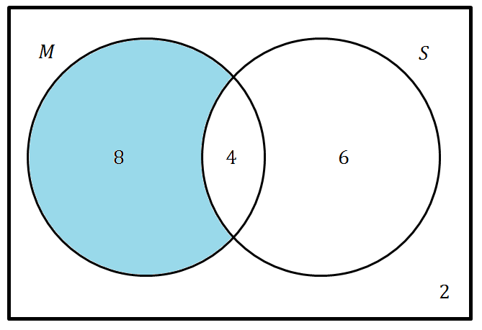
$$M$$
$$S$$
A survey of 20 people asked how they preferred their tea to be made.
The results were as follows:
4 liked milk and sugar
8 liked only milk
6 liked only sugar
2 liked neither milk or sugar
$$8$$
$$4$$
$$6$$
$$2$$
One of the 20 people was asked at random how they preferred their tea.
What is the probability that the chosen person preferred only milk?
$$P\left(M∩S^{′}\right)=\frac{8}{20}$$

Slide 14
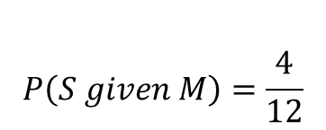
$$M$$
$$S$$
A survey of 20 people asked how they preferred their tea to be made.
The results were as follows:
4 liked milk and sugar
8 liked only milk
6 liked only sugar
2 liked neither milk or sugar
$$8$$
$$4$$
$$6$$
$$2$$
One of the 20 people was asked at random how they preferred their tea.
Given that a person is selected who prefers milk, what is the probability that the chosen person prefers sugar?
$$P\left(S given M\right)=\frac{4}{12}$$

Slide 15
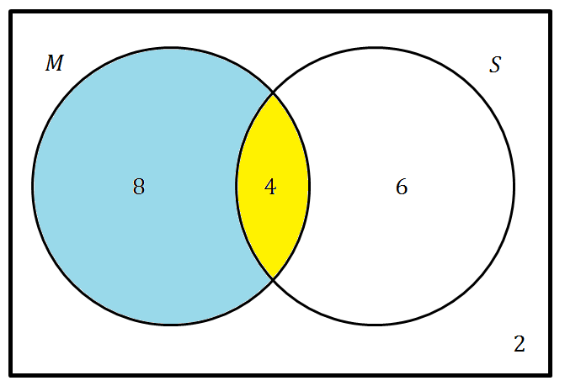
$$M$$
$$S$$
A survey of 20 people asked how they preferred their tea to be made.
The results were as follows:
4 liked milk and sugar
8 liked only milk
6 liked only sugar
2 liked neither milk or sugar
$$8$$
$$4$$
$$6$$
$$2$$
One of the 20 people was asked at random how they preferred their tea.
Given that a person is selected who prefers milk, what is the probability that the chosen person prefers sugar?
$$P\left(S given M\right)=\frac{4}{12}$$

Slide 16
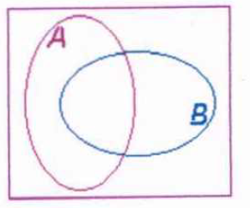








Shade the correct region
$$A$$
$$A′$$
$$A∩B$$
$$(A∩B)′$$
$$A∪B$$
$$(A∪B)′$$
$$A∩B′$$
$$A′∩B$$
Notes:
Print

Slide 17
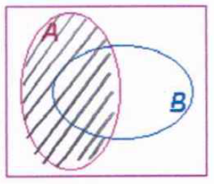
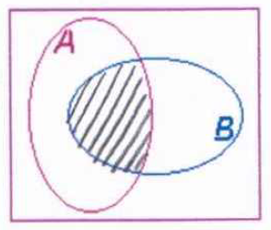
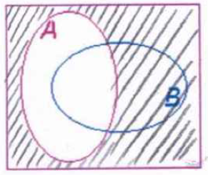
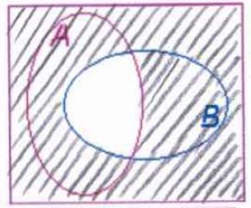
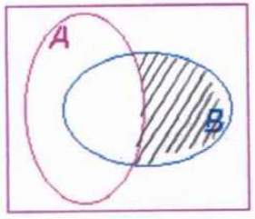
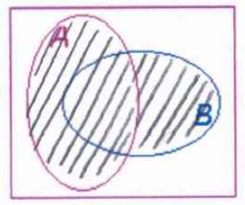
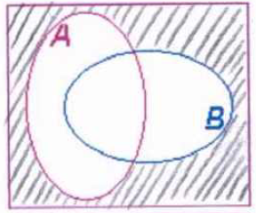
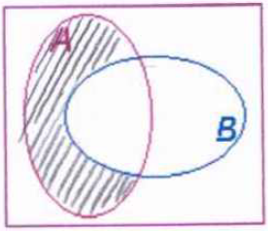
Check your work
$$A$$
$$A′$$
$$A∩B$$
$$(A∩B)′$$
$$A∪B$$
$$(A∪B)′$$
$$A∩B′$$
$$A′∩B$$

Slide 18
Your Turn
A group of 200 Year 10 students are asked if they own a dog or a cat.
32 own both a dog and a cat;
25 students only have a cat;
95 students own a dog.
Produce a Venn diagram to represent this situation.
Devise a set of 12 probability questions to ask a friend about the Venn diagram.
Ensure you work out the answers (including the set notation) for
the questions you have devised.
Notes:
Allow students to refer to their shaded regions worksheet

Slide 19
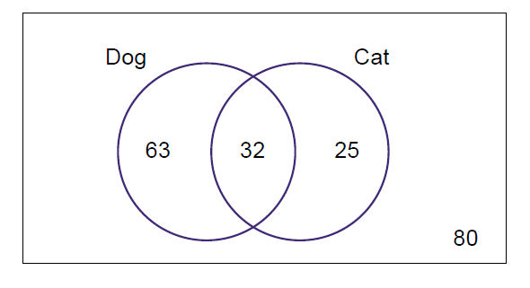
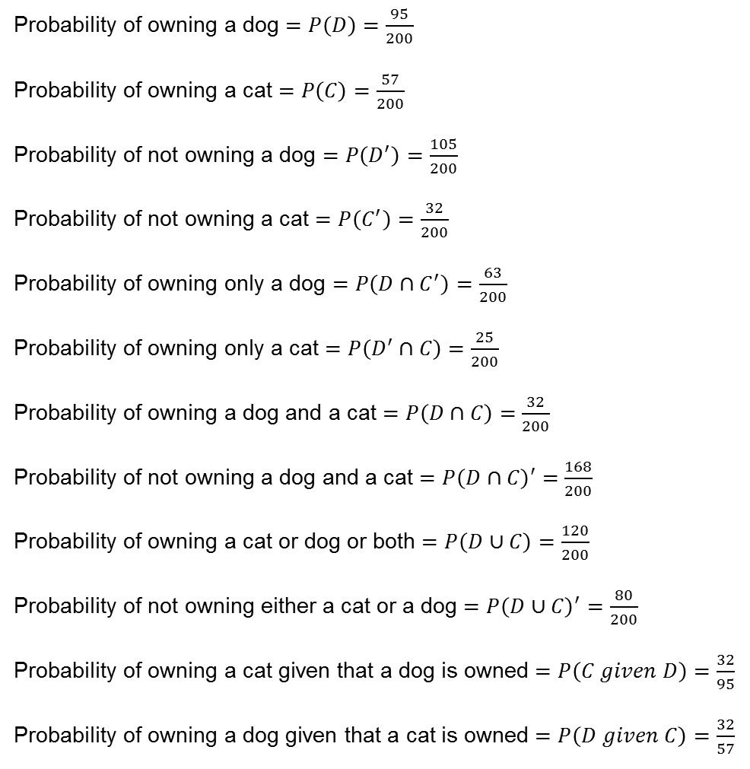
Mark your work
Probability of owning a dog $=P\left(D\right)=\frac{95}{200}$
Probability of owning a cat $=P\left(C\right)=\frac{57}{200}$
Probability of not owning a dog $=P\left(D^{′}\right)=\frac{105}{200}$
Probability of not owning a cat $=P\left(C^{′}\right)=\frac{32}{200}$
Probability of owning only a dog $=P\left(D∩C^{′}\right)=\frac{63}{200}$
Probability of owning only a cat $=P\left(D^{′}∩C\right)=\frac{25}{200}$
Probability of owning a dog and a cat $=P\left(D∩C\right)=\frac{32}{200}$
Probability of not owning a dog and a cat $=P\left(D∩C\right)′=\frac{168}{200}$
Probability of owning a cat or dog or both $=P\left(D∪C\right)=\frac{120}{200}$
Probability of not owning either a cat or a dog $=P{\left(D∪C\right)}^{′}=\frac{80}{200}$
Probability of owning a cat given that a dog is owned $=P\left(C given D\right)=\frac{32}{95}$
Probability of owning a dog given that a cat is owned $=P\left(D given C\right)=\frac{32}{57}$
Notes:
There are more options… check with students any other questions that they have devised.

Slide 20
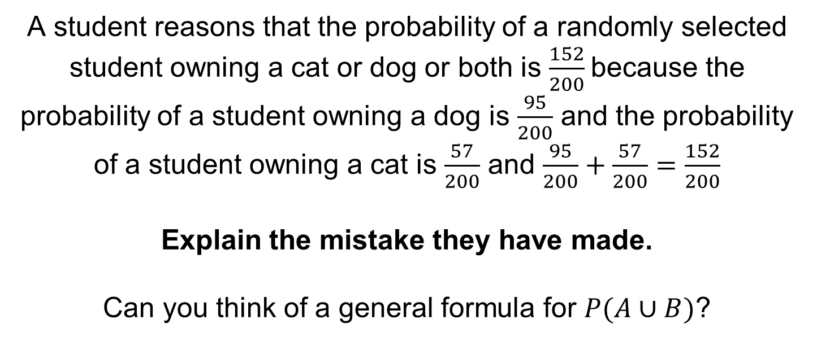
A student reasons that the probability of a randomly selected student owning a cat or dog or both is $\frac{152}{200}$because the probability of a student owning a dog is $\frac{95}{200}$ and the probability of a student owning a cat is $\frac{57}{200}$ and $\frac{95}{200}+\frac{57}{200}=\frac{152}{200}$
Explain the mistake they have made.
Can you think of a general formula for $P(A∪B)$?
Notes:
$$P\left(A∪B\right)=P\left(A\right)+P\left(B\right)−P(A∩B)$$

Slide 21
Further Practise
1. 90 children were asked what type of bottled water they took to school.
Their replies are as follows:
52 took sparkling water
36 took still water
14 took both types of water
(a) Show this information on a Venn diagram.
(b) Given that a child takes sparkling water, find the probability that this child also takes still water.
(c) Given that a child takes still water, find the probability that this child also takes sparkling water.
2. In a group of 40 students 6 are left-handed, 18 have size 8 feet and 2 are left-handed with size 8 feet.
(a) Find the probability that a student is left-handed or has size 8 feet,
(b) Given that the student is left-handed, find the probability that a student has size 8 feet.
3. In a survey 100 people were asked whether they watched snooker or cricket when it was on TV.
20 watched neither, 75 watched snooker, 32 watched cricket.
A person is selected at random.
(a) Find the probability that this person watched both cricket and snooker.
(b) Given that this person watched snooker, work out the probability that this person watched cricket.

Slide 22
4. There are 180 students at a college following a general course in computing.
Students on this course can choose to take up to three extra options.
112 take systems support
70 take developing software
81 take networking
35 take developing software and systems support
28 take networking and developing software
40 take systems support and networking
4 take all three extra options
Draw a Venn diagram to show this information.
A student from the course is chosen at random.
(b) Find the probability that this student takes
(i) none of the three extra options, (ii) networking only.
Students who want to become technicians take systems support and networking.
(c) Given that a randomly chosen student wants to become a technician, find the probability that this student takes all three extra options.
5. 100 people were asked which sports they watched on television.
Here are the results.
36 people watched cricket
28 people watched rugby
36 people watched football
17 people watched both cricket and rugby
19 people watched both cricket and football
15 people watched both rugby and football
10 people watched all three sports
(a) Draw a Venn diagram to show this information.
One of the 100 people is selected at random.
(b) Given that a person watches cricket, find the probability that this person also watches football.
(c) Given that a person watches at least one of the sports, find the probability that this person watches all three.

Slide 23
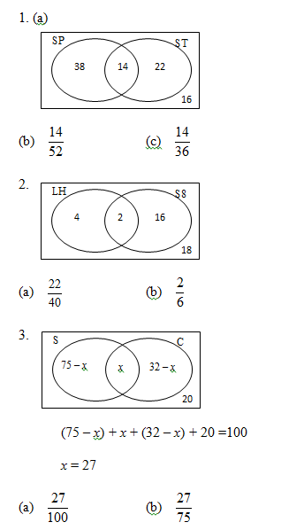
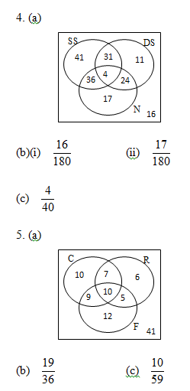
Mark your work

Slide 24
Exam Questions

Slide 25
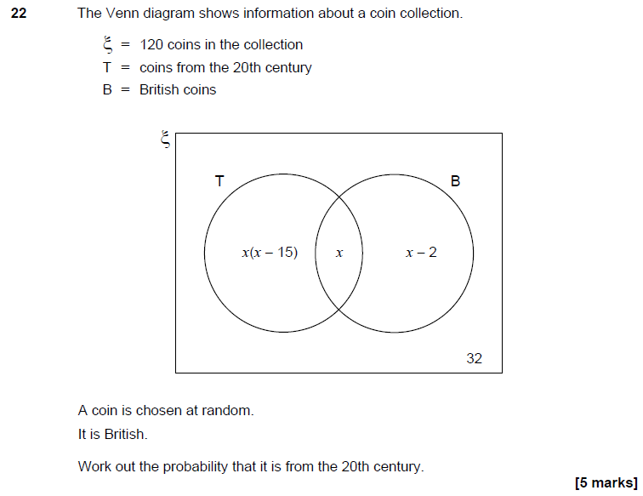
Notes:
Set 1 Paper 2

Slide 26
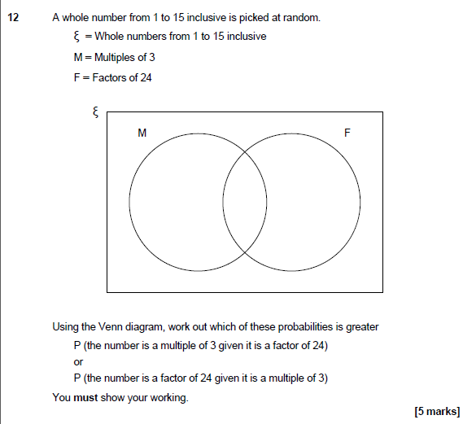
Notes:
Set 4 Paper 2

Slide 27
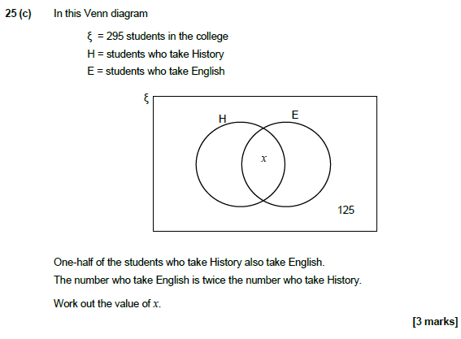
Notes:
Set 3 Paper 1

