Slide 1
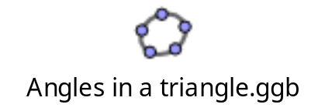
What do you remember about angles in a triangle from Primary school?
How can we show that this?

Slide 2
1) What transformation took place when we moved the slider?
2) Did the rotation change the measures of the blue or green angles?
3) From your observations, what is the sum of the interior angles of any triangle?
4) Why is that the case?

Slide 3
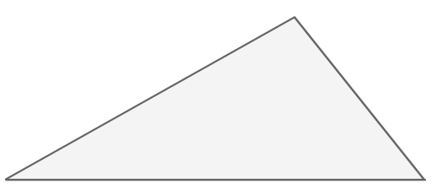
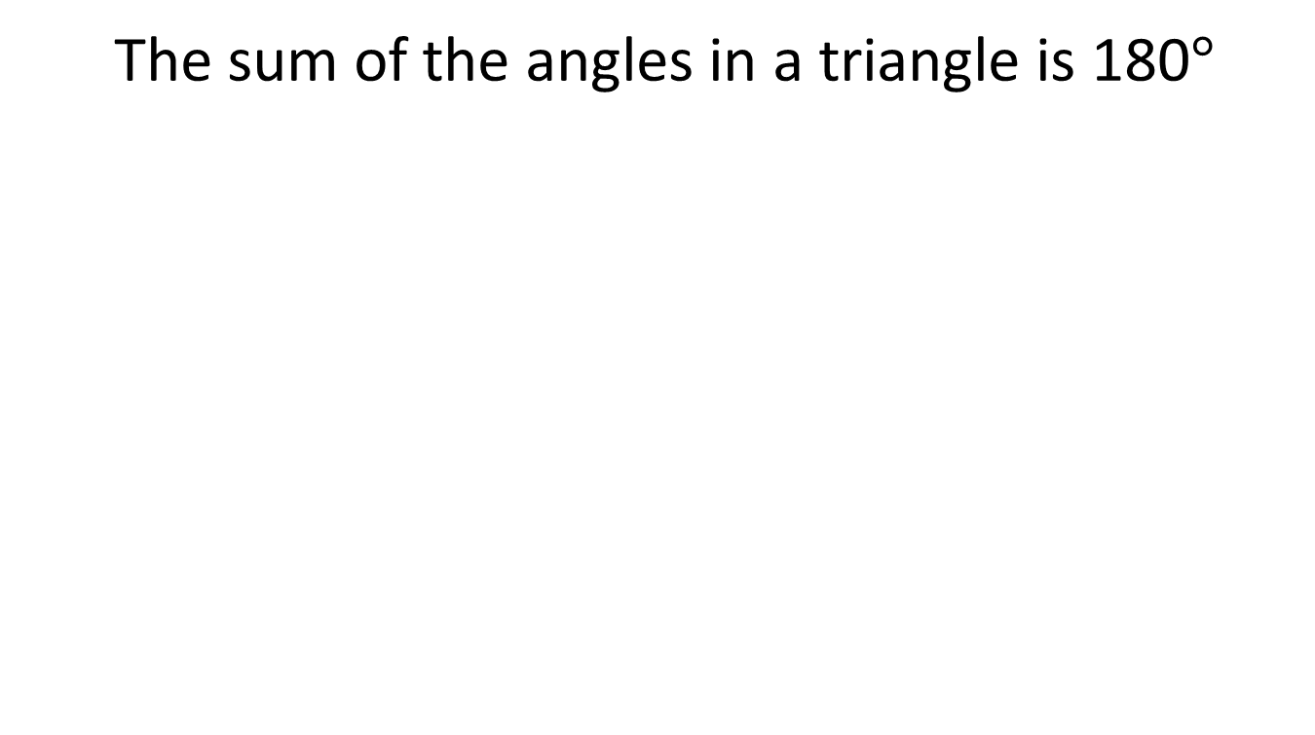
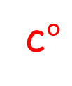
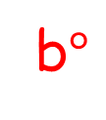
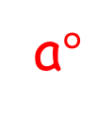
The sum of the angles in a triangle is 180$°$
b$°$
a$°$
c$°$
Give as many combinations as you can in the time you have
Give a combination that will not work – it will not make a triangle

Slide 4
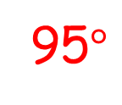
The sum of the angles in a triangle is 180$°$
95$°$
a$°$
c$°$
Give as many combinations as you can in the time you have
Give a combination that will not work – it will not make a triangle

Slide 5
The sum of the angles in a triangle is 180$°$
95$°$
a$°$
c$°$
Could this triangle be a right angled triangle?

Slide 6
On your whiteboards:
Find the missing angles
Explain how you found the answer
45°
45°
x°
x°
60°
75°
x°
75°
60°

Slide 7
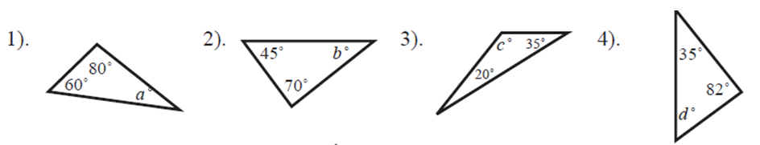
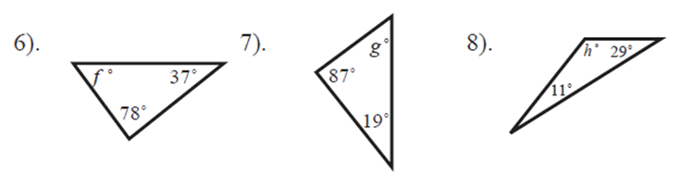
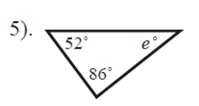
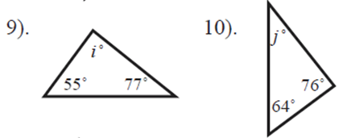
In your books:
Write a maths sentence for each diagram
Find the missing angles

Slide 8
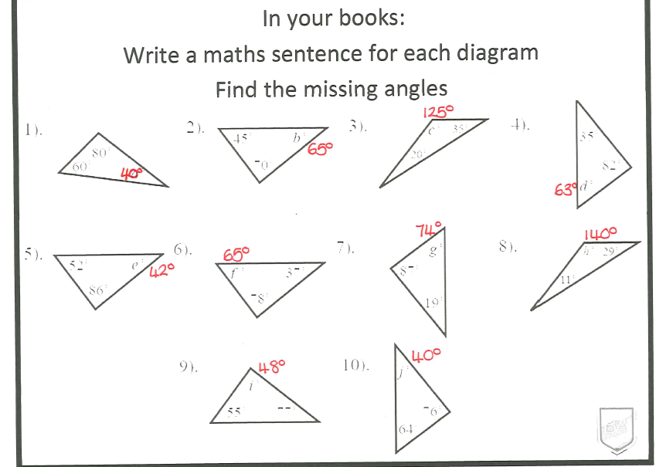

Slide 9
Challenge:
Write a maths sentence for each diagram, then use it to find x and the size of each angle
x°
2x°
2x°
60°
3x°
45°

Slide 10
On your whiteboards:
Find the missing angles
45°
x°
45°
60°
x°
75°
x°
75°
60°

Slide 11
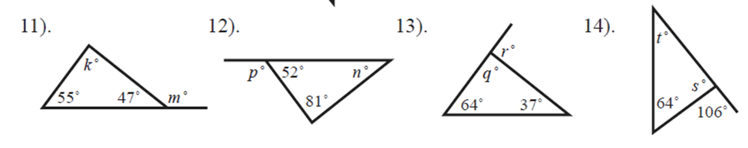
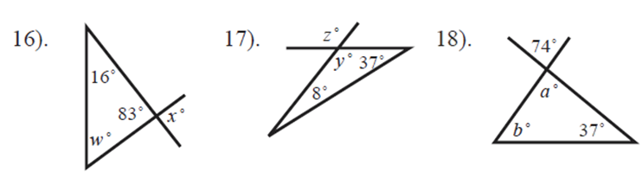
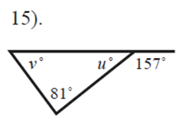
In your books:
Write a maths sentence for each letter.
Find the missing angles

Slide 12
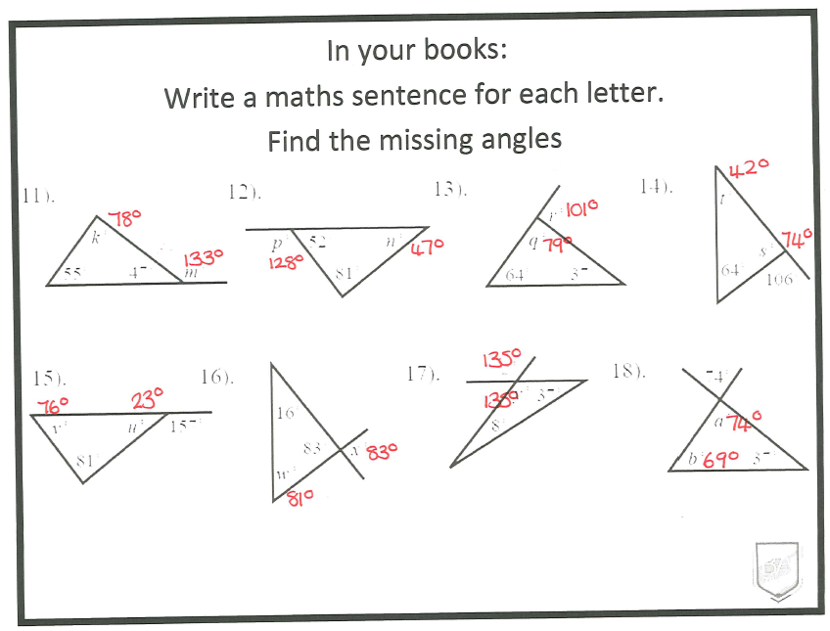

Slide 13
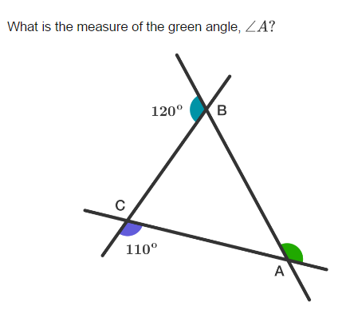
Challenge

Slide 14
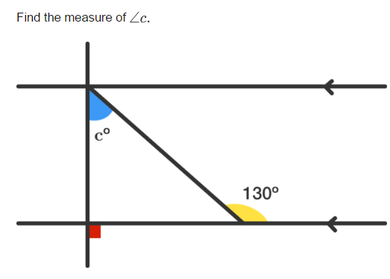
Challenge

Slide 15
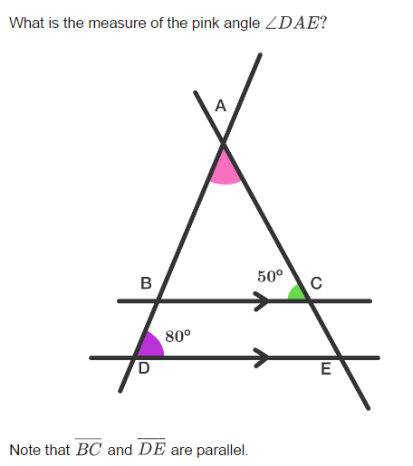
Challenge

Slide 16
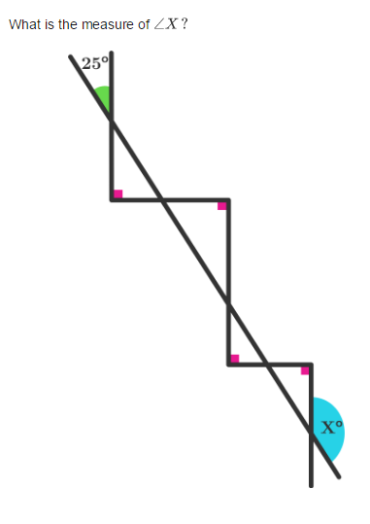
Challenge

