Slide 1
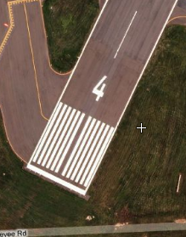
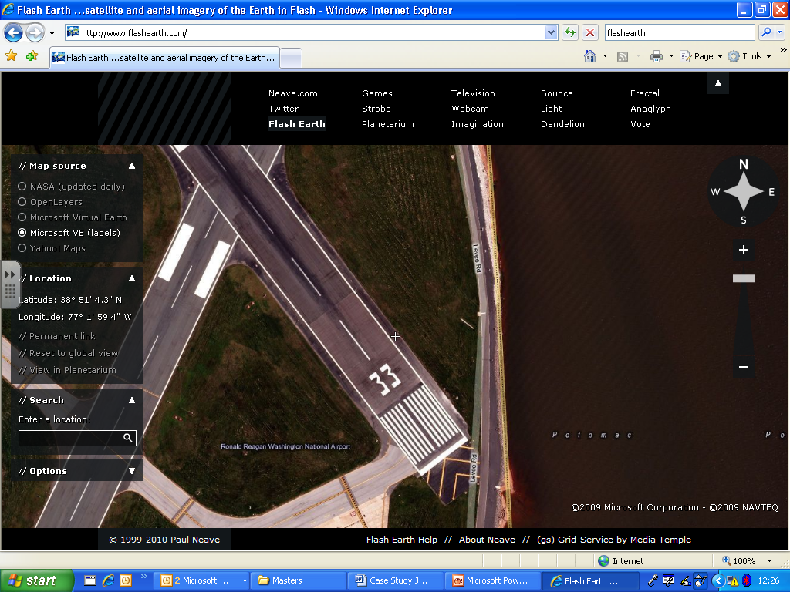
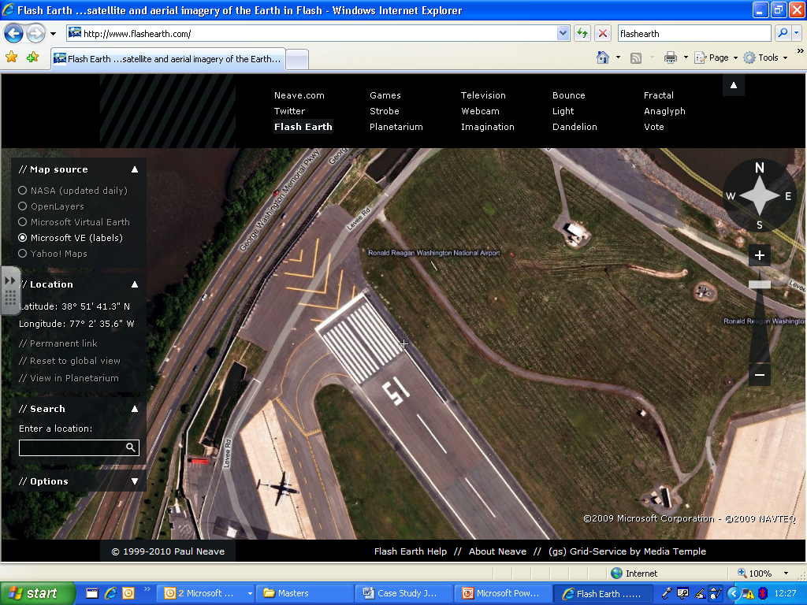
Have you ever noticed the numbers painted on
airport runways?
These numbers represent BEARINGS

Slide 2
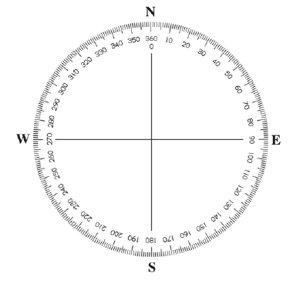


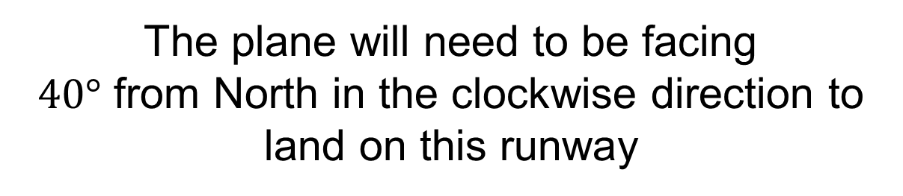
This $4$ represents $40°$
The plane will need to be facing
$40°$ from North in the clockwise direction to land on this runway

Slide 3

This $4$ represents $40°$
The pilot will need to land the plane with a bearing of $040°$

Slide 4

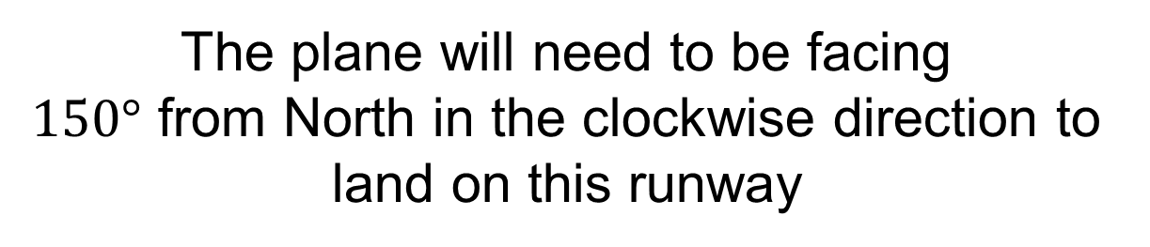
What does this number tell the pilot?
The plane will need to be facing
$150°$ from North in the clockwise direction to land on this runway

Slide 5

What does this number tell the pilot?
The pilot will need to land the plane with a bearing of $150°$

Slide 6
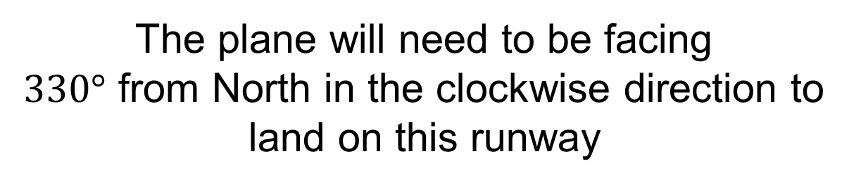
What does this number tell the pilot?
The plane will need to be facing
$330°$ from North in the clockwise direction to land on this runway

Slide 7

What does this number tell the pilot?
The pilot will need to land the plane with a bearing of $330°$

Slide 8
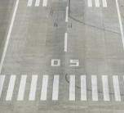
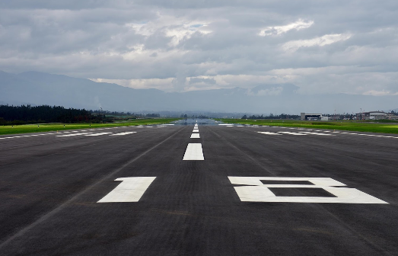
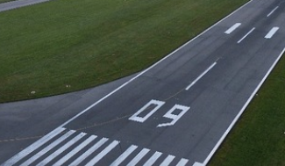
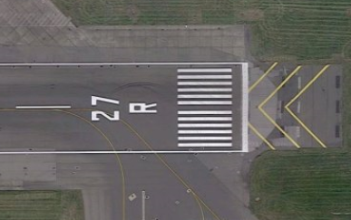
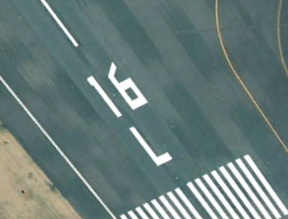
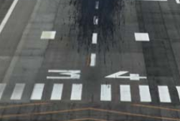
Draw the bearings on your compass for these landing runways

Slide 9
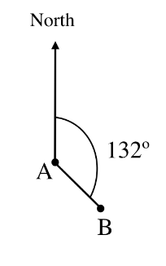
Here is the bearing of B from A

Slide 10
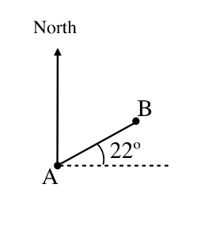

On your whiteboards:
What is the bearing of B from A?
$$68°$$

Slide 11
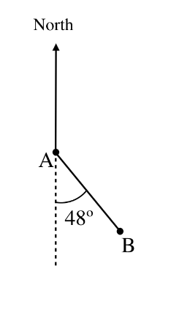

On your whiteboards:
What is the bearing of B from A?
$$132°$$

Slide 12
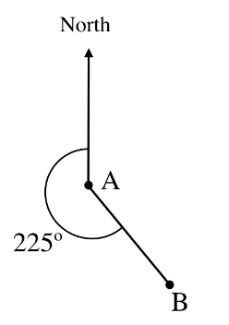

On your whiteboards:
What is the bearing of B from A?
$$135°$$

Slide 13
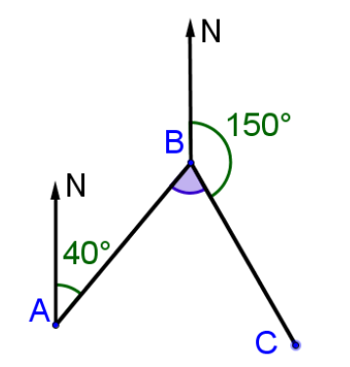
On your whiteboards:
What is the bearing of B from A?

Slide 14

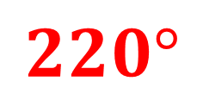

On your whiteboards:
What is the bearing of A from B?
$$220°$$
$$140°$$
$$70°$$

Slide 15
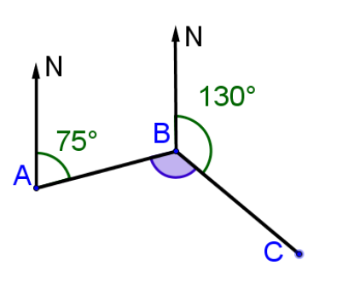

On your whiteboards:
What is the bearing of B from A?
$$075°$$

Slide 16



On your whiteboards:
What is the bearing of B from A?
$$255°$$
$$105°$$
$$125°$$

Slide 17
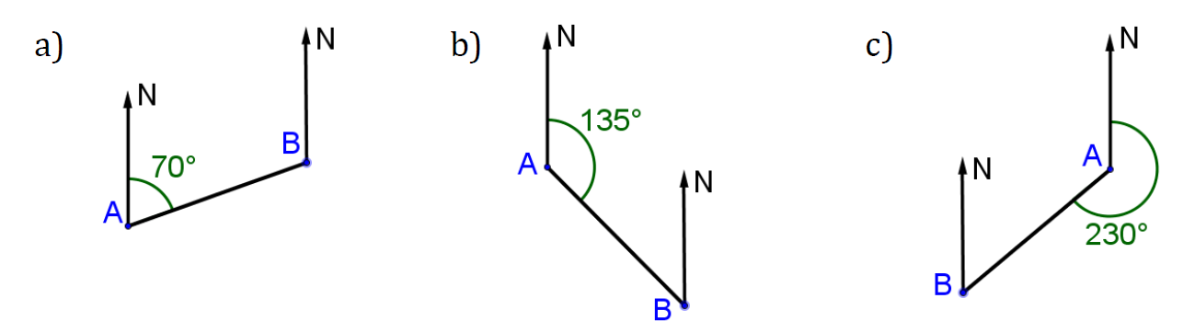
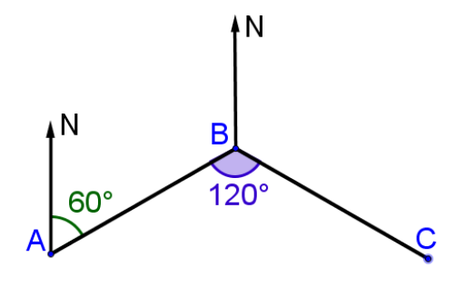
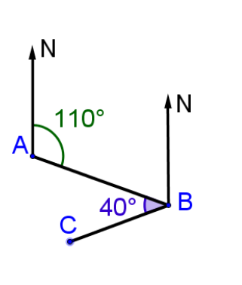
Your Turn:
1. Calculate the bearing of A from B

Slide 18
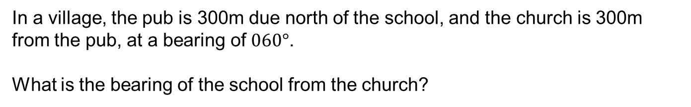
Challenge
In a village, the pub is 300m due north of the school, and the church is 300m from the pub, at a bearing of $060°$.
What is the bearing of the school from the church?
Notes:
Acknowledgements: Nrich https://nrich.maths.org/6263/solution

