Slide 1
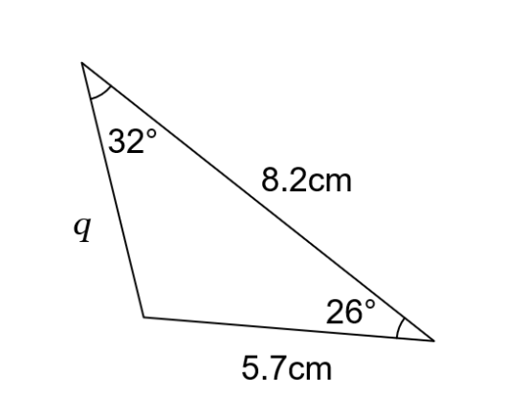

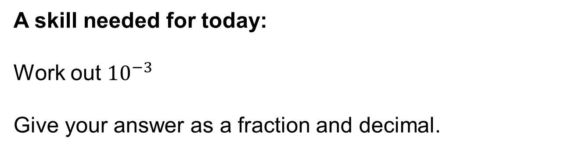


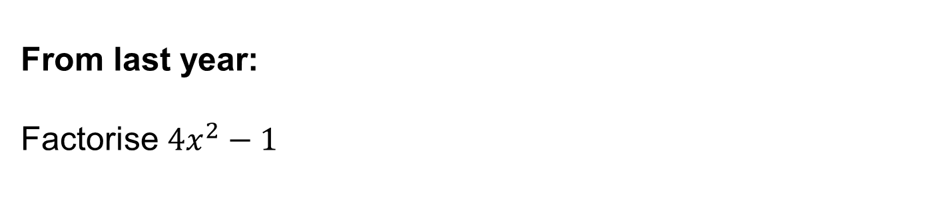
A skill needed for today:
Work out ${10}^{−3}$
Give your answer as a fraction and decimal.
$$3$$
$$2$$
$$1$$
From last term:
Work out the missing length, q
From last year:
Factorise ${4x}^{2}−1$
Notes:
Timed spaced retrieval – non calculator

Slide 2
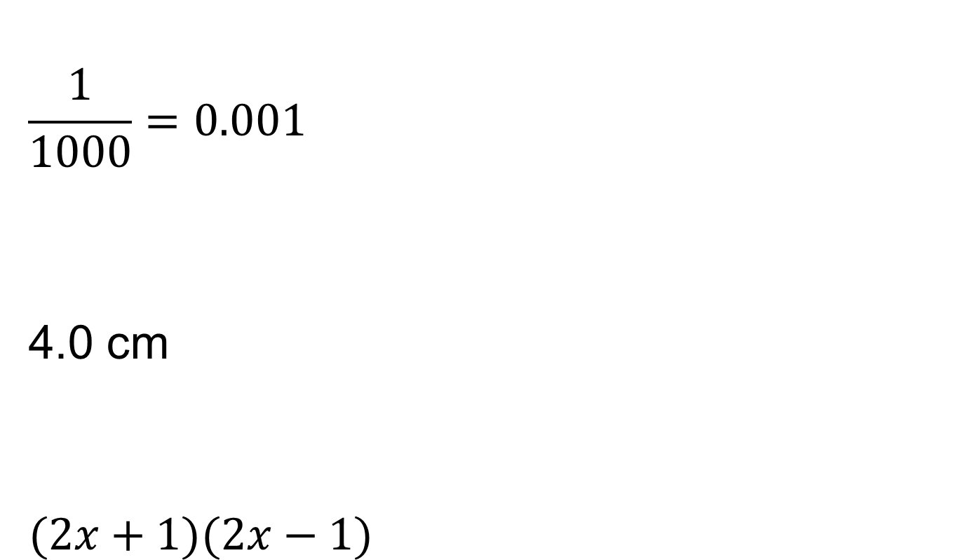
Mark your work
$$\frac{1}{1000}=0.001$$
4.0 cm
$$(2x+1)(2x−1)$$

Slide 3
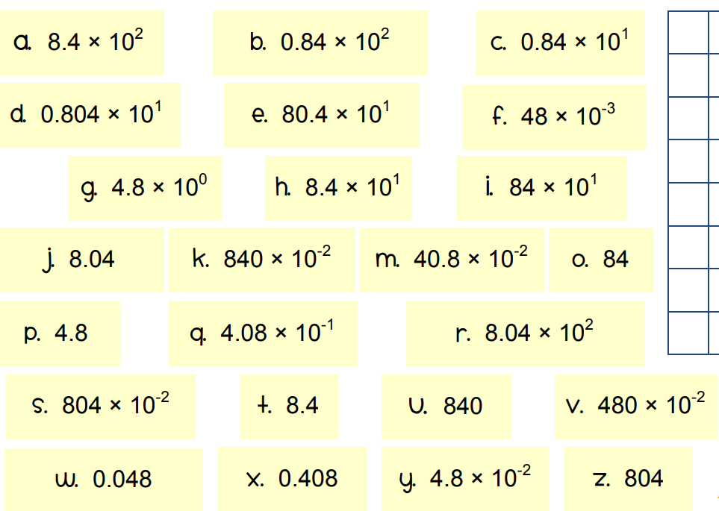
In pairs, put these numbers into groups of 3 that are equivalent.
Notes:
Task 1

Slide 4
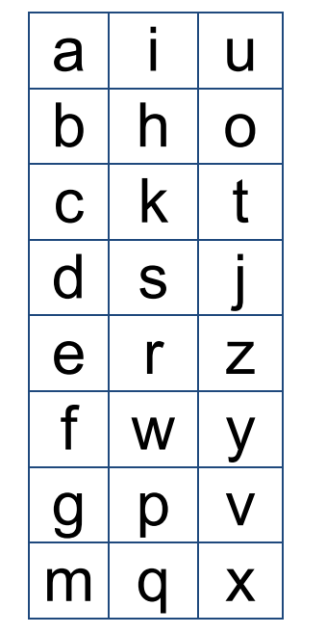
Check your work

Slide 5
Which of these values are written in STANDARD FORM?
Notes:
Questioning and recapping from last lesson

Slide 6
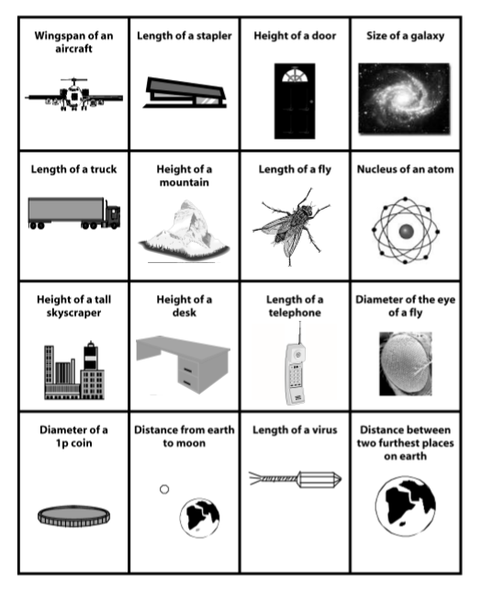
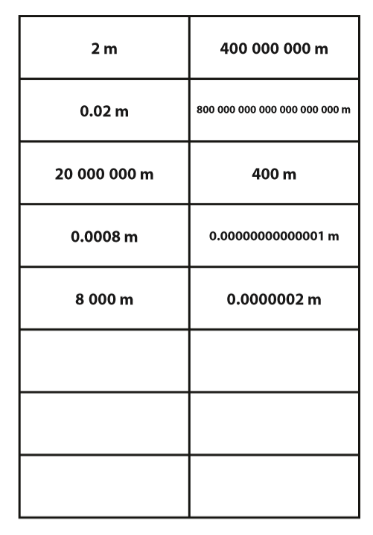
Notes:
Task 2 – Match the objects to their sizes. If students find this difficult ask them to put the objects and values in order of size., smallest to largest. The blank cards are for students to estimate the remaining sizes.

Slide 7
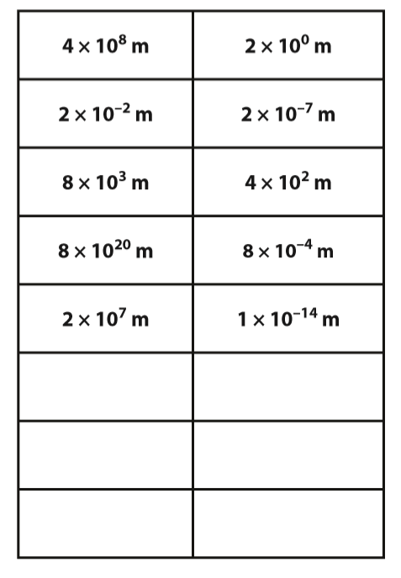
Now match these values to your other cards.

Slide 8
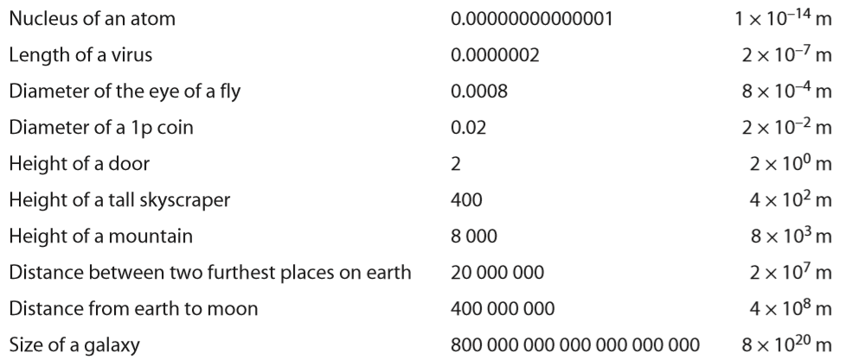
Answers
Notes:
In order of size

Slide 9
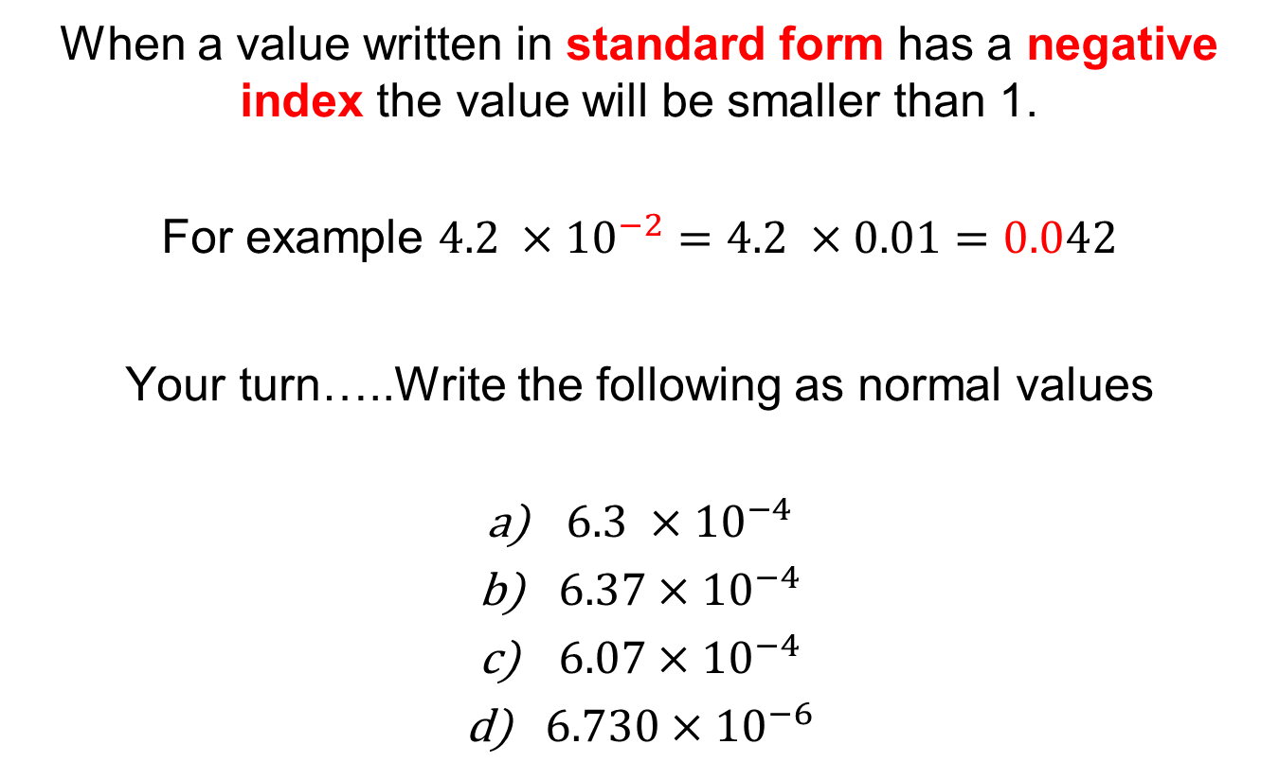
Title: Very Small Numbers
When a value written in standard form has a negative index the value will be smaller than 1.
For example $4.2 ×{10}^{−2}=4.2 ×0.01=0.042$
Your turn…..Write the following as normal values
$6.3 ×{10}^{−4}$
$6.37×{10}^{−4}$
$6.07×{10}^{−4}$
$6.730×{10}^{−6}$

Slide 10
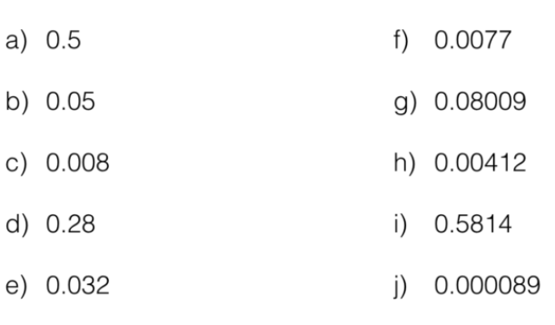
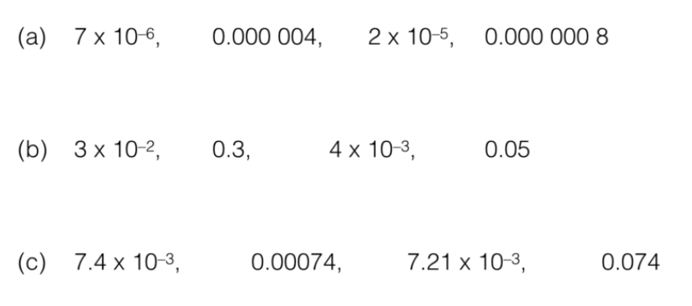
Further Practise
Write these numbers in standard form:
Put these values in order

Slide 11
Mark your work

Slide 12
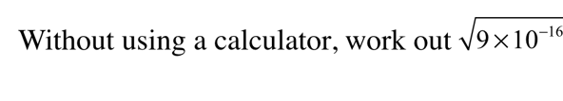
Challenge
Notes:
2.07 × 10¹³ or 2.1 × 10¹³ or 2 × 10¹³

