Slide 1
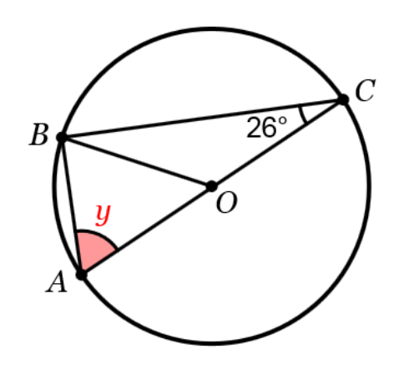
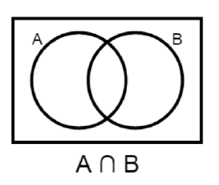



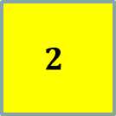

A skill needed for today:
Work out $4.6 ×{10}^{3}$
$$3$$
$$2$$
$$1$$
From last term:
Work out the missing angle, y.
From last year:
Copy and shade the correct region
Challenge: ?
Notes:
Timed spaced retrieval – non calculator

Slide 2
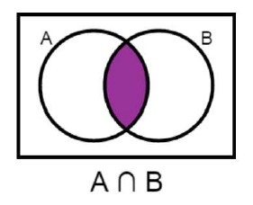
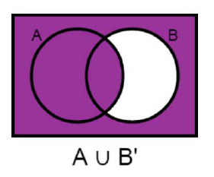
Mark your work
4600
64⁰

Slide 3
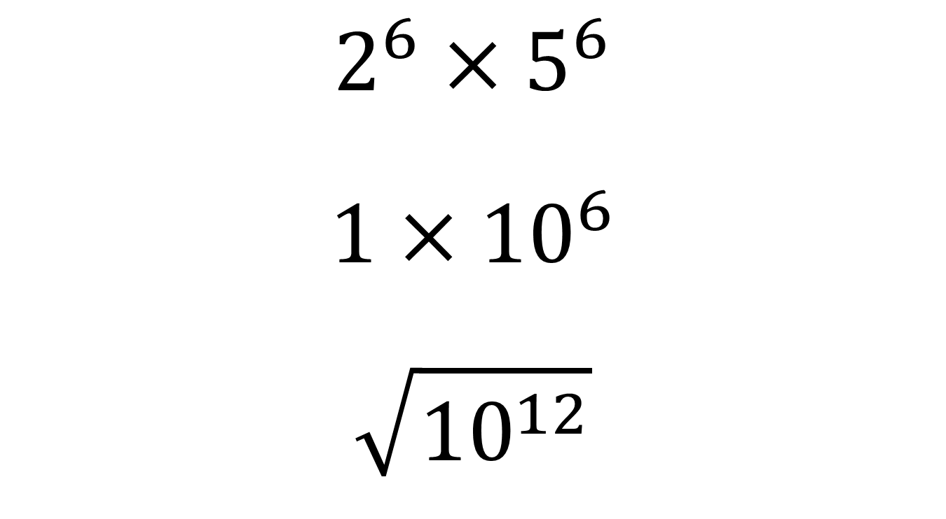
What is the number?
$$2^{6}×5^{6}$$
$$1×{10}^{6}$$
$$\sqrt{{10}^{12}}$$
Notes:
Ask students in pairs to work out the number that can be evaulated for each of these calculations

Slide 4
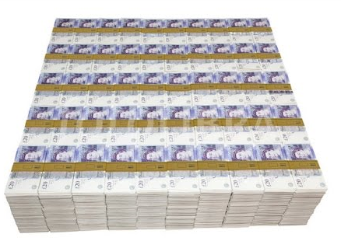
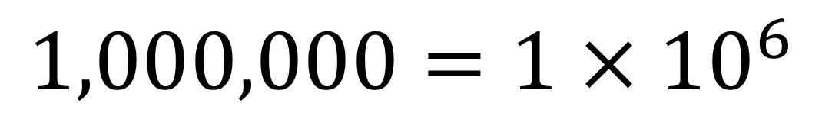
$$1,000,000=1×{10}^{6}$$
Notes:
Ask students in pairs to work out the number that can be evaulated for each of these calculations

Slide 5

10 000 000 000 000 000 000 000 000 000 000 000 000 000 000 000 000 000 000 000 000 000 000 000 000 000 000 000 000 000 000 000 000 000
This large number contains 100 zeroes.
What is this number called?
HINT : a very popular search engine was named after it…
But it’s actually spelt GOOGOL.

Slide 6
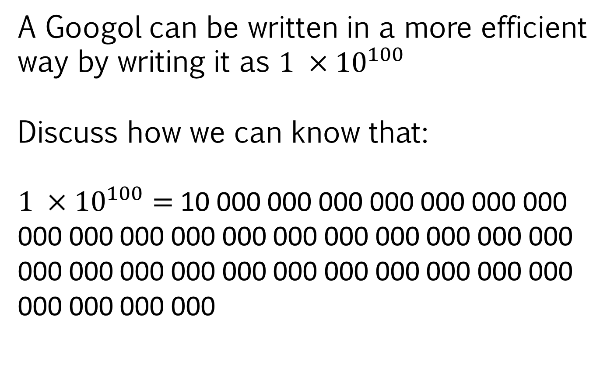
A Googol can be written in a more efficient way by writing it as $1 ×{10}^{100}$
Discuss how we can know that:
$1 ×{10}^{100}=$10 000 000 000 000 000 000 000 000 000 000 000 000 000 000 000 000 000 000 000 000 000 000 000 000 000 000 000 000 000 000 000 000 000

Slide 7
On your whiteboards write the following values in a similar, more efficient way:
1 000 000 000
7 000 000 000
7 300 000 000
7 340 000 000
Notes:
Compare and share whiteboards

Slide 8
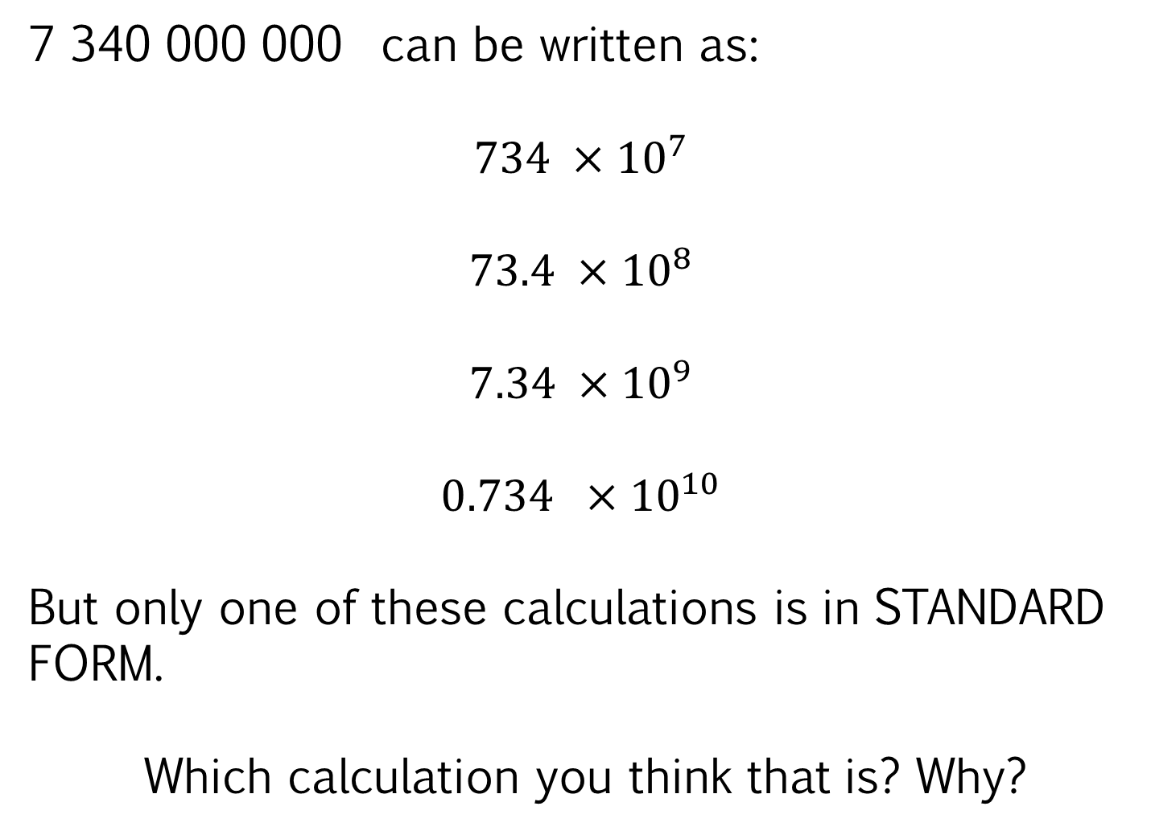
7 340 000 000 can be written as:
$$734 ×{10}^{7}$$
$$73.4 ×{10}^{8}$$
$$7.34 ×{10}^{9}$$
$$0.734 ×{10}^{10}$$
But only one of these calculations is in STANDARD FORM.
Which calculation you think that is? Why?
Notes:
Allows easier comparison of numbers

Slide 9
$$a ×{10}^{n}$$
A number written in this way is a number written in STANDARD FORM.
It is important to understand that $a$ must be a value greater or equal to 1 but less than 10 and that $n$is a positive or negative integer.

Slide 10





$$12 ×{10}^{4}$$
$$0.12 ×{10}^{4}$$
$$1.2 ×{10}^{−4}$$
Which of these numbers are written in standard form?
$${1.2}^{4}$$
$$1.2 ×{10}^{0.4 }$$
$$1.2 ×{10}^{4}$$

Slide 11
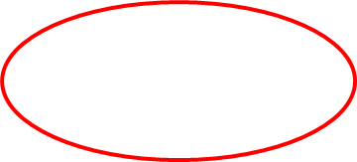


$$12 ×{10}^{4}$$
$$0.12 ×{10}^{4}$$
$$1.2 ×{10}^{−4}$$
Which of these numbers are written in standard form?
$${1.2}^{4}$$
$$1.2 ×{10}^{0.4 }$$
$$1.2 ×{10}^{4}$$

Slide 12
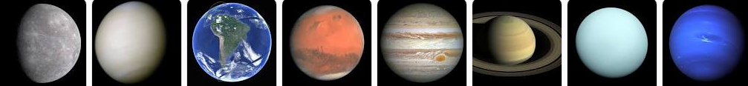
Here are the distances of each planet from the sun.
Write each distance in standard form.
Mercury – 60,000,000 km
Venus – 110,000,000 km
Earth – 149,600,000 km
Mars – 207,900,000 km
Jupiter – 778.3 million km
Saturn – 1427 million km
Uranus – 2871.1 million km
Neptune – 4497.1 million km
Notes:
Compare and share whiteboards

Slide 13
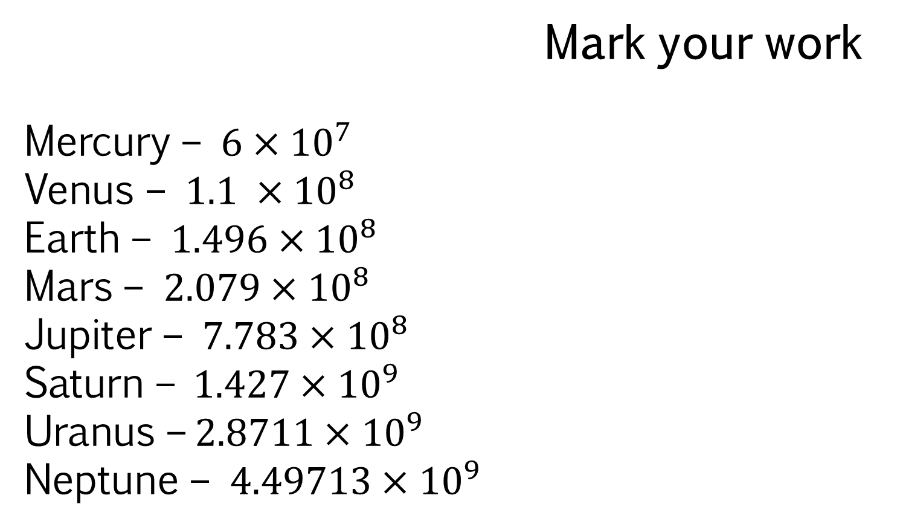
Mark your work
Mercury – $6×{10}^{7}$
Venus – $1.1 ×{10}^{8}$
Earth – $1.496×{10}^{8}$
Mars – $2.079×{10}^{8}$
Jupiter – $7.783×{10}^{8}$
Saturn –$1.427×{10}^{9}$
Uranus –$2.8711×{10}^{9}$
Neptune – $4.49713×{10}^{9}$
Notes:
Compare and share whiteboards

Slide 14
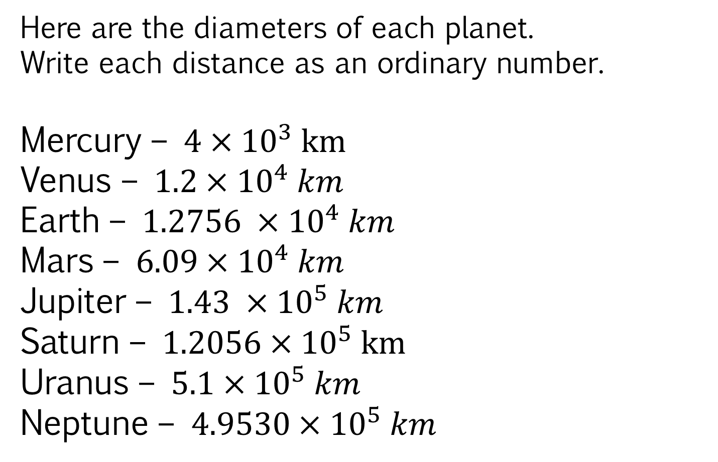
Here are the diameters of each planet.
Write each distance as an ordinary number.
Mercury – $4×{10}^{3} km$
Venus – $1.2×{10}^{4} km$
Earth – $1.2756 ×{10}^{4} km$
Mars – $6.09×{10}^{4} km$
Jupiter – $1.43 ×{10}^{5} km$
Saturn – $1.2056×{10}^{5} km$
Uranus – $5.1×{10}^{5} km$
Neptune – $4.9530×{10}^{5} km$
Notes:
Compare and share whiteboards

Slide 15
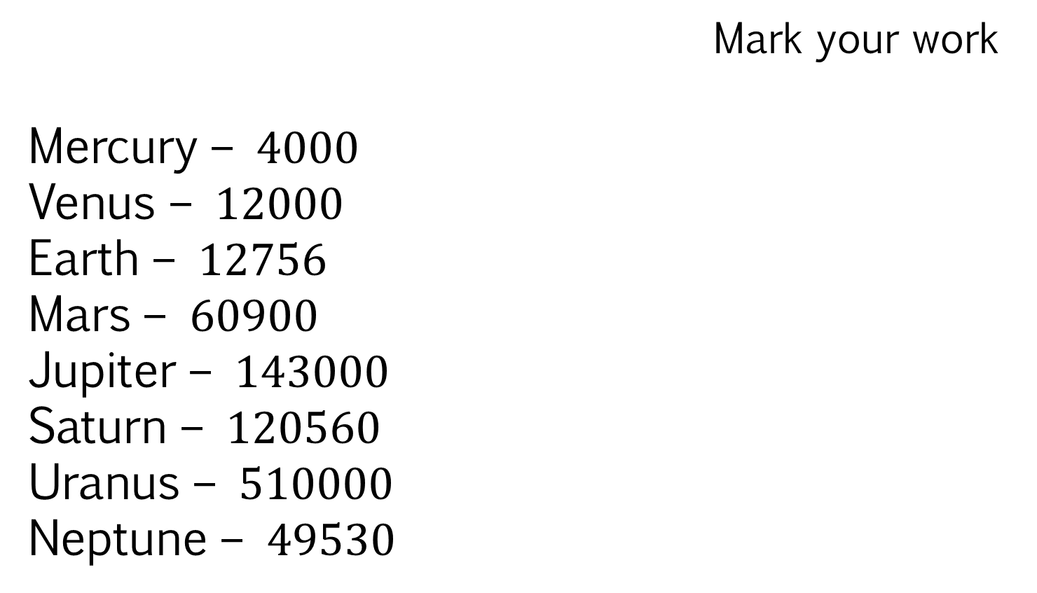
Mark your work
Mercury – $4000$
Venus – $12000$
Earth – $12756$
Mars – $60900$
Jupiter – $143000$
Saturn – $120560$
Uranus – $510000$
Neptune – $49530$
Notes:
Compare and share whiteboards

Slide 16
Challenge
In the body, the ratio of the number of red blood cells to the total of all cells = 5 : 9
It is estimated that there are 3.72 × 10¹³ cells in total.
Work out the number of red blood cells.
Give your answer in standard form to an appropriate degree of accuracy.
Notes:
2.07 × 10¹³ or 2.1 × 10¹³ or 2 × 10¹³

