Slide 1
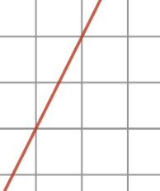

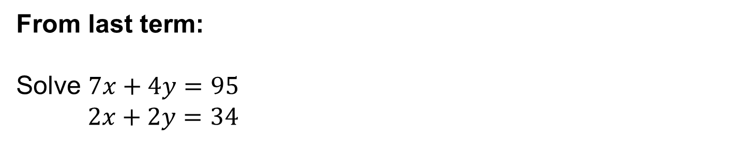



A skill needed for today:
What is the gradient of this line segment?
$$3$$
$$2$$
$$1$$
From last term:
Solve $7x+4y=95$
$2x+2y=34$
From last year:
Expand and simplify $(2x+1)(x−9)$
Notes:
Timed spaced retrieval

Slide 2
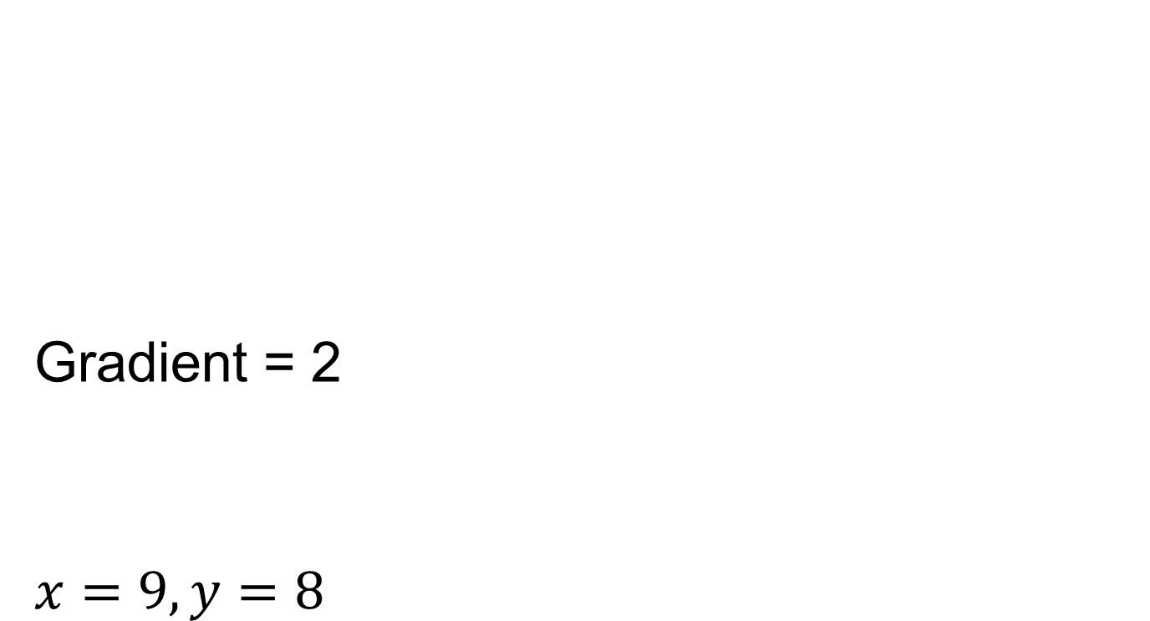
Mark your work
Gradient = 2
$$x=9, y=8$$

Slide 3
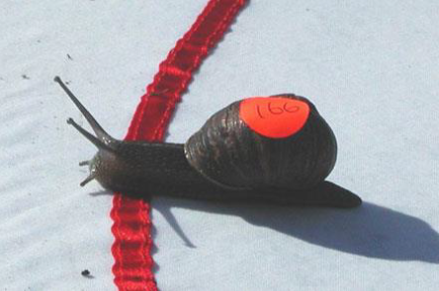
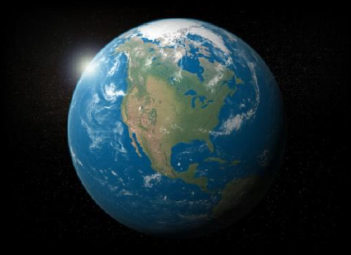
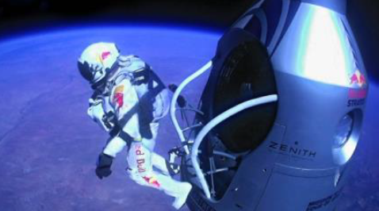
Calculate the average speed
Felix Baumgartner recently set a number of records by jumping out of a balloon 39km above the ground. At one point he was travelling faster than the speed of sound. Altogether he took about 10 minutes to reach the ground.
What was his average speed in km per minute?
According to the 1998 Guinness Book of World Records, the winner of the 1995 world snail racing championships was a garden snail named Archie which completed the 33cm racecourse in exactly 2 minutes.
What was the speed of the snail, in cm per minute?
The earth is hurtling through space in its orbit around the sun. Since we’re all travelling with it at the same speed (relative to the sun) we don’t notice the effect, but every year (around 365 days) we accompany our planet on a
940 million km journey around the sun.
What speed is this, in kilometres per day?
Put these in order from slowest to fastest with calculations to support your answer.
Notes:
Calculator Allowed

Slide 4
Mark your work
Felix: 3.9 km/min
Snail: 16.5 cm/min
Earth: 2575342 km/day
Order: Snail 0.0099km/h, Felix 234 km/h, Earth 107306 km/h

Slide 5


A ball is thrown in the air from a height of 1m above the ground.
$$height (m)$$
$$time(s)$$
Sketch a graph that shows the distance of the ball from the ground until the ball hits the ground.
Notes:
Share and compare whiteboards/worksheets

Slide 6
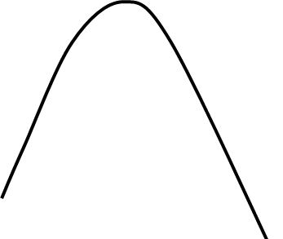








Why is the line curved and not straight?
$$height (m)$$
$$height (m)$$
$$1$$
$$1$$
$$time(s)$$
$$time(s)$$
Speed is not always constant
Notes:
Share and compare whiteboards

Slide 7
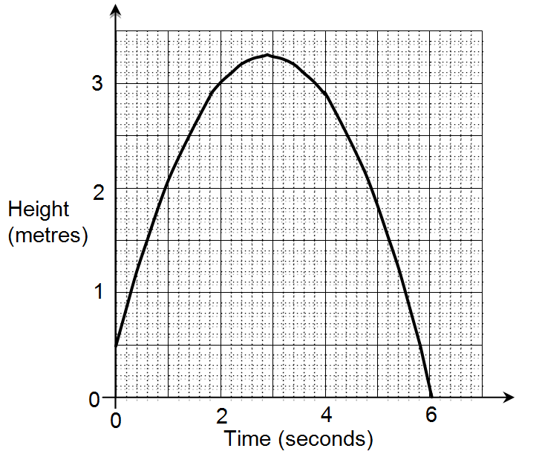
Here is the graph with all values marked on the axes.
How could we estimate the speed of the
ball at 1 second?

Slide 8

Using a tangent to the curve can estimate the distance travelled in a given time interval.
Distance
Time
Distance = 1 m
Time Taken = 0.8 s
Speed = $1÷0.8=1.25 ms^{−1}$

Slide 9
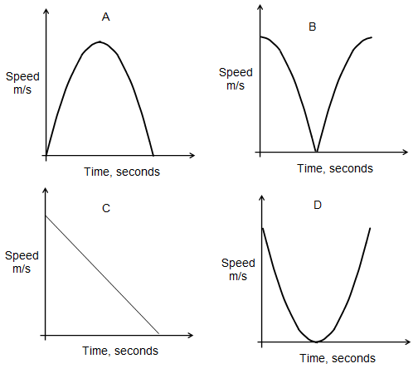
Your Turn
Work out the speed of the ball when t = 2 seconds
After how many seconds did the ball reach its maximum height?
Which sketch graph shows the speed of the ball?

Slide 10
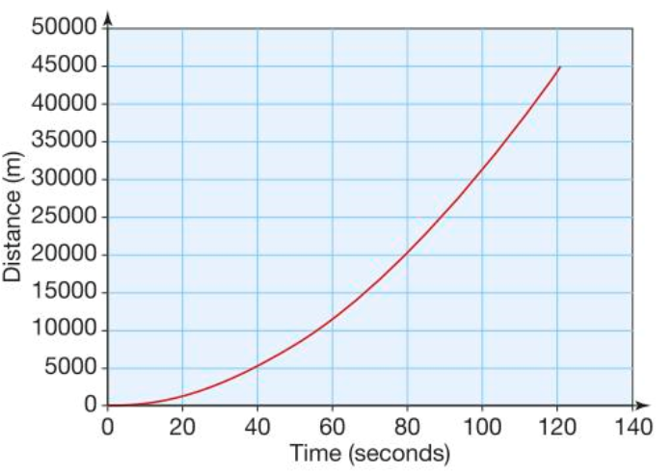
The graph shows the distance of a space shuttle from Earth over a 2 minute period.
Work out the average speed for the 2 minutes journey in km/min
Estimate the speed of the space shuttle at 90 seconds in km/s

Slide 11
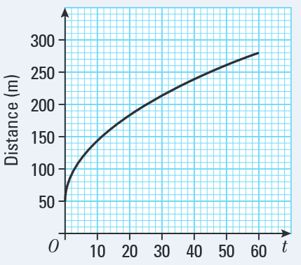
The graph shows the distance that a car has travelled in its first minute measured from a point on a road.
Calculate the average speed of the car for the entire journey in m/s
2. Estimate the speed at the following
times:
3. Use this to sketch a speed – distance
graph
Time | Speed
10
20
30
40
50

Slide 12
Challenge
I walked to the bike shop at a speed of 3 miles per hour, and cycled back along the same route of 12 miles per hour.
What was my average speed for
the whole trip?
Notes:
Acknowledgements: Nrich https://nrich.maths.org/2410
Answer = 4.8 miles per hour

