Slide 1
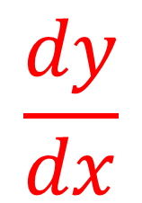
Finding the gradient
In general, the gradient of any line is given by finding the difference in two y-coordinates divided by the difference in the two corresponding x-coordinates.
This can more simply be referred to as:
Difference in y
$$\frac{dy}{dx}$$
Difference in x
Notes:
Do this as a class so students understand how

Slide 2
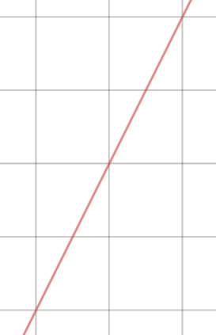



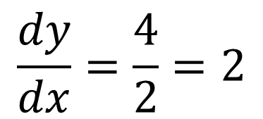


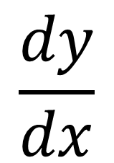

$$\frac{dy}{dx}$$
Finding the gradient
Worked Example
Find the gradient of the line that passes through the points (2,7) and (4,11)
$$dy=y_{2}−y_{1}$$
$$dx=x_{2}−x_{1}$$
$$dy=11−7$$
$$dx=4−2$$
$$dy=4$$
$$dx=2$$
$$\frac{dy}{dx}=\frac{4}{2}=2$$
Notes:
Silent teacher approach for worked example.

Slide 3
$$\frac{dy}{dx}$$
Finding the gradient
Worked Example
Find the gradient of the line that passes through the points (2,7) and (4,11)
Your Turn
Find the gradient of the line that passes through the points (4,10) and (2,7)
$$dy=y_{2}−y_{1}$$
$$dx=x_{2}−x_{1}$$
$$dy=11−7$$
$$dx=4−2$$
$$dy=4$$
$$dx=2$$
$$\frac{dy}{dx}=\frac{4}{2}=2$$
Notes:
Silent teacher approach for worked example.

Slide 4



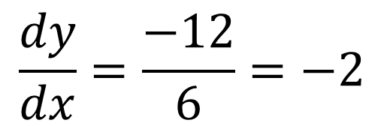


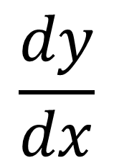

$$\frac{dy}{dx}$$
Finding the gradient
On your whiteboards (no calculator)
Find the gradient of the line that passes through the points (-2,1) and (4,-11)
$$dy=y_{2}−y_{1}$$
$$dx=x_{2}−x_{1}$$
$$dy=−11−1$$
$$dx=4−(−2)$$
$$dy=−12$$
$$dx=6$$
$$\frac{dy}{dx}=\frac{−12}{6}=−2$$

Slide 5
$$\frac{dy}{dx}$$
Finding the gradient
On your whiteboards: (no calculator)
Find the gradient of the line that passes through the points (-2,-6) and (10,-20)
Notes:
Share and compare whiteboards

Slide 6
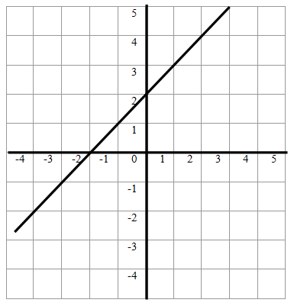
$$\frac{dy}{dx}$$
Finding the gradient
On your whiteboards: (no calculator)
Find the gradient of this line
Notes:
Share and compare whiteboards

Slide 7
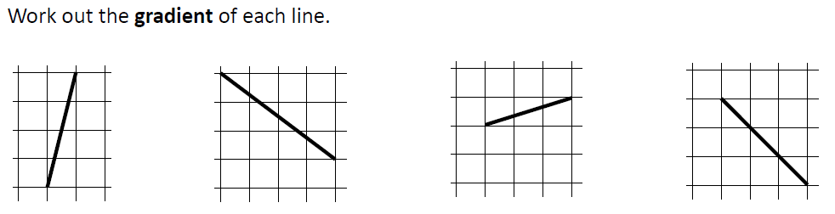
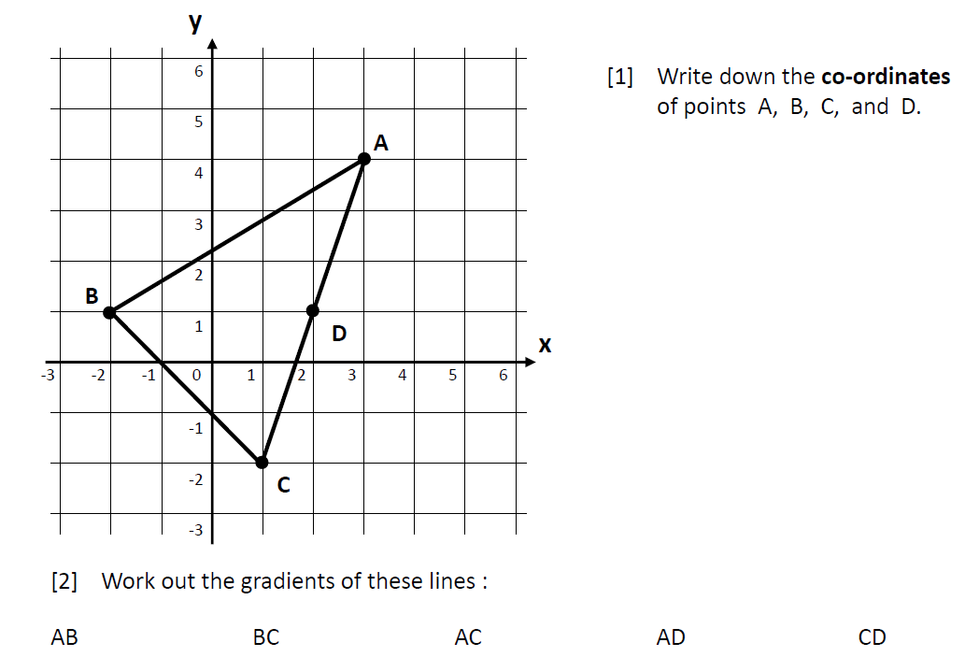

Slide 8
Answers
4 -3/4 1/3 -1
A (3,4) B (-2,1)
C (1,-2) D (2,1)
AB: 3/5
BC: -1
AC: 3
AD: 3
CD: 3

Slide 9




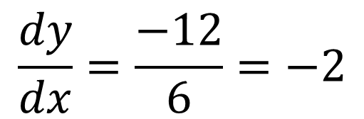
Working out the y-intercept
Worked Example
Find the equation of the line that passes through the points (-2,1) and (4,-11)
Your Turn
Find the equation of the line that passes through the points (2,6) and (4,20)
$$\frac{dy}{dx}=\frac{−12}{6}=−2$$
$$y=−2x+c$$
$$1=−2(−2)+c$$
$$1=4+c$$
$$c=−3$$
Notes:
Silent Teacher

Slide 10
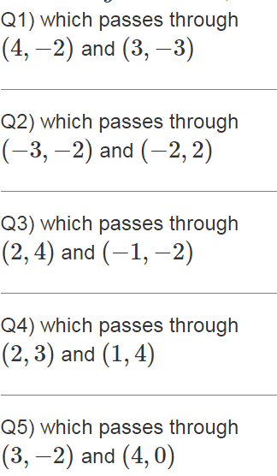
Work out the y-intercept of the following lines:
What are the equations
of these straight lines?

Slide 11
Mark your work
-6
10
2
5
-8

Slide 12
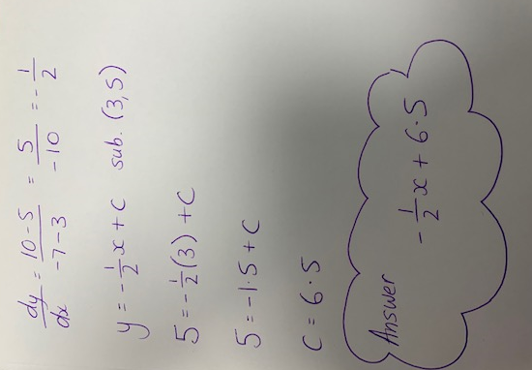
Spot the Mistake
A student calculates the equation of the straight line passing through points (3, 5) and (-7, 10)

Slide 13
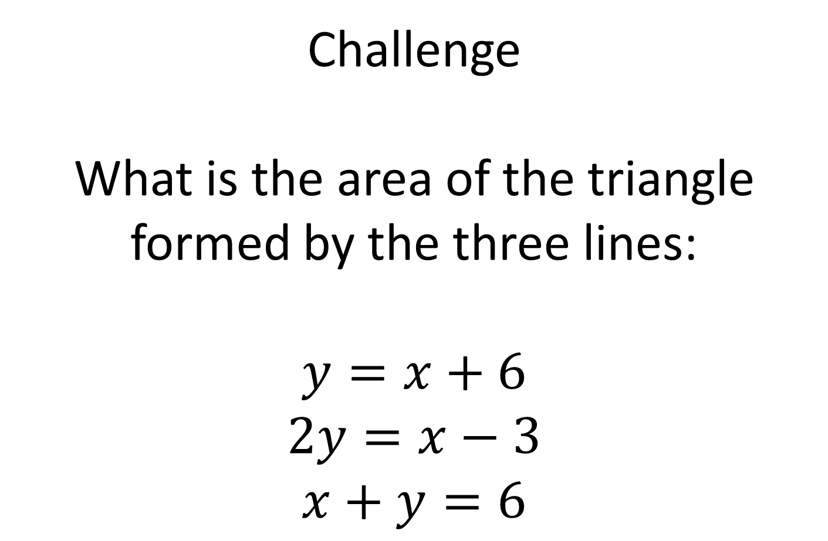
Challenge
What is the area of the triangle formed by the three lines:
$$y=x+6$$
$$2y=x−3$$
$$x+y=6$$

Slide 14
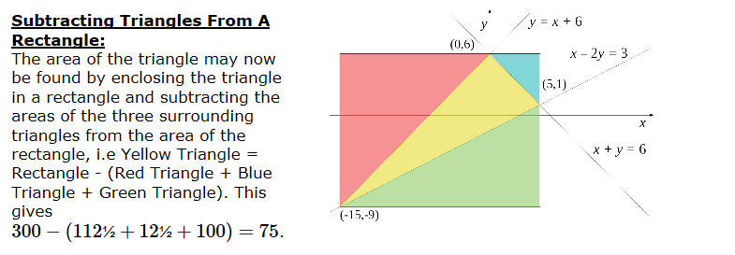
Notes:
Acknowledgements: Nrich and Andrew Wyatt

