Slide 1
Circle Theorems
Give a REASON for each answer
Numbered Heads Together

Slide 2
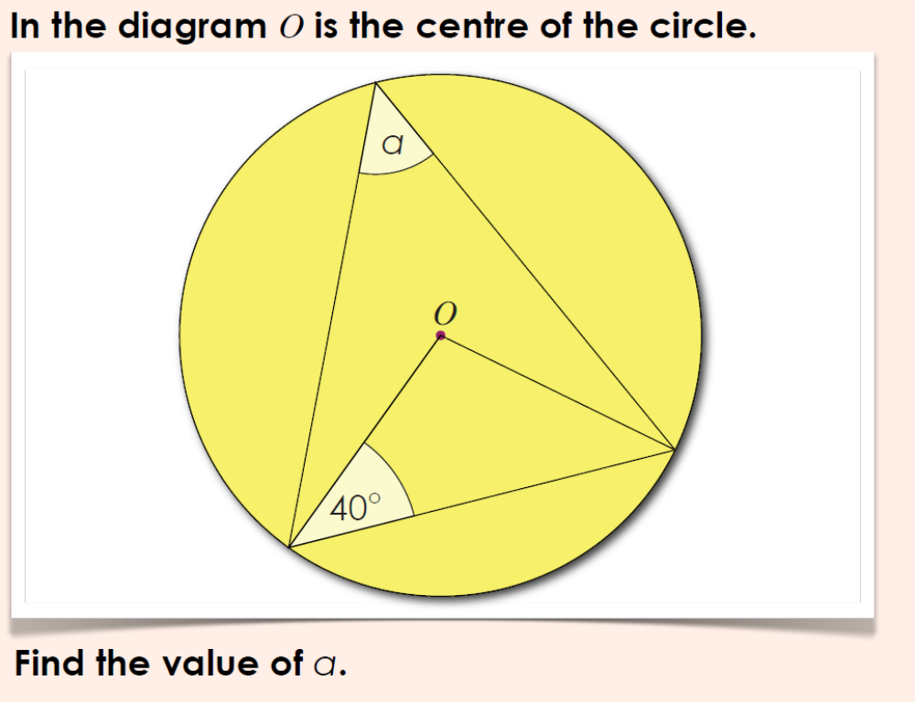
Question 1

Slide 3
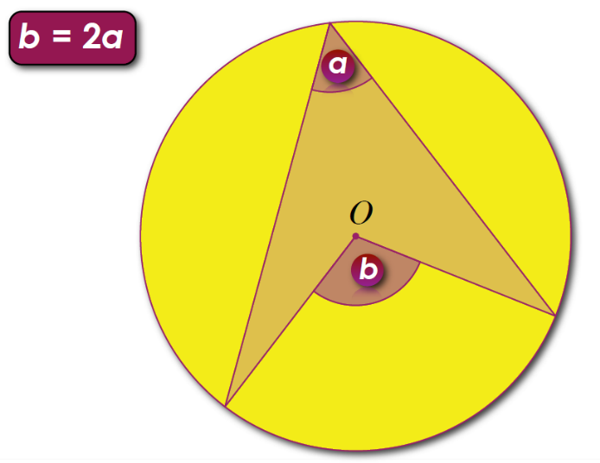
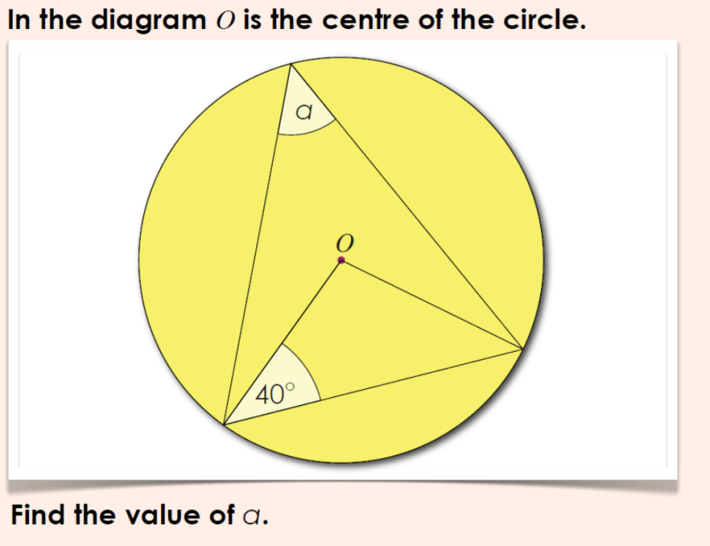

Answer 1
The angle at the centre is twice the angle at the circumference.
The Radii form an Isosceles Triangle.

Slide 4
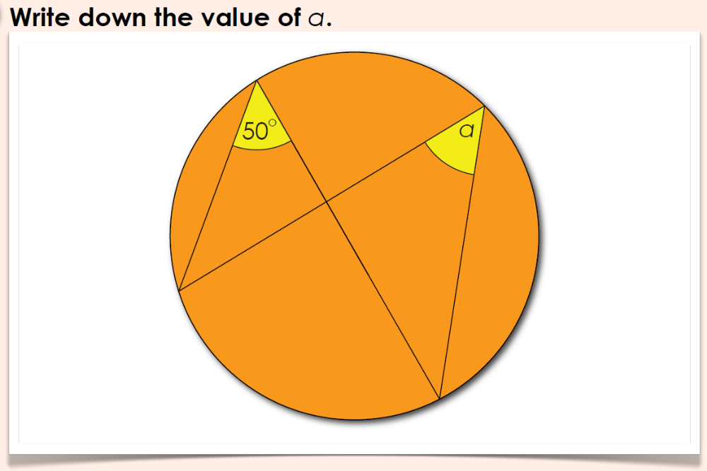
Question 2

Slide 5
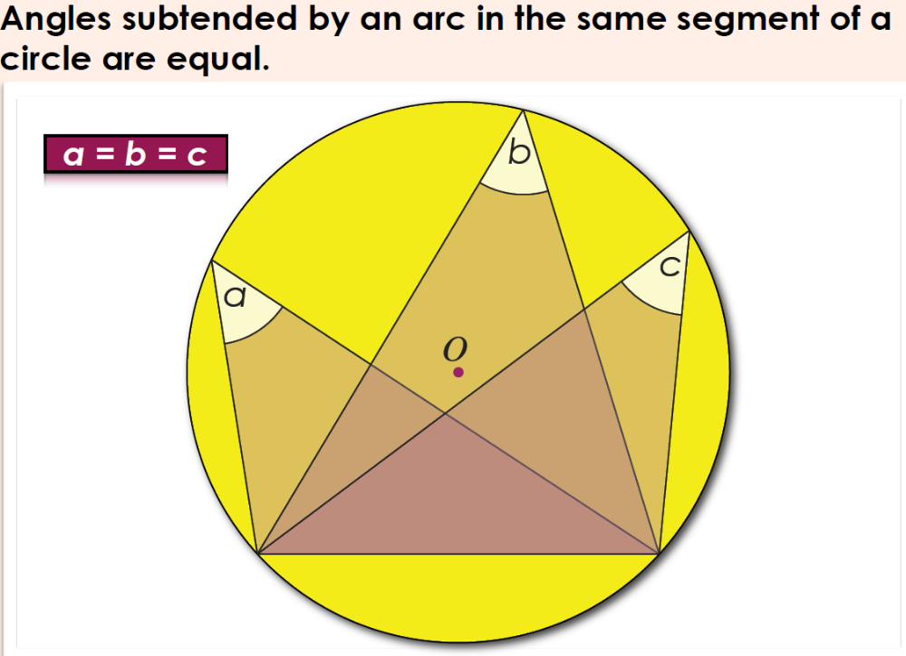
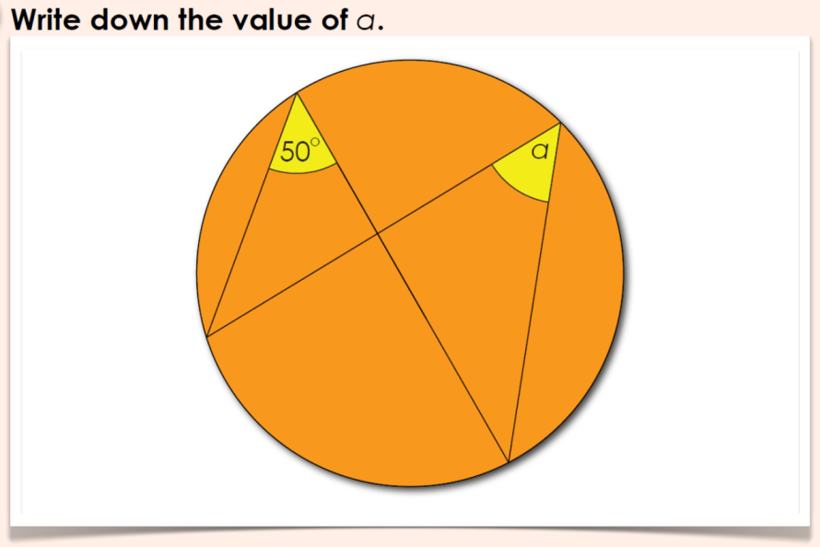
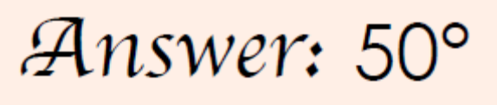
Answer 2
Angles in the same segment are equal.

Slide 6
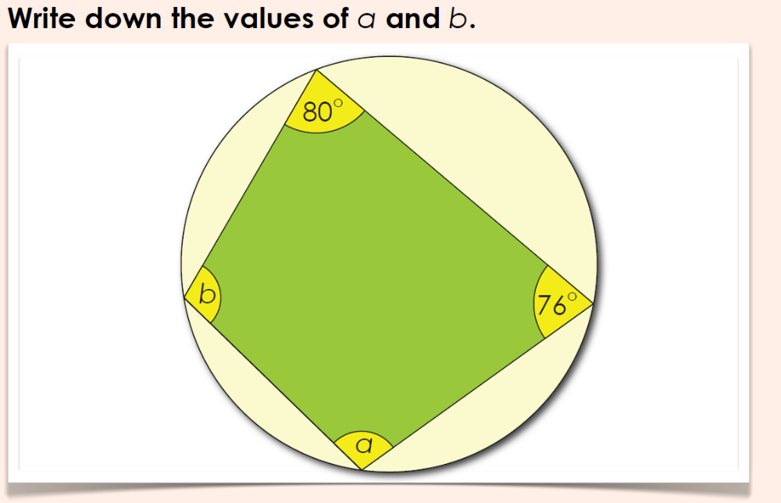
Question 3

Slide 7
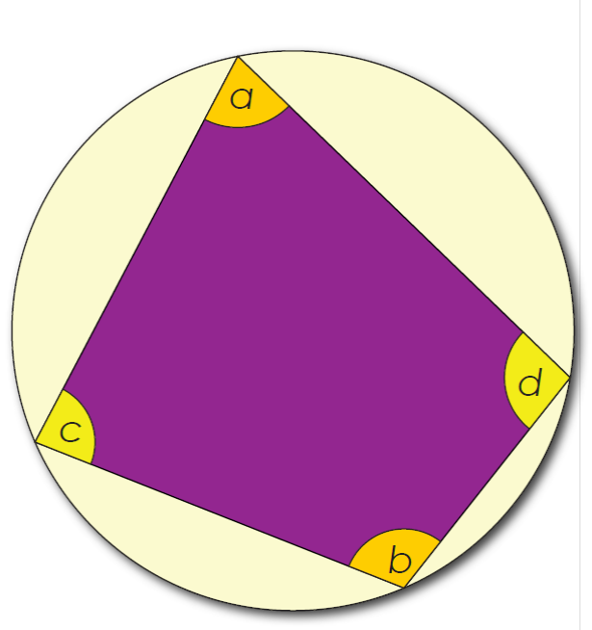

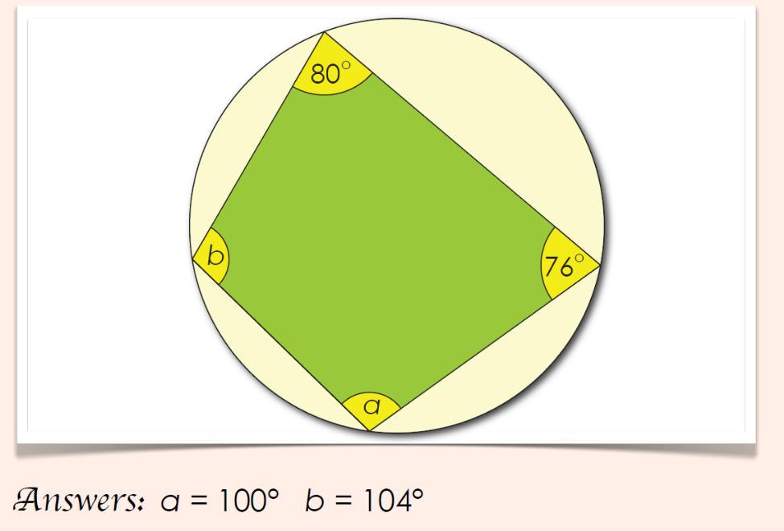
Answer 3
Opposite Angles in a Cyclic Quadrilateral add up to 180.

Slide 8
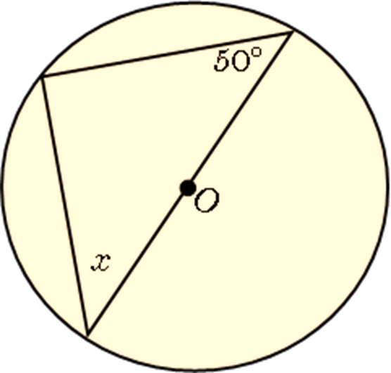
Question 4
Work out the size of angle x

Slide 9
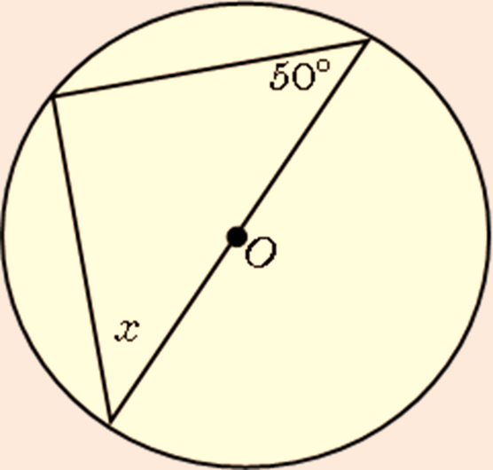
Answer 4
The angle in a semi circle is 90
x = 40

Slide 10
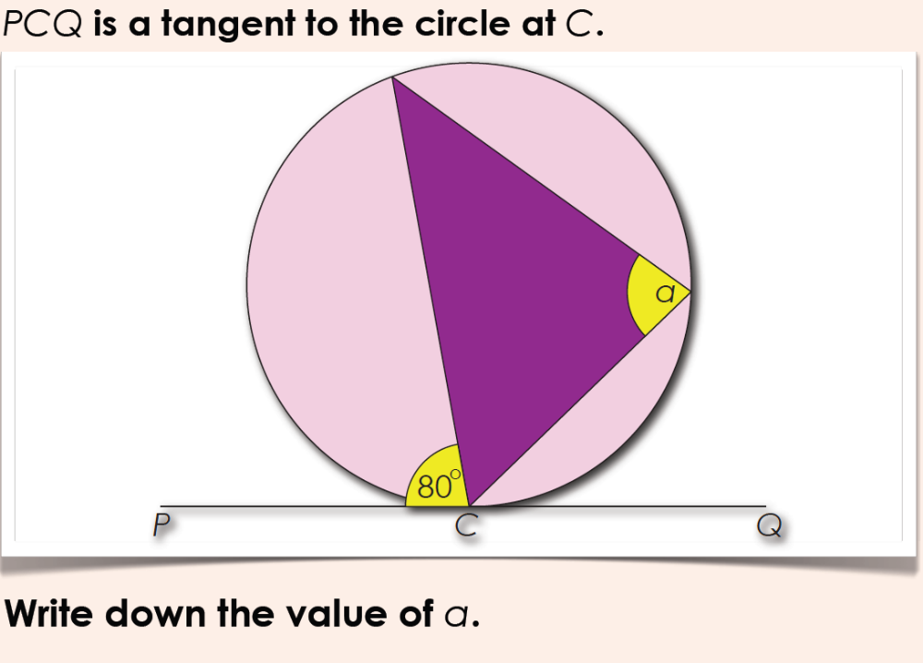
Question 5

Slide 11
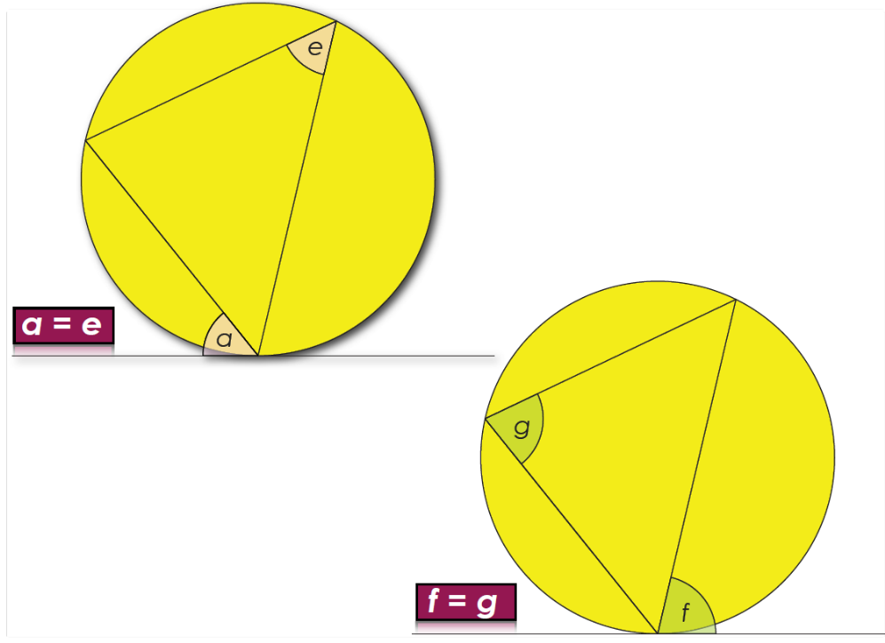
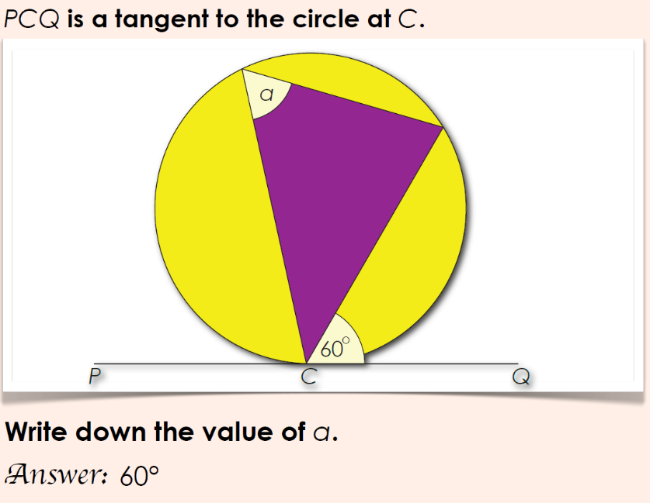
Answer 5
The Alternate Segment Theorem.

Slide 12
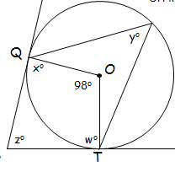
Question 6
Work out angle z

Slide 13
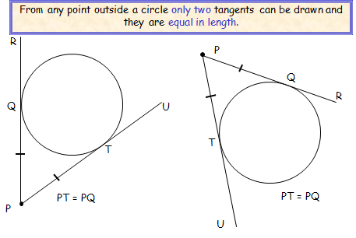
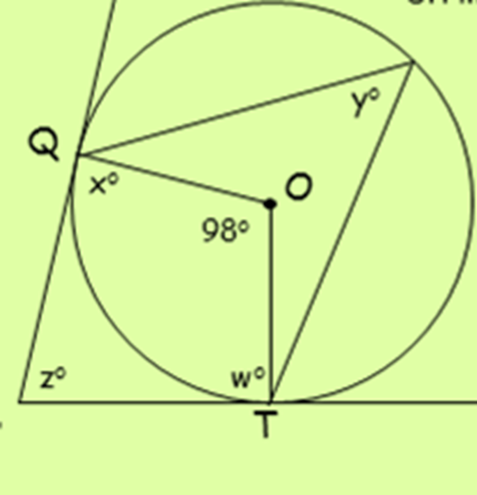
Answer 6
Tangents to a circle from a point outside the circle are equal in length
Radius meets tangent at 90
Z = 82

