Slide 1
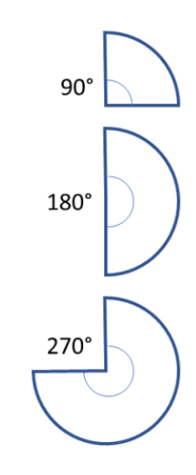
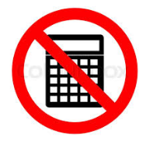
On your whiteboards
The radius of this circle is 30 cm
What is the circumference of this circle in terms of pi? Show your calculation.
Notes:
Compare and share C = 60 x pi and C = 2 x 30 x pi

Slide 2
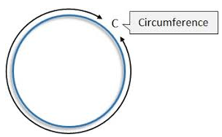
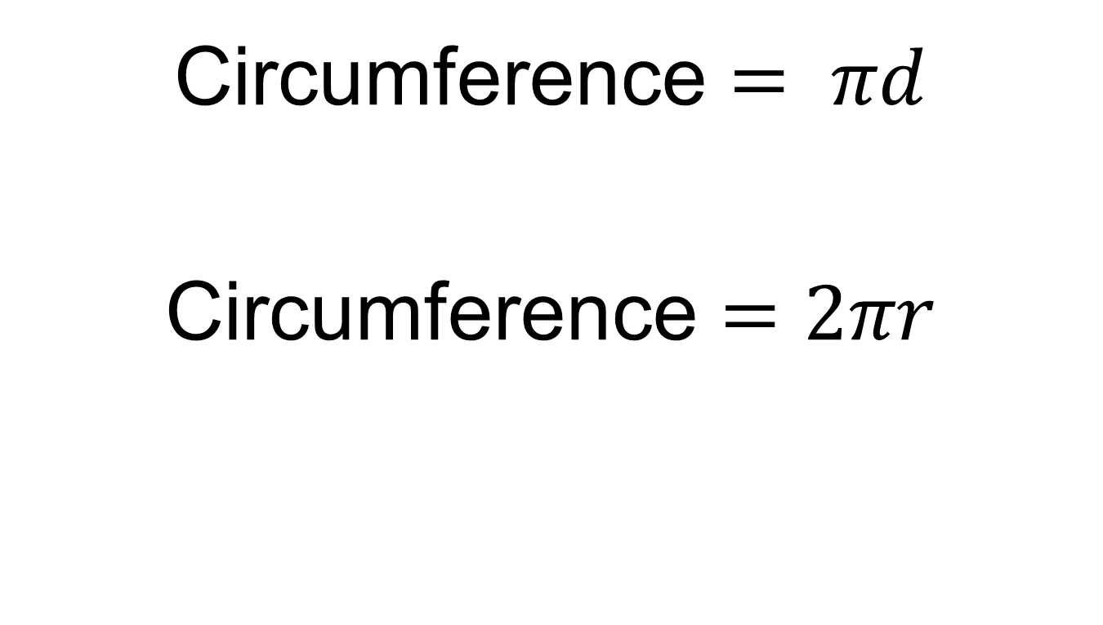
Circumference $= πd$
Circumference $=2πr$

Slide 3

On your whiteboards
What is the length of the arc of this sector in terms of pi?
$$30cm$$

Slide 4
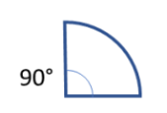

On your whiteboards
What is the length of the arc of this sector in terms of pi?
$$30 cm$$

Slide 5
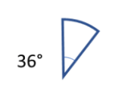
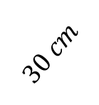
On your whiteboards
What is the length of the arc of this sector in terms of pi?
$$30 cm$$

Slide 6
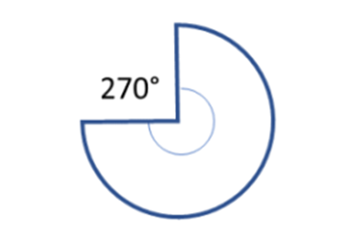

On your whiteboards
What is the length of the arc of this sector in terms of pi?
$$30cm$$

Slide 7
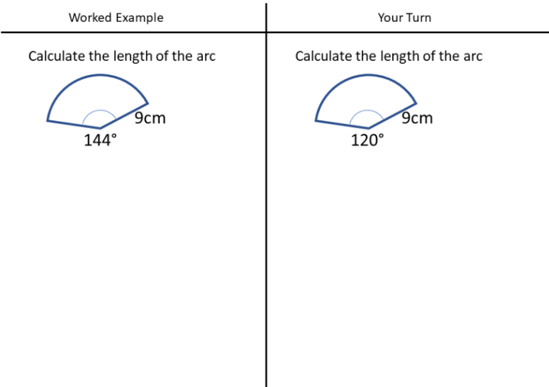
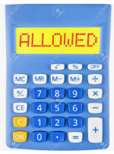
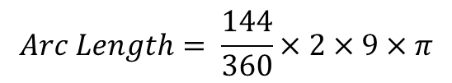


Title: Arc Length
$$Arc Length= \frac{144}{360}×2×9×π$$
$$=22.61 cm (2dp)$$
$$Area=27π {cm}^{2}$$
Notes:
Calculator allowed now
Your Turn = 18.8 (6pi)

Slide 8
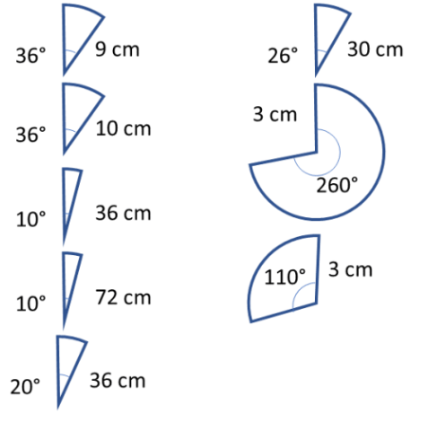
In your books:
Calculate the arc length of these sectors.
Give you answers to 2 decimal places
1.
6.
2.
7.
3.
8.
4.
5.

Slide 9
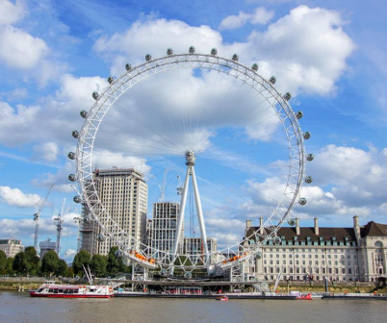
Challenge
The London Eye has a radius of 67.5m.
It holds 32 capsules.
How far apart are each of the capsules?
Notes:
Approx. 13.3m

Slide 10
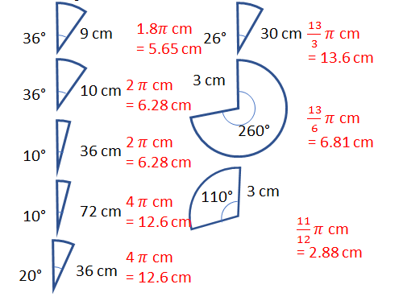
Mark your work

Slide 11
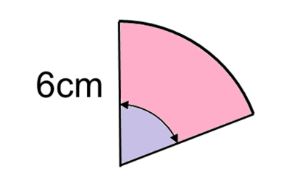
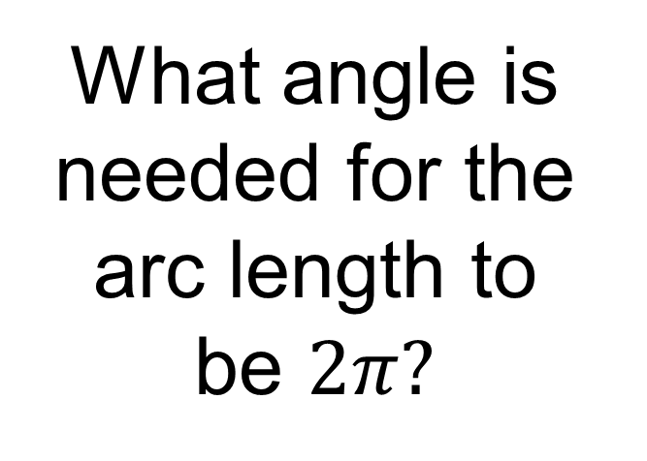
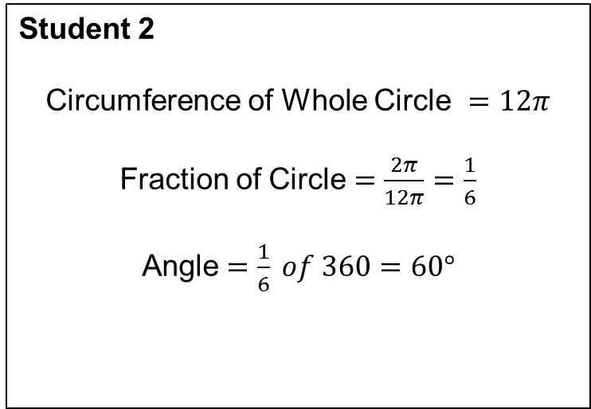
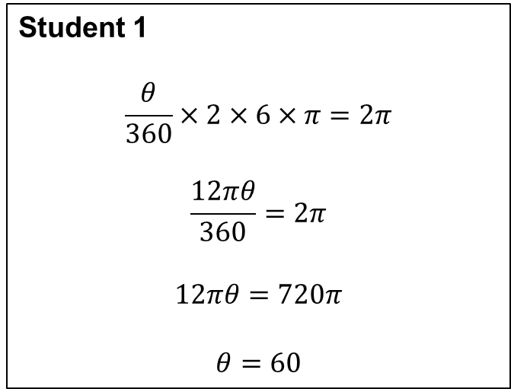
What angle is needed for the arc length to
be $2π?$
Student 1
$$\frac{θ}{360}×2×6×π=2π$$
$$\frac{12πθ}{360}=2π$$
$$12πθ=720π$$
$$θ=60$$
Student 2
Circumference of Whole Circle $=12π$
Fraction of Circle $=\frac{2π}{12π}=\frac{1}{6}$
Angle $=\frac{1}{6} of 360=60°$

Slide 12
Discuss each method.
Which do you prefer? Why?
Student 1
$$\frac{θ}{360}×2×6×π=2π$$
$$\frac{12πθ}{360}=2π$$
$$12πθ=720π$$
$$θ=60$$
Student 2
Circumference of Whole Circle $=12π$
Fraction of Circle $=\frac{2π}{12π}=\frac{1}{6}$
Angle $=\frac{1}{6} of 360=60°$

Slide 13
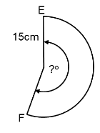
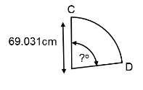
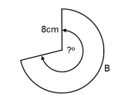
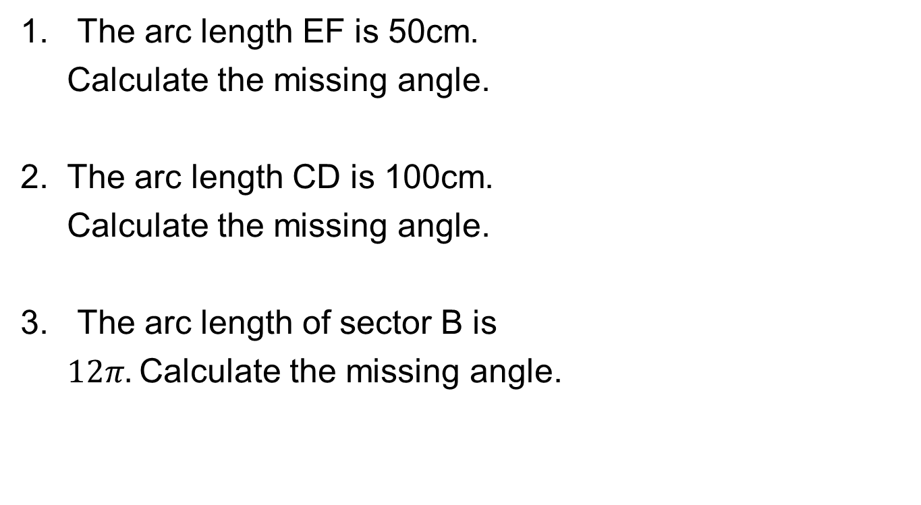
Your Turn…
The arc length EF is 50cm.
Calculate the missing angle.
2. The arc length CD is 100cm.
Calculate the missing angle.
The arc length of sector B is
$12π.$Calculate the missing angle.
Notes:
Acknowledgements: variationtheory.com

Slide 14
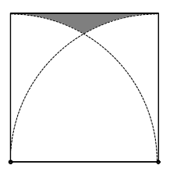
Challenge
The perimeter of this square is 4cm.
The arcs are drawn with centres on the two vertices of the square as shown.
Calculate the shaded area.

