Slide 1
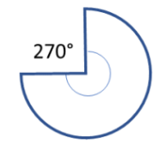
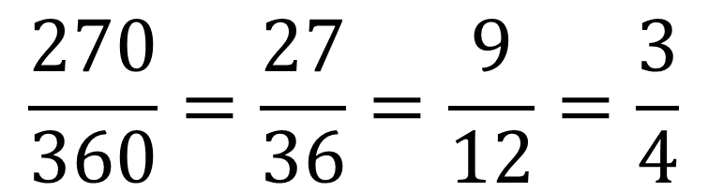
What fraction of the whole circle is this sector?
$$\frac{270}{360}=\frac{27}{36}=\frac{9}{12}=\frac{3}{4}$$
Notes:
Compare and share solutions

Slide 2

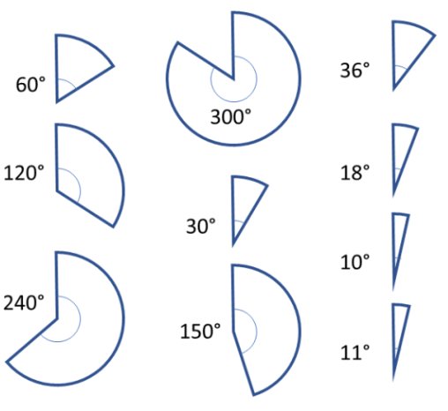
Which fractions do these sectors represent?
Simplify your answers

Slide 3
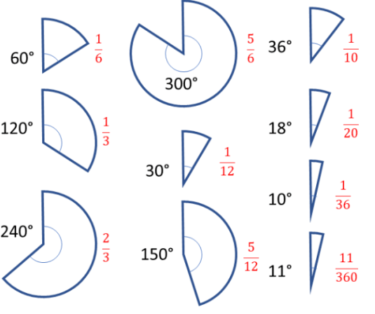
Mark your work

Slide 4
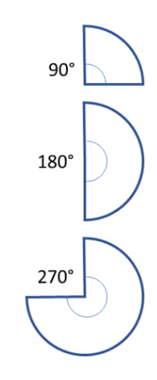
On your whiteboards
The radius of this circle is 10cm
What is the area of this circle in terms of pi?

Slide 5

On your whiteboards
What is the area of this sector in terms of pi?
$$10cm$$

Slide 6
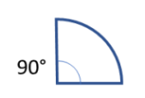

On your whiteboards
What is the area of this sector in terms of pi?
$$10cm$$

Slide 7
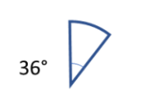
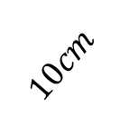
On your whiteboards
What is the area of this sector in terms of pi?
$$10cm$$

Slide 8
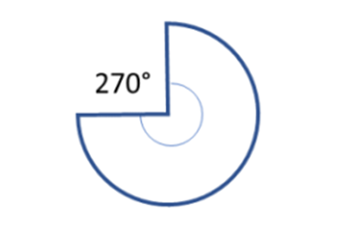

On your whiteboards
What is the area of this sector in terms of pi?
$$10cm$$

Slide 9
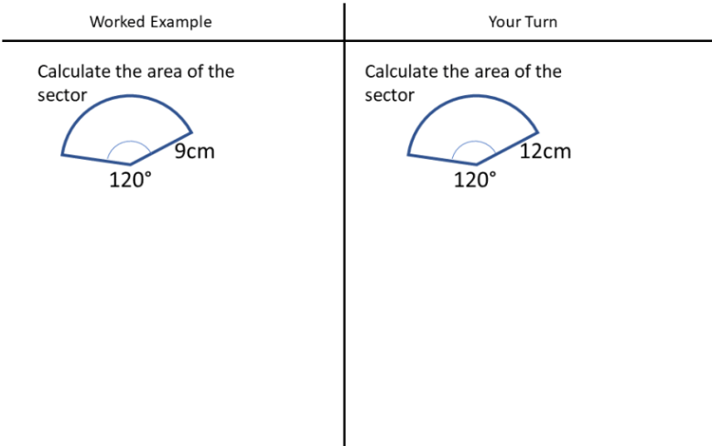

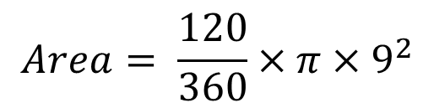
Title: Area of Sectors
$$Area= \frac{120}{360}×π×9^{2}$$
$$Area=27π {cm}^{2}$$
Notes:
Calculator allowed now

Slide 10
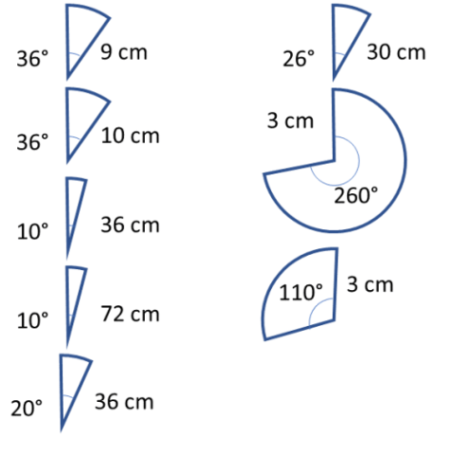
In your books:
Calculate the area of these sectors.
Give you answers in terms of pi
1.
6.
2.
7.
3.
8.
4.
5.

Slide 11
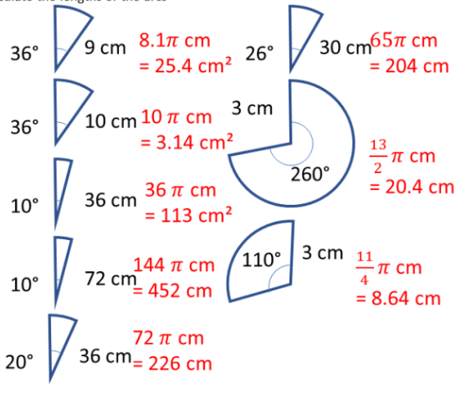
Mark your work

Slide 12
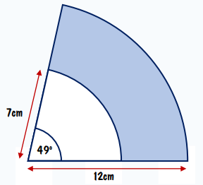
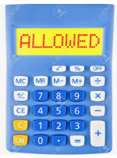
On your whiteboards
What is the area of the shaded region to 3 significant figures?
Notes:
40.6

Slide 13
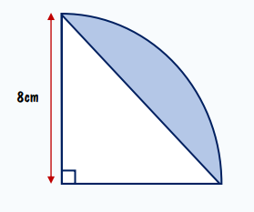
On your whiteboards
What is the area of the shaded region to 3 significant figures?

Slide 14
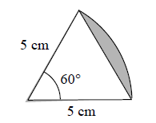
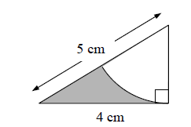
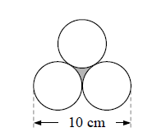
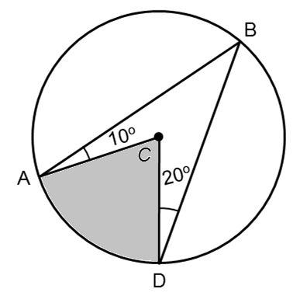

Challenge Questions
Calculate the shaded areas to 3sf
$$5cm$$
Notes:
Acknowledgements: variationtheory.com

Slide 15
Mark your work
2.26
1.83
4.03
13.1

