Slide 1
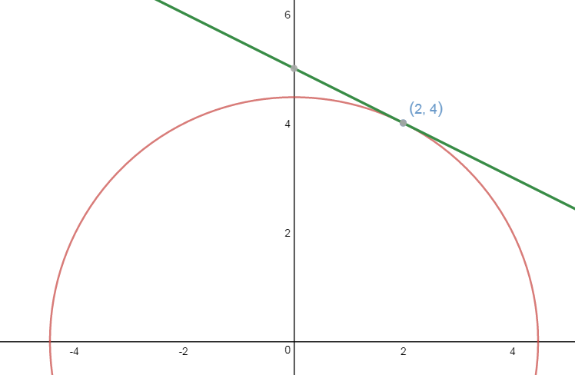
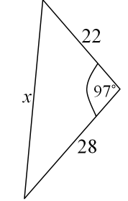

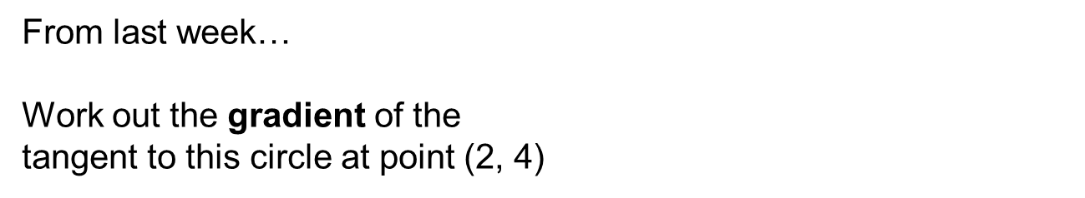


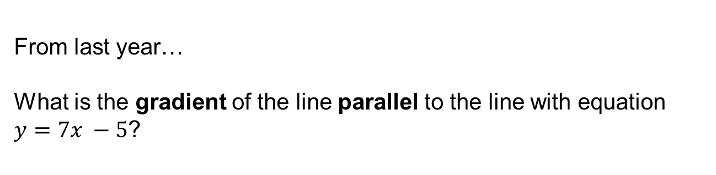
From last week…
Work out the gradient of the
tangent to this circle at point (2, 4)
$$3$$
$$2$$
$$1$$
From last month…
Work out the area of this triangle.
Give your answer to 3 significant figures.
From last year…
What is the gradient of the line parallel to the line with equation $y=7x −5$?
Notes:
Timed spaced retrieval

Slide 2
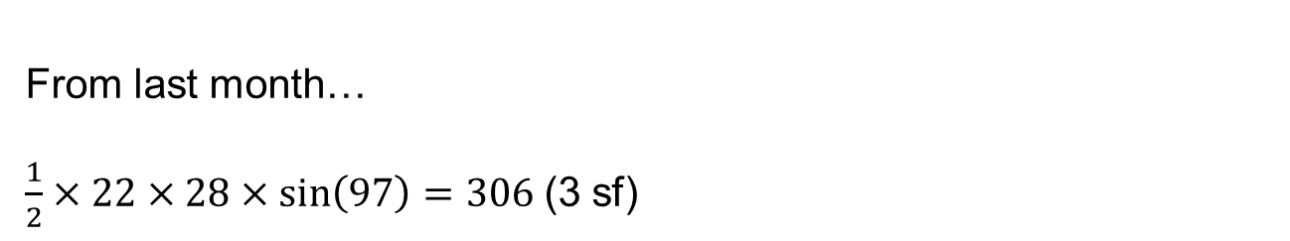
From last week…
Gradient of radius to point (2, 4) is 2 so the gradient of tangent is -0.5
From last month…
$\frac{1}{2}×22×28×\sin\left(97\right)=306$(3 sf)
From last year…
Parallel lines have the same gradient so 7
Notes:
Timed spaced retrieval

Slide 3
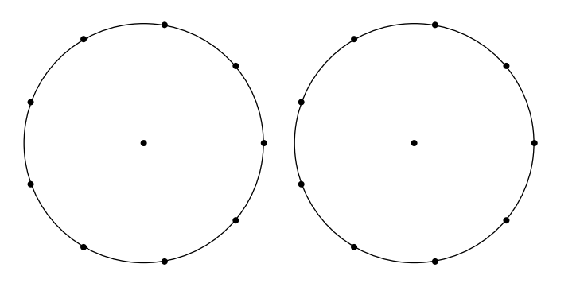
Today we will be drawing on these circles (again)

Slide 4
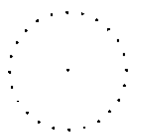
1. Draw a tangent to the circle.
2. Draw a different tangent to the circle.
3. Measure the distances from where each tangent touches the circle to where the tangents intersect.
What do you notice?

Slide 5
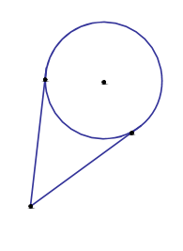
Two tangents from a point to a circle are equal in length
Demo

Slide 6
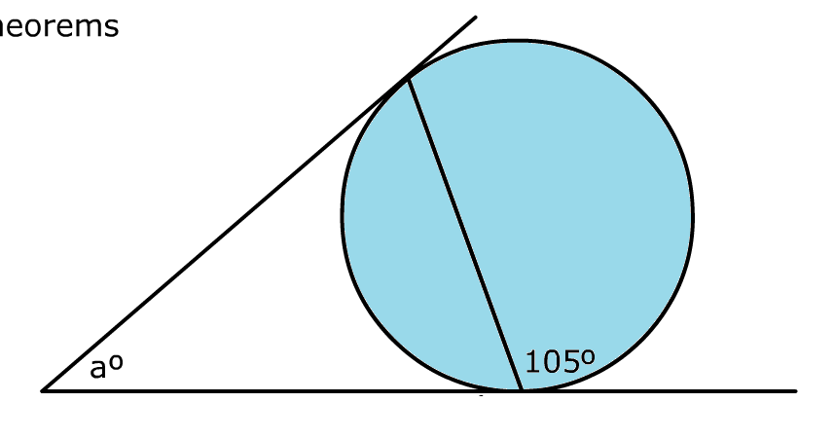
On your whiteboards:
Work out the missing angle

Slide 7
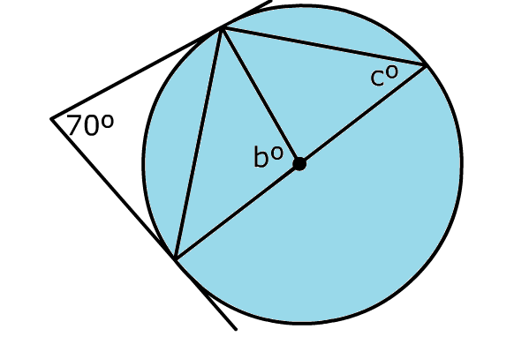
On your whiteboards:
Work out the missing angle

Slide 8
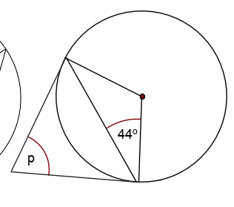
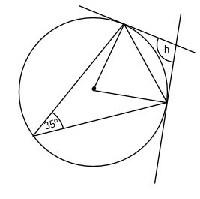
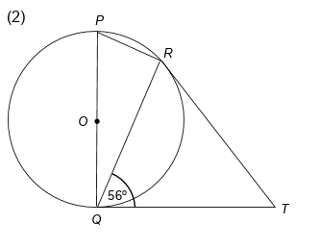
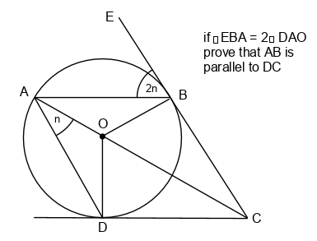
Work out the missing angles
b
a
c) Obtuse angle PRT?
d) Prove that AB is parallel
to DC

Slide 9
Mark your work
a = 88
b = 110
PRT = 146

Slide 10
1. Using the points provided draw a chord.
2. Make a triangle using your chord and any points on the circumference.
3. Draw a tangent to any of the vertices of your triangle.
4. Measure an angle made between the tangent and triangle.
5. Measure the angle in triangle in
opposite segment
Discuss your angles with your partner, what do you notice?

Slide 11
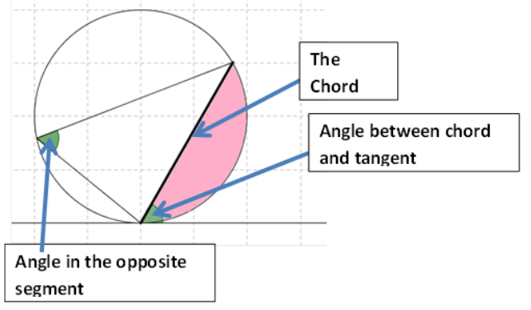
Alternate Segment Theorem
Demo

Slide 12
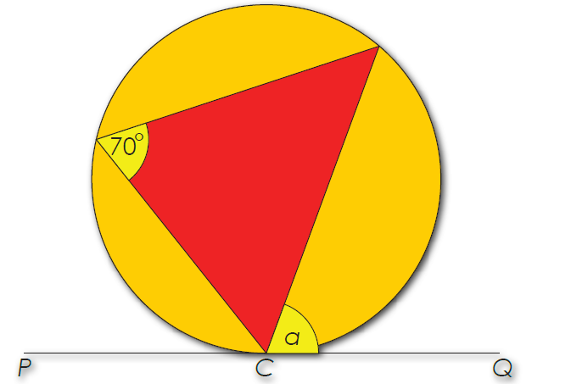
On your whiteboards:
Work out the missing angle

Slide 13
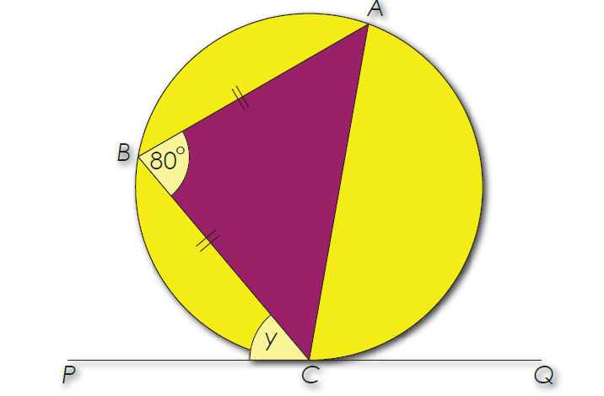
On your whiteboards:
Work out the missing angles

Slide 14
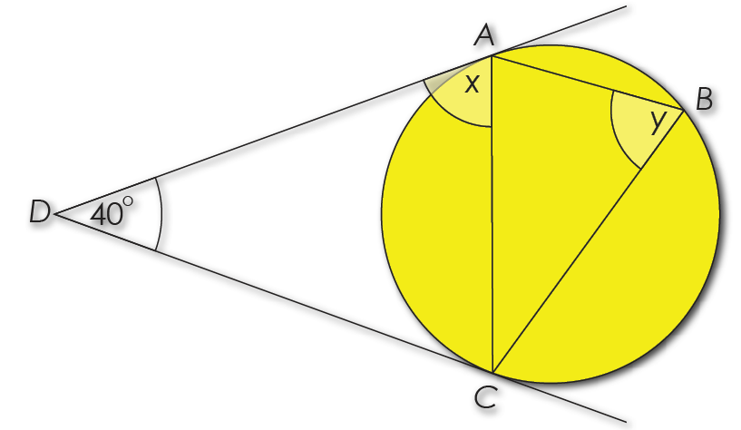
On your whiteboards:
Work out the missing angles

Slide 15
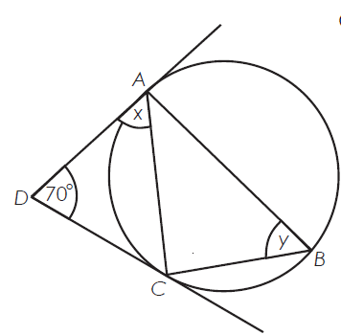
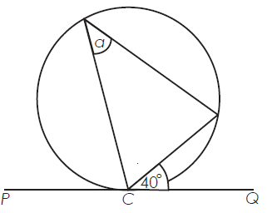
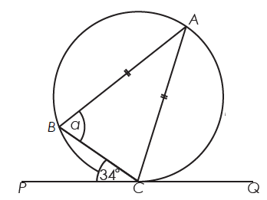
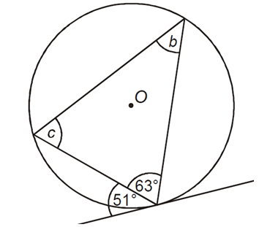
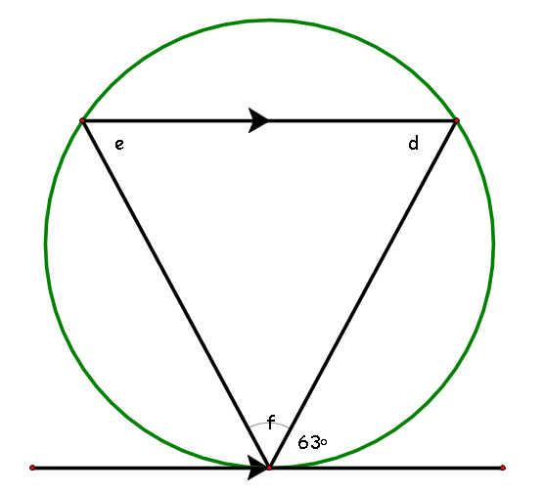





Work out the missing angles
$$1.$$
$$2.$$
$$3.$$
$$4.$$
$$5.$$
d

Slide 16
Mark your work
a = 40
a = 73
3. x = 55 and y = 55
4. b = 51 and c = 66
5. d = 63, e = 63 and f = 54

Slide 17
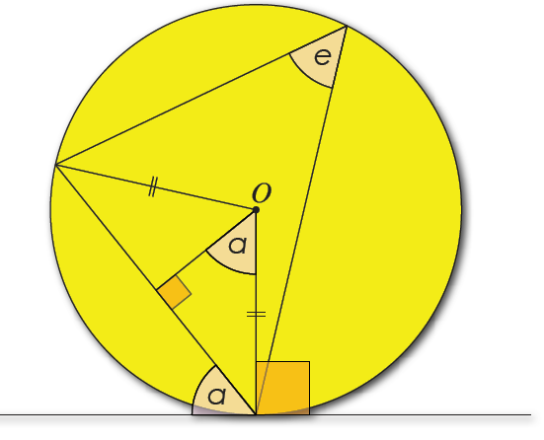
Challenge
Prove the
Alternate Segment Theorem
HINT:
Notes:
Acknowledgements: Don Steward

