Slide 1
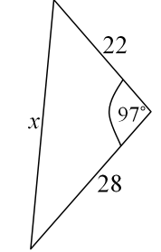

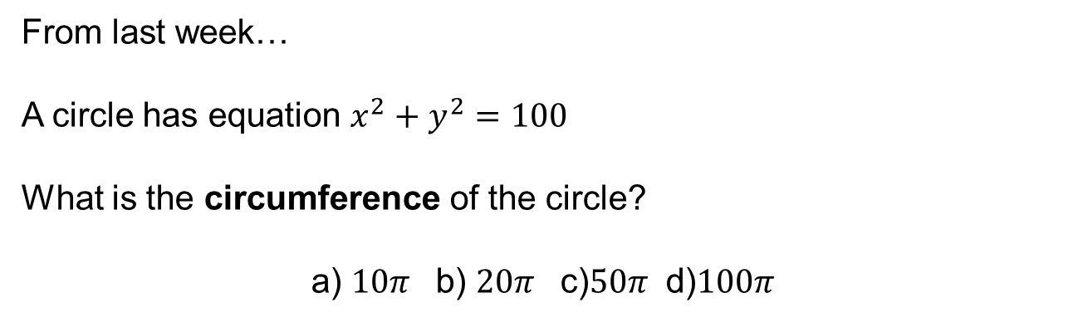


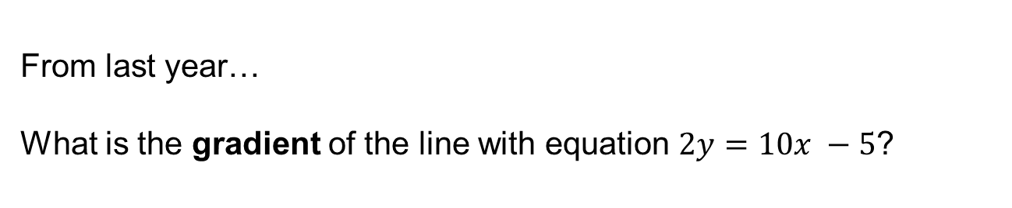
From last week…
A circle has equation $x^{2}+y^{2}=100$
What is the circumference of the circle?
a) $10π$ b) $20π$ c)$50π$ d)$100π$
$$3$$
$$2$$
$$1$$
From last month…
Work out the missing length, x, to 3 significant figures
From last year…
What is the gradient of the line with equation $2y=10x −5$?
Notes:
Timed spaced retrieval

Slide 2

From last week… $20π$
From last month…
$$a^{2}={22}^{2}+{28}^{2}−2×22×28×\cos{97}$$
$$a=37.7$$
From last year…
$$5$$
Notes:
Timed spaced retrieval

Slide 3
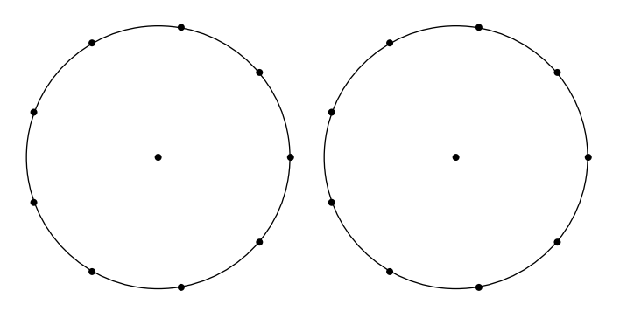
Today we will be drawing on these circles.

Slide 4
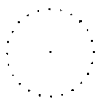
1. Draw a chord using any two points.
2. Make a triangle using your chord and any point of the circumference.
3. Draw a different triangle using your chord in the same segment.
4. Measure the angle in each triangle that is opposite your chord.
Discuss your angle with your partner, what do you notice?

Slide 5






C
Proof
B
$$x$$
$$y$$
Discuss:
What is a possible expression for the obtuse angle DOA?
How do you know?
O
D
$$Angle DOA=2x=2y$$
A
$$∴2x=2y$$
$$x=y$$
$$∎$$

Slide 6
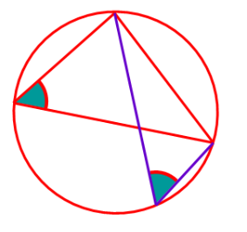
Angles in the same segment are equal
Demo

Slide 7
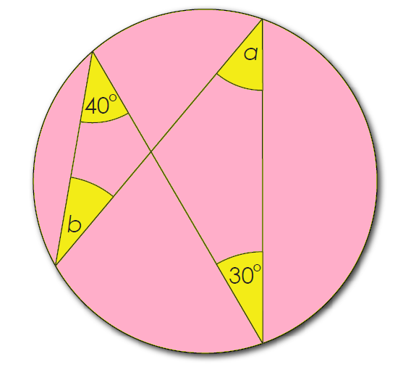
On your whiteboards:
Work out the missing angle

Slide 8
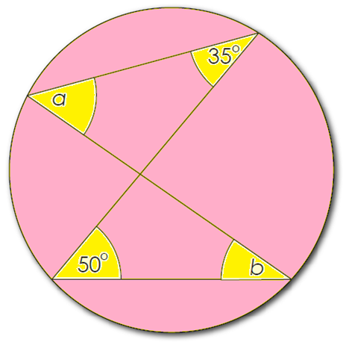
On your whiteboards:
Work out the missing angles

Slide 9
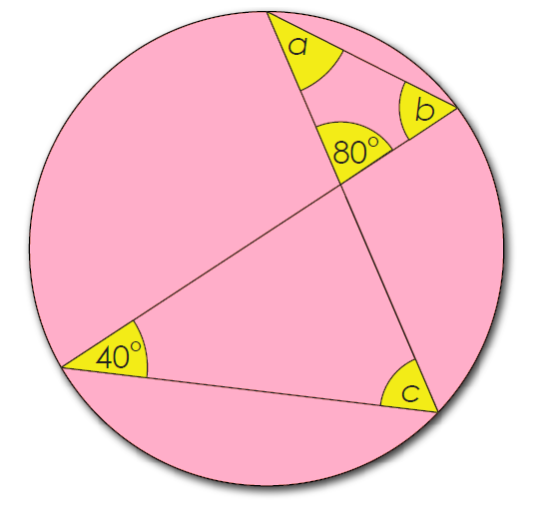
On your whiteboards:
Work out the missing angles

Slide 10
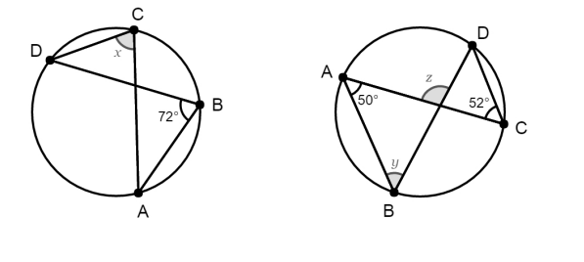
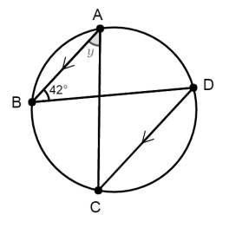
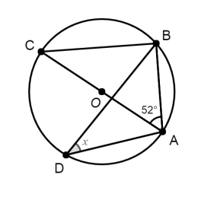
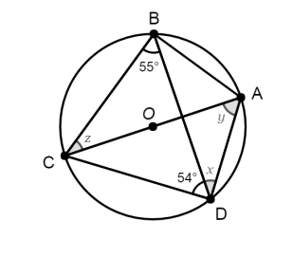





Work out the missing angles
$$1.$$
$$2.$$
$$3.$$
$$4.$$
$$5.$$

Slide 11
Mark your work
1. x = 72
2. y = 52, z = 102
3. y = 42
4. x = 38
5. x = 36, y = 55 and z =36

Slide 12
1. Using the points provided draw a chord.
2. Make a quadrilateral using your chord and any points on the circumference.
3. Measure opposite angles inside your quadrilateral.
Discuss your angles with your partner, what do you notice?

Slide 13
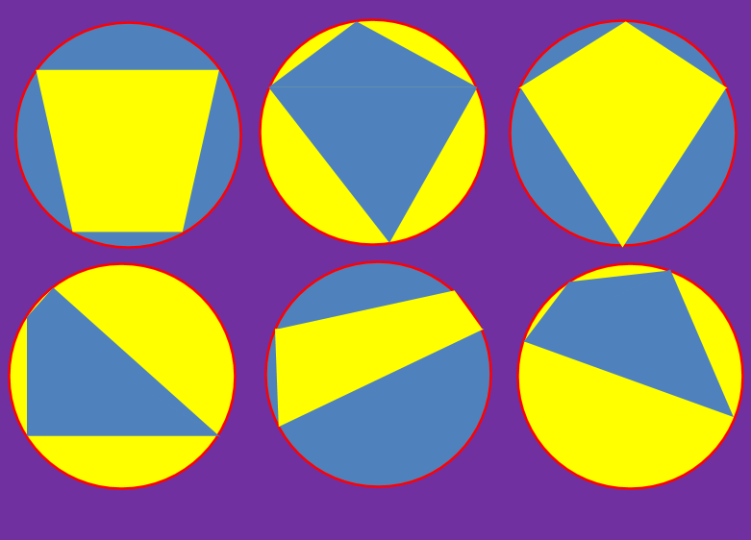
Opposite angles in a cyclic quadrilateral sum to 180 degrees
Demo

Slide 14
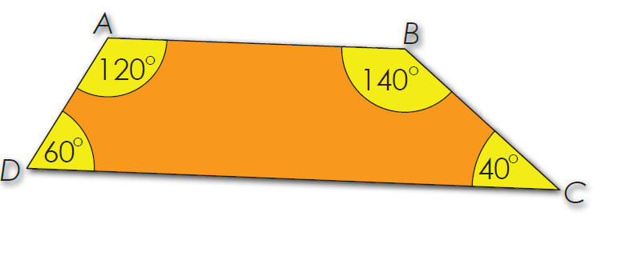
On your whiteboards:
Is this a Cyclic Quadrilateral?
How do you know?

Slide 15
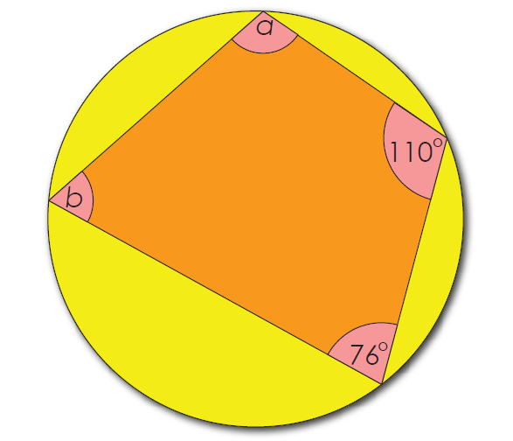
On your whiteboards:
Work out the missing angles

Slide 16
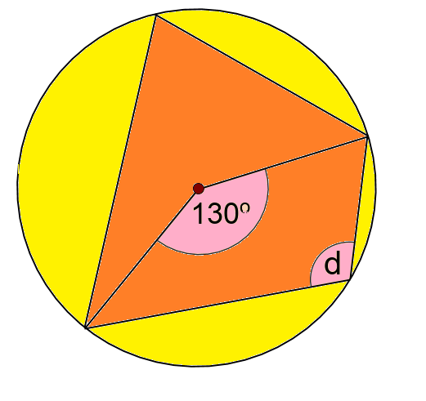
On your whiteboards:
Work out the missing angle

Slide 17
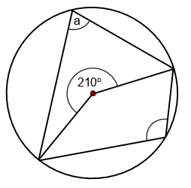
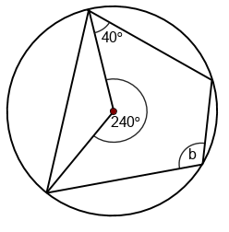
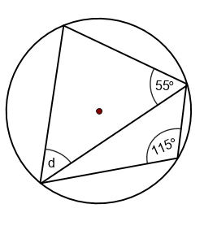
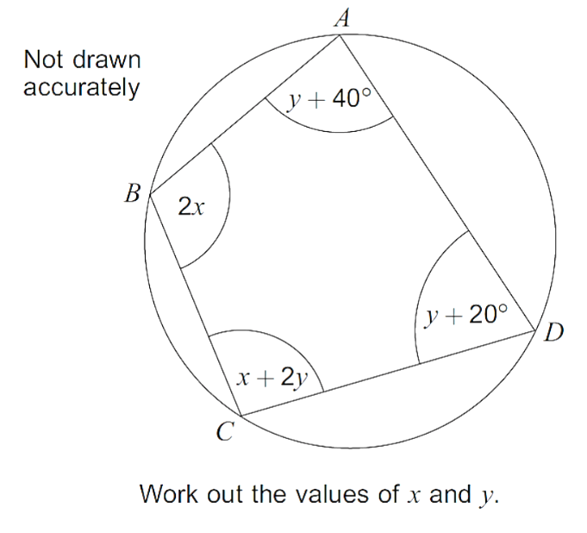
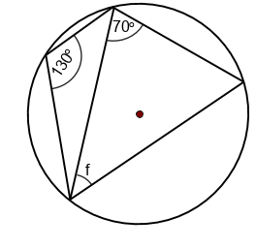
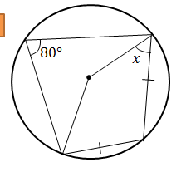







Work out the missing angles
$$1$$
$$2$$
$$3$$
b
$$4$$
$$5$$
$$5...$$
$$6$$

Slide 18
Mark your work
1. a = 75 and b = 105
2. b = 80
3. d = 60
4. f = 60
5. x = 50
6. x = 68 and y = 24

Slide 19
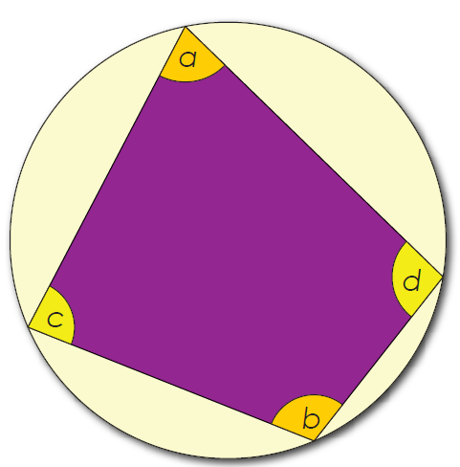
Challenge
Prove that the opposite angles in a cyclic quadrilateral always sum to 180 degrees.
Notes:
Acknowledgements: Don Steward

