Slide 1
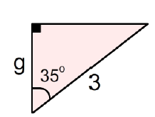

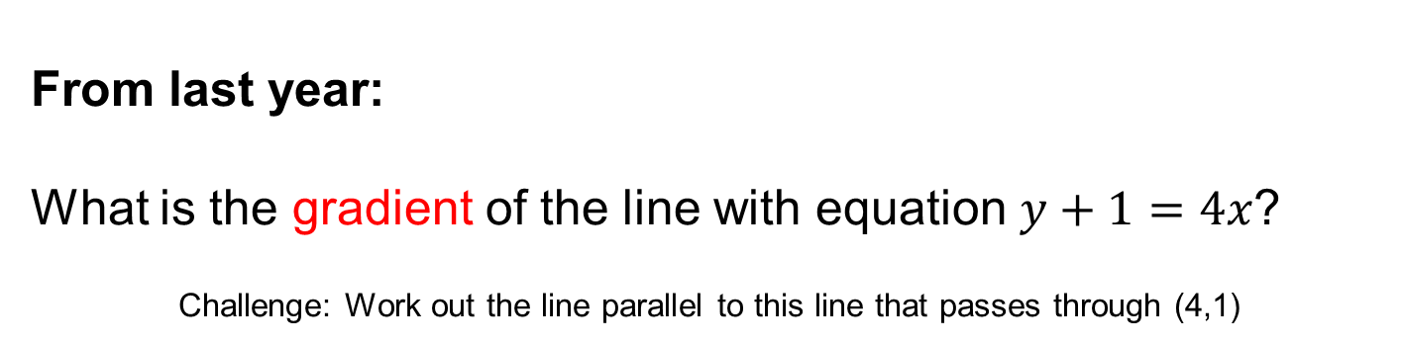


A skill needed for today:
Write the following in hours:
(a) 1 hour 30 minutes
(b) 45 minutes
(c) 2 hours 20 minutes
$$3$$
$$2$$
$$1$$
From last term:
Work out the missing length to 1 decimal place
From last year:
What is the gradient of the line with equation $y+1=4x$?
Challenge: Work out the line parallel to this line that passes through (4,1)
Notes:
Timed spaced retrieval

Slide 2
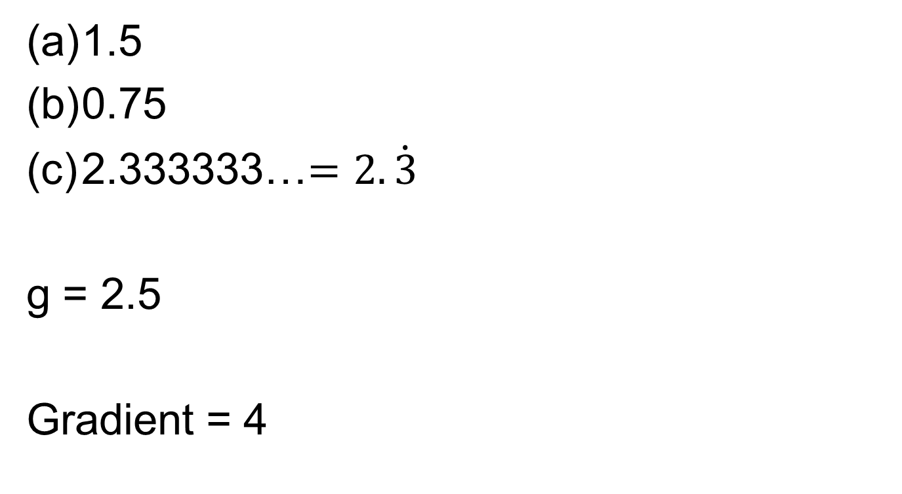
Mark your work
1.5
0.75
2.333333…$=2.\dot{3}$
g = 2.5
Gradient = 4

Slide 3



What do these road signs mean?
What do they all have in common?

Slide 4
40 miles per hour speed limit
End of a minimum 30 miles per hour speed limit
National Speed Limit
60 miles per hour on a single carriageway
70 miles per hour on a dual carriageway or motorway

Slide 5
In the UK, speed on our roads is measured in miles per hour.
But there are many other units that can
be used for speed.
Discuss in your pairs other possible
units for the speed of an object and how they can be written
Notes:
After 2 mins collect possible units for speed on the board. Explain how all of the correct units for speed represent a measure for distance per a unit of time.

Slide 6
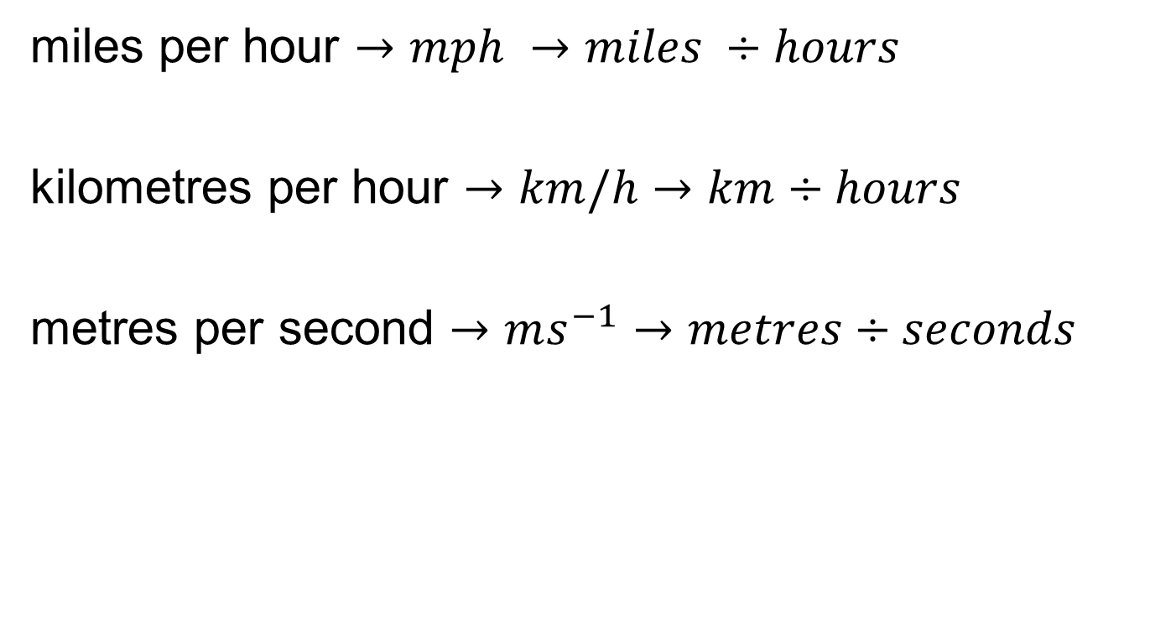
Some units for Speed
miles per hour $→mph →miles ÷hours$
kilometres per hour $→km/h→km÷hours$
metres per second $→ms^{−1}→metres÷seconds$
Notes:
Ask students to notice how sometimes the word “per” is sometimes abbreviated to a p or is abbreviated to a / or how units can be written using a negative index

Slide 7
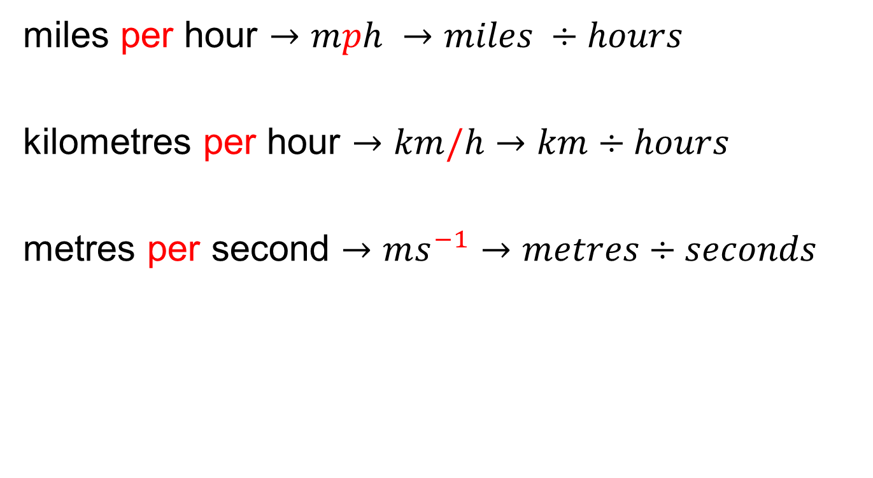
Some units for Speed
miles per hour $→mph →miles ÷hours$
kilometres per hour $→km/h→km÷hours$
metres per second $→ms^{−1}→metres÷seconds$
Notes:
Ask students to notice how sometimes the word “per” is sometimes abbreviated to a p or is abbreviated to a / or how units can be written using a negative index

Slide 8
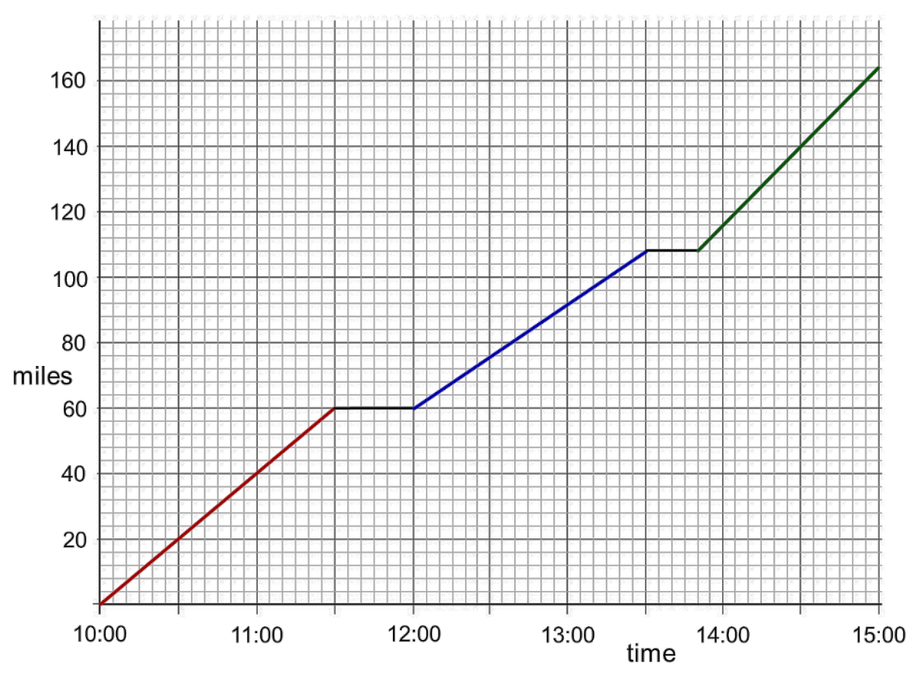
Create a story for this distance-time graph
Notes:
Give students a print out of this slide
Allow students 5 minutes to create their own story for this graph and annotate graph accordingly

Slide 9
What is the speed for the first part of the journey?
Notes:
Share the different ways of calculating this… 40 miles travelled in 1 hour = 40 mph or 60 miles travelled in 1.5 hours = 40 mph

Slide 10
Now work out the speed for the second and third parts of this journey.
Work out the average speed for the entire journey.

Slide 11
Now work out the speed for the second and third parts of this journey.
In one hour a distance of 32 miles has been travelled so speed is 32 mph
Work out the average speed for the entire journey.

Slide 12
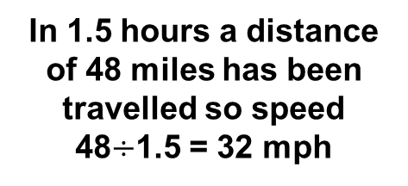
Now work out the speed for the second and third parts of this journey.
In 1.5 hours a distance of 48 miles has been travelled so speed 48$÷$1.5 = 32 mph
Work out the average speed for the entire journey.

Slide 13
Now work out the speed for the second and third parts of this journey.
In 1 hour a distance of 48 miles has been travelled so speed is 48 mph
Work out the average speed for the entire journey.

Slide 14
Entire time taken for journey = 5 hours
Entire Distance Travelled = 164 miles
Average Speed = $164÷5=32.8 mph$

Slide 15
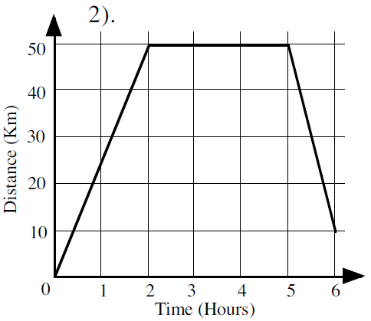
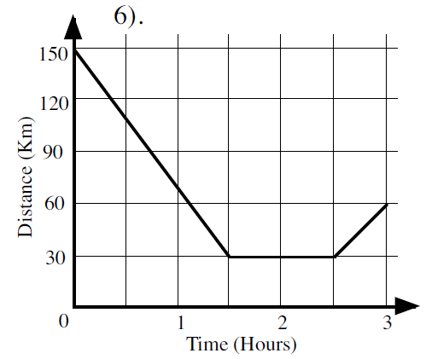
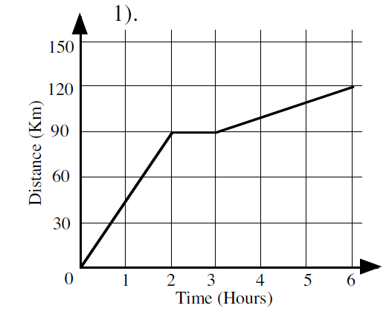
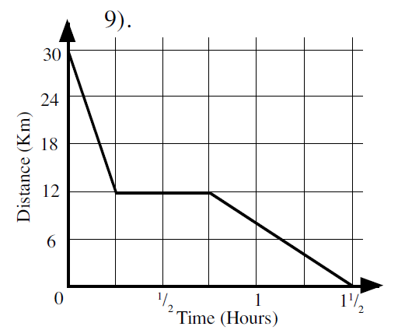
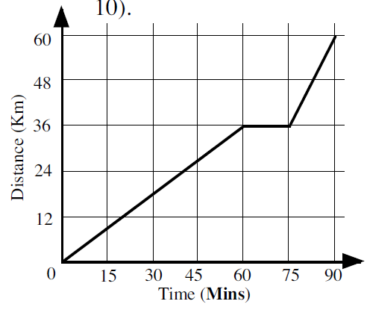
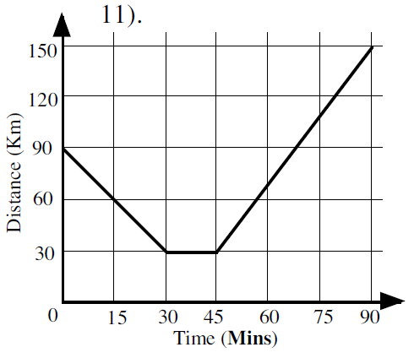
In your books: work out the average speed for each journey in km/h
1.
2.
3.
4.
5.
6.
Notes:
Print this slide for students to refer to

Slide 16
Mark your work
20 km/h
15 km/h
50 km/h
20 km/h
40km/h
120km/h

Slide 17
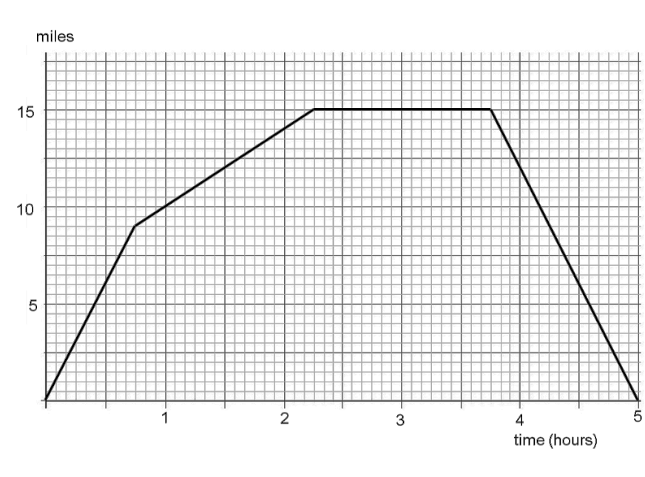
Challenge
Starting from home, a cyclist went for _____ miles at a constant speed of _____ mph.
After _____ minutes from home the cyclist got a puncture and so walked at a steady speed of ____ mph for ____ hours.
When the cyclist was ____ miles from home she stopped for _____ hours and fixed the puncture.
She then cycled home at a constant speed of ____ mph.
Notes:
Acknowledgements: Don Steward

