Slide 1

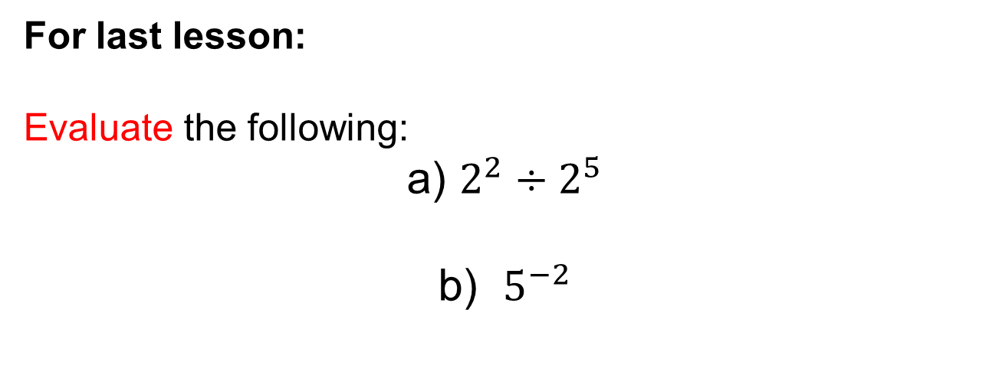


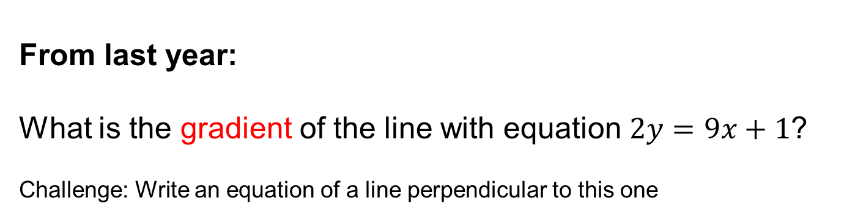
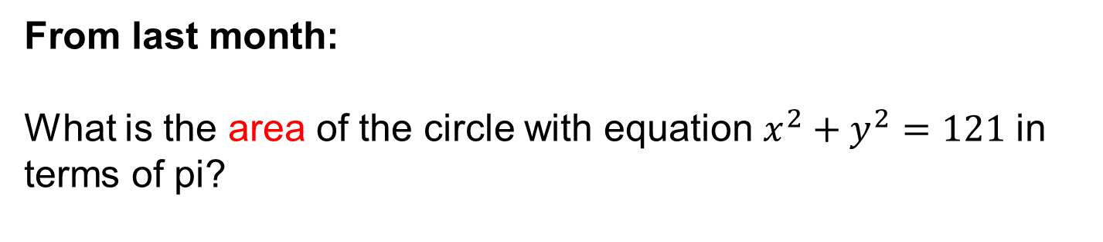
For last lesson:
Evaluate the following:
a) $2^{2}÷2^{5}$
b) $5^{−2}$
$$3$$
$$2$$
$$1$$
From last month:
What is the area of the circle with equation $x^{2}+y^{2}=121$ in terms of pi?
From last year:
What is the gradient of the line with equation $2y=9x+1$?
Challenge: Write an equation of a line perpendicular to this one
Notes:
Timed spaced retrieval

Slide 2
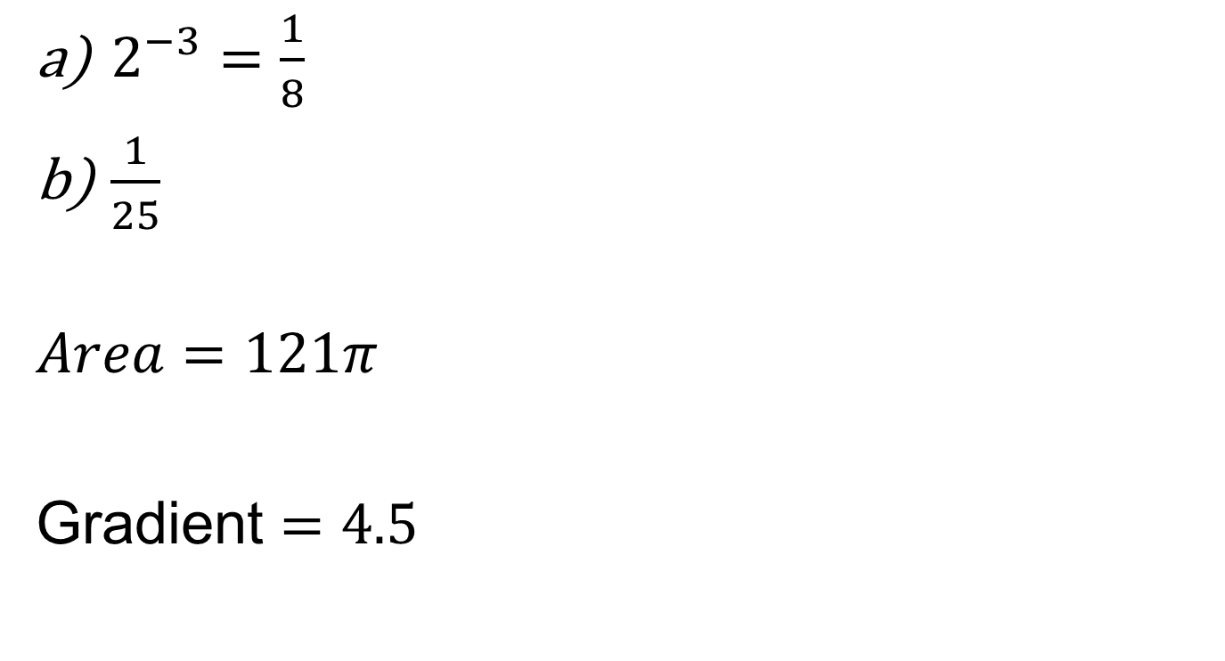
Mark your work
$2^{−3}=\frac{1}{8}$
$\frac{1}{25}$
$$Area=121π$$
Gradient $=4.5$

Slide 3
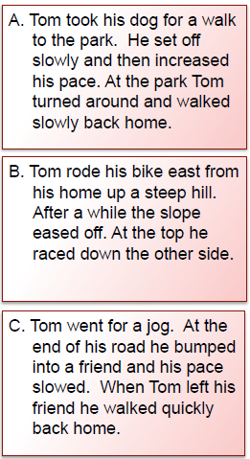
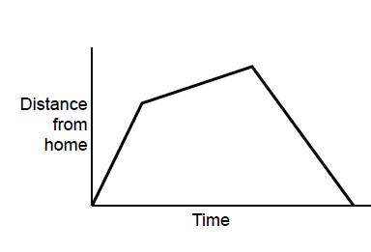
In pairs decide which story fits this graph
You must be able to give at least two justifications for your choice
Notes:
After 3 minutes…Question pairs who think A, question pairs who think B , question pairs who think C

Slide 4
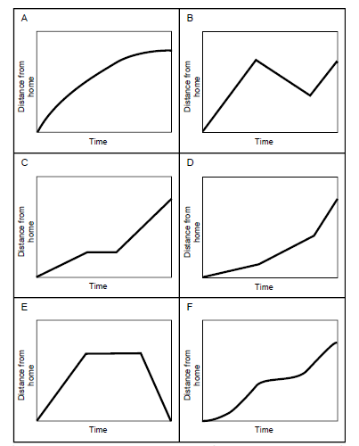
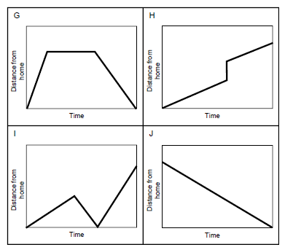
Now in your pairs you are going to be given these 10 graphs
Take it in turns to match a story to a graph, you must explain your
reasoning with your partner
Notes:
Allow approx 20 minutes for this activity. After this time allow pairs the opportunity to view another pairs solution

Slide 5
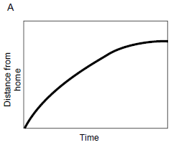
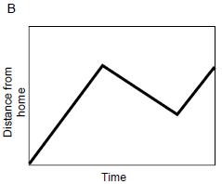

Notes:
Ask students to share their stories for Graph B

Slide 6
Check your work
Graph A – Interpretation 5
Graph B – Interpretation 10
Graph C – Interpretation 4
Graph D – Interpretation 2
Graph E – Interpretation 6
Graph F – Interpretation 3
Graph G – Interpretation 1
Graph H – Interpretation 8
Graph I – Interpretation 7
Graph J – Interpretation 9

Slide 7
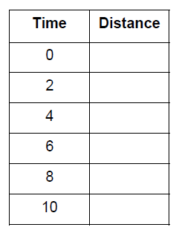
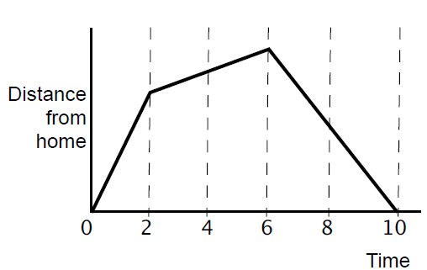
On your whiteboards: make up some data for this graph.
Notes:
Share and compare whiteboards. Are these values realistic? What might the units be? Is the speed constant at any point? How can you tell?

Slide 8
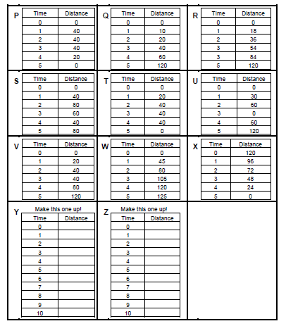
Now in your pairs you are going to be match the data tables to your graphs and stories.
Notes:
Again encourage students to take turns matching a graph to a table of data and explain their thinking to their partner.

Slide 9
Check your work
Graph A – Interpretation 5 – Table W
Graph B – Interpretation 10 – Table S
Graph C – Interpretation 4 – Table V
Graph D – Interpretation 2 – Table Q
Graph E – Interpretation 6 – Table T
Graph F – Interpretation 3
Graph G – Interpretation 1 – Table P
Graph H – Interpretation 8 – Table 8
Graph I – Interpretation 7 – Table U
Graph J – Interpretation 9 – Table X
Notes:
Compare and share tables created for Graph F

