Slide 1
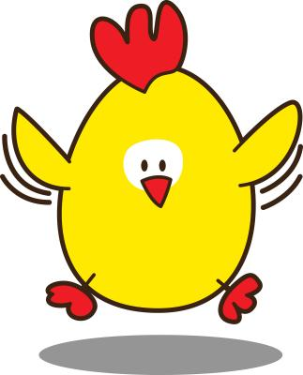
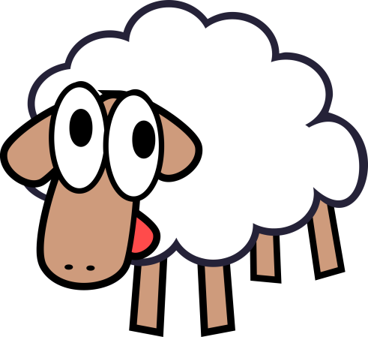
I’ve got sheep and chickens on my farm.
In total there are 22 legs and there are 8 heads.
How many sheep and chickens have I got?

Slide 2
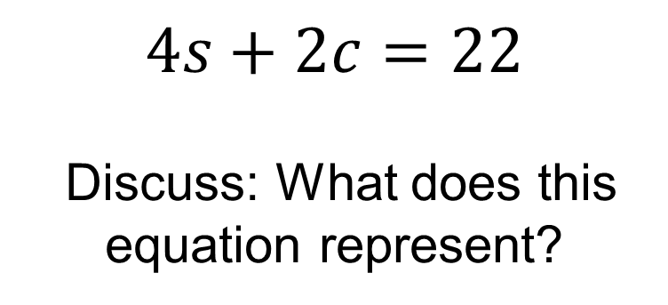
I’ve got sheep and chickens on my farm.
In total there are 22 legs and there are 8 heads.
How many sheep and chickens have I got?
$$4s+2c=22$$
Discuss: What does this equation represent?

Slide 3
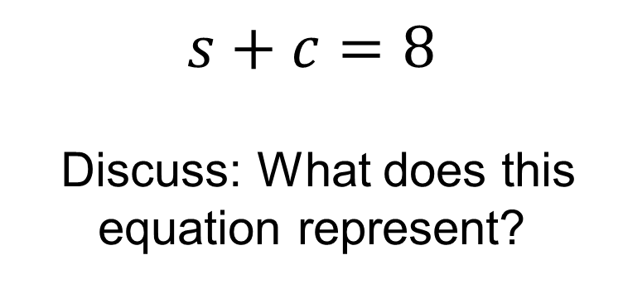
I’ve got sheep and chickens on my farm.
In total there are 22 legs and there are 8 heads.
How many sheep and chickens have I got?
$$s+c=8$$
Discuss: What does this equation represent?

Slide 4
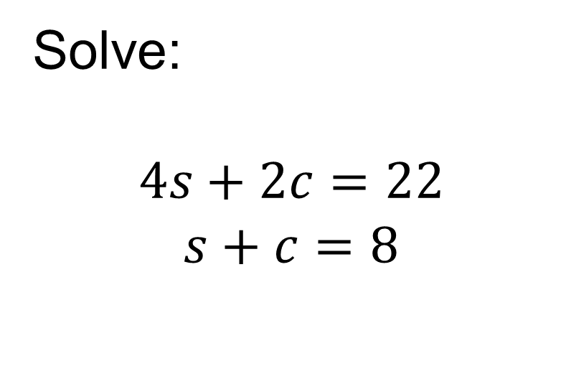
I’ve got sheep and chickens on my farm.
In total there are 22 legs and there are 8 heads.
How many sheep and chickens have I got?
Solve:
$$4s+2c=22$$
$$s+c=8$$
Notes:
Demonstrate with and without a bar model

Slide 5
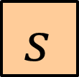
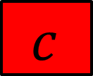

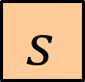




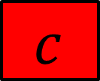
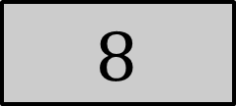
I’ve got sheep and chickens on my farm.
In total there are 22 legs and there are 8 heads.
How many sheep and chickens have I got?
$$s$$
$$s$$
$$s$$
$$s$$
$$c$$
$$c$$
$$22$$
$$s$$
$$c$$
$$8$$

Slide 6



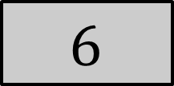
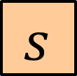



I’ve got sheep and chickens on my farm.
In total there are 22 legs and there are 8 heads.
How many sheep and chickens have I got?
$$s$$
$$s$$
$$s$$
$$s$$
$$c$$
$$c$$
$$22$$
$$s$$
$$s$$
$$c$$
$$c$$
$$6$$
$$16$$
$$2s=6$$
$$s=3$$

Slide 7







I’ve got sheep and chickens on my farm.
In total there are 22 legs and there are 8 heads.
How many sheep and chickens have I got?
$$3$$
$$3$$
$$3$$
$$3$$
$$c$$
$$c$$
$$22$$
$$3$$
$$c$$
$$8$$
$$3+c=8$$
$$c=5$$

Slide 8



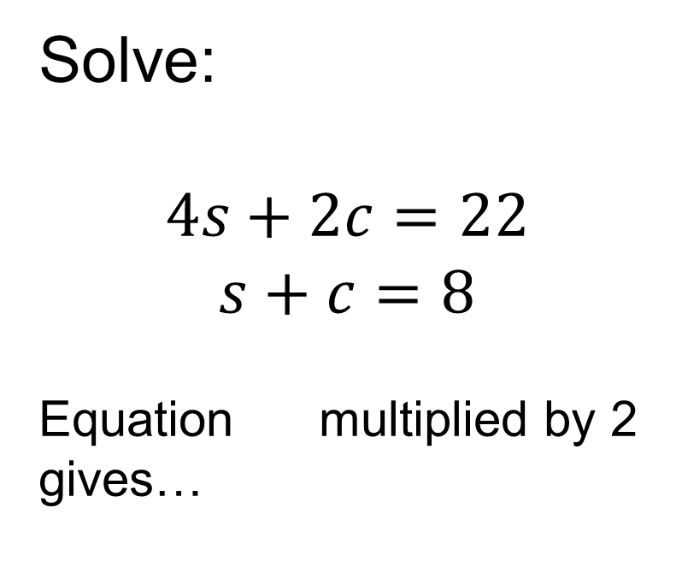
I’ve got sheep and chickens on my farm.
In total there are 22 legs and there are 8 heads.
How many sheep and chickens have I got?
Solve:
$$4s+2c=22$$
$$s+c=8$$
Equation multiplied by 2 gives…
$$1$$
$$2$$
$$2$$
Notes:
Demonstrate with and without a bar model

Slide 9
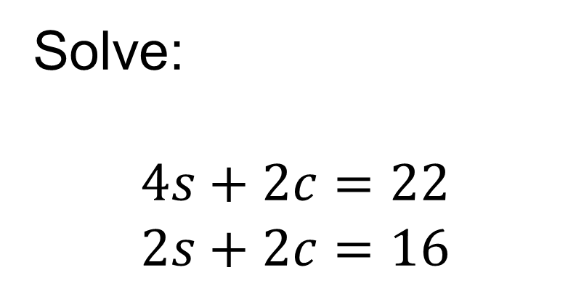
I’ve got sheep and chickens on my farm.
In total there are 22 legs and there are 8 heads.
How many sheep and chickens have I got?
Solve:
$$4s+2c=22$$
$$2s+2c=16$$
$$1$$
$$2$$
Subtracting the equations to eliminate c gives…
Notes:
Demonstrate with and without a bar model

Slide 10

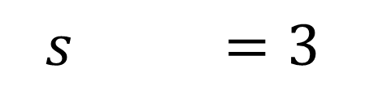
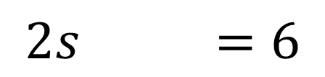
I’ve got sheep and chickens on my farm.
In total there are 22 legs and there are 8 heads.
How many sheep and chickens have I got?
Solve:
$$4s+2c=22$$
$$2s+2c=16$$
$$1$$
$−$
$$2$$
$$2s =6$$
$$s =3$$
Notes:
Demonstrate with and without a bar model

Slide 11

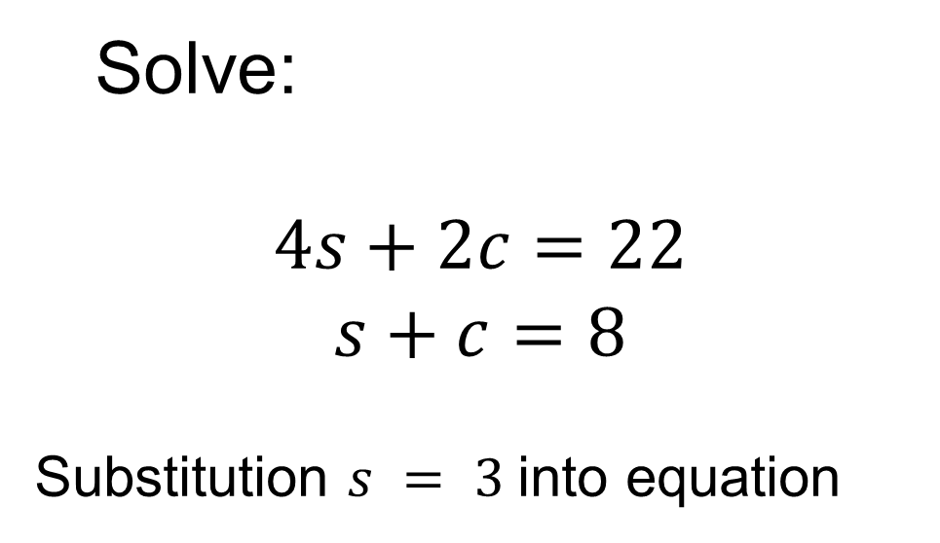


I’ve got sheep and chickens on my farm.
In total there are 22 legs and there are 8 heads.
How many sheep and chickens have I got?
Solve:
$$4s+2c=22$$
$$s+c=8$$
Substitution $s = 3$into equation
$$1$$
$$2$$
$$2$$
$$3+c=8$$
$$c=5$$
Notes:
Demonstrate with and without a bar model

Slide 12
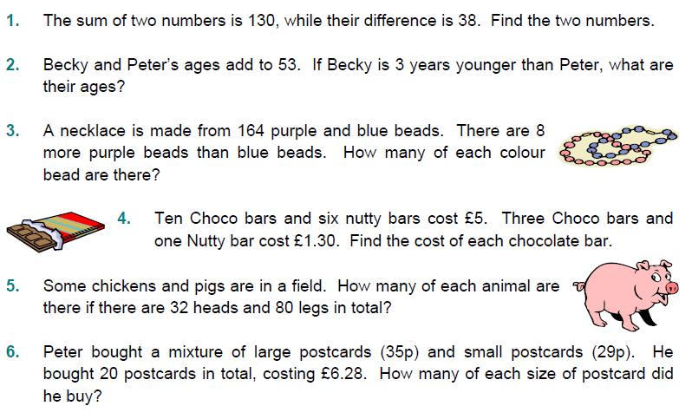
In your books..
Notes:
Acknowledgements: TeachitMaths

Slide 13
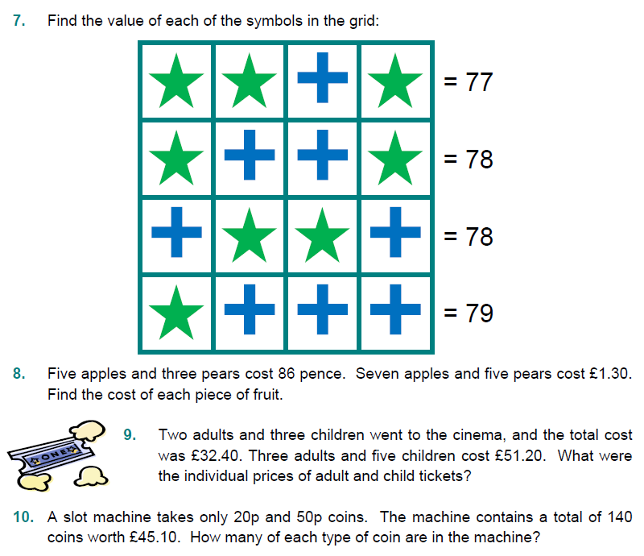

Slide 14
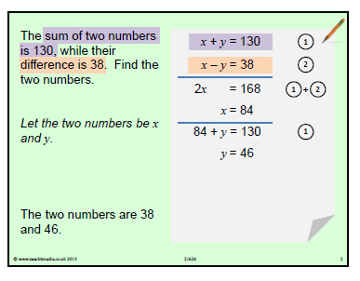
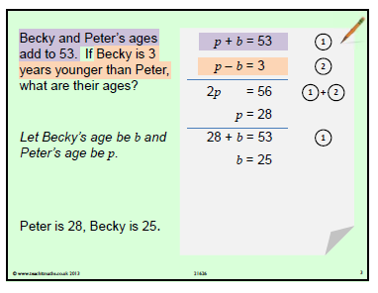
Mark your work:

Slide 15
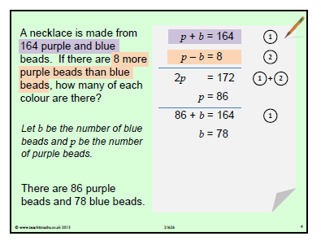
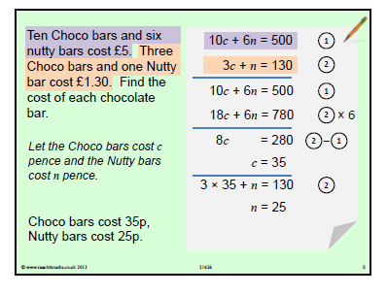
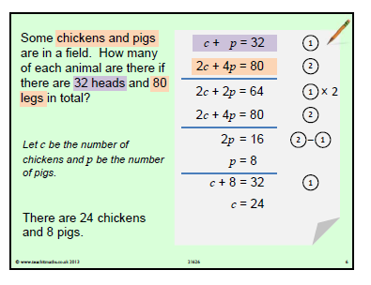
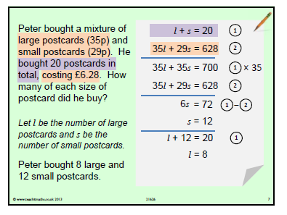

Slide 16
