Slide 1
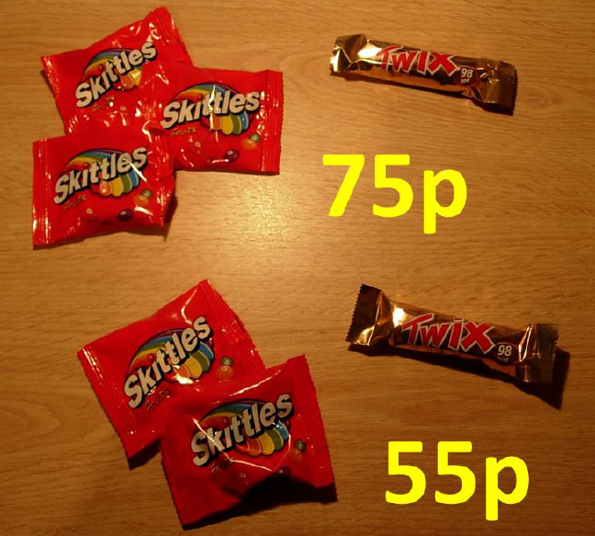
How much does a bag of Skittles cost?
How much does a Twix cost?
Notes:
Share answers from the class for students understand that there are many possibilities

Slide 2
There is not enough information here to determine the actual cost of a bag of Skittles and a Twix.

Slide 3
How much does a bag of Skittles cost?
How much does a Twix cost?
How do you know?
Notes:
Discuss how given the additional information about the cost of two bags of Skittles and a Twix we can calculate the actual cost of each.

Slide 4
When we do not know two values we need two pieces of information to calculate them.

Slide 5
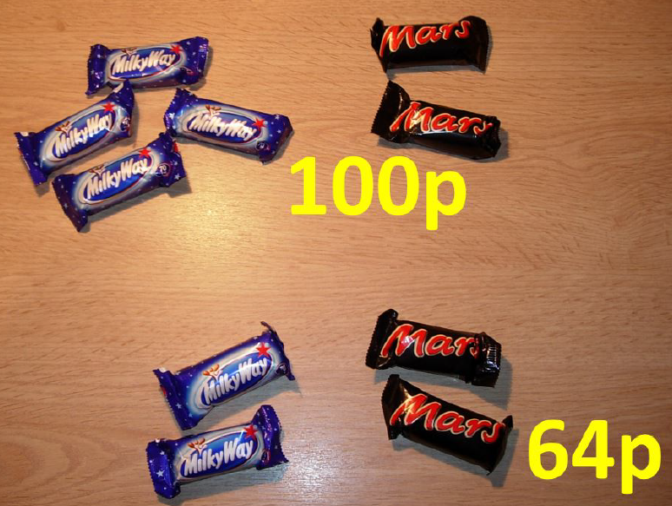
How much does a Milky Way cost?
How much does a Mars Bar cost?
How do you know?

Slide 6
On your whiteboards draw a pair of bar models to help you solve this problem
Notes:
Share and compare students bar models.

Slide 7











$$w$$
$$w$$
$$w$$
$$w$$
$$m$$
$$m$$
$$100$$
$$w$$
$$w$$
$$m$$
$$m$$
$$?$$
$$64$$
What does w represent?
What does m represent?
Notes:
The DIFFERENCE is 36
The DIFFERENCE is 2w

Slide 8



$$w$$
$$w$$
$$36$$
How much does a Milky Way cost?
Notes:
The DIFFERENCE is 36
The DIFFERENCE is 2w

Slide 9
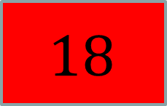
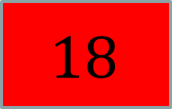


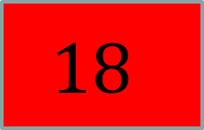

$$18$$
$$18$$
$$18$$
$$18$$
$$m$$
$$m$$
$$100$$
$$18$$
$$18$$
$$m$$
$$m$$
$$64$$
Write down a calculation that would give us the cost of a Mars Bar (m)
And another…

Slide 10




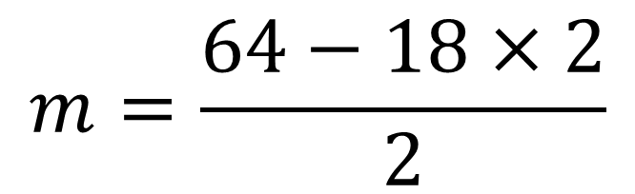
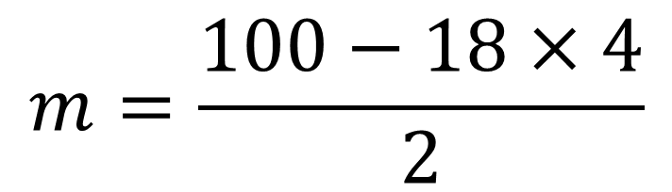
$$18$$
$$18$$
$$18$$
$$18$$
$$m$$
$$m$$
$$1$$
$$100$$
$$18$$
$$18$$
$$m$$
$$m$$
$$2$$
$$64$$
$$m=\frac{100−18×4}{2}$$
$$1$$
$$m=\frac{64−18×2}{2}$$
$$2$$

Slide 11
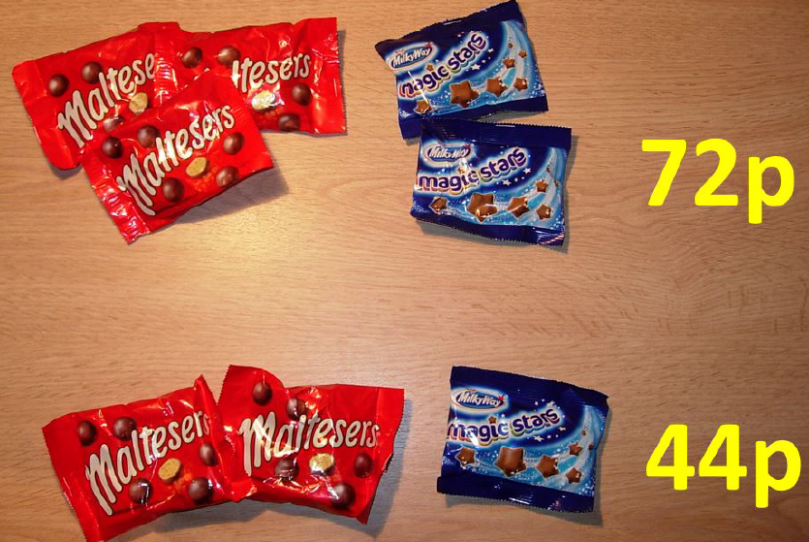
How much does a bag of Maltesers
cost?
How much does a bag of Magic Stars
cost?

Slide 12









$$m$$
$$m$$
$$m$$
$$s$$
$$s$$
$$72$$
$$m$$
$$m$$
$$s$$
$$44$$
What does m represent?
What does s represent?

Slide 13
$$m$$
$$m$$
$$m$$
$$s$$
$$s$$
$$72$$
$$m$$
$$m$$
$$s$$
$$44$$
A student thinks that a bag of Maltesers costs 14p.
Why are they wrong?

Slide 14





$$m$$
$$m$$
$$m$$
$$s$$
$$s$$
$$72$$
$$m$$
$$m$$
$$m$$
$$m$$
$$s$$
$$s$$
$$88$$
Discuss:
What is the same here?
What is different?

Slide 15
$$m$$
$$m$$
$$m$$
$$s$$
$$s$$
$$72$$
$$m$$
$$m$$
$$m$$
$$m$$
$$s$$
$$s$$
$$88$$
Discuss:
How does this bar model help us to solve the problem?

Slide 16



$$m$$
$$m$$
$$m$$
$$s$$
$$s$$
$$?$$
$$72$$
$$m$$
$$m$$
$$m$$
$$m$$
$$s$$
$$s$$
$$88$$
What value goes here?
How do you know?
Notes:
The DIFFERENCE is a bag of maltesers
The DIFFERENCED is 16p

Slide 17
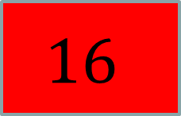

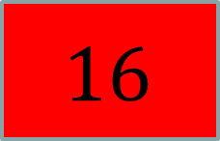

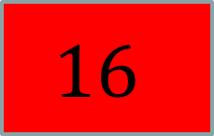
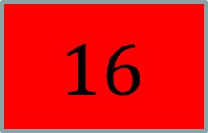

$$16$$
$$16$$
$$16$$
$$s$$
$$s$$
$$72$$
$$16$$
$$16$$
$$16$$
$$16$$
$$s$$
$$s$$
$$88$$
Write down a calculation that would give us the cost of a bag of Magic Stars (s)
And another…

Slide 18
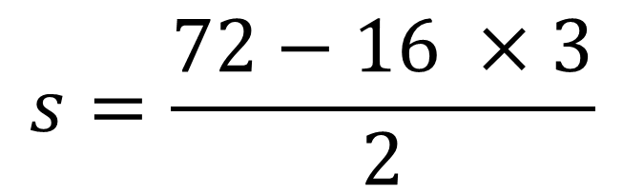
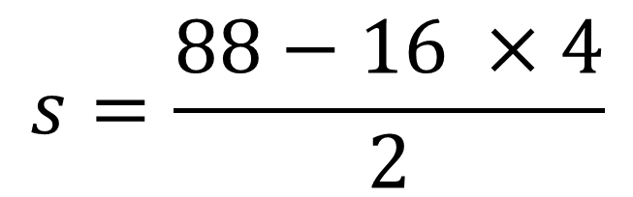



$$16$$
$$16$$
$$16$$
$$s$$
$$s$$
$$1$$
$$72$$
$$16$$
$$16$$
$$16$$
$$16$$
$$s$$
$$s$$
$$2$$
$$88$$
$$s=\frac{72−16 ×3}{2}$$
$$1$$
$$s=\frac{88−16 ×4}{2}$$
$$2$$

Slide 19
2 apples and 2 oranges cost 84p
1 apple and 3 oranges cost 80p
Draw a bar model and use it to work out the cost of an apple and an orange.
Notes:
Share and compare students solutions

Slide 20








$$a$$
$$a$$
$$o$$
$$o$$
$$84$$
$$a$$
$$o$$
$$o$$
$$o$$
$$80$$

Slide 21





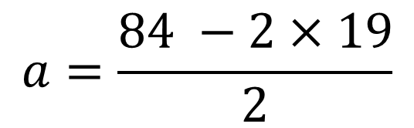



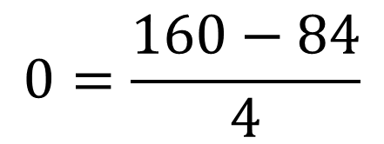




In your pairs, describe this method:
$$a$$
$$a$$
$$o$$
$$o$$
$$84$$
$$?$$
$$a$$
$$a$$
$$o$$
$$o$$
$$o$$
$$o$$
$$o$$
$$o$$
$$160$$
$$0=\frac{160−84}{4}$$
$$a=\frac{84 −2×19}{2}$$

Slide 22




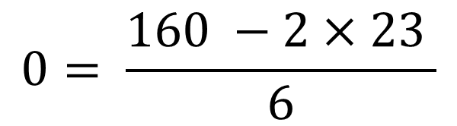




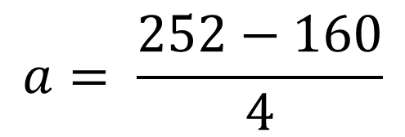









In pairs, describe this method:
$$a$$
$$a$$
$$a$$
$$a$$
$$a$$
$$a$$
$$o$$
$$o$$
$$o$$
$$o$$
$$o$$
$$o$$
$$252$$
$$a$$
$$a$$
$$o$$
$$o$$
$$o$$
$$o$$
$$o$$
$$o$$
$$?$$
$$160$$
$$a= \frac{252−160}{4}$$
$$0= \frac{160 −2×23 }{6}$$

Slide 23
Practise on whiteboards first, then in your books:
In Aldi, three bananas and one apple cost £1.50, two bananas and one apple cost £1.10. Work out the cost of a banana and an apple from Aldi.
In Tesco, four bananas and one apple cost £2.00, two bananas and one apple cost £1.20. Work out the cost of a banana and an apple from Tesco.
In Waitrose, one banana and five apples cost £2.90, one banana and three apples cost £1.90. Work out the cost of a banana and an apple from Waitrose.
Notes:
Independent Work

Slide 24
Practise on whiteboards first, then in your books:
4. In Sainsbury's, a mango and three pears cost £3.30, a mango and two pears cost £3.05. Work out the cost of a mango and a pear from Sainsbury’s.
5. In Asda, two mangoes and three pears costs £3.40, one mango and two pears costs £1.90. Work out the cost of a mango and a pear from Asda.
6. In Coop, three mangoes and three pears costs £5.25, two mangoes and four pears costs £5.00. Work out the cost of a mango and a pear from Coop.

Slide 25
Mark your work:
Bananas costs 40p each and Apples costs 30p each
Bananas costs 40p each and Apples cost 40p each
Bananas cost 40p each and Apples are 50p each

Slide 26
Mark your work:
4. Pears cost 25p each and a mango costs £2.55
5. Pears cost 40p each and a mango costs £1.10
6. Pears cost 75p each and a mango costs £1

Slide 27
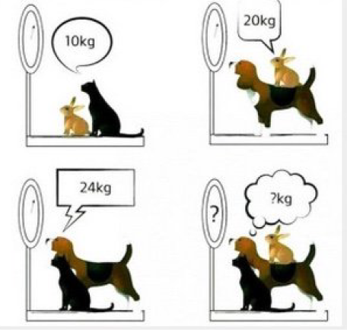
Challenge: Find the combined weight of all three animals.
Notes:
Acknowledgements: Challenge from Don Steward

