Slide 1


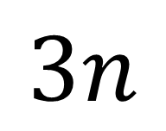






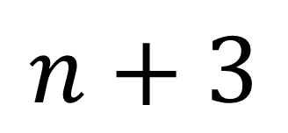


Which is larger?
$$3n$$
$$n+3$$
or
How do you know?
$$n$$
$$n$$
$$n$$
$$n$$
$$n$$
$$n$$
$$n$$
$$3$$
$$n$$
$$3$$
Notes:
Share and compare whiteboards but don’t give full solution yet

Slide 2

Olaf is spending the day at a lake.
He wants to hire a rowing boat for some of the time.
Nick’s Boat Hire charges £5 per hour.
Isla’s Boat Hire chares £10 plus £1 per hour.
Whose boat should Olaf choose?
Notes:
Ask students for their immediate responses

Slide 3
Olaf is spending the day at a lake.
He wants to hire a rowing boat for some of the time.
Nick’s Boat Hire charges £5 per hour.
Isla’s Boat Hire chares £10 plus £1 per hour.
Whose boat should Olaf choose?
Notes:
Ask students to consider the problem further in small groups

Slide 4
Olaf is spending the day at a lake.
He wants to hire a rowing boat for some of the time.
Nick’s Boat Hire charges £5 per hour.
Isla’s Boat Hire chares £10 plus £1 per hour.
Whose boat should Olaf choose?
Notes:
Collect numerical data on the total cost for various hours and represent data randomly on the board

Slide 5
Olaf is spending the day at a lake.
He wants to hire a rowing boat for some of the time.
Nick’s Boat Hire charges £5 per hour.
Isla’s Boat Hire chares £10 plus £1 per hour.
Whose boat should Olaf choose?
Notes:
Collect numerical data on the total cost for various hours and represent data randomly on the board

Slide 6
Olaf is spending the day at a lake.
He wants to hire a rowing boat for some of the time.
Nick’s Boat Hire charges £5 per hour.
Isla’s Boat Hire chares £10 plus £1 per hour.
Whose boat should Olaf choose?
Hours | Nick (£) | Isla (£)
0
1
2
3
10
Notes:
Complete table with students

Slide 7
Olaf is spending the day at a lake.
He wants to hire a rowing boat for some of the time.
Nick’s Boat Hire charges £5 per hour.
Isla’s Boat Hire chares £10 plus £1 per hour.
Whose boat should Olaf choose?
Hours | Nick (£) | Isla (£)
0 | 0 | 10
1 | 5 | 11
2 | 10 | 12
3 | 15 | 13
10 | 50 | 21
On your whiteboards represent the hire-rules algebraically.
Notes:
Share and compare students responses and record a selection of them on the board
Select the equations that will enable students to solve simultaneously eg. C = 5h and C = 10 + h

Slide 8









Olaf is spending the day at a lake.
He wants to hire a rowing boat for some of the time.
Nick’s Boat Hire charges £5 per hour.
Isla’s Boat Hire chares £10 plus £1 per hour.
Whose boat should Olaf choose?
Hours | Nick (£) | Isla (£)
0 | 0 | 10
1 | 5 | 11
2 | 10 | 12
3 | 15 | 13
10 | 50 | 21
Are Nick’s and Isla’s charges ever equal?
$$h$$
$$h$$
$$h$$
$$h$$
$$h$$
$$c$$
$$h$$
$$10$$
$$c$$
Notes:
Lead students to enable them to solve simultaneously

Slide 9
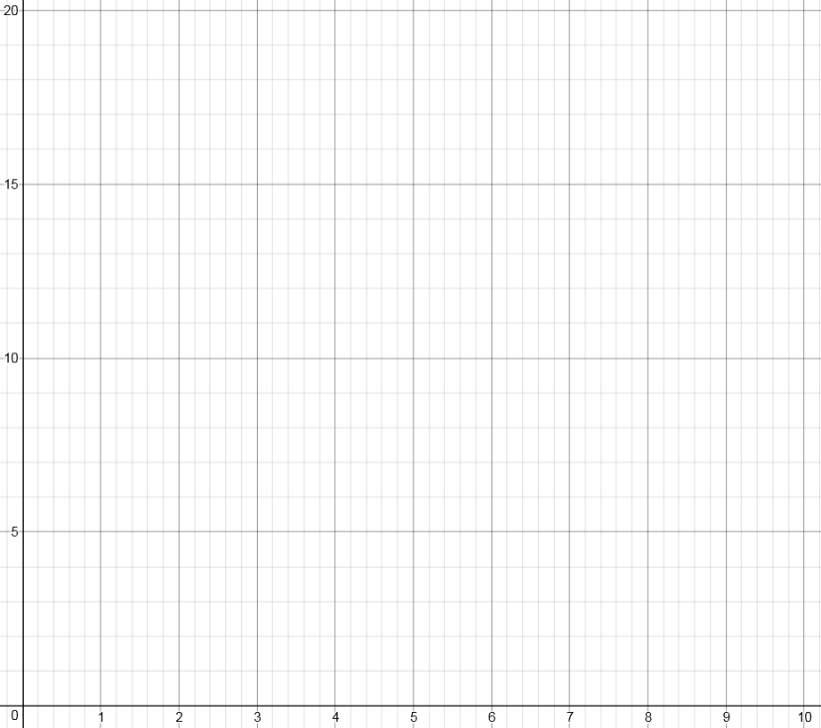
Olaf is spending the day at a lake.
He wants to hire a rowing boat for some of the time.
Nick’s Boat Hire charges £5 per hour.
Isla’s Boat Hire chares £10 plus £1 per hour.
Whose boat should Olaf choose?
Hours | Nick (£) | Isla (£)
0 | 0 | 10
1 | 5 | 11
2 | 10 | 12
3 | 15 | 13
10 | 50 | 21
Represent the data as points on a graph
Notes:
Provide axes for students to use..

Slide 10
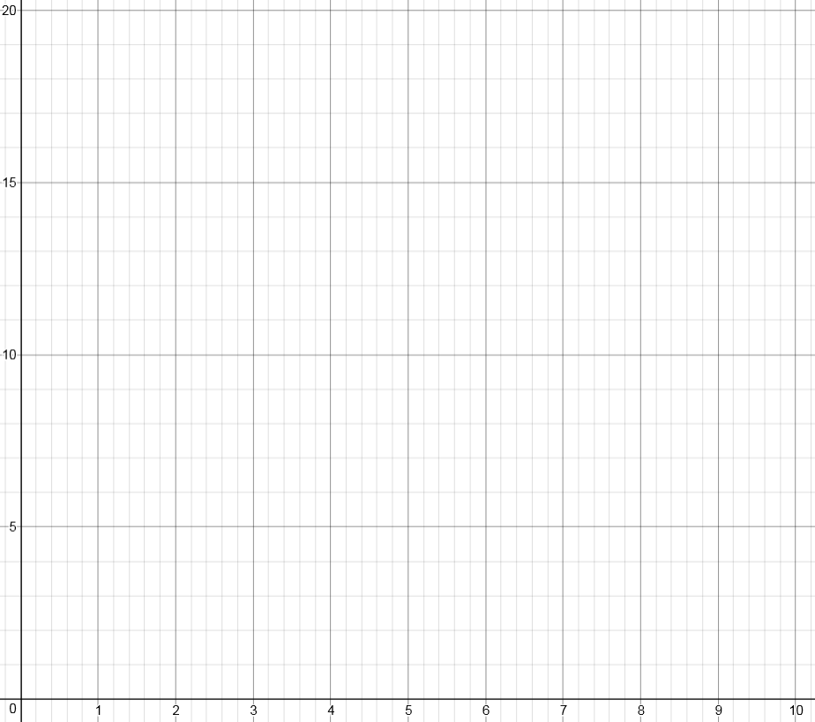
Notes:
“Can we draw a line through the points?”

Slide 11
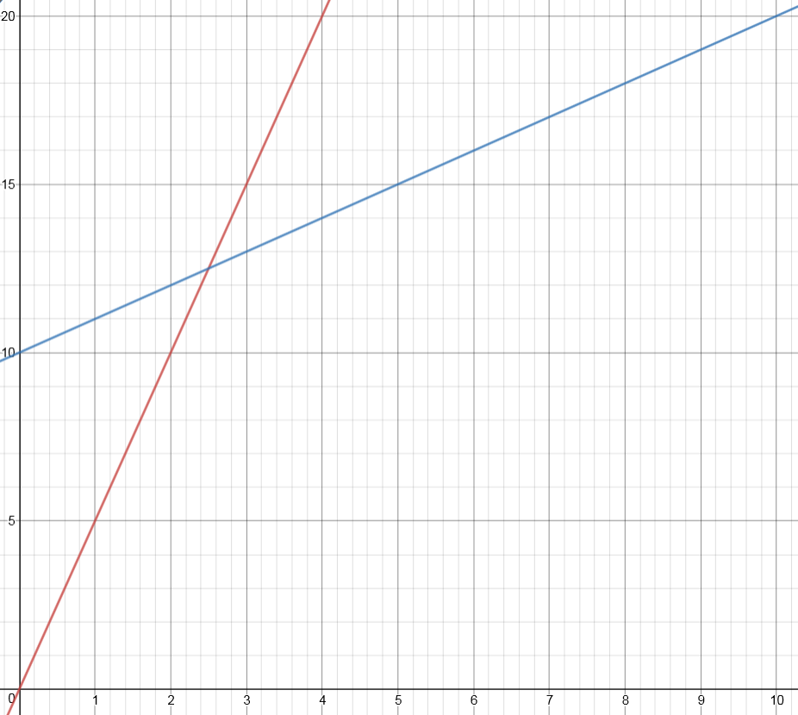
What do you notice?
The intersection can be calculated by solving two simultaneous equations

Slide 12
Which is larger?
$$3n$$
$$n+3$$
or
How do you know?
Notes:
Acknowledgements: ICCAMS

