Slide 1

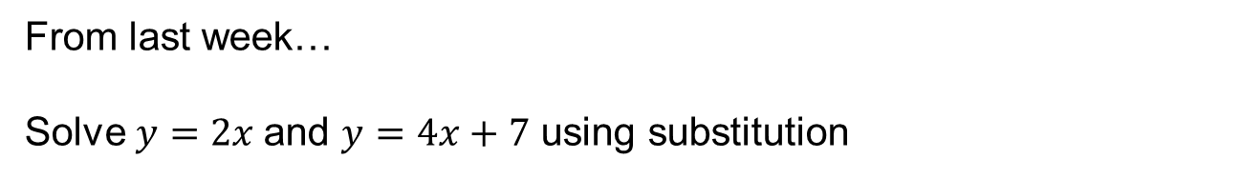


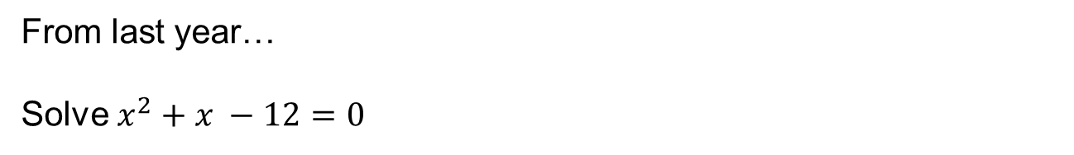
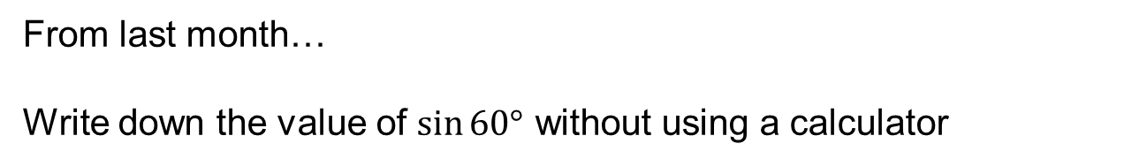
From last week…
Solve $y=2x$and $y=4x+7$ using substitution
$$3$$
$$2$$
From last month…
Write down the value of $\sin{60°}$ without using a calculator
$$1$$
From last year…
Solve $x^{2}+x −12=0$
Notes:
Timed spaced retrieval

Slide 2

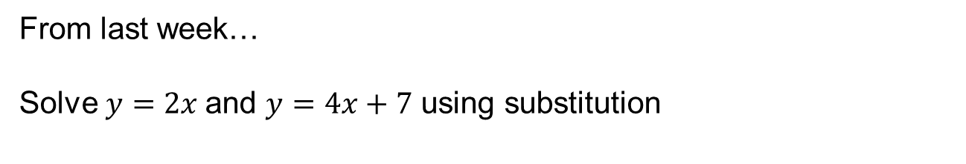






From last week…
Solve $y=2x$and $y=4x+7$ using substitution
$$2x=4x+7$$
-$2x=7$
$$x=−3.5$$
$$y=−7$$
From last month…
Write down the value of $\sin{60°}$ without using a calculator
$$\frac{\sqrt{3}}{2}$$
From last year…
Solve $x^{2}+x −12=0$
$$\left(x+4\right)\left(x−3\right)=0$$
$$x=−4, x=3$$

Slide 3
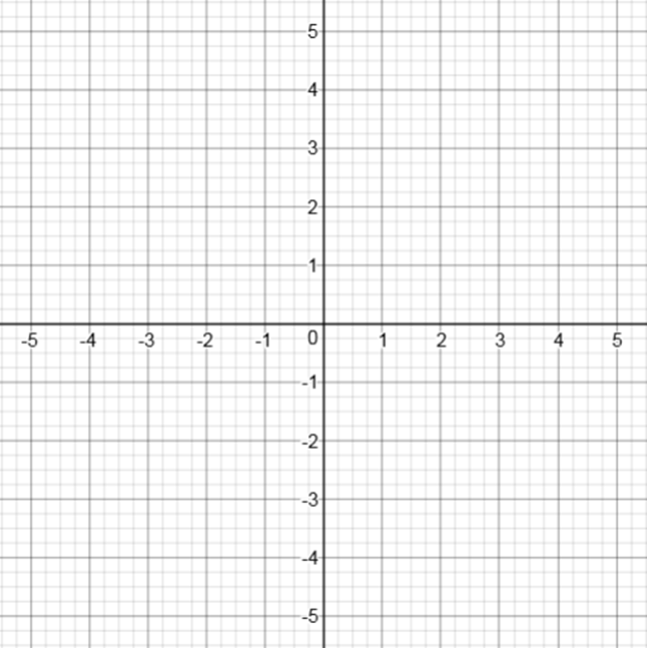
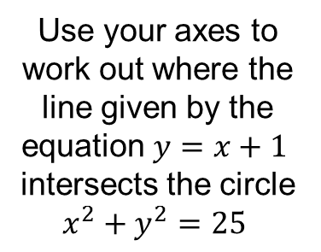
Use your axes to work out where the line given by the equation $y=x+1$
intersects the circle
$$x^{2}+y^{2}=25$$
Notes:
Use prepared axes from previous lesson

Slide 4
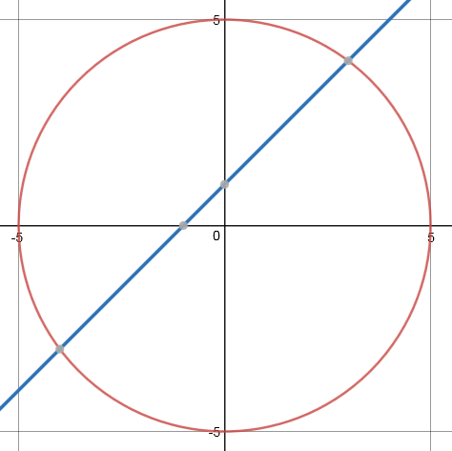
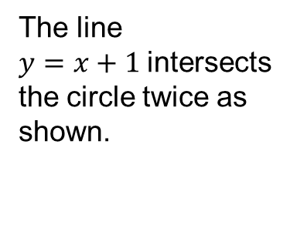


The line
$y=x+1$intersects the circle twice as shown.
$$(3, 4)$$
How could we have worked out these points of intersection without sketching the graphs?
$$(−4,3)$$

Slide 5
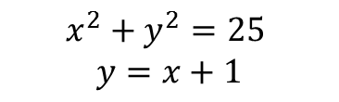
Solving this pair of simultaneous equations will gives us the points of intersection.
$$x^{2}+y^{2}=25$$
$$y=x+1$$

Slide 6

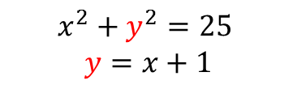





Solving this pair of simultaneous equations will gives us the points of intersection.
$$x^{2}+y^{2}=25$$
$$y=x+1$$
Substituting for y gives:
$$x^{2}+({x+1)}^{2}=25$$
$$x^{2}+x^{2}+2x+1=25$$
$${2x}^{2}+2x−24=0$$
$$x^{2}+x−12=0$$
$$\left(x+4\right)\left(x−3\right)=0$$
$$x=−4, x=3$$

Slide 7


Solving this pair of simultaneous equations will gives us the points of intersection.
$$x^{2}+y^{2}=25$$
$$y=x+1$$
Using the equation of the straight line to calculate y:
$$x=−4, x=3$$
$$y=−3, x=4$$

Slide 8
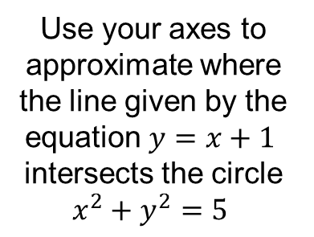
Use your axes to approximate where the line given by the equation $y=x+1$
intersects the circle
$$x^{2}+y^{2}=5$$

Slide 9
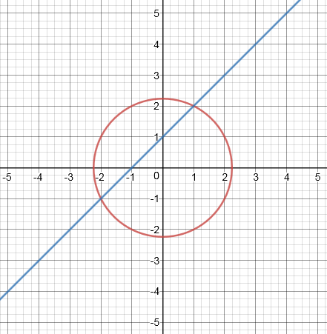
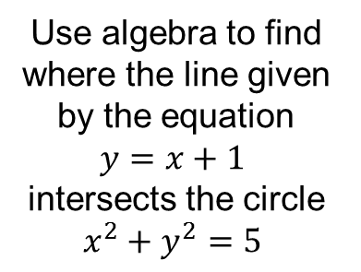
Use algebra to find where the line given by the equation $y=x+1$
intersects the circle
$$x^{2}+y^{2}=5$$

Slide 10
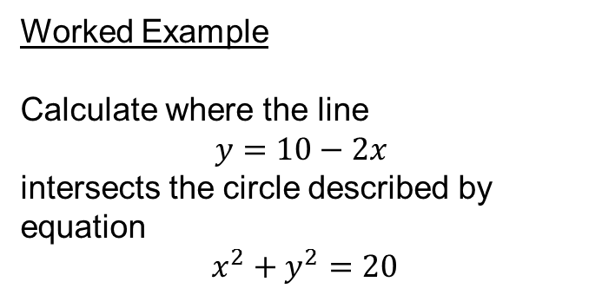
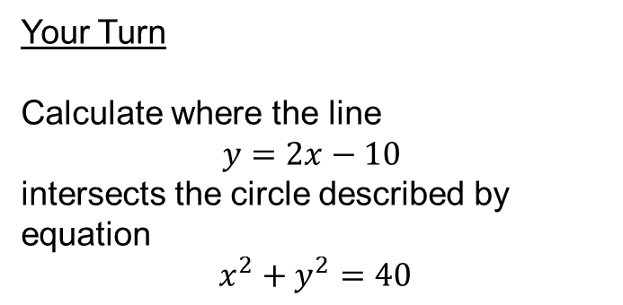
Title – Intersections of curves and lines
Worked Example
Calculate where the line
$$y=10−2x$$
intersects the circle described by equation
$$x^{2}+y^{2}=20$$
Your Turn
Calculate where the line
$$y=2x−10$$
intersects the circle described by equation
$$x^{2}+y^{2}=40$$
Notes:
Silently model working then question each stage. Students then complete their turn in silence.

Slide 11
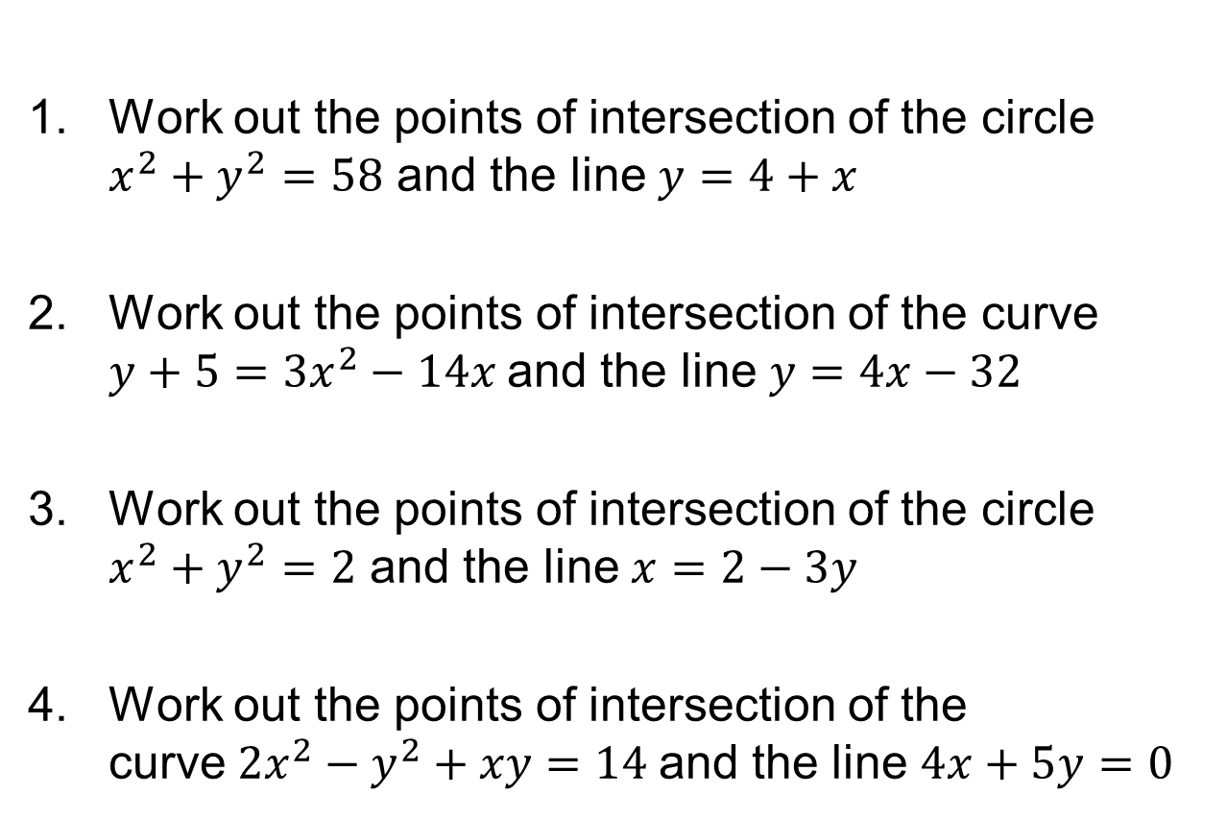
In your book:
Work out the points of intersection of the circle $x^{2}+y^{2}=58$ and the line $y=4+x$
Work out the points of intersection of the curve $y+5={3x}^{2}−14x$and the line $y=4x−32$
Work out the points of intersection of the circle $x^{2}+y^{2}=2$ and the line $x=2−3y$
Work out the points of intersection of the curve${2x}^{2}−y^{2}+xy=14$and the line $4x+5y=0$

Slide 12
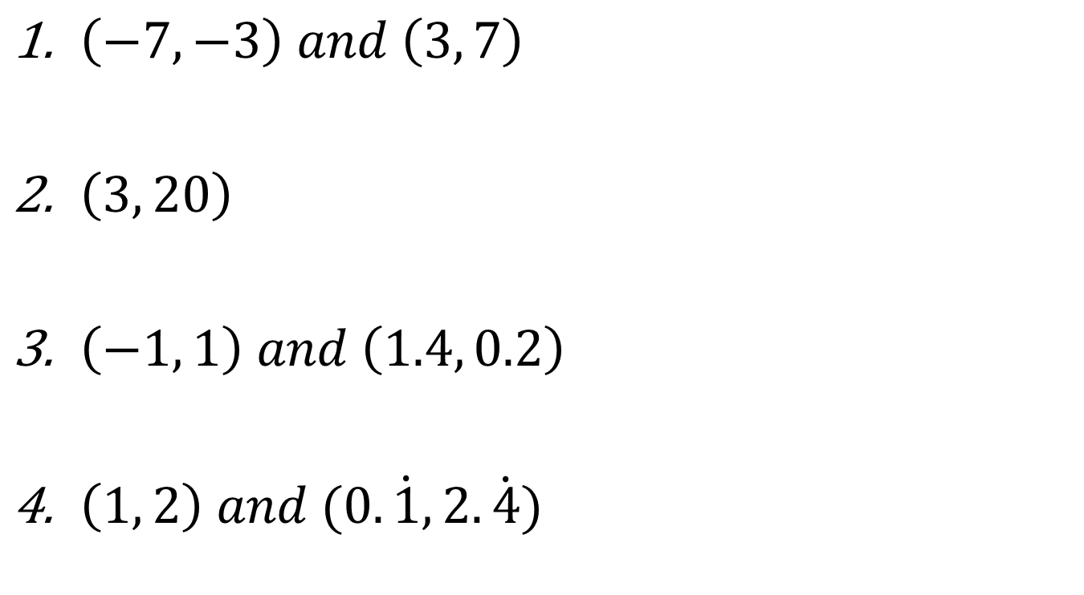
Mark your work
$\left(−7, −3\right) and \left(3, 7\right)$
$\left(3, 20\right)$
$\left(−1, 1\right) and \left(1.4, 0.2\right)$
$\left(1, 2\right) and (0.\dot{1}, 2.\dot{4})$

Slide 13
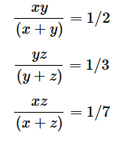
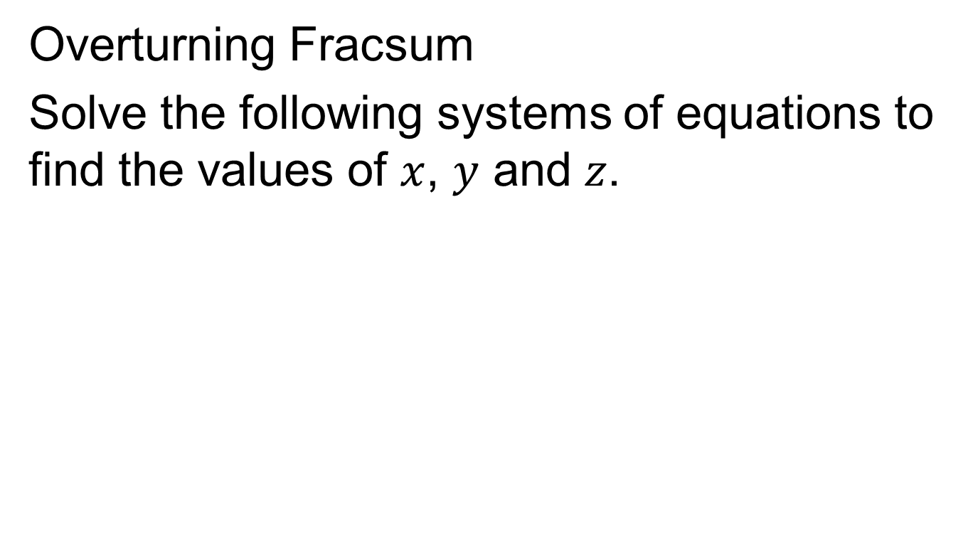
Challenge
Overturning Fracsum
Solve the following systems of equations to find the values of $x$, $y$ and $z$.
Notes:
https://nrich.maths.org/264/solution
X = 1/3, y = -1, z = ¼

