Slide 1
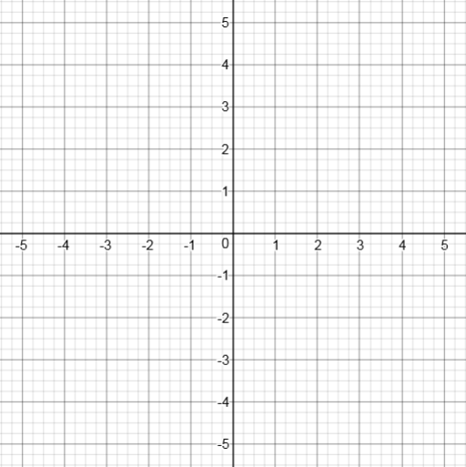

Slide 2
Calculate the distance of this point from the origin

Slide 3
Calculate the distance of this point from the origin

Slide 4
Calculate the distance of this point from the origin

Slide 5
Plot a point that is exactly 5 units from the origin
And another..
And another..

Slide 6
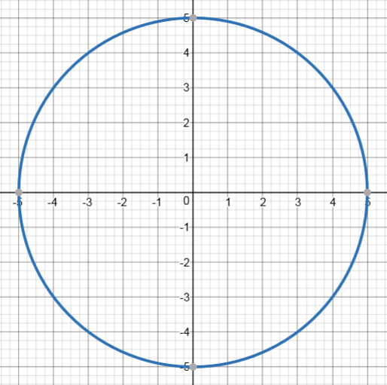
All of your points should lie on the circumference of this circle

Slide 7
All of your points should lie on the circumference of this circle.
What else do these coordinates have in common?

Slide 8
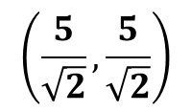






$$(−3, 4)$$
All of your points should lie on the circumference of this circle.
What else do these coordinates have in common?
$$\left(\frac{5}{\sqrt{2}}, \frac{5}{\sqrt{2}}\right)$$
$$(−5,0)$$
$$(5,0)$$
$$(−4,−3)$$
$$(3, −4)$$
$$(0,−5)$$

Slide 9
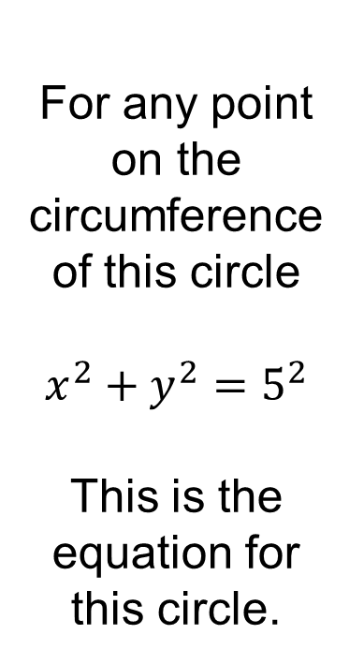


For any point on the circumference of this circle
$$x^{2}+y^{2}=5^{2}$$
This is the equation for this circle.
$$y$$
$$x$$

Slide 10
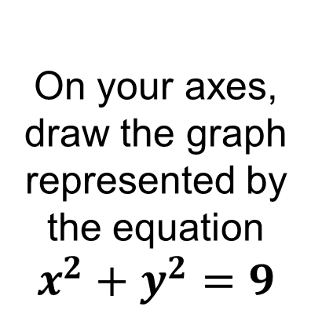
On your axes,
draw the graph represented by the equation
$$x^{2}+y^{2}=9$$

Slide 11
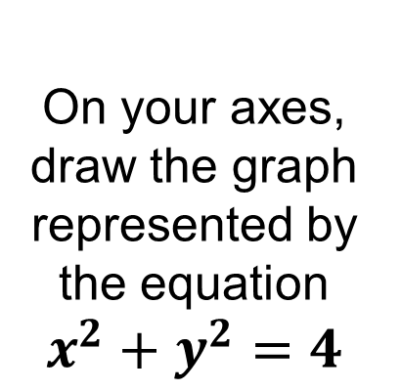
On your axes,
draw the graph represented by the equation
$$x^{2}+y^{2}=4$$

Slide 12
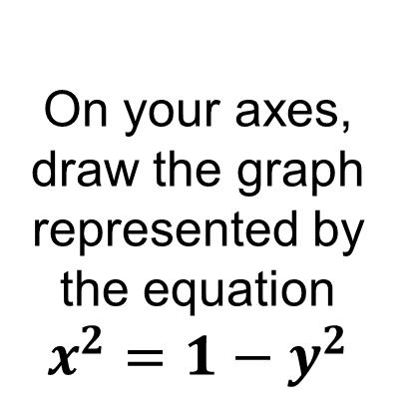
On your axes,
draw the graph represented by the equation
$$x^{2}=1−y^{2}$$

Slide 13
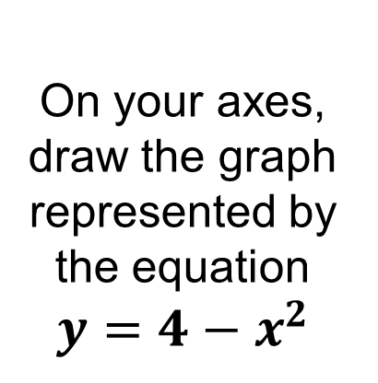
On your axes,
draw the graph represented by the equation
$$y=4−x^{2}$$
Notes:
An example of what it is not..

Slide 14
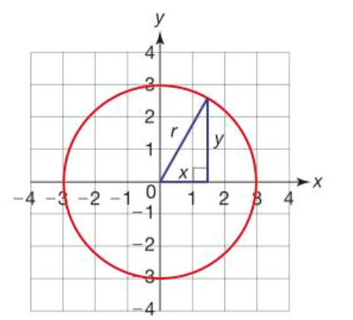
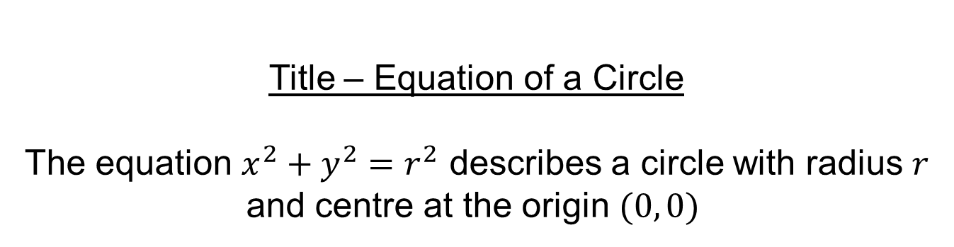
Title – Equation of a Circle
The equation $x^{2}+y^{2}=r^{2}$ describes a circle with radius $r$ and centre at the origin $(0, 0)$

Slide 15
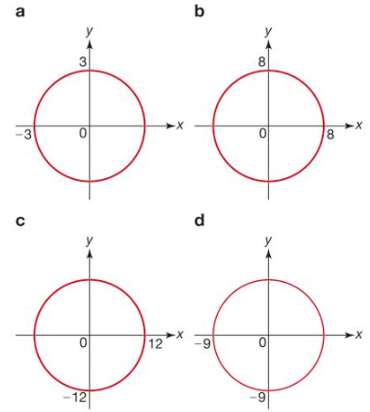
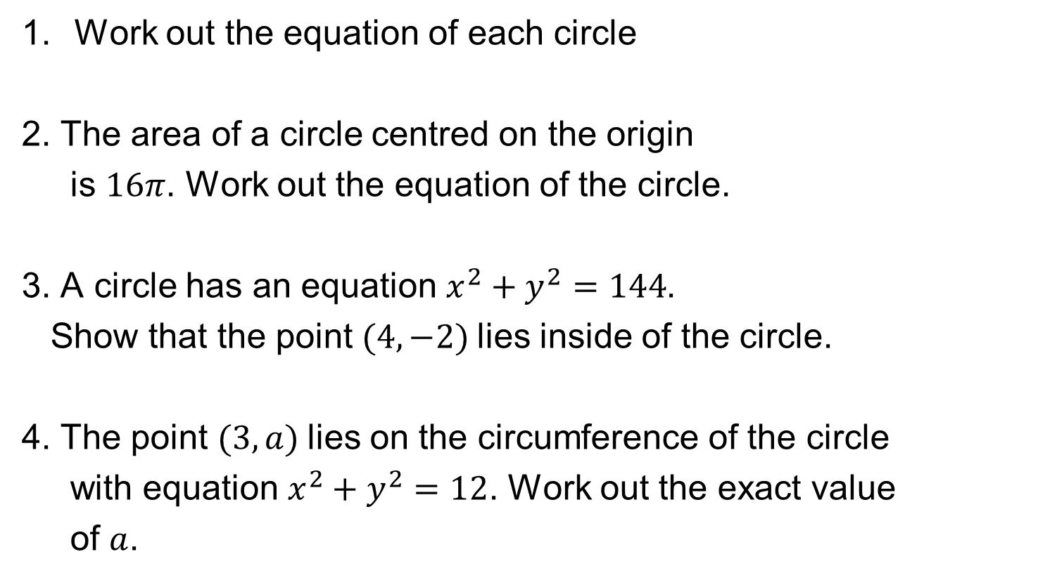
In your books:
Work out the equation of each circle
2. The area of a circle centred on the origin
is $16π$. Work out the equation of the circle.
3. A circle has an equation $x^{2}+y^{2}=144$.
Show that the point $(4, −2)$lies inside of the circle.
4. The point $(3, a)$lies on the circumference of the circle
with equation $x^{2}+y^{2}=12$. Work out the exact value
of $a$.

Slide 16
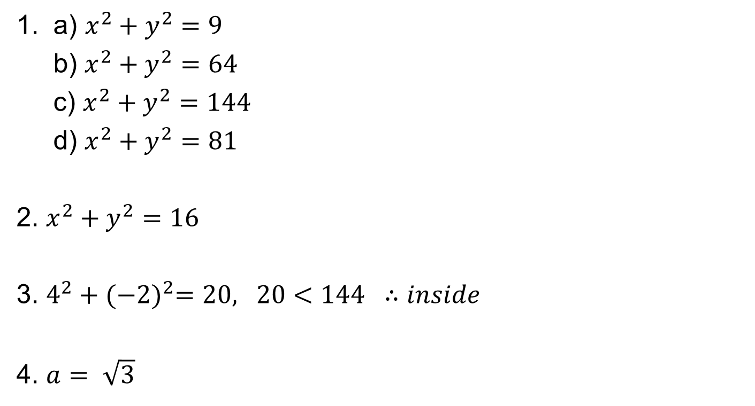
Mark your work
1. a) $x^{2}+y^{2}=9$
b) $x^{2}+y^{2}=64$
c) $x^{2}+y^{2}=144$
d) $x^{2}+y^{2}=81$
2. $x^{2}+y^{2}=16$
3. $4^{2}+{(−2)}^{2}=20, 20<144 ∴inside$
4. $a= \sqrt{3}$

Slide 17
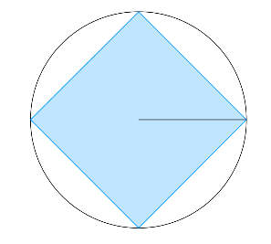
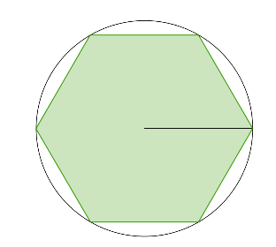
Challenge
The area of the square is 2 units²
The circle is centred about the origin
Work out the exact equation of the circle.
What is the area of a regular hexagon inscribed in the same circle?
Notes:
Acknowledgements: Nrich
r = 1
Hexagon area =1$.5\sqrt{3}$

