Slide 1
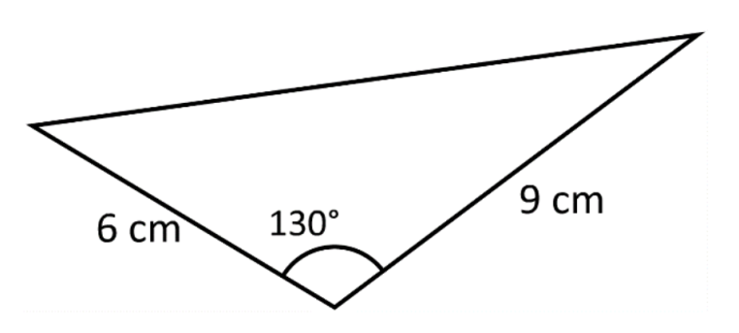
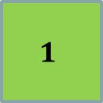
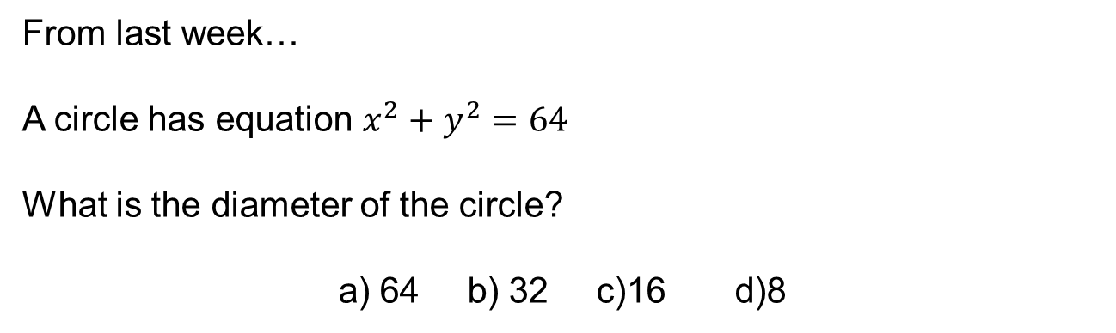
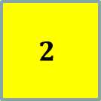

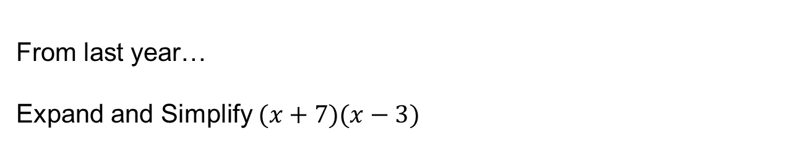
From last week…
A circle has equation $x^{2}+y^{2}=64$
What is the diameter of the circle?
a) 64 b) 32 c)16 d)8
$$3$$
$$2$$
$$1$$
From last month…
Work out the area of this triangle
From last year…
Expand and Simplify $(x+7)(x−3)$
Notes:
Timed spaced retrieval

Slide 2
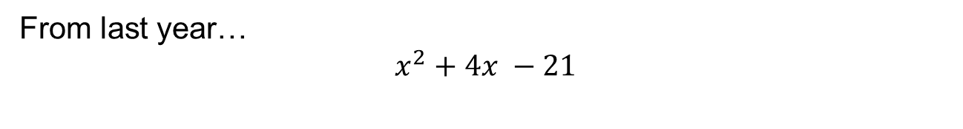
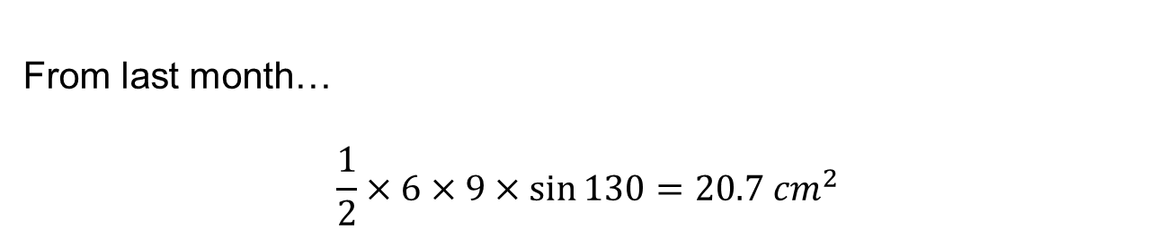
From last week…
$$r=8 so d=16$$
From last month…
$$\frac{1}{2}×6×9×\sin{130=20.7 {cm}^{2}}$$
From last year…
$x^{2}+4x −21$
Notes:
Timed spaced retrieval

Slide 3
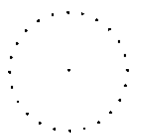
1. Using the points provided draw a diameter.
2. Make a triangle using your diameter and any point of the circumference.
3. Measure the angle opposite the centre of the circle.
Discuss your angle with your partner, what do you notice?

Slide 4







$$y°$$
$$x°$$
Proof
Discuss:
How do we know that these angles are equal?
$$y°$$
$$x°$$
$$x+x+y+y=180$$
$$2x+2y=180$$
$$∴x+y=90 ∎$$

Slide 5
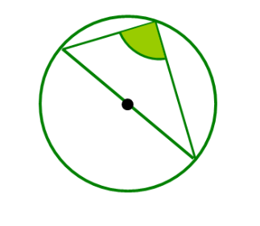
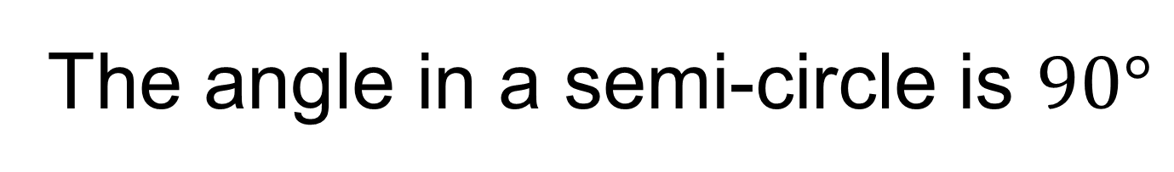
The angle in a semi-circle is $90°$
Demo 1

Slide 6
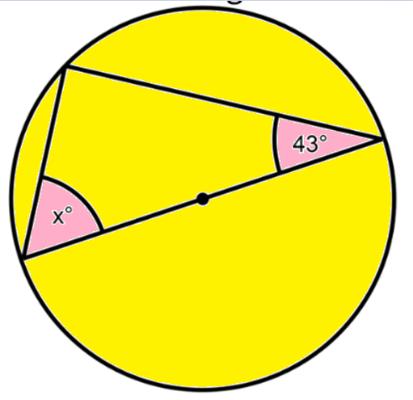
On your whiteboards:
Work out the missing angle

Slide 7
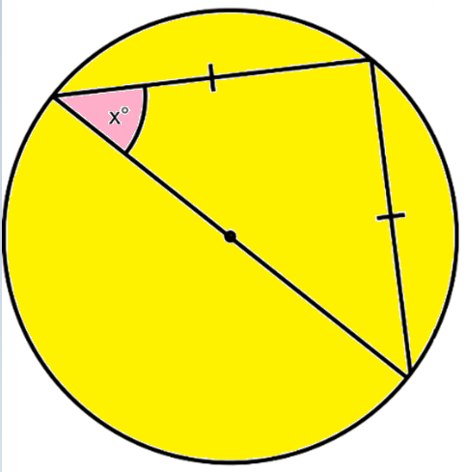
On your whiteboards:
Work out the missing angle

Slide 8
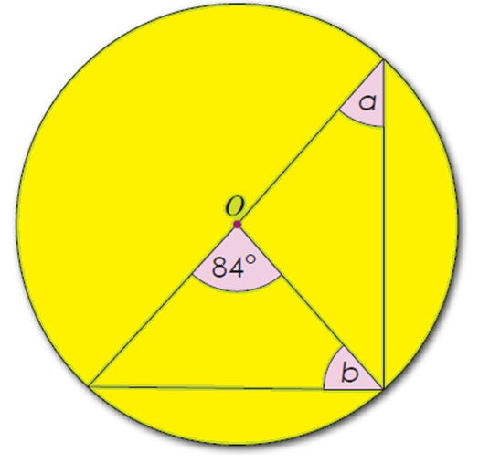
On your whiteboards:
Work out the missing angles

Slide 9
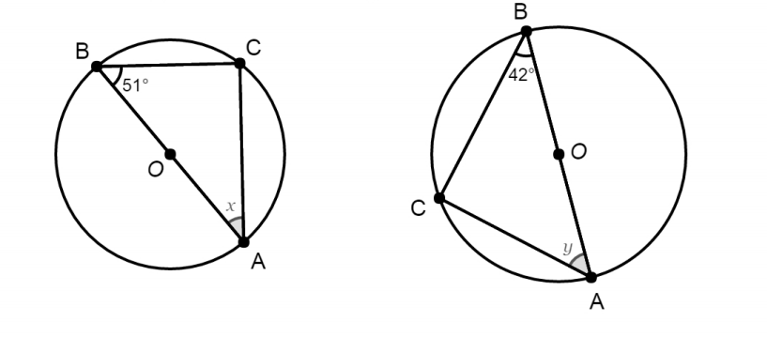
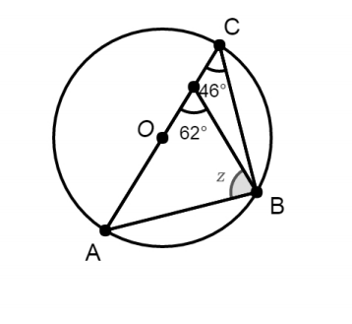
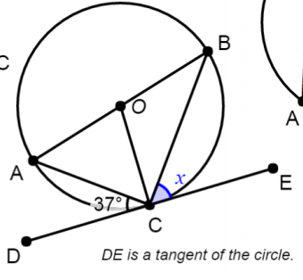
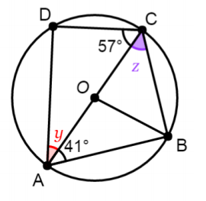





Work out the missing angles
$$1.$$
$$2.$$
$$3.$$
$$4.$$
$$5.$$

Slide 10
Mark your work
1. x = 39
2. y = 48
3. z =74
4. x = 53
5. y = 33 and z = 49

Slide 11
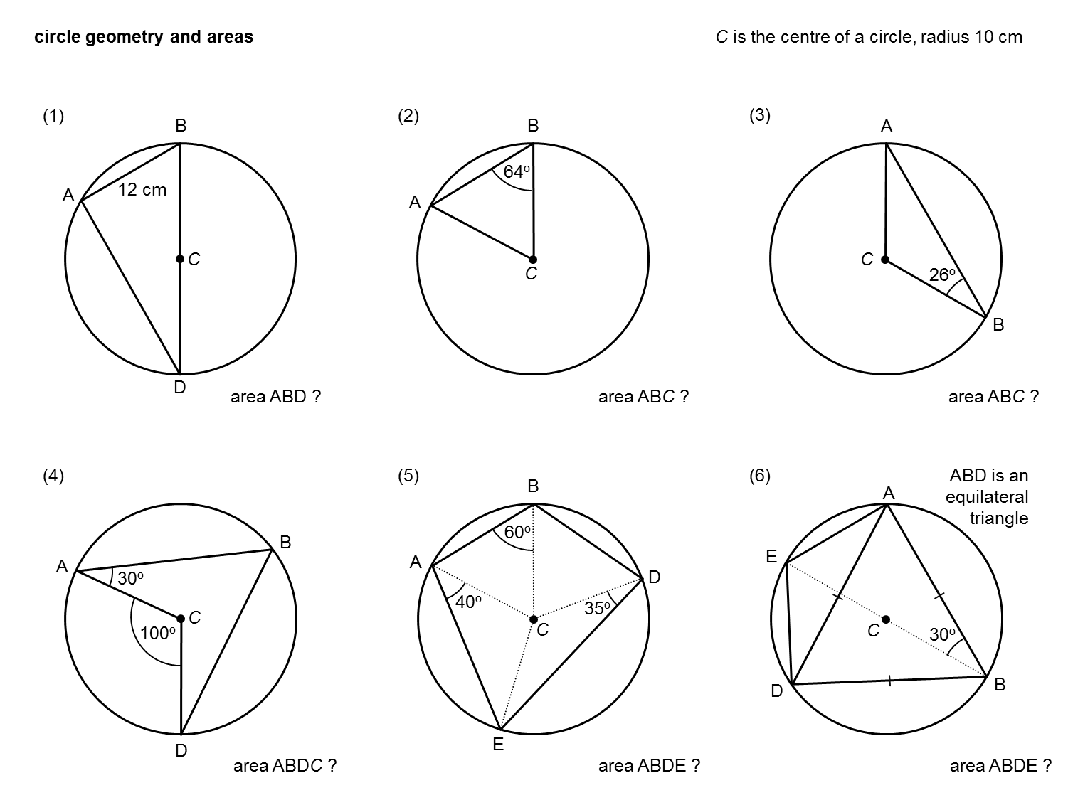
Challenge
The radius of this circle is 10cm.
Work out the area of the quadrilateral ABDE
Notes:
Acknowledgements: Don Steward

Slide 12
1. Using the points provided draw a chord.
2. Make a triangle using your chord and any point of the circumference.
3. Make another triangle using the same chord and the centre of the circle.
4. Measure the angle subtended by the arc at the centre of the circle.
5. Measure the angle subtended by the arc at the circumference.
Discuss your angles with your partner, what do you notice?

Slide 13









B
Proof
Discuss:
How do we know that these angles are equal?
A
$$x$$
$$y$$
$$2y$$
$$2x$$
O
What expression can we write for angle BOC?
$$y$$
$$x$$
$$Angle BOC= 180 −2x$$
C
What expression can we write for this angle?
$$180−\left(180−2x\right)=2x$$
What expression can we write for this angle?
$$2y$$

Slide 14



B
$$Angle ACB=x+y$$
A
$$x$$
$$y$$
$$2y$$
$$2x$$
O
$$Angle AOB=2x+2y$$
$$y$$
$$x$$
$$Angle AOB=2(x+y)$$
C

Slide 15
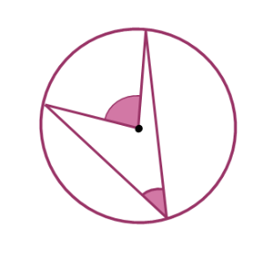
The angle at the centre is double the angle at the circumference.
Demo 2

Slide 16
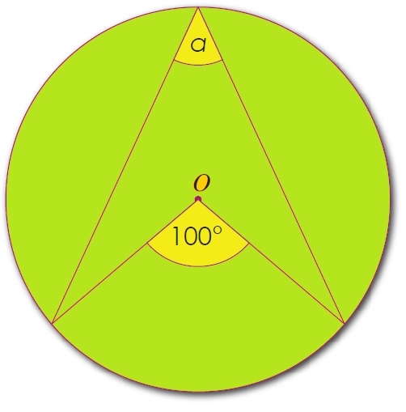
On your whiteboards:
Work out the missing angle

Slide 17
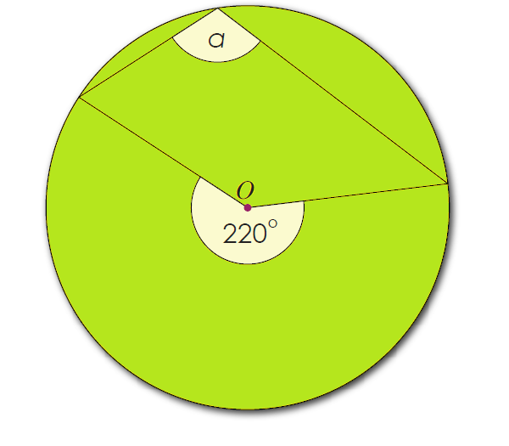
On your whiteboards:
Work out the missing angle

Slide 18
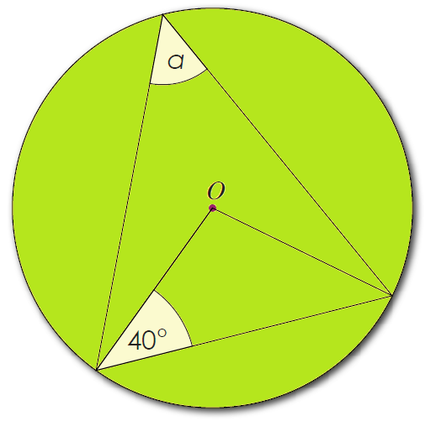
On your whiteboards:
Work out the missing angle

Slide 19
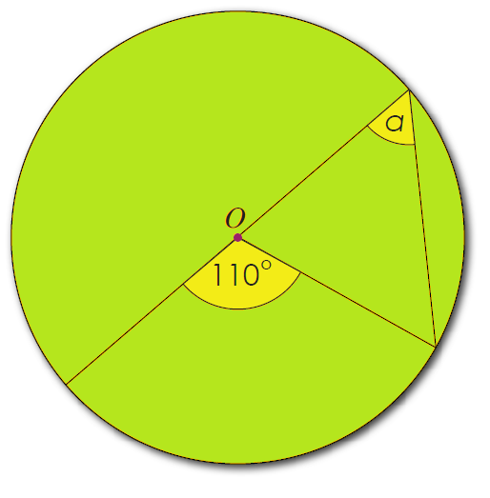
On your whiteboards:
Work out the missing angle

Slide 20
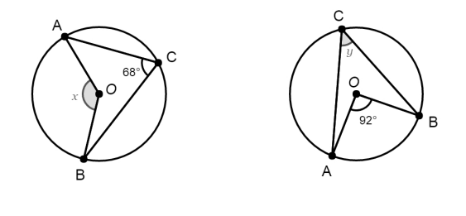
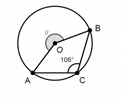
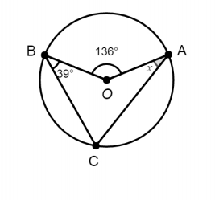
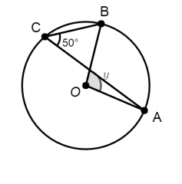


Work out the missing angles
$$1.$$
$$2.$$
$$3.$$
$$4.$$
$$5.$$

Slide 21
Mark your work
1. x = 34
2. y = 46
3. y = 212
4. x = 29
5. y = 100

Slide 22
Challenge
The radius of this circle is 10cm.
Work out the area of the quadrilateral ABDC
Notes:
Acknowledgements: Don Steward

