Slide 1
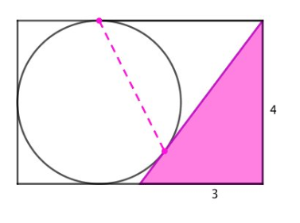
Here is a circle and a right-angled triangle inside a rectangle.
The measurements are in centimetres.
Work out as many things as you can!
Notes:
Acknowledgements – Ed Southall

Slide 2
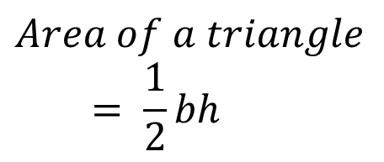
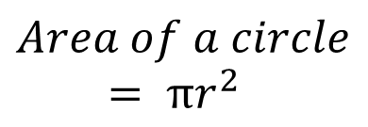
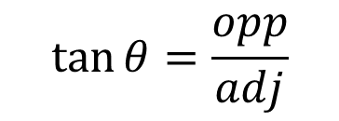

The radius and tangent meet at 90⁰
$a^{2}+b^{2}=c^{2}$
$$Area of a circle= πr^{2}$$
$$Area of a triangle= \frac{1}{2}bh$$
$$\tan{θ=\frac{opp}{adj}}$$
$$a^{2}=b^{2}+c^{2}−2bccosA$$
Notes:
Possible Scaffold

Slide 3
Some ideas
Work out the length of the
hypotenuse.
How long is the chord?
What fraction is shaded?
What is the area of the minor segment?
What are the angles in the Triangle?
Area of the Circle? Triangle?
Rectangle?
Notes:
Another possible scaffold

Slide 4
Mark your work
Triangle
Hypotenuse = 5cm
Area = 6cm²
Angles 90, 36.9 and 53.1 degrees

Slide 5
Circle
Radius = 2cm
Area = 12.6cm² (1 dp)
Chord = 3.6cm (1dp)
Area of Minor Segment = 2.8cm² (1 dp)

Slide 6
Rectangle
Length = 6cm
Area = 24cm²
Fraction of rectangle shaded = ¼

Slide 7
