Slide 1
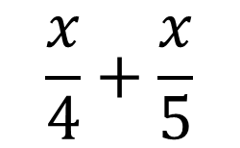
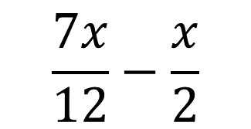
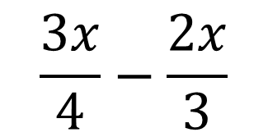
Find the odd one out
$$\frac{x}{4}+\frac{x}{5}$$
$$\frac{3x}{4}−\frac{2x}{3}$$
$$\frac{7x}{12}−\frac{x}{2}$$
Extension:
Can you make another question that would give the same answer?

Slide 2
A rectangle has width $\frac{x}{5}$ and height $\frac{x}{7}$
Label a diagram with the information you have been given
Are there any other lengths you know?
Add them to your diagram

Slide 3
A rectangle has width $\frac{x}{5}$ and height $\frac{x}{7}$
How could we calculate the perimeter of this shape?
Write an expression for the perimeter of the shape
Give your answer as a single fraction

Slide 4
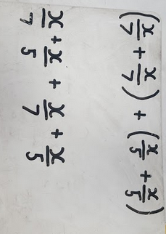
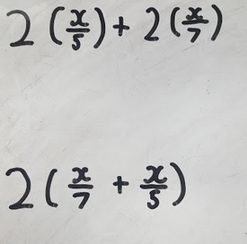
In pairs compare the following methods, how have they formed their expression?
Think – are all the brackets necessary?

Slide 5


In your books
Title: Perimeters with algebraic fractions
A rectangle has width $\frac{2x}{5}$ and height $\frac{x}{6}$
By drawing a diagram to represent the question, write an expression for the perimeter of the shape
Give your answer as a single fraction
Extension: What is the area of the rectangle?
Notes:
This lesson runs fine without the bits in books however, for a more fidgety group that doesn’t cope well with a 100% whiteboard lesson and discussion, break it up with an example question following each activity

Slide 6
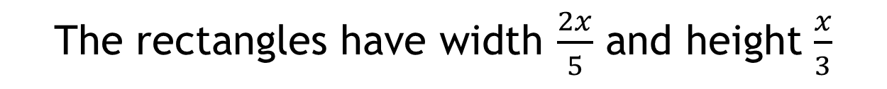
This shape is made from three identical rectangles
The rectangles have width $\frac{2x}{5}$ and height $\frac{x}{3}$
Label your diagram with the information you have been given
Are there any other lengths you know?
Add them to your diagram
Notes:
Upper groups may attempt to divide the width by 2 for the smaller lengths – if they do, let them carry on! Use it as an example to demonstrate to the rest

Slide 7
This shape is made from three identical rectangles
The rectangles have width $\frac{2x}{5}$ and height $\frac{x}{3}$
How could we calculate the perimeter of this shape?
Write an expression for the perimeter of the shape
Give your answer as a single fraction

Slide 8
Comparing methods …
What measurements did you add together to find the perimeter?
Did we all add the same lengths?
Are we all correct?
Which was the most efficient method?

Slide 9
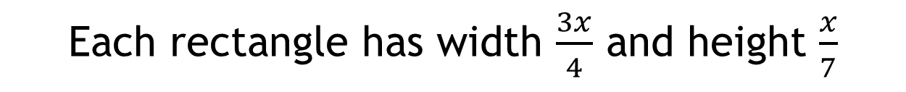
In your books
Each rectangle has width $\frac{3x}{4}$ and height $\frac{x}{7}$
By drawing a diagram to represent the question, write an expression for the perimeter of the shape
Give your answer as a single fraction
Extension: What is the area of the shape?
Notes:
This lesson runs fine without the bits in books however, for a more fidgety group that doesn’t cope well with a 100% whiteboard lesson and discussion, break it up with an example question following each activity

