Slide 1
At least one member of each school per group
Sit next to someone you haven’t sat next to yet
Don’t eat the sweets yet
Thank you!

Slide 2
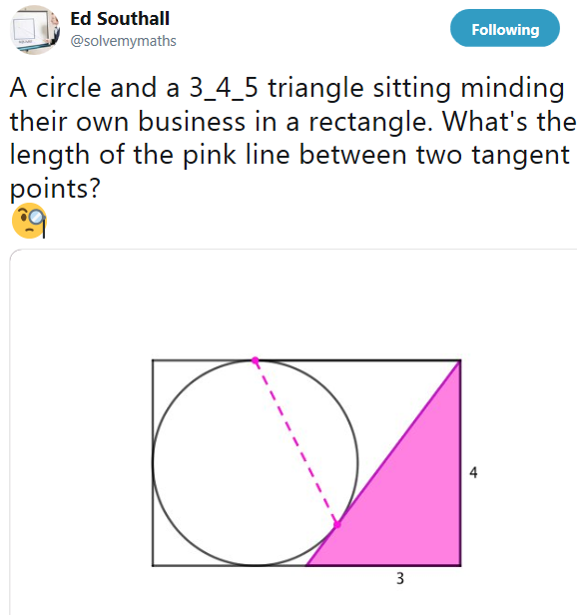
What is the question?

Slide 4
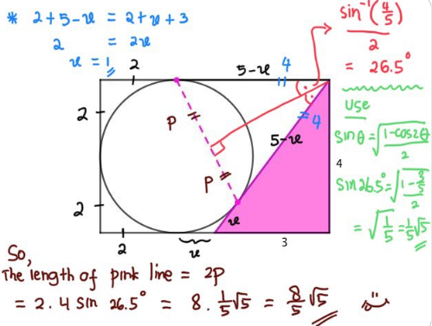

Slide 5
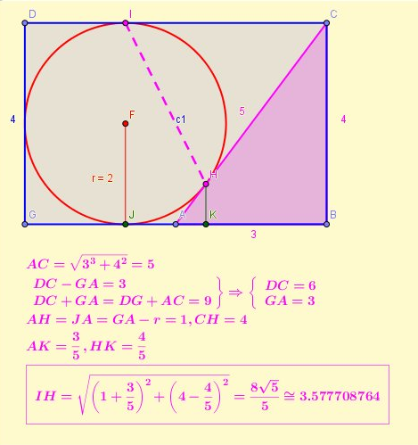

Slide 6
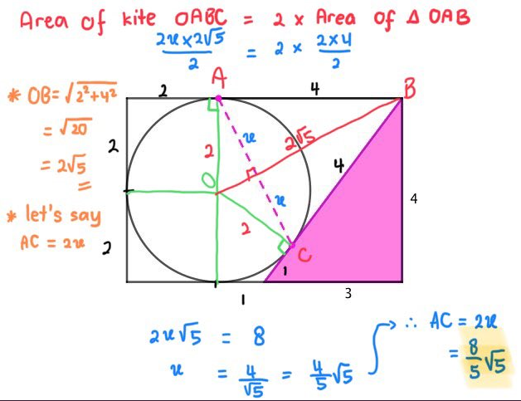

Slide 7
Key Objectives
Improve teaching and learning of Mathematics across the trust
Raise attainment in Mathematics in all schools across the trust
SWAG

Slide 8
This year priorities
Develop SoL into Year 10
Improve challenge in Year 7
Facilitate further collaboration between Maths departments
Embed Common Assessment Framework

Slide 9
Authenticity + Consistency + Expectation

Slide 10
What is “Mastery”?
A mastery approach; a set of principles and beliefs.
A mastery curriculum.
Teaching for mastery: a set of pedagogic practices.
Achieving mastery of particular topics and areas of mathematics.
Notes:
The essential idea behind mastery is that all children need a deep understanding of the mathematics they are learning.
A mastery approach; a set of principles and beliefs.
This includes a belief that all pupils are capable of understanding and doing mathematics, given sufficient time. Pupils are neither ‘born with the maths gene’ nor ‘just no good at maths.’ With good teaching, appropriate resources, effort and a ‘can do’ attitude all children can achieve in and enjoy mathematics.
2. A mastery curriculum
One set of mathematical concepts and big ideas for all. All pupils need access to these concepts and ideas and to the rich connections between them. There is no such thing as ‘special needs mathematics’ or ‘gifted and talented mathematics’. Mathematics is mathematics and the key ideas and building blocks are important for everyone.
3. Teaching for mastery: a set of pedagogic practices that keep the class working together on the same topic, whilst at the same time addressing the need for all pupils to master the curriculum. Challenge is provided through depth rather than acceleration into new content. More time is spent on teaching topics to allow for the development of depth. Carefully crafted lesson design provides a scaffolded, conceptual journey through the mathematics, engaging pupils in reasoning and the development of mathematical thinking.
4. Achieving mastery of particular topics and areas of mathematics.
Mastery is not just being able to memorise key facts and procedures and answer test questions accurately and quickly. It involves knowing ‘why’ as well as knowing ‘that’ and knowing ‘how.’ It means being able to use one’s knowledge appropriately, flexibly and creatively and to apply it in new and unfamiliar situations.

Slide 11
Secondary Mathematics Teaching for Mastery
Some themes and key principles:
All pupils can succeed; mistakes are valuable opportunities for new learning.
Whole-class interactive teaching; all pupils working together on the same lesson content at the same time.
Pupils master concepts before moving to the next part of the curriculum sequence, allowing no pupil to be left behind.
Early intervention to ensure pupils keep up (not catch up).
Typical lesson content includes questioning, short tasks, explanation, demonstration, and discussion.
Lesson design focuses on small steps through a carefully sequenced learning journey.
Notes:
This document is an attempt to distil some important aspects of what teaching for mastery at Key Stages 3 and 4 might look like and results from ideas generated during the planning of the Secondary Teaching for Mastery

Slide 12
Significant time is spent developing deep knowledge of the key ideas needed to underpin future learning.
Procedural fluency and conceptual understanding are developed in tandem.
Structures and connections are emphasised.
Well crafted examples using variation focus students’ attention on key learning points and both ‘what it is’ and ‘what it is not’.
Key facts are learnt to avoid cognitive overload and to enable pupils to focus on new concepts.
Intelligent practice aims to develop conceptual understanding and encourage reasoning and mathematical thinking, as well as reinforcing their procedural fluency.

Slide 13
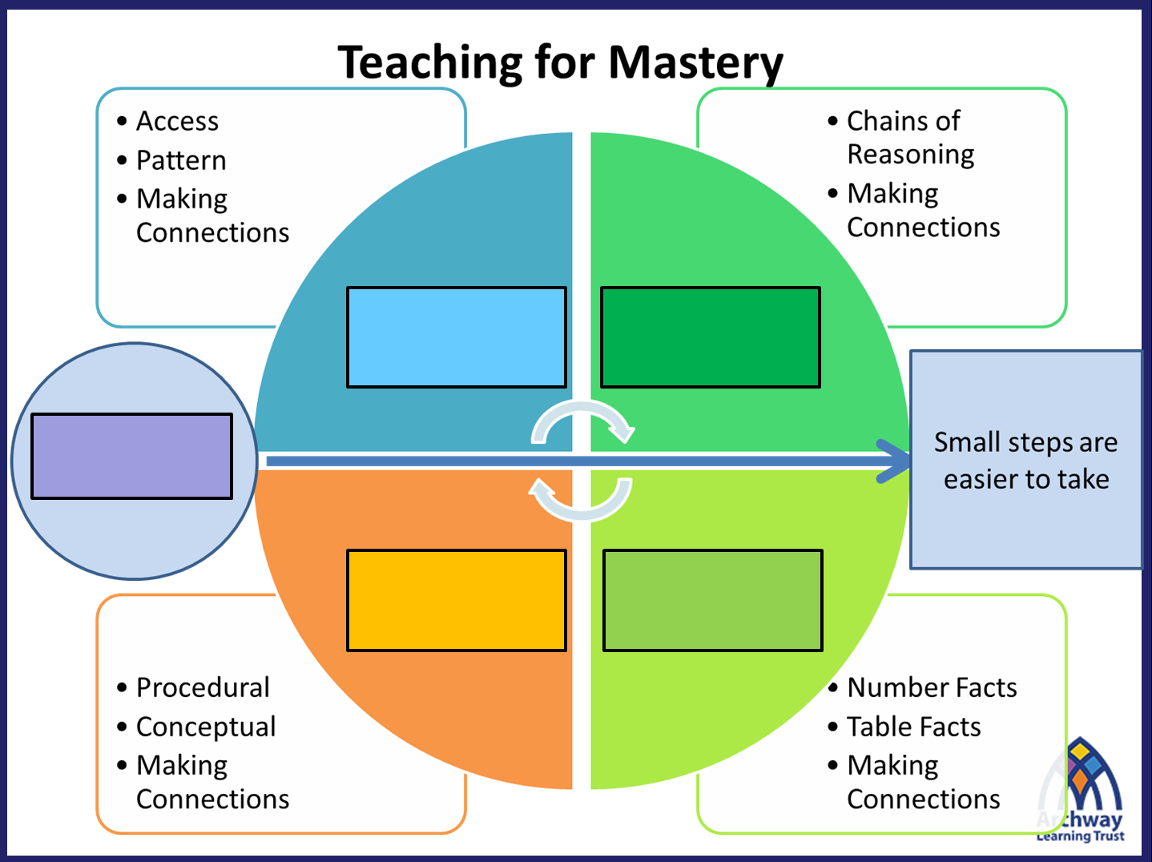

Slide 14
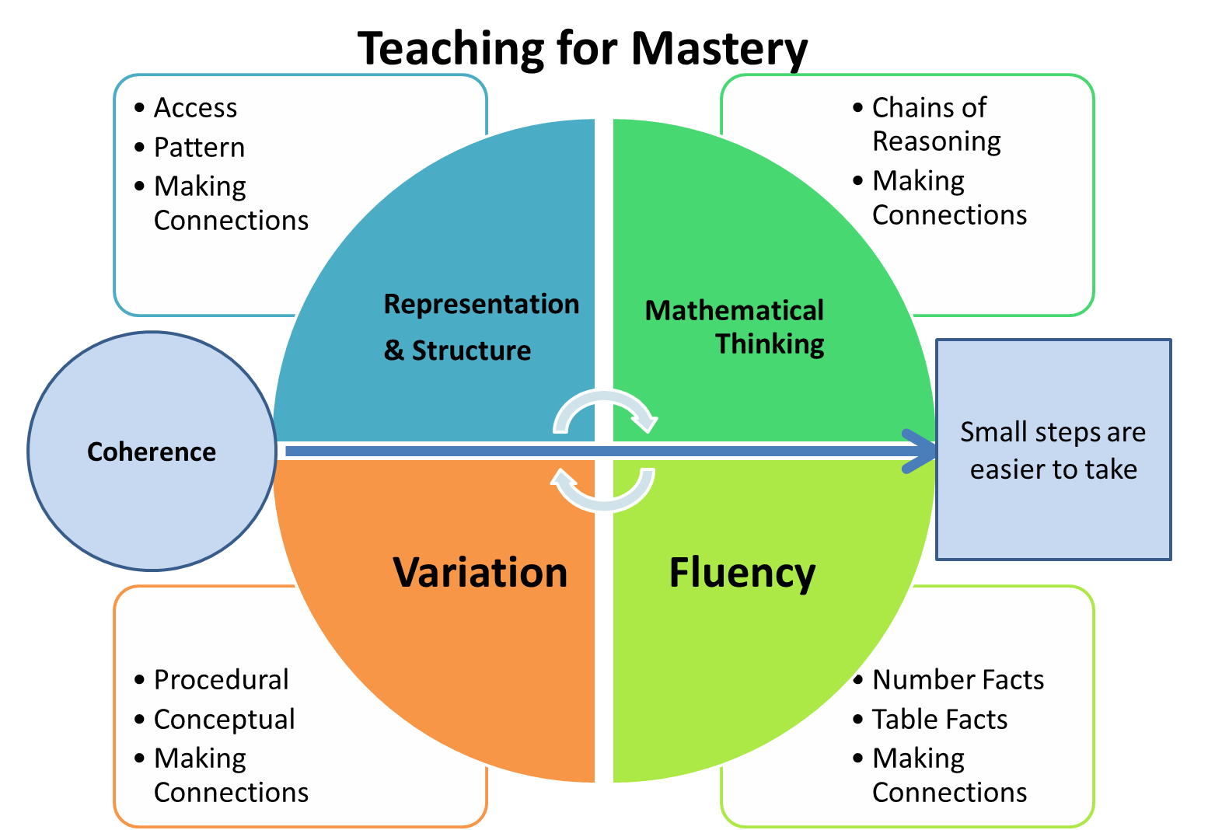
Notes:
5 big ideas from Mastery Specialist Programme

Slide 15
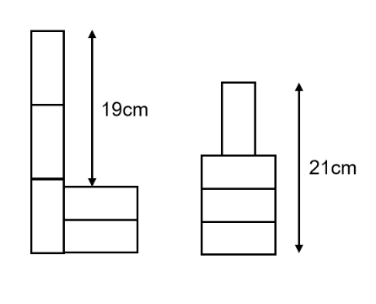
Challenge: These structures are made of congruent rectangles. Find the dimensions of the congruent rectangle.
Notes:
From Year 10 Autumn 2 Lesson 2

Slide 16
Simultaneous Equations Lesson
Look out for the 5 big ideas:
Coherence
Representation & Structure
Variation
Fluency
Mathematical Thinking

Slide 17
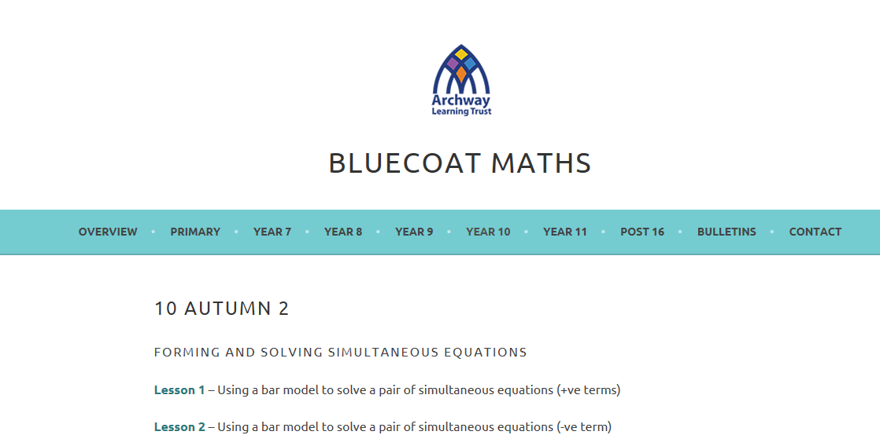
Year 10 Autumn 2 Lesson 1

Slide 18
Year 10 Autumn 2 Lesson 2

Slide 19
Year 10 Autumn 2 Lesson 3

Slide 20
Reflection
Where did you see the big ideas?
Coherence
Representation & Structure
Variation
Fluency
Mathematical Thinking
Notes:
Reflect on lesson – how does it differ to what would normally be taught?

Slide 21
Concrete Pictorial Abstract
Bruner’s theory focuses on three models of representation of mathematical ideas.
Enactive model
Iconic mode
Symbolic mode
Learners can access abstract ideas through manipulating objects to derive enactive knowledge. Then diagrams help them acquire iconic knowledge to act as a bridge to formal symbolic knowledge.

Slide 22
Algebra & Arithmetic
To fully understand & achieve procedural fluency, learners would benefit from developing a “sense of the structure” behind the way mathematics works.
Representing that structure in ways other than numerically or a generalised format can support that (Hewitt 2010)
Notes:
Approaching Algebra Arithmetically ATM Publication 2010

Slide 23
Multiple Embodiment
Dienes theory includes the principle that mathematical ideas should be presented in various forms for learners to acquire them.
Ban Har explains, for the bar method to be consistent with Dienes idea of multiple embodiment, students should be presented with actual and generic objects, cut-out and diagrammatic versions of objects as well as proportional & non-proportional diagrams to represent quantities
Notes:
Ban Har : Bar Modelling a Problem Solving tool (2010)

Slide 24
Algebraic methods before formal algebra
“the model method is less abstract than the algebraic method and can be introduced before students learn to solve algebraic equations.”
Learners.. “will appreciate better the use of symbols to represent quantities as they have experienced using bars to represent quantities..”
Kho (1987)
Notes:
Kho, T.H. (1987) Mathematical models for solving arithmetic problems.
In Proceedings of the Fourth South East Asian Conference on Mathematics (SEACME)

Slide 25
Ofsted
“Where satisfactory teaching dominated, pupils often experienced mathematics as a series of apparently unconnected topics, because teachers missed opportunities to make links.
…Pupils relied on memorising methods, because teachers emphasised emulating the worked examples rather than why the methods work.
Most of the teacher’s questions required factual answers only.” (Made to Measure May 2012)

Slide 26
Ofsted Recommendation
Schools should develop the expertise of staff:
in choosing teaching approaches and activities that foster pupils’ deeper understanding, including through the use of practical resources, visual images and information and communication technology
in checking and probing pupils’ understanding during the lesson, and adapting teaching accordingly
(Made to Measure May 2012)
Notes:
variable nature of some not all expressions or letters.

Slide 27
When we present a collection of examples or exercises related to some mathematical idea to our pupils what do we want them to be looking for?
What do we want them to pay attention to?

Slide 28
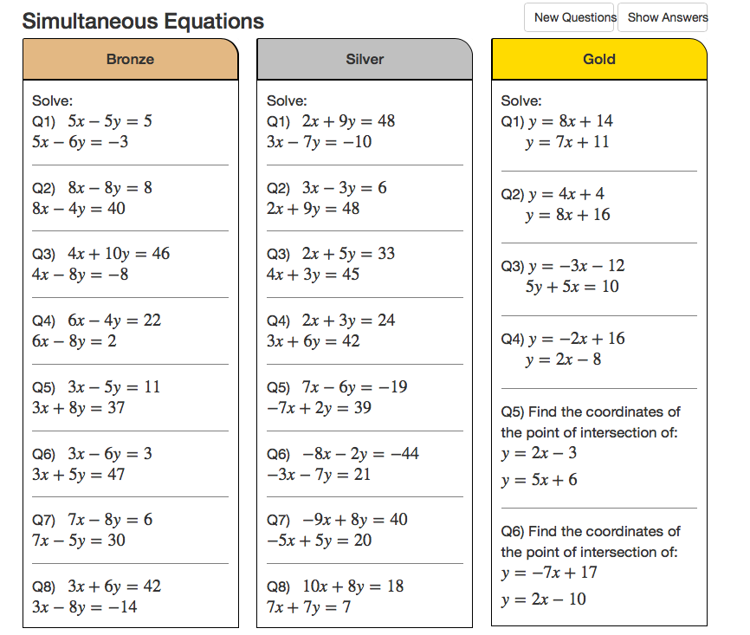
What are these examples
examples
of?
Notes:
Discussion (10 mins) … two resources focusing on solving simultaneous equations
What are these examples examples of?
Which question is the easiest/hardest?
What is the key learning point(s)?
How many lessons?
Notice: They are all ‘standard’

Slide 29
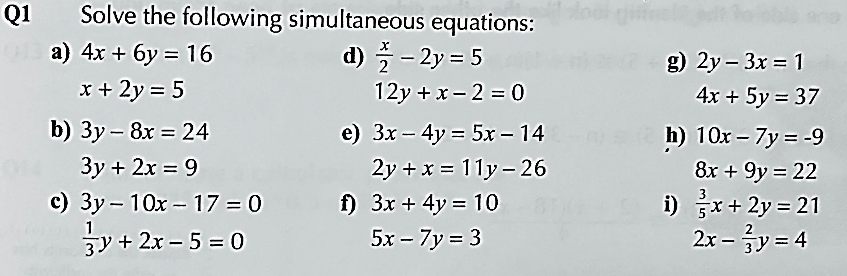
What are these examples
examples of ?
Notes:
Compare and contrast with these questions …
What are these examples examples of?
Which question is the easiest/hardest?
What is the key learning point(s)?
How many lessons?
Notice: They are a mixture of ‘standard’ and non-standard (c, d, e, g)

