Slide 1
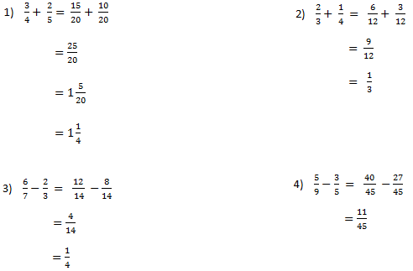
Each of the following questions have mistakes – can you find them?

Slide 2
The rules for adding and subtracting algebraic fractions are the same as for numerical fractions

Slide 3
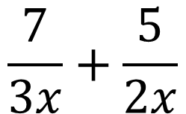
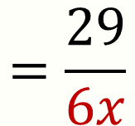
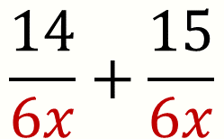
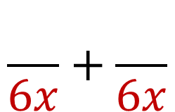
Calculate
$$\frac{7}{3x}+\frac{5}{2x}$$
Why can these fractions not be added as they are?
Use a Venn diagram to find the common denominator of 3x and 2x?
$$\frac{}{6x}+\frac{}{6x}$$
$$\frac{14}{6x}+\frac{15}{6x}$$
$$=\frac{29}{6x}$$
Why is the common denominator $6x?$

Slide 4
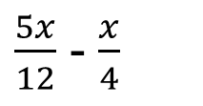
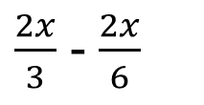
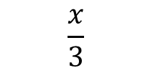
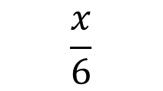
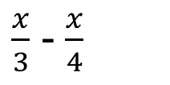
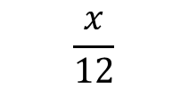
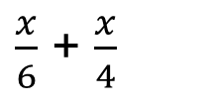
Sort these expressions into equivalent pairs.
Which is the odd one out?
$\frac{5x}{12}$ - $\frac{x}{4}$
$\frac{x}{6}$ + $\frac{x}{4}$
$\frac{2x}{3}$ - $\frac{2x}{6}$
$\frac{x}{3}$ - $\frac{x}{4}$
$$\frac{x}{6}$$
$$\frac{x}{12}$$
$$\frac{x}{3}$$

Slide 5
Sort these expressions into equivalent pairs.
Which is the odd one out?
$\frac{5x}{12}$ - $\frac{x}{4}$
$\frac{x}{6}$ + $\frac{x}{4}$
$\frac{2x}{3}$ - $\frac{2x}{6}$
$\frac{x}{3}$ - $\frac{x}{4}$
$$\frac{x}{6}$$
$$\frac{x}{12}$$
$$\frac{x}{3}$$

Slide 6
Sort these expressions into equivalent pairs.
Which is the odd one out?
$\frac{5x}{12}$ - $\frac{x}{4}$
$\frac{x}{6}$ + $\frac{x}{4}$
$\frac{2x}{3}$ - $\frac{2x}{6}$
$\frac{x}{3}$ - $\frac{x}{4}$
$$\frac{x}{6}$$
$$\frac{x}{12}$$
$$\frac{x}{3}$$

Slide 7
Sort these expressions into equivalent pairs.
Which is the odd one out?
$\frac{5x}{12}$ - $\frac{x}{4}$
$\frac{x}{6}$ + $\frac{x}{4}$
$\frac{2x}{3}$ - $\frac{2x}{6}$
$\frac{x}{3}$ - $\frac{x}{4}$
$$\frac{x}{6}$$
$$\frac{x}{12}$$
$$\frac{x}{3}$$

Slide 8

In your books
Title: Adding and subtracting algebraic fractions
Work through Section 1 on the worksheet (10 minutes)
Work in your pairs if you need help. Ensure you know how to explain your answers.
Books will be chosen at random to show to the class.

Slide 9
In your books
Title: Adding and subtracting algebraic fractions
Either:
Continue or redo Section 1 is you need to.
Or
Work through the rest of the sheet

Slide 10
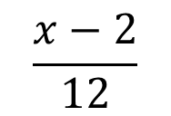
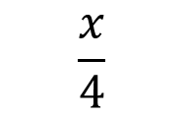
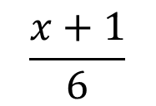
Challenge Problem
Find the sum of these expressions
$$\frac{x−2}{12}$$
$$\frac{x+1}{6}$$
$$\frac{x}{4}$$

Slide 11
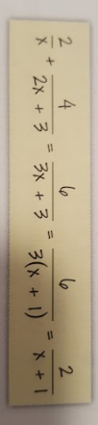
To finish …
Sally writes:
Do you agree or disagree?
If you disagree – what should Sally have done?

