Slide 1
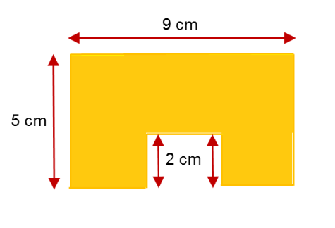
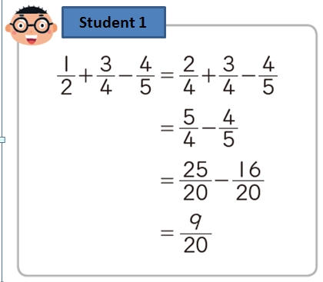
?
?
?
Discuss:
Is student 1 correct?
How do you know?
“The missing lengths
are 3cm each”

Slide 2
What is the perimeter?
Notes:
Mini Whiteboards.
Acknowledgements: https://donsteward.blogspot.com/search/label/perimeter

Slide 3
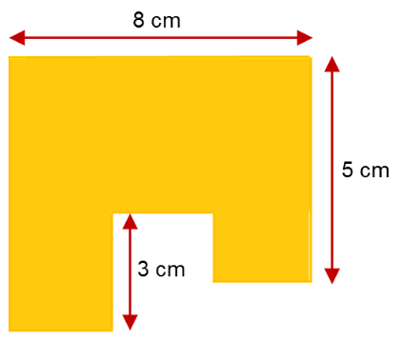
Establish that the perimeter is 32cm
Notes:
Mini Whiteboards.

Slide 4
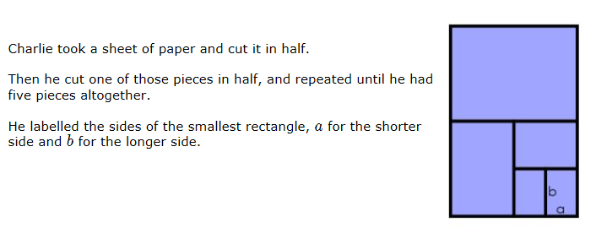
Perimeter Expressions
Charlie took a sheet of paper and cut it in half. Then he cut one of those pieces in half, and he repeated this until he had five pieces all together.
He labelled the sides of the smaller rectangle, a for the shorter side and b for the longer side.
Notes:
Need pieces of A4 paper and scissors…

Slide 5
Cut along the lines on your sheet.
Keep every section
How can we compare the lengths of the pieces?
Does that help you find the dimensions of the other rectangles?
Perimeter Expressions

Slide 6
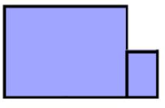
Perimeter Expressions
Here is a shape that Charlie made by combining the largest and the smallest rectangles.
What would the perimeter be?
10a + 4b

Slide 7
Perimeter Expressions
Alison combined her rectangles in a different way. She got the perimeter 8a + 6b
What could her combination look like?

Slide 8
Perimeter Expressions
Charlie and Alison made sure that their rectangles always met along an edge, with corners touching.
Combining the smallest and largest rectangles, what perimeters can you create?

Slide 9
Perimeter Expressions
Using two or more rectangles, create some other combinations in this same way.
They must be placed edge to edge.

Slide 10
Perimeter Expressions
Partner A:
Make your own combination but DON’T SHOW YOUR PARTNER. Tell your partner the perimeter.
Partner B:
Your mission is to find the combination that your partner has created.
If you come up with a new combination with the same perimeter - what is the same and what is different?

Slide 11
Perimeter Expressions
What is the largest perimeter you can make?
Why is this the largest perimeter?
Can you make two different shapes with the same perimeter?
Can you make a shape with the perimeter 7a + 4b?

Slide 12
Perimeter Expressions
d
c
What would happen if we name the sides of a different rectangle?
Lets name the larges
t rectangle sides c and d …
What would the perimeter of the other rectangles be?
(Only using the letters c and d)

Slide 13
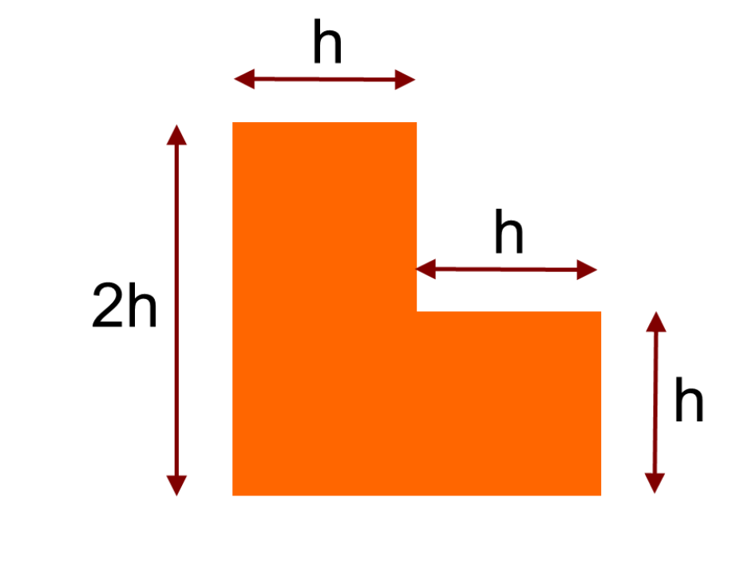
What is the perimeter?
Notes:
Checking for understanding, on whiteboards:
https://donsteward.blogspot.com/2012/02/l-shaped-perimters.html

Slide 14
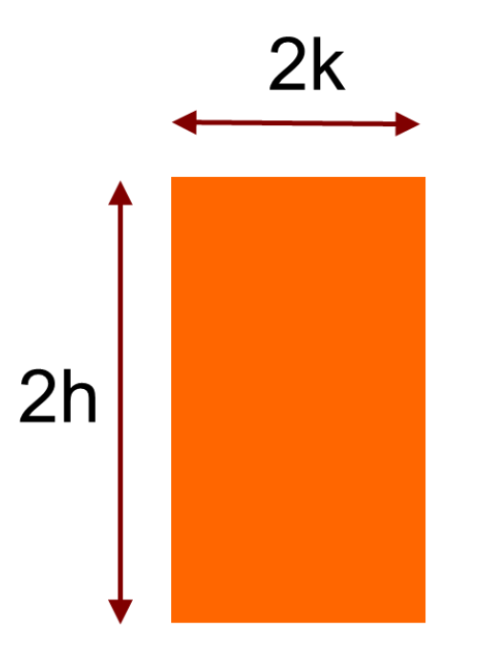
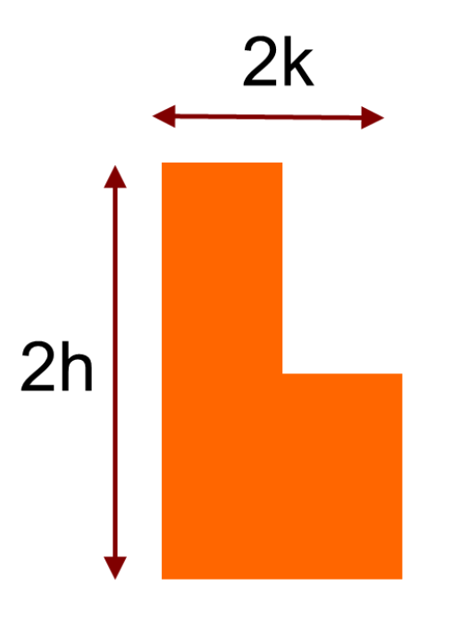
What is the perimeter?
Notes:
https://donsteward.blogspot.com/2012/02/l-shaped-perimters.html

Slide 15
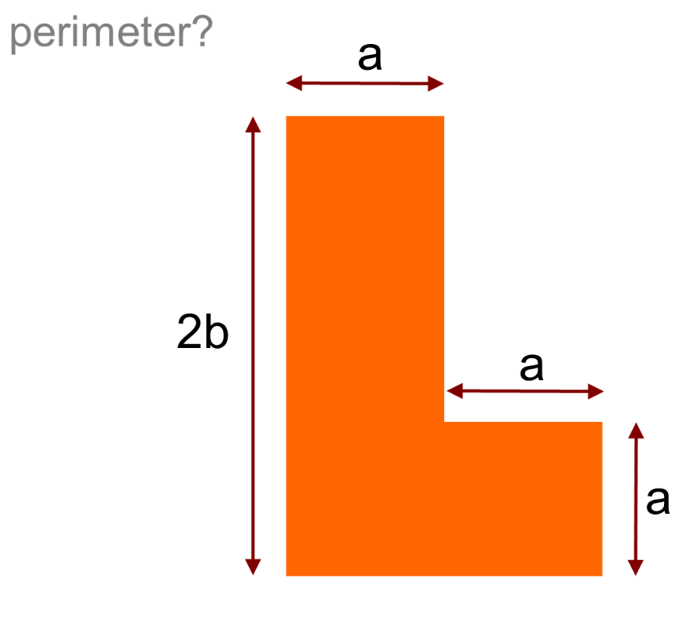
What is the perimeter?
Notes:
https://donsteward.blogspot.com/2012/02/l-shaped-perimters.html

Slide 16
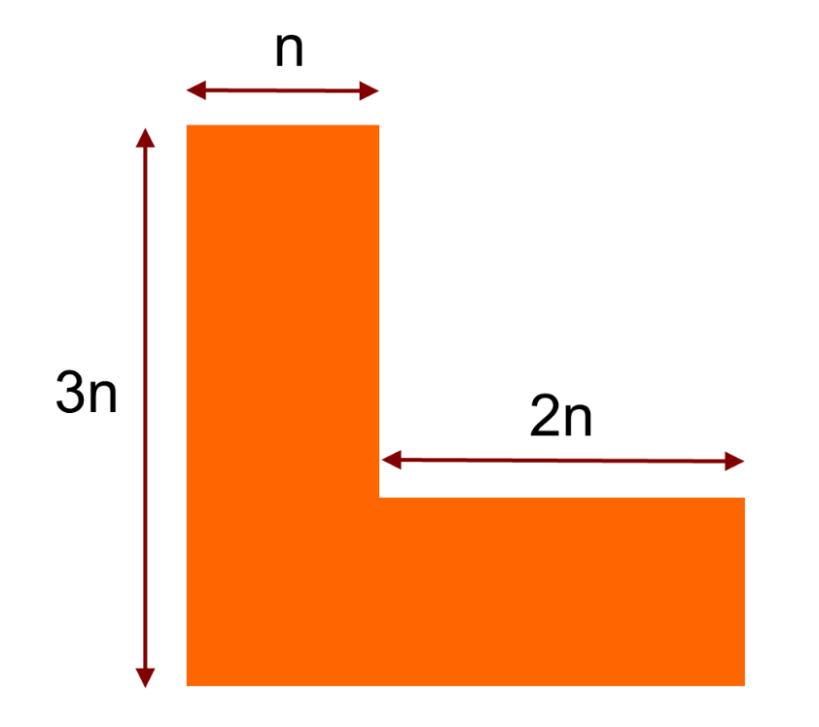
What is the perimeter?
Notes:
https://donsteward.blogspot.com/2012/02/l-shaped-perimters.html

Slide 17
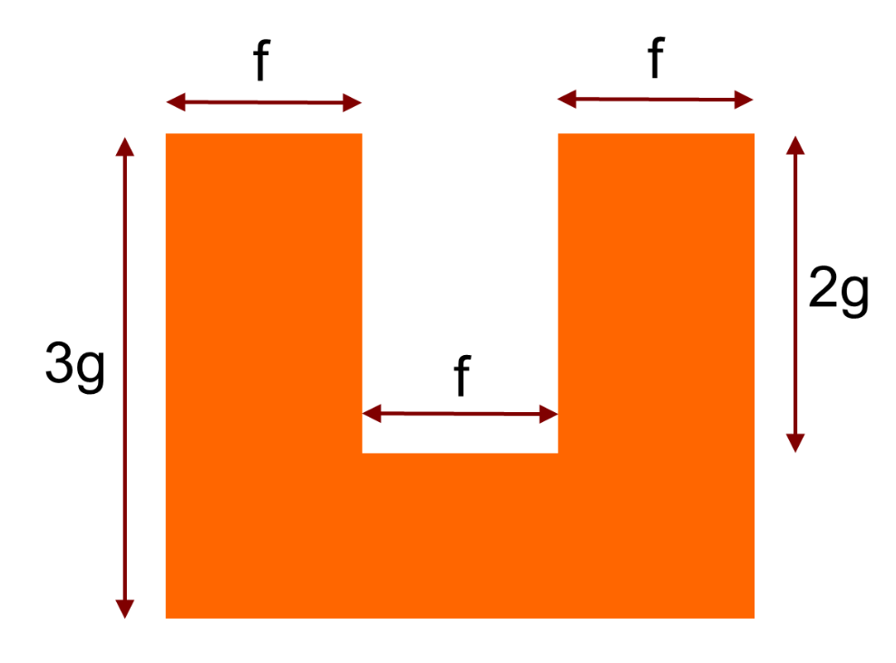
What is the perimeter?
Notes:
https://donsteward.blogspot.com/2012/02/l-shaped-perimters.html

Slide 18
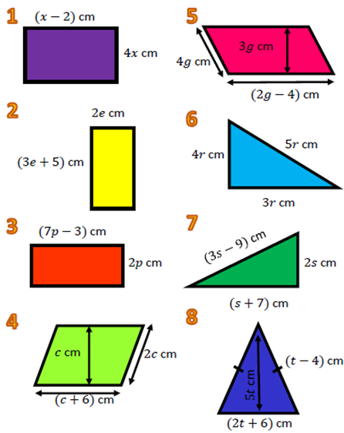
In your book:
Title: Algebraic Perimeters
Find the perimeter of each shape.
Simplify your answers as much as you can.

Slide 19
Mark your work:
6x – 4
10e + 10
18p – 6
4c + 12
12g – 8
12r
6s – 2
4t – 2

Slide 20
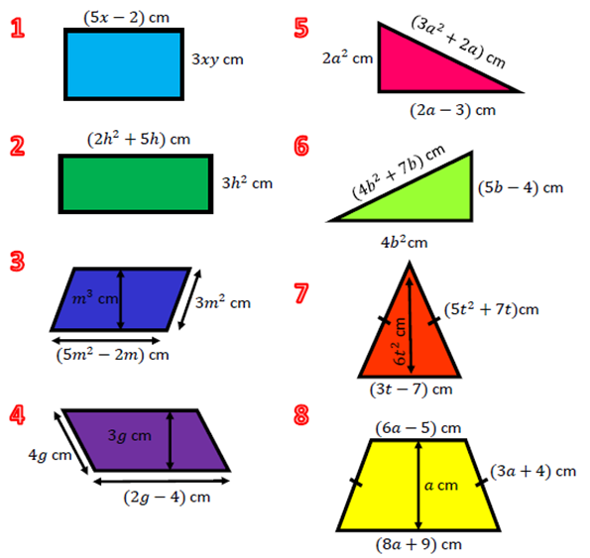
More practise:

Slide 21
Mark your work:
10x + 6xy – 4
10h² + 10h
16m² – 4m
12g – 8
5a² + 4a – 3
8b² + 12b – 4
10t² + 17t – 7
20a + 12

