Slide 1
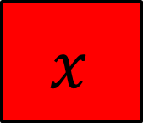

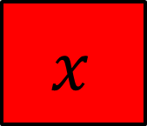
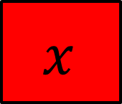



$$x$$
$$x$$
$$x$$
$$x$$
$$7$$
$$y$$
$$y$$
On your whiteboards write an equation that represents this bar model
And another…
And another…

Slide 2


Draw a pair of bar models to represent the following pair of simultaneous equations
$$3x−y=9$$
$$2x−y=5$$

Slide 3
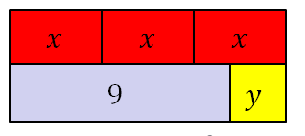
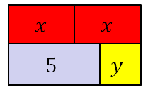


$$3x−y=9$$
$$2x−y=5$$

Slide 4
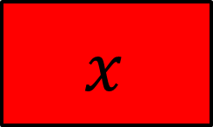
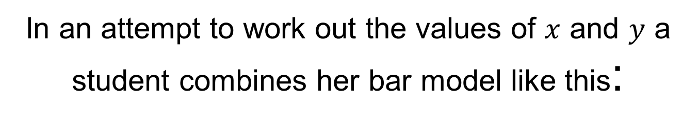







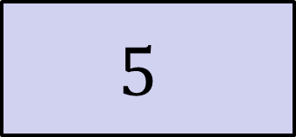
In an attempt to work out the values of $x$ and $y$ a student combines her bar model like this:
$$x$$
$$x$$
$$x$$
$$x$$
$$x$$
$$5$$
$$y$$
$$9$$
$$y$$
Discuss: Why isn’t this helpful?

Slide 5



$$3x−y=9$$
$$2x−y=5$$
$$?$$
What is the value of $x$?
How do you know?

Slide 6


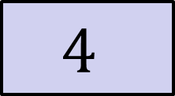

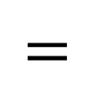
$$3x−y=9$$
$$2x−y=5$$
$$−$$
$$4$$
$$x$$
$$=$$
$$4$$

Slide 7

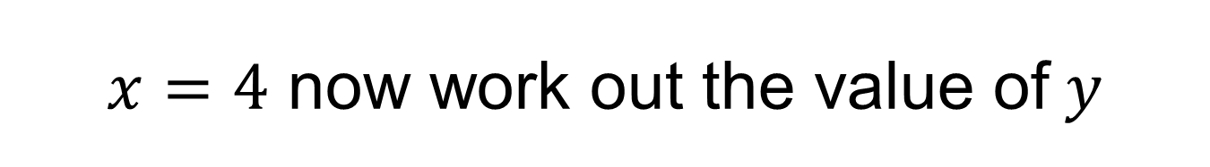




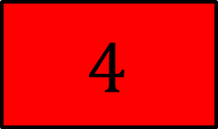

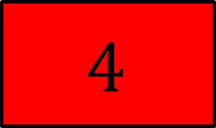

Using the first equation:
Using the first bar model:
$$3x−y=9$$
$$4$$
$$4$$
$$4$$
$$3×4−y=9$$
$$9$$
$$y$$
$$12−y=9$$
$$y=12 −9$$
$x=4$ now work out the value of$y$

Slide 8


On your whiteboards, solve:
$$5x−2y=45$$
$$3x−2y=25$$
Notes:
Allow students to use bar model/elimination
Share and compare whiteboards

Slide 9

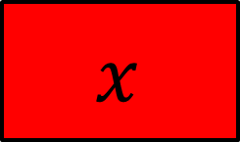




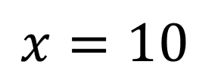

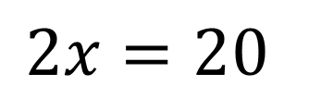










$$x$$
$$x$$
$$x$$
$$x$$
$$x$$
$$45$$
$$y$$
$$y$$
$$x$$
$$x$$
$$x$$
$$x$$
$$x$$
$$20$$
$$25$$
$$y$$
$$y$$
$$2x=20$$
$$x=10$$

Slide 10

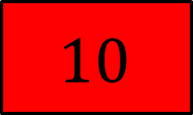

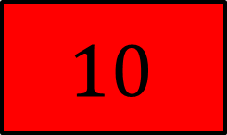

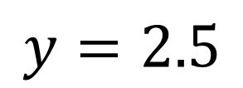

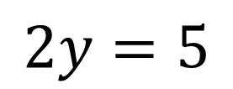

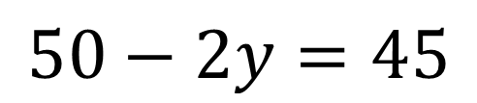
$$10$$
$$10$$
$$10$$
$$10$$
$$10$$
$$1$$
$$45$$
$$y$$
$$y$$
$$50−2y=45$$
$$2y=5$$
$$y=2.5$$

Slide 11




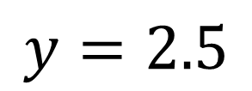
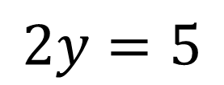

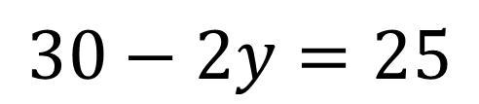
$$10$$
$$10$$
$$10$$
$$2$$
$$25$$
$$y$$
$$y$$
$$30−2y=25$$
$$2y=5$$
$$y=2.5$$

Slide 12
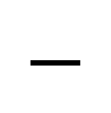

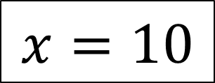
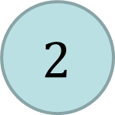
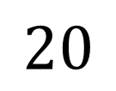


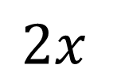
Subtracting the equations
$$1$$
$$−$$
$$2$$
$$5x−2y=45$$
$$−$$
$$3x−2y=25$$
$$2x$$
$$=$$
$$20$$
$$x=10$$
Notes:
Allow students to use bar model/elimination
Share and compare whiteboards

Slide 13
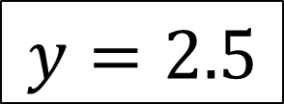
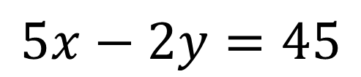
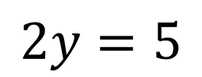
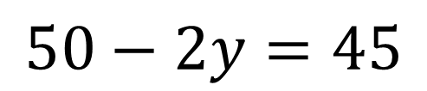
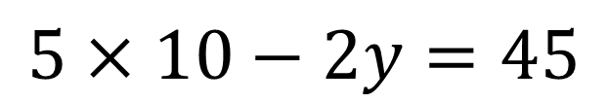

$$5x−2y=45$$
$$1$$
$$5×10−2y=45$$
$$50−2y=45$$
$$2y=5$$
$$y=2.5$$

Slide 14


On your whiteboards, solve:
$$2x−3y=13$$
$$2x −5y=9$$
Notes:
Allow students to use bar model/elimination
Share and compare whiteboards

Slide 15







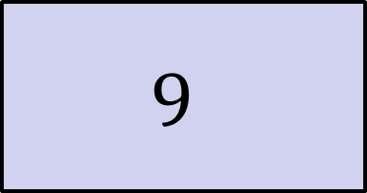






$$x$$
$$x$$
$$2x−3y=13$$
$$13$$
$$y$$
$$y$$
$$y$$
$$x$$
$$x$$
$$2x −5y=9$$
$$9$$
$$y$$
$$y$$
$$y$$
$$y$$
$$y$$
Notes:
Allow students to use bar model/elimination
Share and compare whiteboards

Slide 16
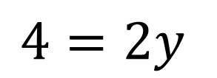
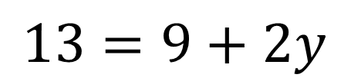
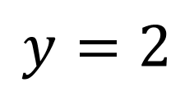
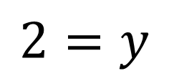
$$13$$
$$13=9+2y$$
$$4=2y$$
$$2=y$$
$$9$$
$$y$$
$$y$$
$$y=2$$
Notes:
Allow students to use bar model/elimination
Share and compare whiteboards

Slide 17








$$x$$
$$x$$
$$13$$
$$2$$
$$2$$
$$2$$
$$x$$
$$x$$
$$9$$
$$2$$
$$2$$
$$2$$
$$2$$
$$2$$
Notes:
Allow students to use bar model/elimination
Share and compare whiteboards

Slide 18

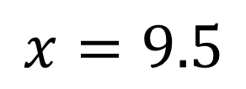
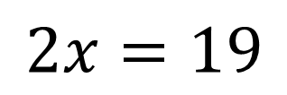
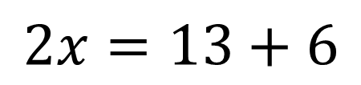
$$x$$
$$x$$
$$1$$
$$13$$
$$2$$
$$2$$
$$2$$
$$2x=13+6$$
$$2x=19$$
$$x=9.5$$
Notes:
Allow students to use bar model/elimination
Share and compare whiteboards

Slide 19



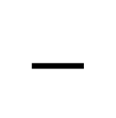

$$2x−3y=13$$
$$−$$
$$2x −5y=9$$
$$2y=4$$
$$y=2$$
Notes:
Allow students to use bar model/elimination
Share and compare whiteboards

Slide 20
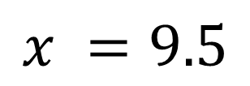

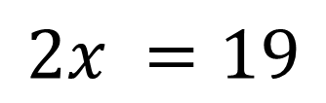
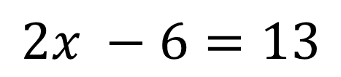
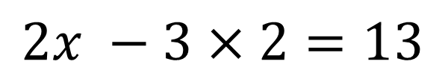
$$2x−3y=13$$
$$1$$
$$2x −3×2=13$$
$$2x −6=13$$
$$2x =19$$
$$x =9.5$$

Slide 21


On your whiteboards, solve:
$$2x=1+y$$
$$7x−2y=9.5$$
Notes:
Allow students to use bar model/elimination
Share and compare whiteboards

Slide 22







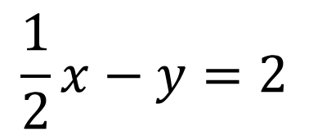


Solve the following using a bar model or elimination.
Practise on whiteboards first, then in your books.
1.
$$3x −3y=36$$
4.
$$−2y+3x=5$$
$$x −3y=6$$
$$2x −4y=2$$
$$3x −y=9$$
$$\frac{1}{2}x−y=2$$
2.
5.
$$3x −2y=6$$
$$3x−2y=24$$
3.
$$2x −y=3$$
$$4x=8.5+y$$

Slide 23
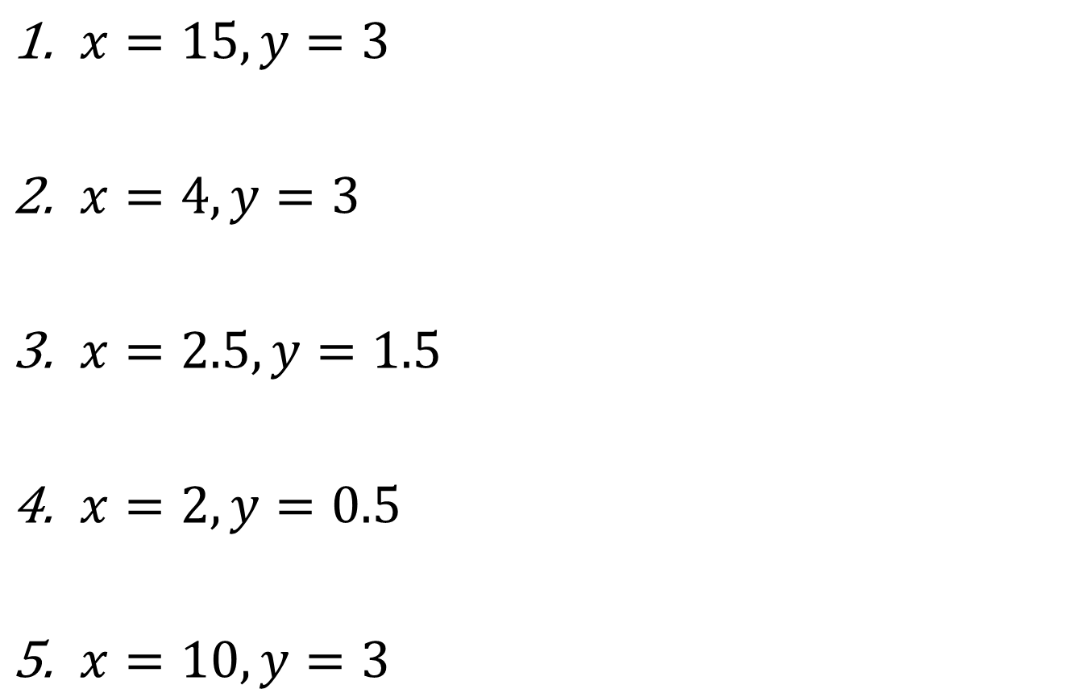
Mark your work
$x=15, y=3$
$x=4, y=3$
$x=2.5, y=1.5$
$x=2, y=0.5$
$x=10, y=3$

Slide 24

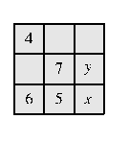
Challenge
Notes:
Acknowledgements: UKMT

Slide 25


