Slide 1
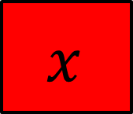
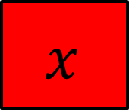


$$x$$
$$x$$
$$y$$
$$7$$
On your whiteboards write an equation that represents this bar model
And another…
And another…

Slide 2





$$x$$
$$x$$
$$x$$
$$x$$
$$x$$
$$14$$
$$y$$
On your whiteboards write an equation that represents this bar model
And another…
And another…

Slide 3
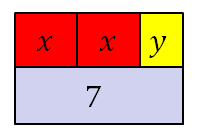
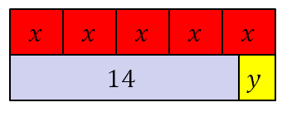



These bar models represent a pair of simultaneous equations
$$2x+y=7$$
$$5x−y=14$$
Today we are going to learn how to find the values of $x$ and $y$

Slide 4
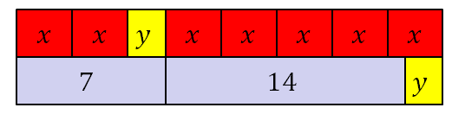
Here are the bar models combined
On your whiteboards write an equation that represents this bar model
And another…
Notes:
Share and compare whiteboards…

Slide 5











$$x$$
$$x$$
$$y$$
$$x$$
$$x$$
$$x$$
$$x$$
$$x$$
$$7$$
$$14$$
$$y$$
On your whiteboards write an equation that represents this bar model
And another…

Slide 6

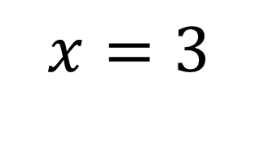


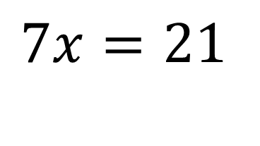
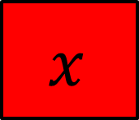

$$x$$
$$x$$
$$x$$
$$x$$
$$x$$
$$x$$
$$x$$
$$7$$
$$14$$
$$7x=21$$
$$x=3$$

Slide 7
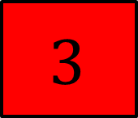
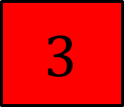

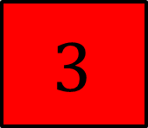




$$3$$
$$3$$
$$y$$
$$3$$
$$3$$
$$3$$
$$3$$
$$3$$
$$7$$
$$14$$
$$y$$
On your whiteboards write a calculation that works out the value of $y$
And another…
And another…

Slide 8
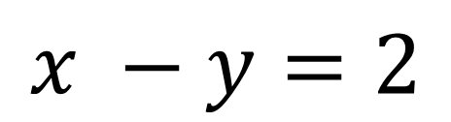
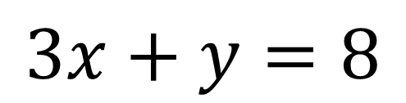
Here is a different pair of simultaneous equations
$$3x+y=8$$
$$x −y=2$$
On your whiteboards draw a pair of bar models to represent these equations

Slide 9
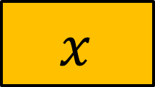
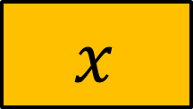

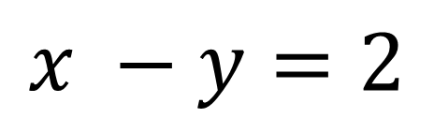


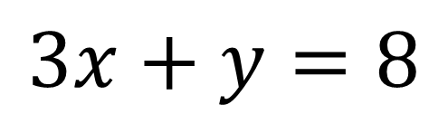

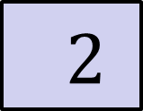


$$3x+y=8$$
$$x$$
$$x$$
$$x$$
$$y$$
$$8$$
$$x −y=2$$
$$x$$
$$2$$
$$y$$
Use your bar models to work out the value of $x$

Slide 10



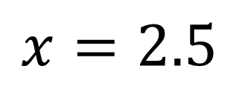


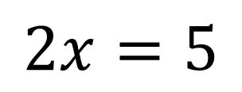

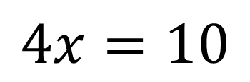

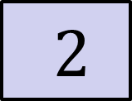
Adding the bar models together gives:
$$x$$
$$x$$
$$x$$
$$y$$
$$x$$
$$8$$
$$2$$
$$y$$
$$4x=10$$
$$2x=5$$
$$x=2.5$$

Slide 11



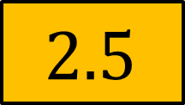
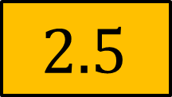


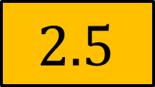
$$x=2.5$$
$$2.5$$
$$2.5$$
$$2.5$$
$$y$$
$$8$$
$$2.5$$
$$2$$
$$y$$
On your whiteboards write down a calculation for $y$
Notes:
Share and compare whiteboards…

Slide 12
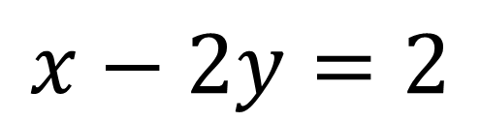
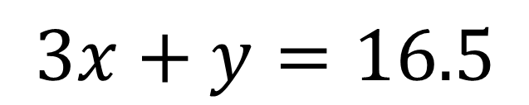
Here is another pair of simultaneous equations
$$3x+y=16.5$$
$$x−2y=2$$
On your whiteboards draw a pair of bar models to represent these equations

Slide 13
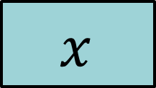

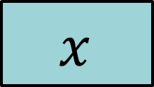
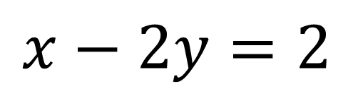


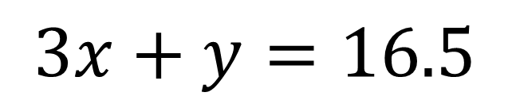




$$3x+y=16.5$$
$$x$$
$$x$$
$$x$$
$$y$$
$$16.5$$
$$x−2y=2$$
$$x$$
$$2$$
$$y$$
$$y$$

Slide 14








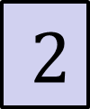
Why doesn’t combining the bar models in this way help us?
$$x$$
$$x$$
$$x$$
$$y$$
$$x$$
$$16.5$$
$$2$$
$$y$$
$$y$$

Slide 15
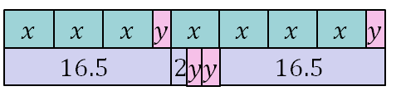
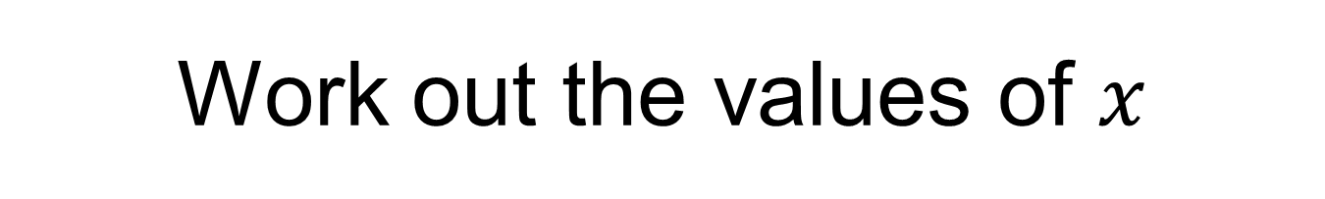
What is the same?
What is different?
Work out the values of $x$

Slide 16
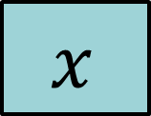



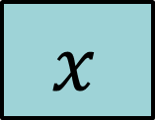


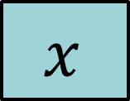


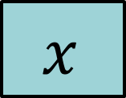



$$x$$
$$x$$
$$x$$
$$y$$
$$x$$
$$x$$
$$x$$
$$x$$
$$y$$
$$16.5$$
$$2$$
$$y$$
$$y$$
$$16.5$$

Slide 17

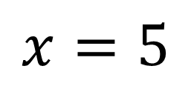

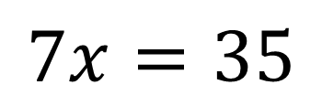




$$x$$
$$x$$
$$x$$
$$x$$
$$x$$
$$x$$
$$x$$
$$16.5$$
$$2$$
$$16.5$$
$$7x=35$$
$$x=5$$

Slide 18
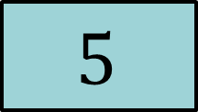
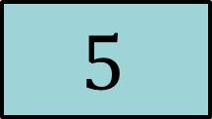
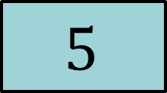


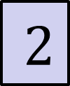

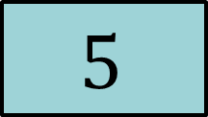
Find the value of $y$
$$5$$
$$5$$
$$5$$
$$y$$
$$16.5$$
$$5$$
$$2$$
$$y$$
$$y$$
Show your calculation

Slide 19
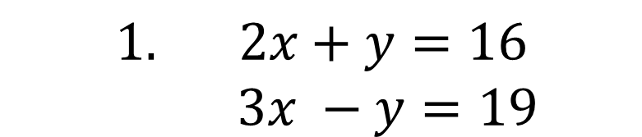
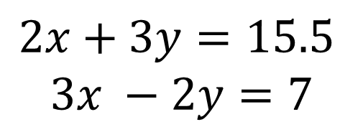
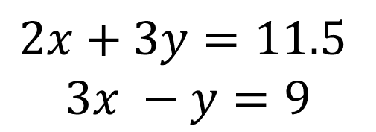
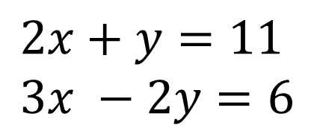
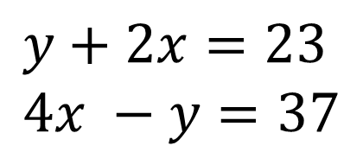
Practise on whiteboards first, then in your books work out x and y for each pair of simultaneous equations:
$$1. 2x+y=16$$
$$3x −y=19$$
3.
$$2x+y=11$$
$$3x −2y=6$$
2.
$$y+2x=23$$
$$4x −y=37$$
4.
$$2x+3y=11.5$$
$$3x −y=9$$
5.
$$2x+3y=15.5$$
$$3x −2y=7$$
Notes:
Acknowledgements: Challenge from Don Steward

Slide 20

Mark your work:
$x=7, y=2$
$x=10, y=3$
$x=4, y=3$
$x=3.5, y=1.5$
$x=4, y=2.5$

Slide 21

Challenge: These structures are made of congruent rectangles. Find the dimensions of the congruent rectangle.
Notes:
Acknowledgements: Challenge by Don Steward
Each rectangle 6cm x 9cm

