Slide 1
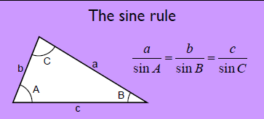
Discuss:
What information must we have to use the sine rule to calculate a missing length?

Slide 2
Two angle and one corresponding side

Slide 3
Discuss:
What information must we have to use the sine rule to calculate a missing angle?

Slide 4
Two sides and one corresponding angle

Slide 5
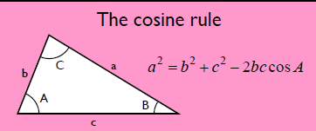
Discuss:
What information must we have to use the cosine rule to calculate a missing length?

Slide 6
Two sides and the angle between them

Slide 7
Discuss:
What information must we have to use the cosine rule to calculate a missing angle?

Slide 8
All three sides are needed to calculate a missing angle

Slide 9
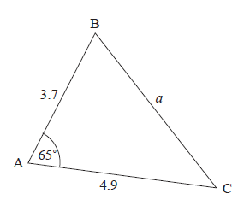
Sine or Cosine?
?

Slide 10
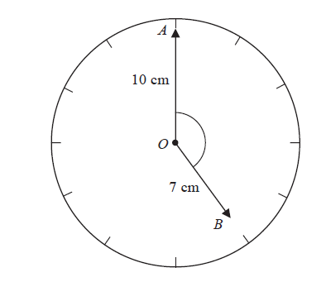
Sine or Cosine?

Slide 11
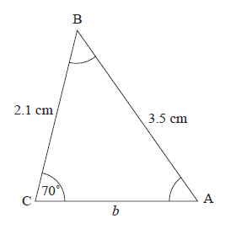
Sine or Cosine?
?

Slide 12
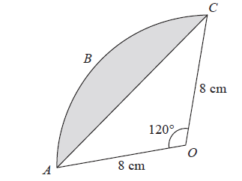
Sine or Cosine?

Slide 13
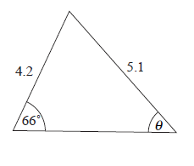
Sine or Cosine?

Slide 14
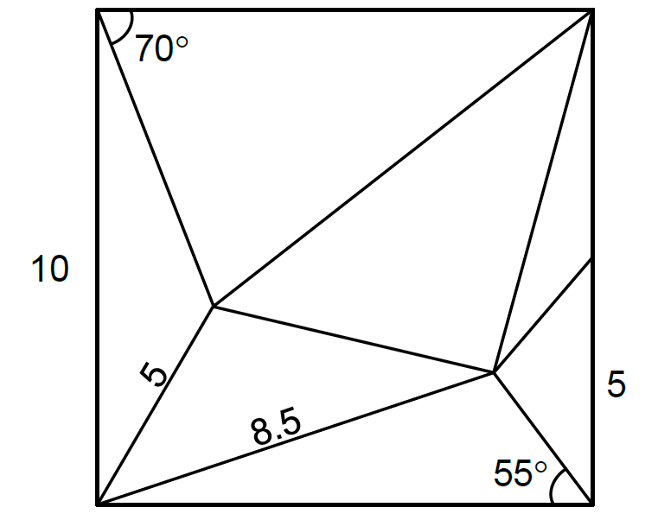
Find all the missing lengths within this 10 x 10 square
Notes:
Acknowledgments: UEA and JustMaths

Slide 15
