Slide 1
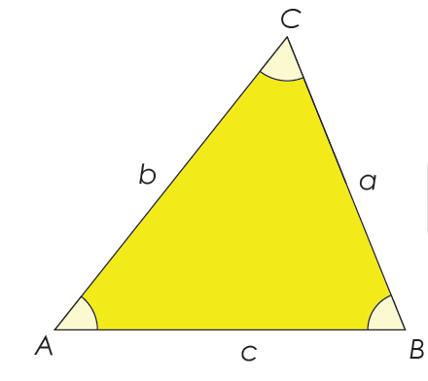

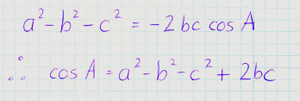
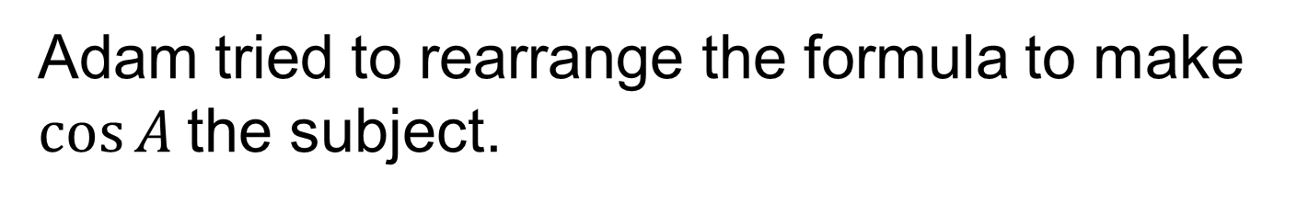
We know that the Cosine rule is:
Adam tried to rearrange the formula to make $cos⁡A$the subject.
Discuss: What mistake did Adam make?

Slide 2
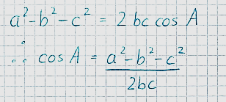

We know that the Cosine rule is:
Adam then tried to rearrange the formula to make $cos⁡A$the subject again.
Discuss: What mistake did Adam make?

Slide 3
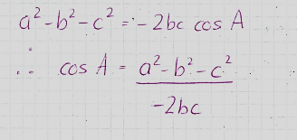

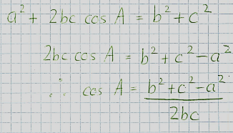
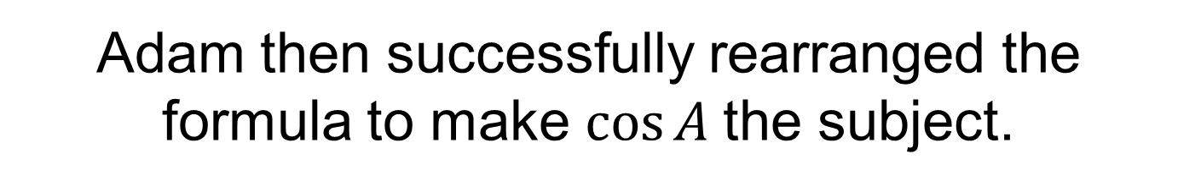
Adam then successfully rearranged the formula to make $cos⁡A$the subject.
Nick then rearranges the formula a different way.
Is it correct?

Slide 4
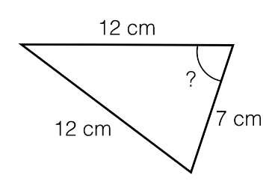
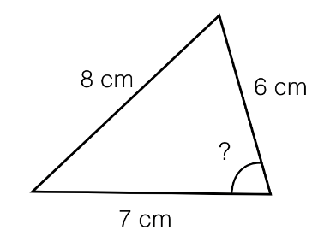

Worked Example
TITLE: Using the Cosine Rule to work out a missing angle
Your Turn
$$x$$
Notes:
Silent Teacher.
C = 5.4 cm

Slide 5
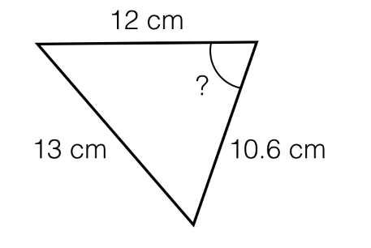
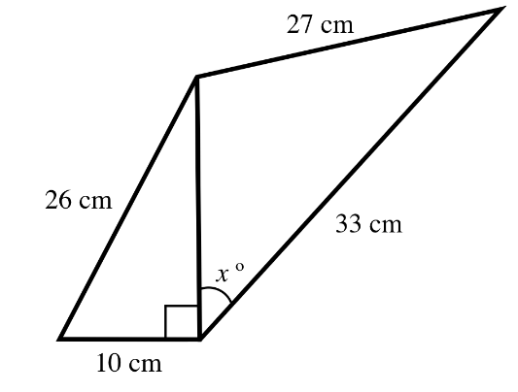
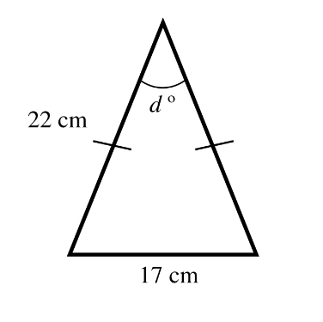
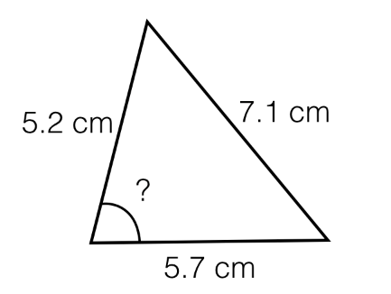
In your books, work out the missing angles to 1 decimal place
a
c
x
b
y

Slide 6
Mark your work:
69.9
81.2
53.8
45.5

Slide 7
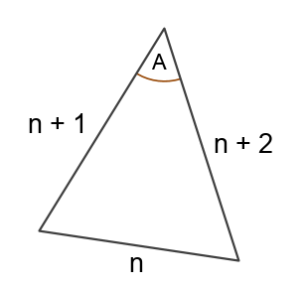
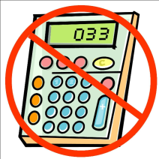
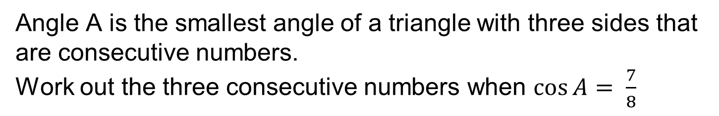
Challenge
Angle A is the smallest angle of a triangle with three sides that are consecutive numbers.
Work out the three consecutive numbers when $\cos{A= \frac{7}{8}}$
Notes:
2, 3, 4

