Slide 1
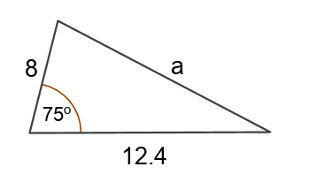

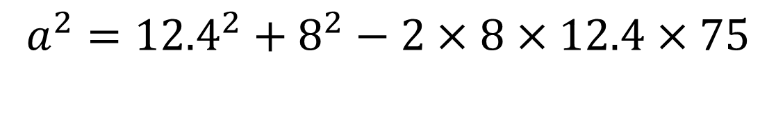
A student attempts to calculate the missing length a.
The answer is wrong – can you spot the mistake?
$$a^{2}={12.4}^{2}+8^{2}−2×8×12.4×75$$

Slide 2
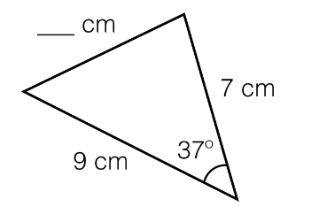
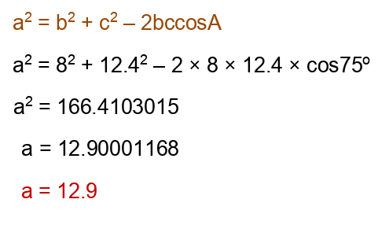


Worked Example
TITLE: Using the Cosine Rule to work out a missing length
Your Turn
c
$$47°$$
$$x$$
Notes:
Silent Teacher.
C = 5.4 cm

Slide 3
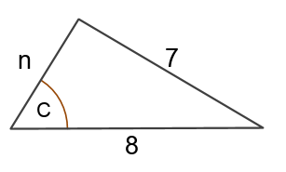

Without a calculator, work out the value of n

Slide 4
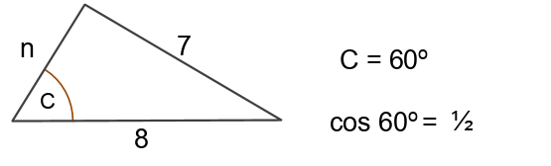
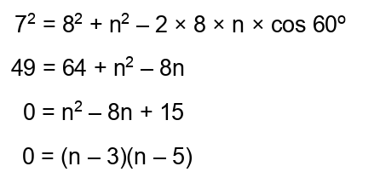

Discuss: How can there be two possibilities?

Slide 5
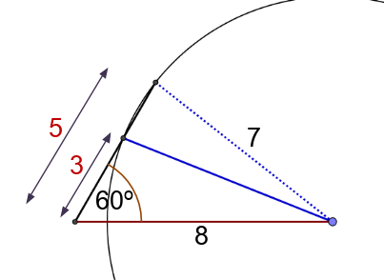

Slide 6
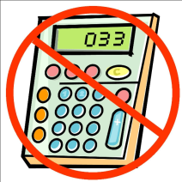
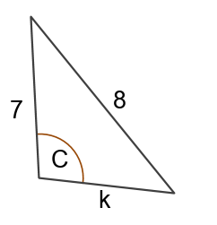
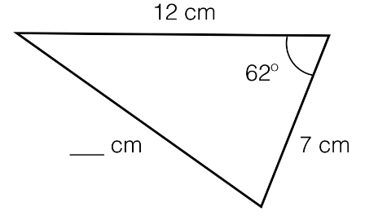
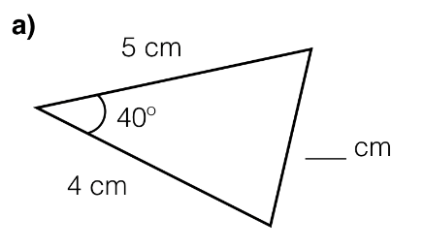
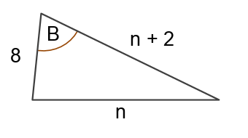

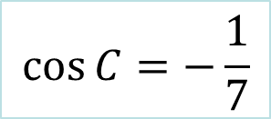


In your books, work out the missing lengths.
$$\cos{C=−\frac{1}{7}}$$
x
$$a$$
$$b$$
z
$$B=60°$$
y

Slide 7
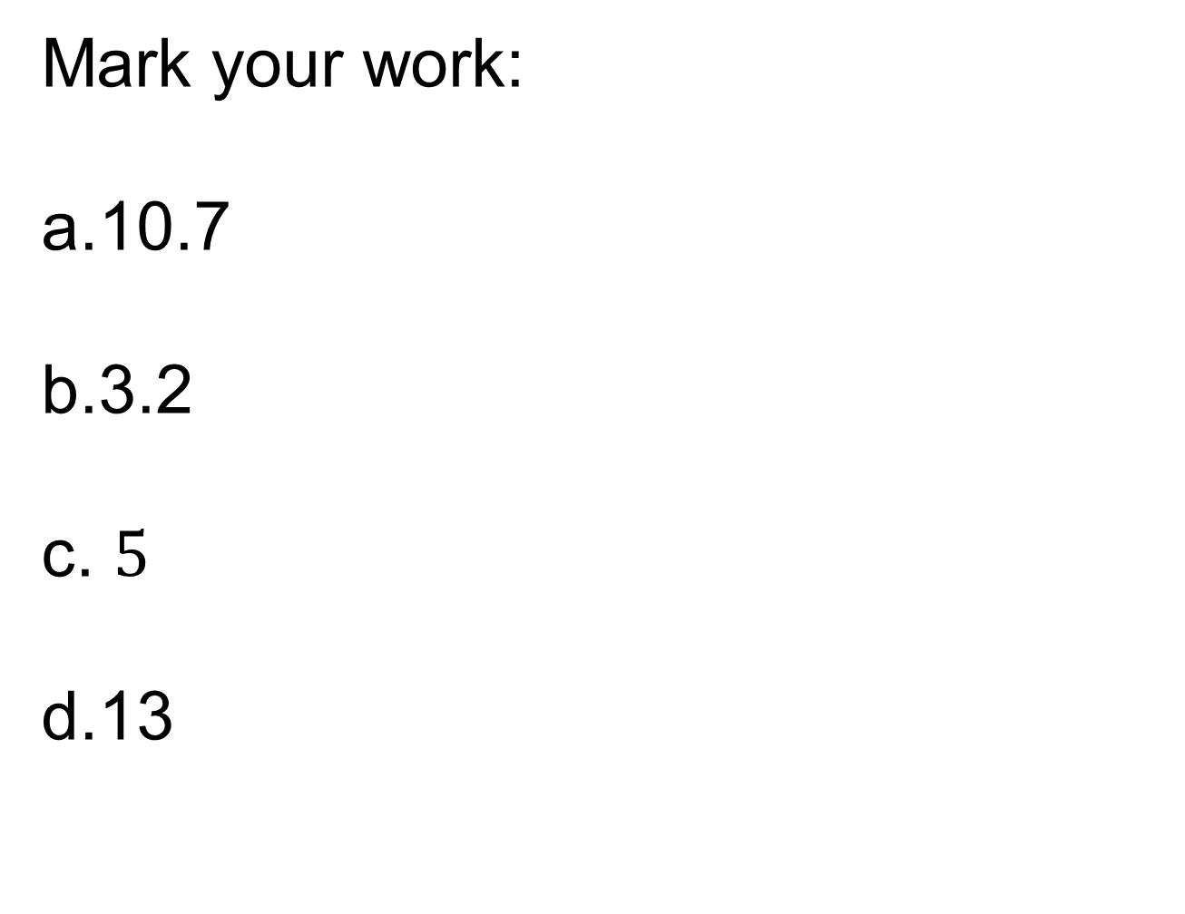
Mark your work:
10.7
3.2
$5$
13

Slide 8
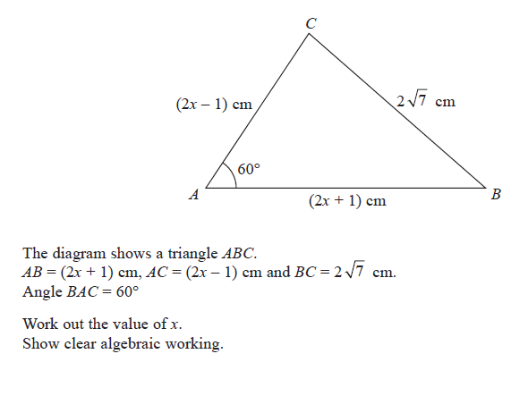
Challenge

Slide 9
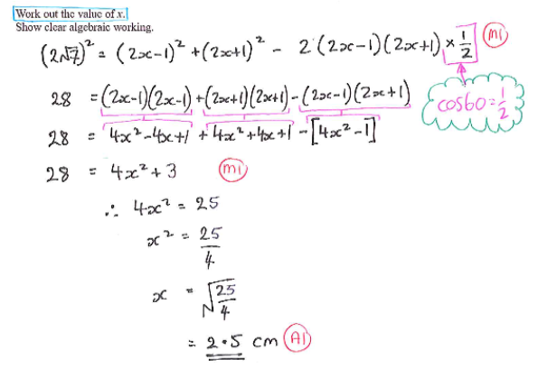
Notes:
Acknowledgments: Don Steward and BossMaths

