Slide 1
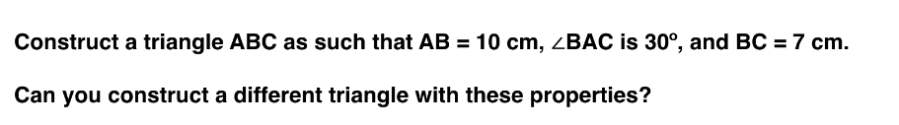
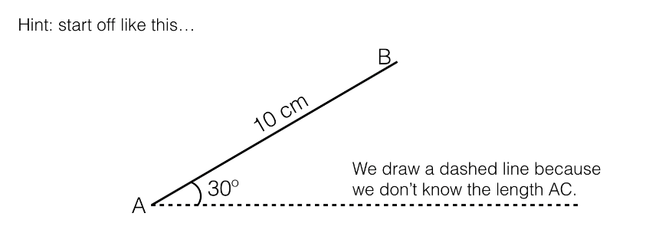

Slide 2
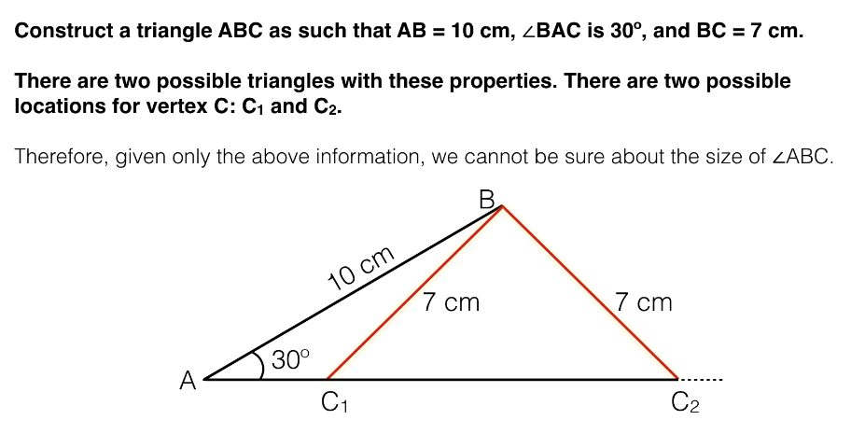

Slide 3
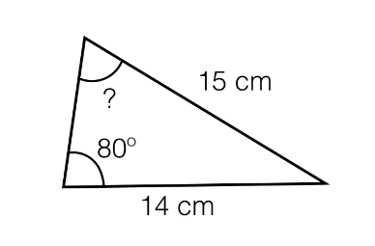
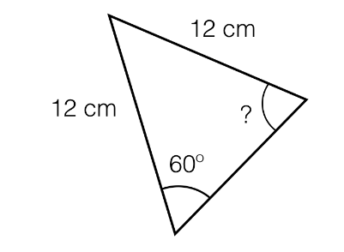


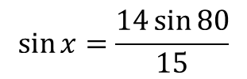
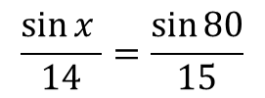


Worked Example
Work out the acute angle, x
TITLE: Using the Sine Rule to work out a missing angle
Your Turn
Work out the acute angle, y
$$x$$
$$x$$
$$y$$
$$\frac{\sin{x }}{14}=\frac{\sin{80}}{15}$$
$$\sin{x=\frac{14\sin{80}}{15}}$$
$$x=\sin^{−1}\left(ANS\right)=66.8°$$
Notes:
Silent Teacher.
Y = 60…

Slide 4
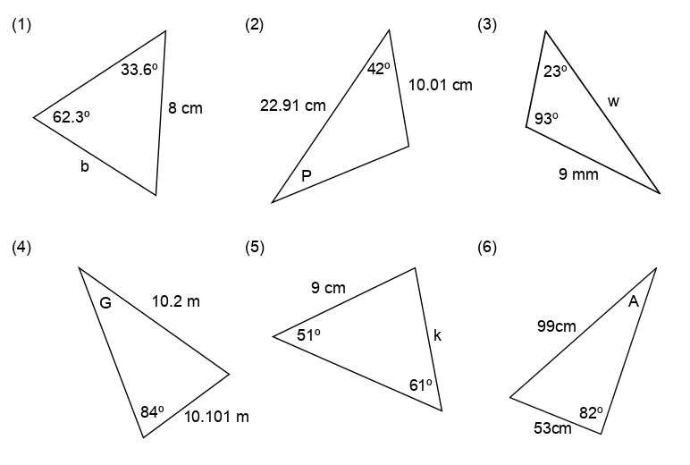



In your books, work out the missing length or acute angle to 3 sf:
$$a$$
$$b$$
Find h, the perpendicular height
$$c$$
Notes:
Questions d, e, f without a calculator

Slide 5
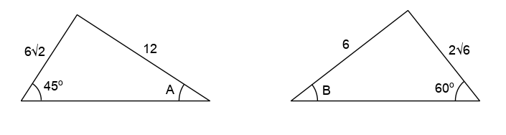
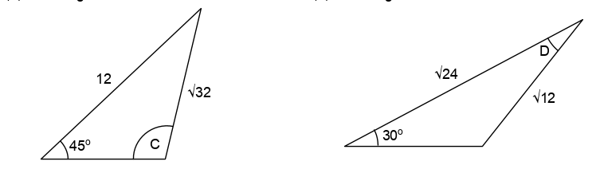

Without a calculator, work out the missing acute angles.
7)
8)
10)
9)
$$4\sqrt{3}$$

Slide 6
Mark your work:
5.00
17.0
23.0
80.0
8.00
32.0
30.0
45.0
9. 60.0
10. 105

Slide 7
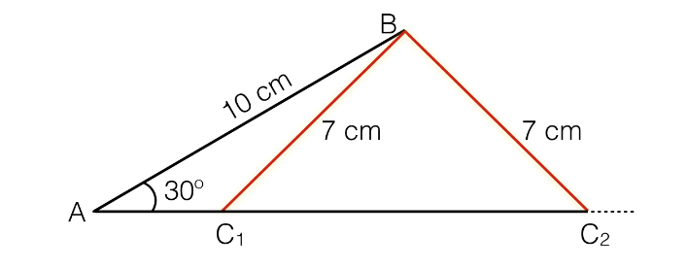

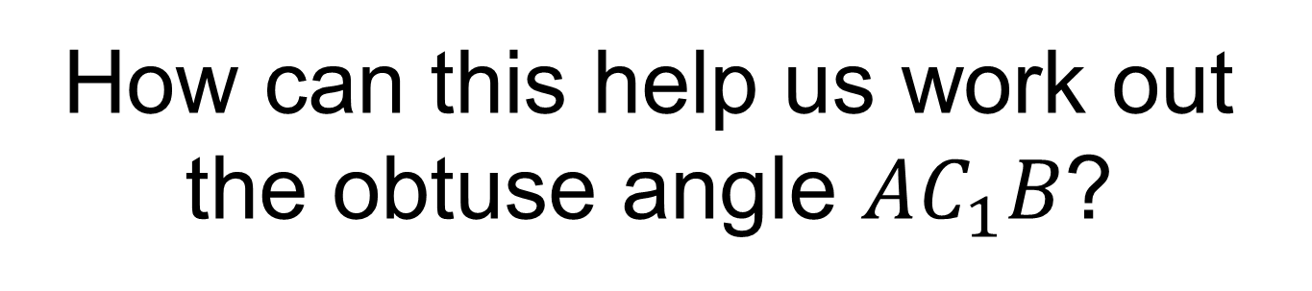
Calculate angle $AC_{2}B$
How can this help us work out the obtuse angle $AC_{1}B$?

Slide 8
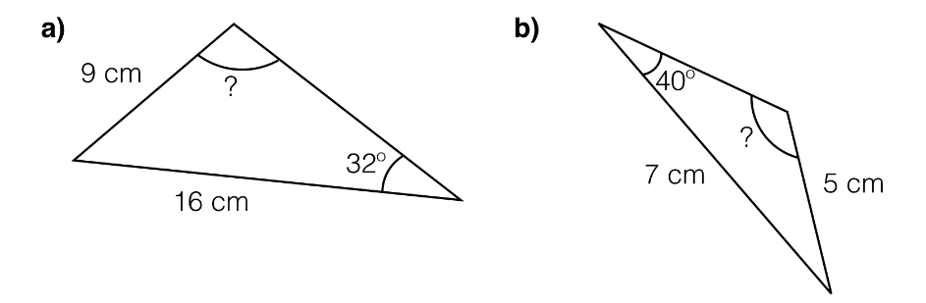
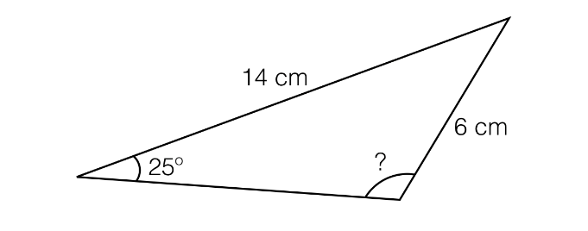
In your books, work out the missing obtuse angles to 1 dp
c)

Slide 9
Mark your work:
109.6
115.9
99.6

Slide 10
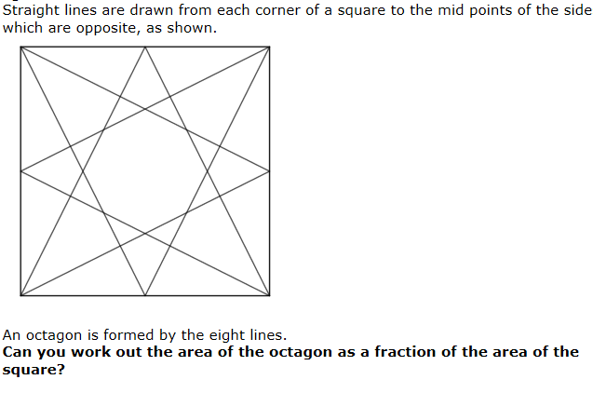
Challenge
Notes:
https://nrich.maths.org/561 for solutions

