Slide 1
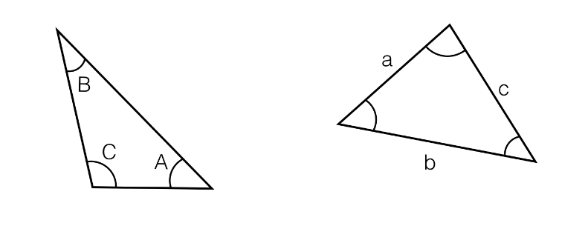
Label the missing lengths and missing angles.

Slide 2
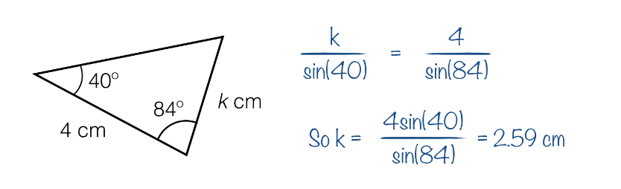
A student attempts to calculate the missing length k.
The answer is wrong – can you spot the mistake?

Slide 3
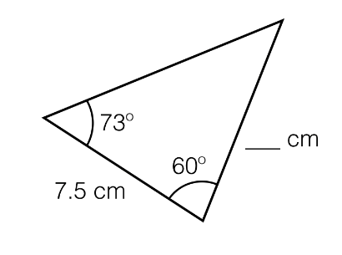
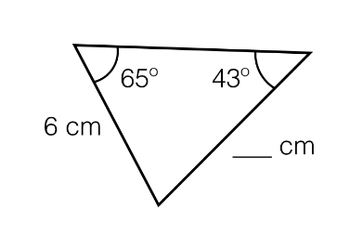

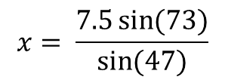
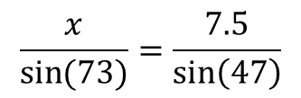



Worked Example
TITLE: Using the Sine Rule to work out a missing length
Your Turn
$$47°$$
$$x$$
$$y$$
$$\frac{x}{\sin{(73)}}=\frac{7.5}{\sin\left(47\right)}$$
$$x= \frac{7.5\sin{(73)}}{\sin{(47)}}$$
$$x=9.81 cm \left(3 sf\right)$$
Notes:
Silent Teacher.
y = 7.97 cm

Slide 4
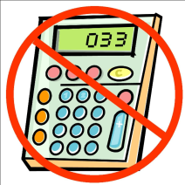
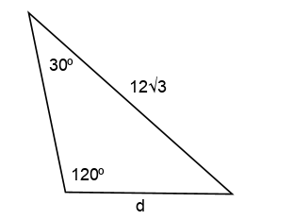
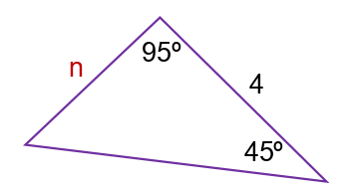
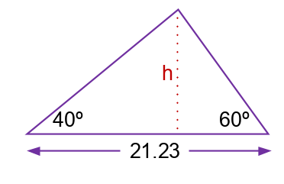
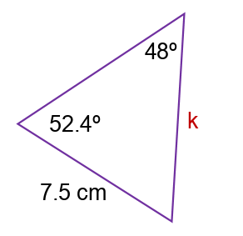
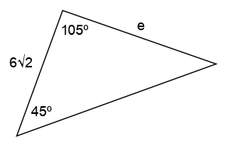
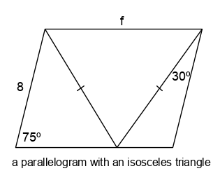
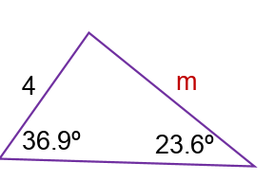




$$Note: sin{120=sin 60 }$$
Work out the missing lengths to 3 sf:
$$a$$
$$b$$
Find h, the perpendicular height
$$c$$
Notes:
Questions d, e, f without a calculator

Slide 5
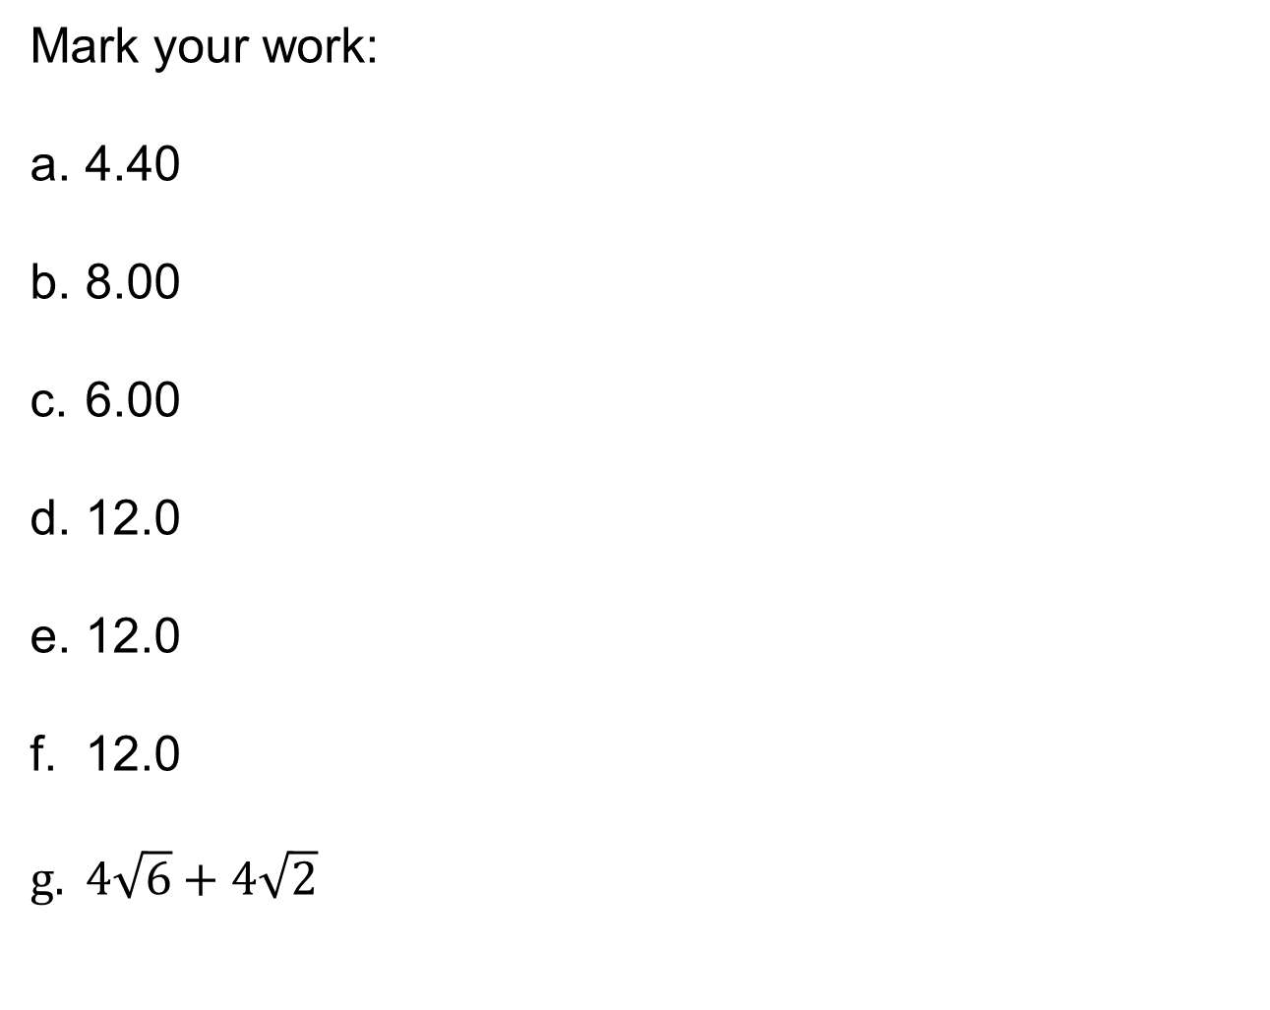
Mark your work:
4.40
8.00
6.00
12.0
12.0
12.0
$4\sqrt{6}+4\sqrt{2}$

Slide 6
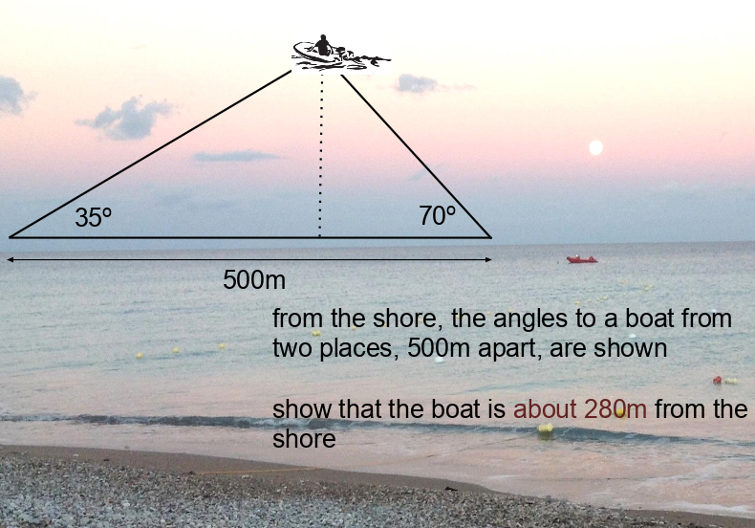
Challenge

Slide 7
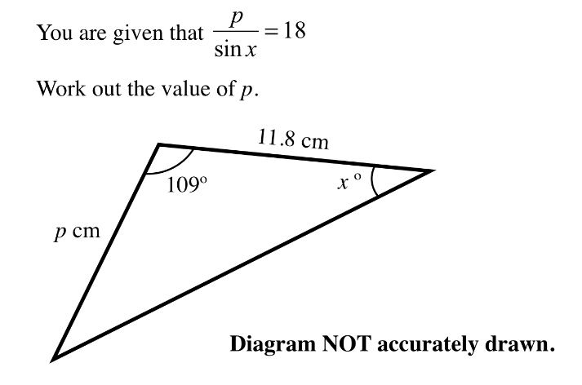
Challenge
Notes:
11.8

