Slide 1
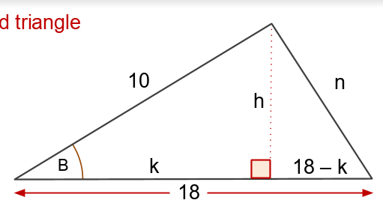

Work out $n$ given that $\cos{B= \frac{7}{9}}$
Using Pythagoras write down two different equations from this triangle.
Notes:
Mini Whiteboards

Slide 2


Work out $n$ given that $\cos{B= \frac{7}{9}}$
Using Pythagoras write down two different equations from this triangle.
$$k^{2}+h^{2}={10}^{2}$$
$${(18−k)}^{2}+h^{2}=n^{2}$$
Notes:
Mini Whiteboards

Slide 3


Work out $n$ given that $\cos{B= \frac{7}{9}}$
Make $h^{2}$the subject of both equations
$$k^{2}+h^{2}={10}^{2}$$
$${(18−k)}^{2}+h^{2}=n^{2}$$
Notes:
Mini Whiteboards

Slide 4




Work out $n$ given that $\cos{B= \frac{7}{9}}$
Make $h^{2}$the subject of both equations
$$k^{2}+h^{2}={10}^{2}$$
$${(18−k)}^{2}+h^{2}=n^{2}$$
$$h^{2}={10}^{2}−k^{2}$$
$$h^{2}=n^{2}−{(18−k)}^{2}$$
Notes:
Mini Whiteboards

Slide 5

Work out $n$ given that $\cos{B= \frac{7}{9}}$
Explain how this equation has now been formed?
${10}^{2}−k^{2}$ $=n^{2}−{(18−k)}^{2}$
Notes:
Mini Whiteboards

Slide 6
Work out $n$ given that $\cos{B= \frac{7}{9}}$
Make $n^{2}$ the subject of this equation.
${10}^{2}−k^{2}$ $=n^{2}−{(18−k)}^{2}$
Notes:
Mini Whiteboards

Slide 7

Work out $n$ given that $\cos{B= \frac{7}{9}}$
Make $n^{2}$ the subject of this equation.
${10}^{2}−k^{2}$ $=n^{2}−{(18−k)}^{2}$
${10}^{2}−k^{2}$ $+{(18−k)}^{2} =n^{2}$
Notes:
Mini Whiteboards

Slide 8

Work out $n$ given that $\cos{B= \frac{7}{9}}$
Expand and simplify the LHS
$$n^{2}={10}^{2}−k^{2}+{(18−k)}^{2}$$
Notes:
Mini Whiteboards

Slide 9
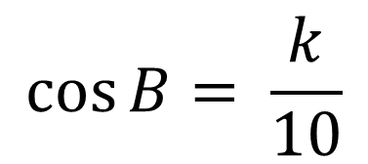

Work out $n$ given that $\cos{B= \frac{7}{9}}$
$$n^{2}=424−36k$$
Write an expression for cos B
$$\cos{B= \frac{k}{10}}$$
Notes:
Mini Whiteboards

Slide 10

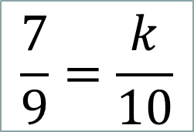
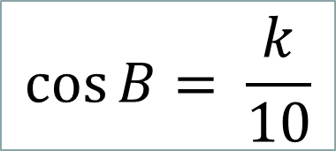
Work out $n$ given that $\cos{B= \frac{7}{9}}$
$$n^{2}=424−36k$$
Explain why 70 = 9k
$$\cos{B= \frac{k}{10}}$$
$$\frac{7}{9}=\frac{k}{10}$$
$$7 ×10=9 ×k$$
Notes:
Mini Whiteboards

Slide 11
Work out $n$ given that $\cos{B= \frac{7}{9}}$
$$n^{2}=424−36k$$
Work out the value of n given that we know that 9k = 70
Notes:
Mini Whiteboards

Slide 12

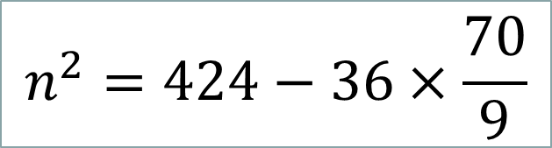
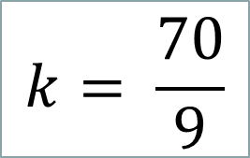


Work out $n$ given that $\cos{B= \frac{7}{9}}$
Work out the value of n given that we know that 9k = 70
$$k= \frac{70}{9}$$
$$n^{2}=424−36k$$
$$n^{2}=144$$
$$n^{2}=424−36×\frac{70}{9}$$
$$n=12$$
Notes:
Mini Whiteboards

Slide 13
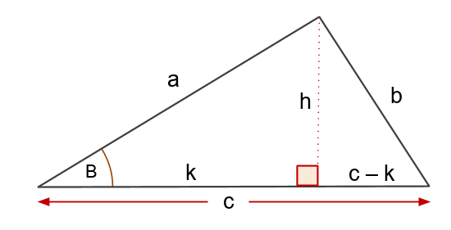
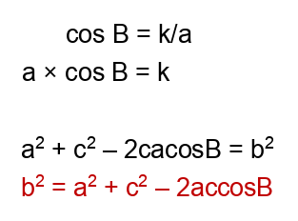
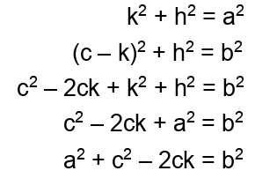
In your pairs discuss each line of working.
Notes:
Mini Whiteboards

Slide 14
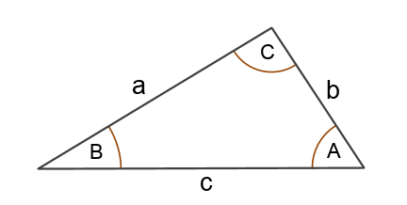



The Cosine Rule

