Slide 1
A Level Scheme of Learning

Slide 2
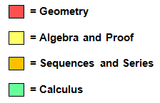
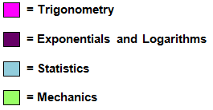
Year 12 Overview
 | September | October |  |  | November |  | December
Mechanics Route | Straight line and circles – Chapter 6 | Proof – Chapter 1 | Assessment | Half Term | Binomial Expansion - Chapter 9 | Differentiation – Chapters 12 and 13 |  | Assessment | Christmas
Statistics Route | Algebraic Manipulation, Quadratic Equations and Simultaneous Equations – Chapters 2, 3 and 4 | Graphs, Linear and quadratic Inequalities – Chapter 5 |  |  | Trigonometry – Chapters 10 and 11 |  | Probability and Statistical Distributions – Chapter 21
 | January |  |  | February |  |  |  | March |  |  | April |  |  | May
Mechanics Route | Integration – Chapter 14 |  | Vectors – Chapter 15 |  | Assessment | Half Term | Kinematics in one dimension – Chapter 16 |  | Forces and Newtons Laws – Chapters 17, 18 and 19 | Half Term | Forces and Newtons Laws – Chapters 17, 18 and 19 | Mock Exam | General Revision
Statistics Route | Probability and Statistical Distributions – Chapter 21 | Statistical Sampling and Hypothesis Testing– Chapter 22 |  |  |  |  | Exponentials and Logarithms – Chapters 7 and 8 |  |  |  | Data Presentation and Interpretation – Chapter 20 |  | General Revision

Slide 3
Year 12 Overview
Summer Term
 | June | July
Mechanics Route | Sequences and Series – Chapter 4
Statistics Route | Functions – Chapter 2 | Further Transformations of Graphs – Chapter 3

Slide 4
Year 13 Overview
 | September |  | October |  |  |  | November |  | December
Mechanics Route | Radian Measure – Chapter 7 |  | Proof – Chapter 1 | Binomial Theorem - Chapter 6 | Assessment | Half Term | Further Differentiation – Chapter 10 | Further Applications of Calculus – Chapter 12 |  | Assessment | Christmas
Statistics Route | Partial Fractions – Chapter 5 | Trigonometry – Chapter 8 |  | Calculus of Exponential and Trigonometric Functions – Chapter 9 |  |  | Further Integration – Chapter 11
 | January |  |  | February |  |  |  | March |  |  | April |  |  | May
Mechanics Route | Differential Equations – Chapter 13 |  | Application of Vectors – Chapter 16 |  | Assessment | Half Term | Projectiles – Chapter 17 |  | Forces in Context – Chapter 18 | Half Term | Moments – Chapter 19 | Mock Exam | General Revision
Statistics Route | Differential Equations – Chapter 13 | Numerical Methods – Chapters 14 and 15 |  |  |  |  | Further Probability – Chapter 20 |  | Statistical Distributions – Chapter 21 |  | Statistical Hypothesis Testing – Chapter 22 |  | General Revision

Slide 5
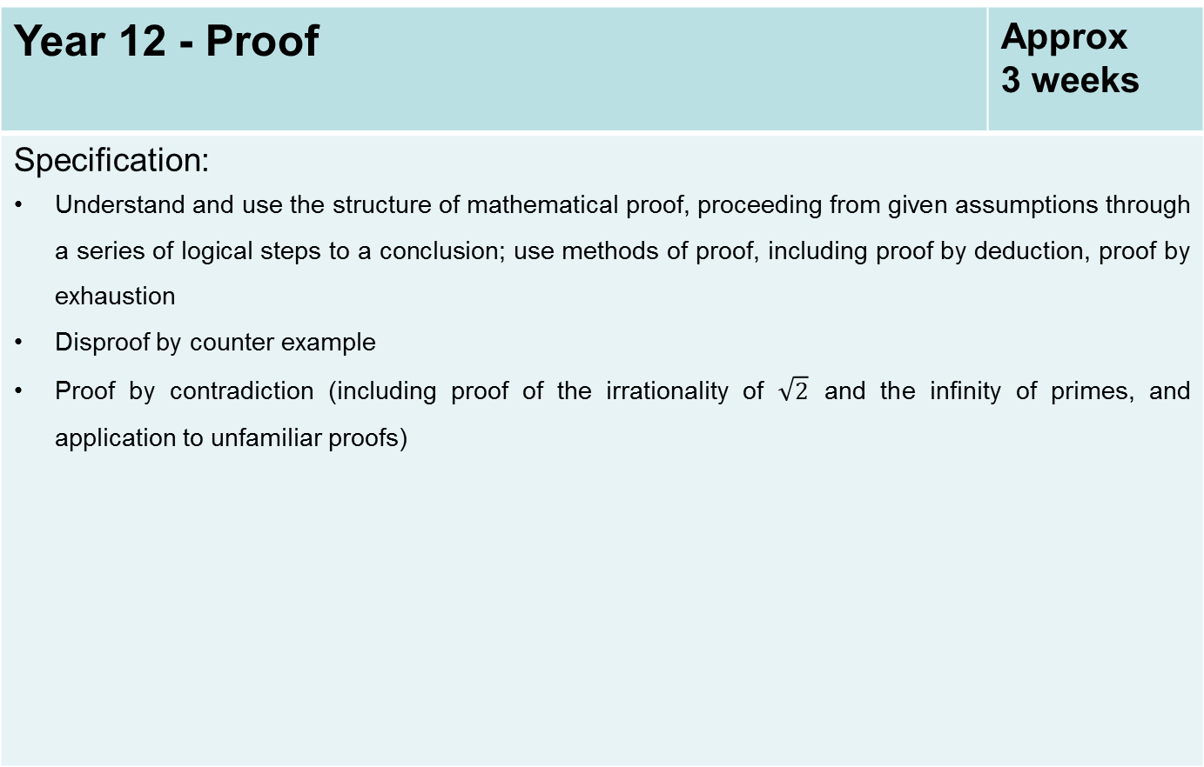
Year 12 - Proof | Approx 3 weeks
Specification: Understand and use the structure of mathematical proof, proceeding from given assumptions through a series of logical steps to a conclusion; use methods of proof, including proof by deduction, proof by exhaustion Disproof by counter example Proof by contradiction (including proof of the irrationality of $\sqrt{2}$ and the infinity of primes, and application to unfamiliar proofs)

Slide 6
Year 12 - Algebraic Manipulation, Quadratic Equations and Simultaneous Equations | Approx 4 weeks
Specification: Understand and use the laws of indices for all rational exponents Use and manipulate surds, including rationalising the denominator Work with quadratic functions and their graphs; the discriminant of a quadratic function, including the conditions for real and repeated roots; completing the square; solution of quadratic equations including solving quadratic equations in a function of the unknown Solve simultaneous equations in two variables by elimination and by substitution, including one linear and one quadratic equation Manipulate polynomials algebraically, including expanding brackets and collecting like terms, factorisation and simple algebraic division; use of the factor theorem

Slide 7
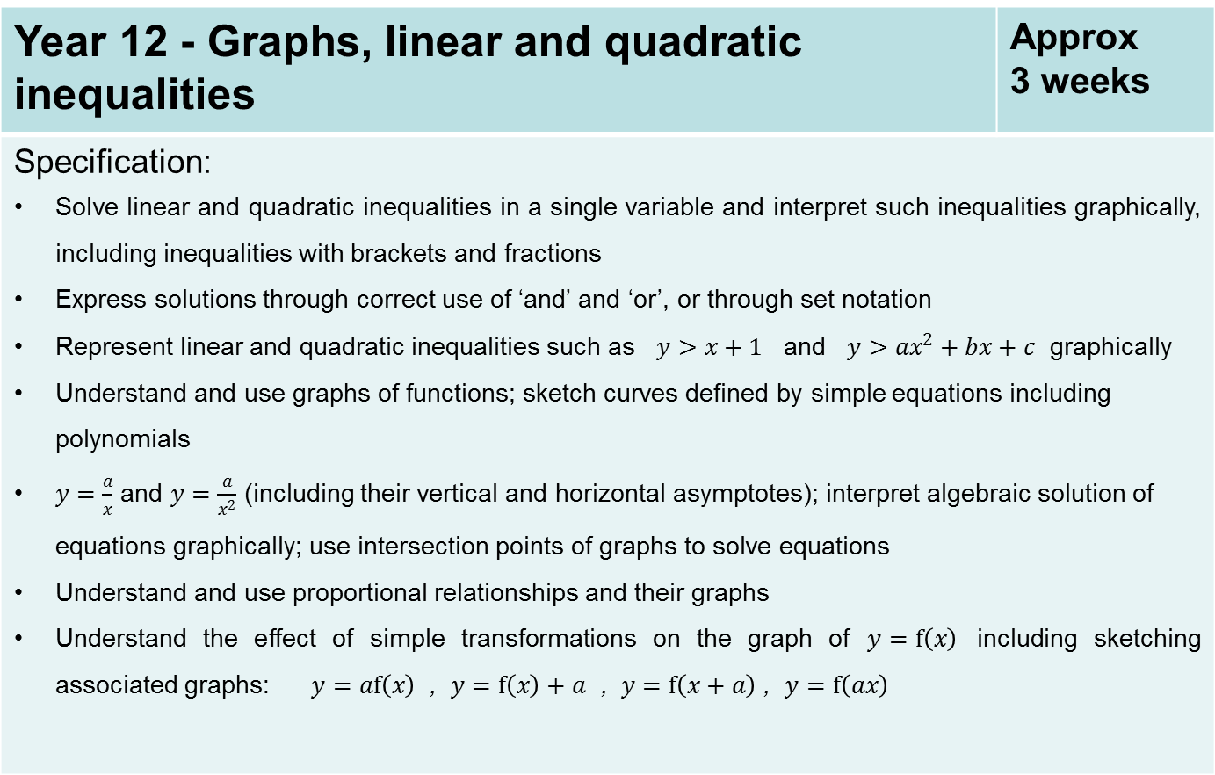
Year 12 - Graphs, linear and quadratic inequalities | Approx 3 weeks
Specification: Solve linear and quadratic inequalities in a single variable and interpret such inequalities graphically, including inequalities with brackets and fractions Express solutions through correct use of ‘and’ and ‘or’, or through set notation Represent linear and quadratic inequalities such as $y>x+1$ and $y>ax^{2}+bx+c$ graphically Understand and use graphs of functions; sketch curves defined by simple equations including polynomials $y=\frac{a}{x}$ and $y=\frac{a}{x^{2}}$ (including their vertical and horizontal asymptotes); interpret algebraic solution of equations graphically; use intersection points of graphs to solve equations Understand and use proportional relationships and their graphs Understand the effect of simple transformations on the graph of $y=f\left(x\right)$ including sketching associated graphs: $y=af\left(x\right)$ , $y=f\left(x\right)+a$ , $y=f\left(x+a\right)$ , $y=f\left(ax\right)$

Slide 8
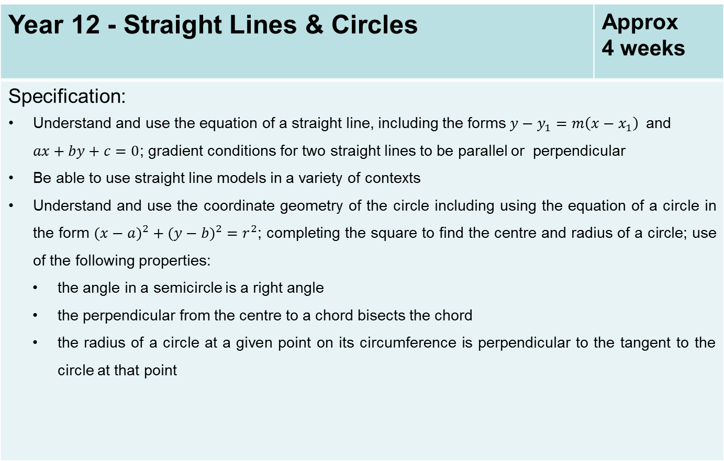
Year 12 - Straight Lines & Circles | Approx 4 weeks
Specification: Understand and use the equation of a straight line, including the forms $y−y_{1}=m\left(x−x_{1}\right)$and $ax+by+c=0$; gradient conditions for two straight lines to be parallel or perpendicular Be able to use straight line models in a variety of contexts Understand and use the coordinate geometry of the circle including using the equation of a circle in the form $(x−{a)}^{2}+(y−{b)}^{2}=r^{2}$; completing the square to find the centre and radius of a circle; use of the following properties: the angle in a semicircle is a right angle the perpendicular from the centre to a chord bisects the chord the radius of a circle at a given point on its circumference is perpendicular to the tangent to the circle at that point

Slide 9
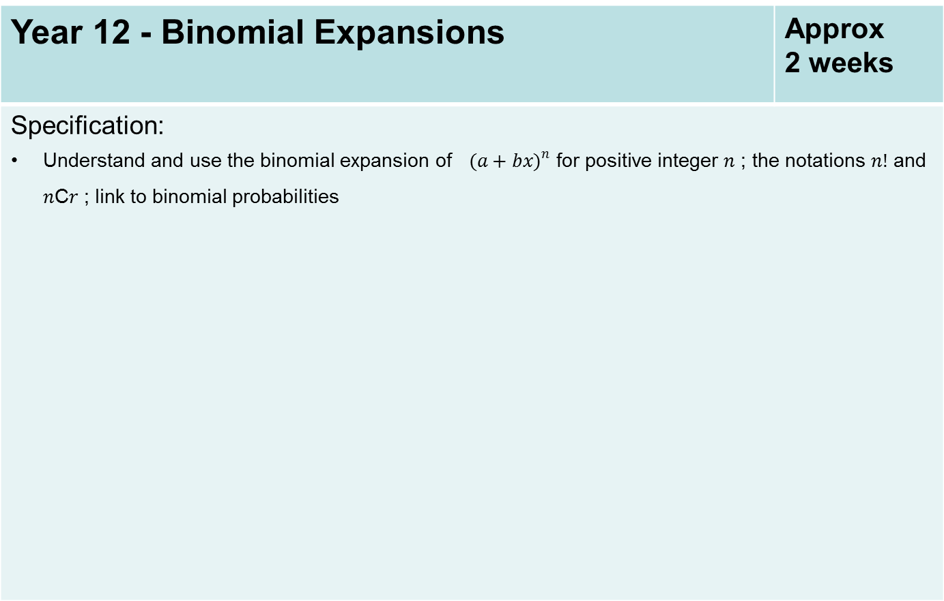
Year 12 - Binomial Expansions | Approx 2 weeks
Specification: Understand and use the binomial expansion of $(a+b{x)}^{n}$ for positive integer $n$ ; the notations $n!$ and $n$C$r$ ; link to binomial probabilities

Slide 10
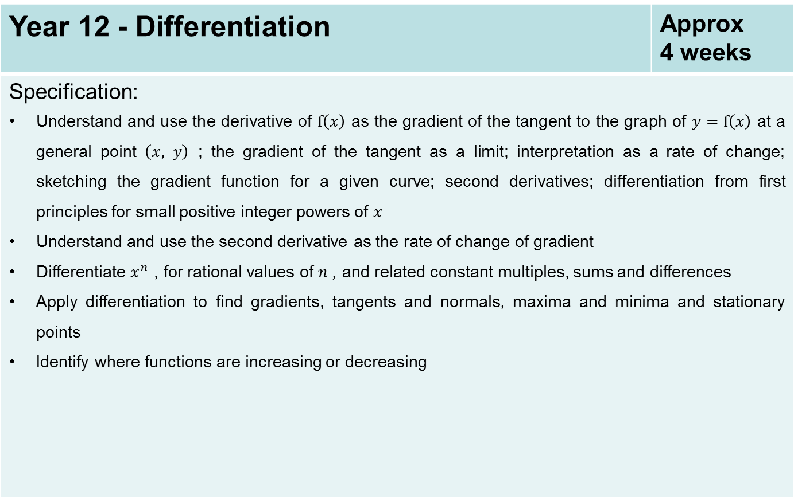
Year 12 - Differentiation | Approx 4 weeks
Specification: Understand and use the derivative of $f\left(x\right)$ as the gradient of the tangent to the graph of $y=f\left(x\right)$ at a general point $\left(x, y\right)$ ; the gradient of the tangent as a limit; interpretation as a rate of change; sketching the gradient function for a given curve; second derivatives; differentiation from first principles for small positive integer powers of $x$ Understand and use the second derivative as the rate of change of gradient Differentiate $x^{n}$ , for rational values of $n$ , and related constant multiples, sums and differences Apply differentiation to find gradients, tangents and normals, maxima and minima and stationary points Identify where functions are increasing or decreasing

Slide 11
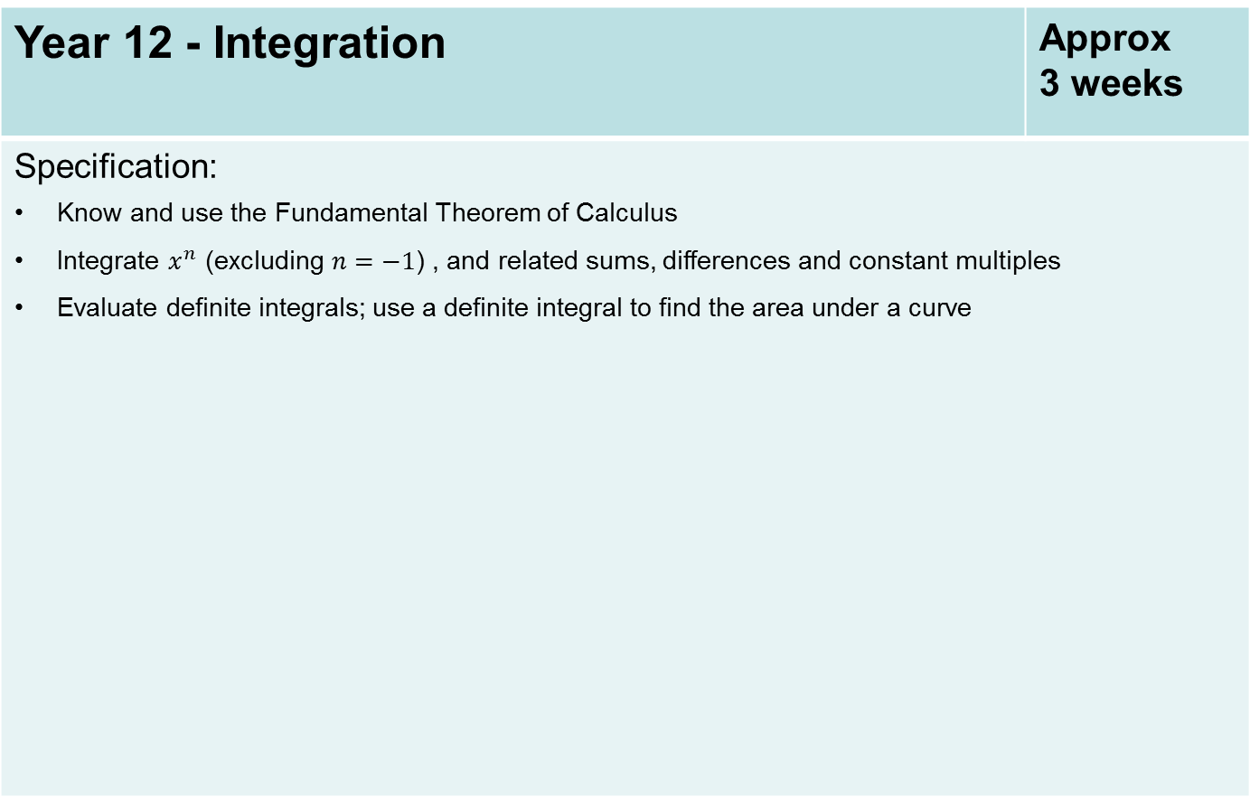
Year 12 - Integration | Approx 3 weeks
Specification: Know and use the Fundamental Theorem of Calculus Integrate $x^{n}$ (excluding $n=−1$) , and related sums, differences and constant multiples Evaluate definite integrals; use a definite integral to find the area under a curve

Slide 12
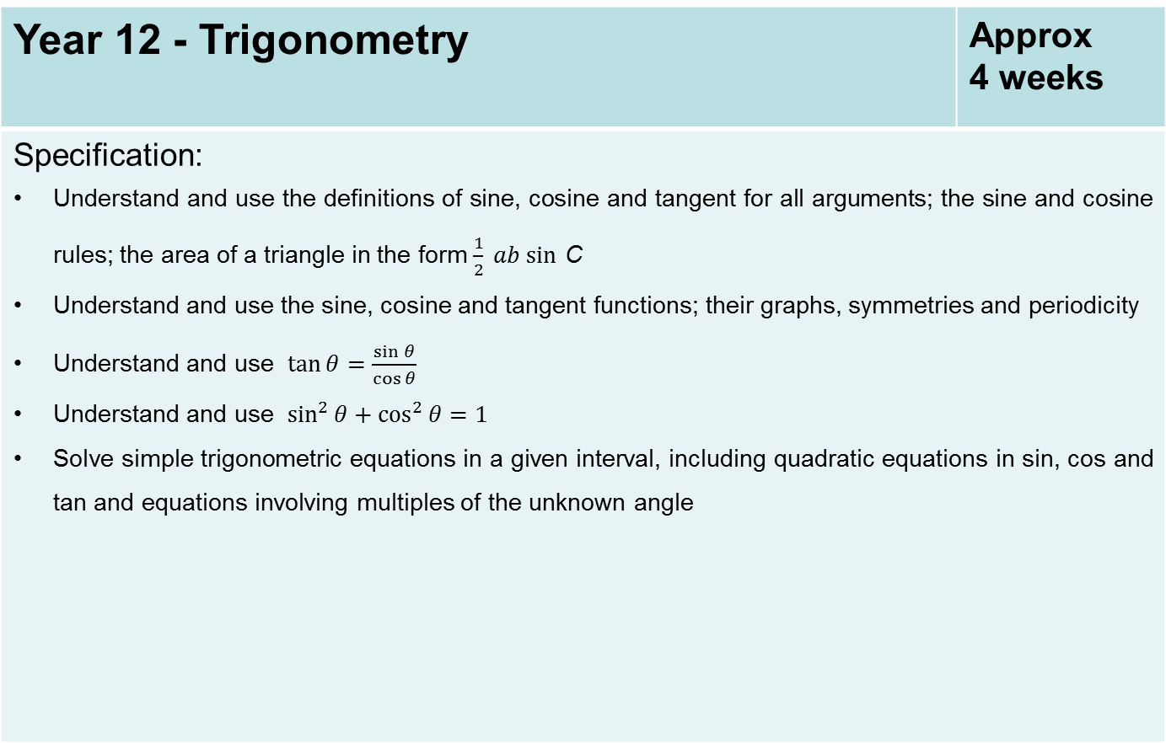
Year 12 - Trigonometry | Approx 4 weeks
Specification: Understand and use the definitions of sine, cosine and tangent for all arguments; the sine and cosine rules; the area of a triangle in the form $\frac{1}{2} ab sin$ C Understand and use the sine, cosine and tangent functions; their graphs, symmetries and periodicity Understand and use $\tan{θ}=\frac{\sin{θ}}{\cos{θ}}$ Understand and use $\sin^{2}{θ+\cos^{2}{θ=1}}$ Solve simple trigonometric equations in a given interval, including quadratic equations in sin, cos and tan and equations involving multiples of the unknown angle

Slide 13
Year 12 - Vectors | Approx 3 weeks
Specification: Use vectors in two dimensions Calculate the magnitude and direction of a vector and convert between component form and magnitude/direction form Add vectors diagrammatically and perform the algebraic operations of vector addition and multiplication by scalars, and understand their geometrical interpretations Understand and use position vectors; calculate the distance between two points represented by position vectors Use vectors to solve problems in pure mathematics and in context, including forces

Slide 14
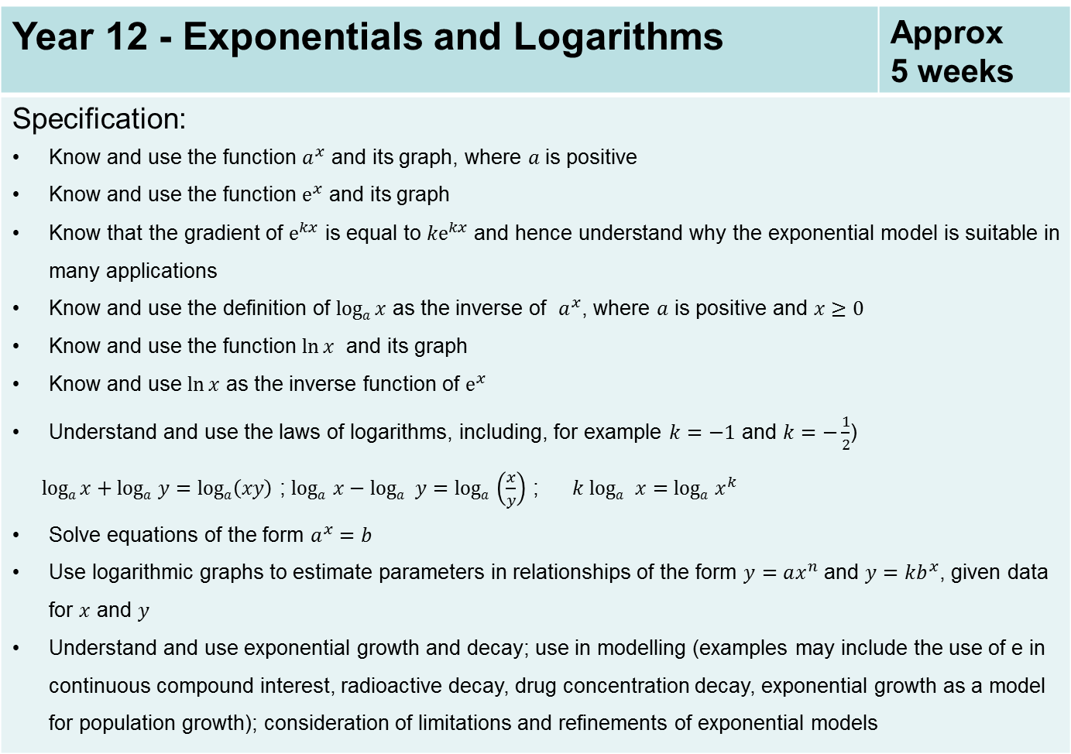
Year 12 - Exponentials and Logarithms | Approx 5 weeks
Specification: Know and use the function $a^{x}$ and its graph, where $a$is positive Know and use the function $e^{x}$ and its graph Know that the gradient of $e^{kx}$ is equal to ${ke}^{kx}$ and hence understand why the exponential model is suitable in many applications Know and use the definition of $loga x$ as the inverse of $a^{x}$, where $a$ is positive and $x≥0$ Know and use the function $\ln{x}$ and its graph Know and use $\ln{x}$ as the inverse function of $e^{x}$ Understand and use the laws of logarithms, including, for example $k=−1$ and $k=−\frac{1}{2}$) $loga x+loga$ $y=loga\left(xy\right)$ ; $loga$ $x−loga$ $y=loga$ $\left(\frac{x}{y}\right)$ ; $k loga$ $x=loga$ $x^{k}$ Solve equations of the form $a^{x}=b$ Use logarithmic graphs to estimate parameters in relationships of the form $y=ax^{n}$ and $y=kb^{x}$, given data for $x$ and $y$ Understand and use exponential growth and decay; use in modelling (examples may include the use of e in continuous compound interest, radioactive decay, drug concentration decay, exponential growth as a model for population growth); consideration of limitations and refinements of exponential models

Slide 15
Year 12 - Statistical Sampling and hypothesis testing | Approx 4 weeks
Specification: Understand and use the terms ‘population’ and ‘sample’ Use samples to make informal inferences about the population Understand and use sampling techniques, including simple random sampling and opportunity sampling Select or critique sampling techniques in the context of solving a statistical problem, including understanding that different samples can lead to different conclusions about the population Understand and apply the language of statistical hypothesis testing, developed through a binomial model: null hypothesis, alternative hypothesis, significance level, test statistic, 1-tail test, 2-tail test, critical value, critical region, acceptance region, p-value Conduct a statistical hypothesis test for the proportion in the binomial distribution and interpret the results in context Understand that a sample is being used to make an inference about the population and appreciate that the significance level is the probability of incorrectly rejecting the null hypothesis

Slide 16
Year 12 - Data Presentation and Interpretation | Approx 3 weeks
Specification: Interpret diagrams for single-variable data, including understanding that area in a histogram represents frequency Connect to probability distributions Interpret scatter diagrams and regression lines for bivariate data, including recognition of scatter diagrams which include distinct sections of the population (calculations involving regression lines are excluded) Understand informal interpretation of correlation Understand that correlation does not imply causation Interpret measures of central tendency and variation, extending to standard deviation Be able to calculate standard deviation, including from summary statistics Recognise and interpret possible outliers in data sets and statistical diagrams Select or critique data presentation techniques in the context of a statistical problem Be able to clean data, including dealing with missing data, errors and outliers

Slide 17
Year 12 - Probability and Statistical Distributions | Approx 4 weeks
Specification: Understand and use mutually exclusive and independent events when calculating probabilities Link to discrete and continuous distributions Understand and use simple, discrete probability distributions (calculation of mean and variance of discrete random variables is excluded), including the binomial distribution, as a model; calculate probabilities using the binomial distribution

Slide 18
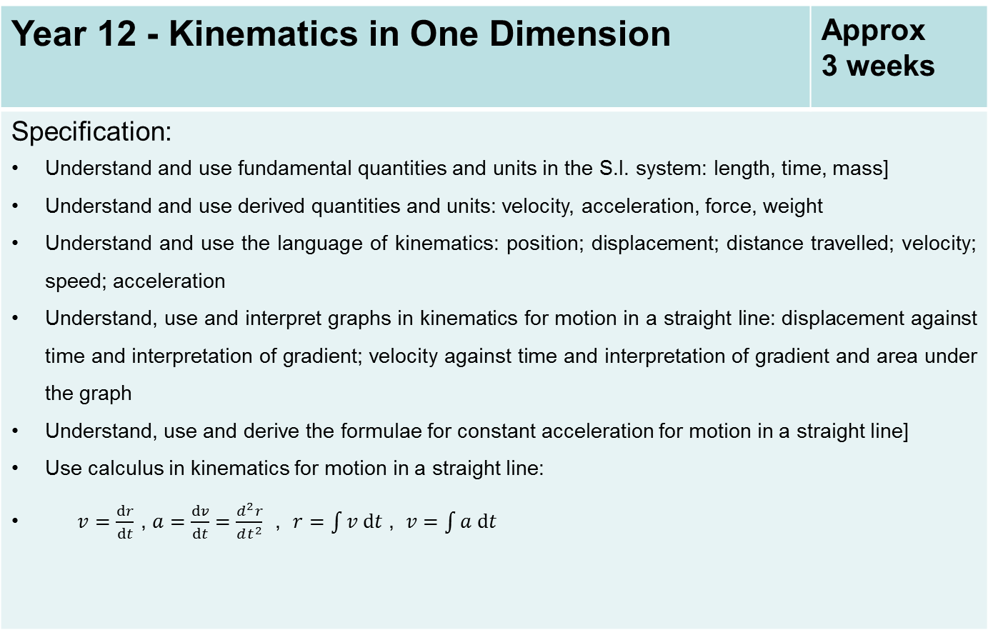
Year 12 - Kinematics in One Dimension | Approx 3 weeks
Specification: Understand and use fundamental quantities and units in the S.I. system: length, time, mass] Understand and use derived quantities and units: velocity, acceleration, force, weight Understand and use the language of kinematics: position; displacement; distance travelled; velocity; speed; acceleration Understand, use and interpret graphs in kinematics for motion in a straight line: displacement against time and interpretation of gradient; velocity against time and interpretation of gradient and area under the graph Understand, use and derive the formulae for constant acceleration for motion in a straight line] Use calculus in kinematics for motion in a straight line: $v=\frac{dr}{dt}$ , $a=\frac{dv}{dt}=\frac{d^{2}r}{dt^{2}}$ , $r=\int{v dt}$ , $v=\int{a dt}$

Slide 19
Year 12 - Forces and Newton’s Laws | Approx 6 weeks
Specification: Understand the concept of a force; understand and use Newton’s first law] Understand and use Newton’s second law for motion in a straight line (restricted to forces in two perpendicular directions or simple cases of forces given as 2-D vectors) Understand and use weight and motion in a straight line under gravity; gravitational acceleration, g , and its value in S.I. units to varying degrees of accuracy (the inverse square law for gravitation is not required and g may be assumed to be constant, but students should be aware that g is not a universal constant but depends on location) Understand and use Newton’s third law; equilibrium of forces on a particle and motion in a straight line (restricted to forces in two perpendicular directions or simple cases of forces given as 2-D vectors); application to problems involving smooth pulleys and connected particles

Slide 20
Year 13 - Functions | Approx 2 weeks
Specification: Understand and use composite functions; inverse functions and their graphs

Slide 21
Year 13 – Further Transformations of graphs | Approx 2 weeks
Specification: The modulus of a linear function Combinations of transformations (translations and stretches)

Slide 22
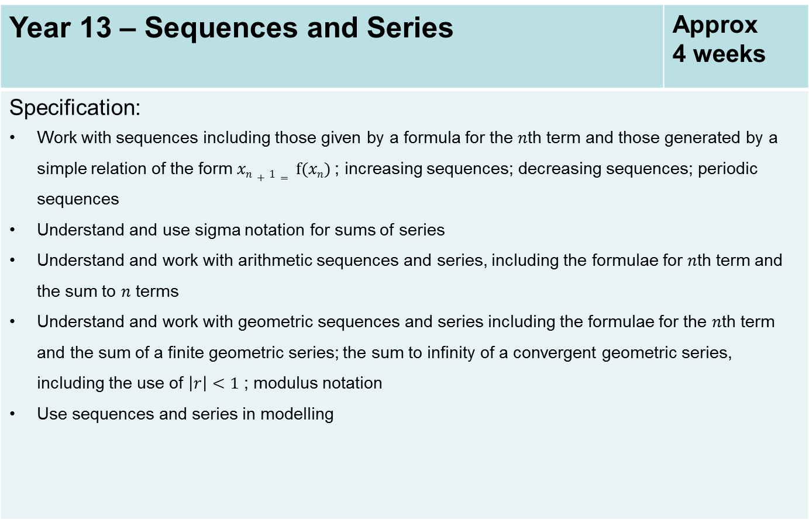
Year 13 – Sequences and Series | Approx 4 weeks
Specification: Work with sequences including those given by a formula for the $n$th term and those generated by a simple relation of the form $xn+1= f(xn)$; increasing sequences; decreasing sequences; periodic sequences Understand and use sigma notation for sums of series Understand and work with arithmetic sequences and series, including the formulae for $n$th term and the sum to $n$ terms Understand and work with geometric sequences and series including the formulae for the $n$th term and the sum of a finite geometric series; the sum to infinity of a convergent geometric series, including the use of $\left|r\right|<1$ ; modulus notation Use sequences and series in modelling

Slide 23

Year 13 - Proof | Approx 2 weeks
Specification: Understand and use the structure of mathematical proof, proceeding from given assumptions through a series of logical steps to a conclusion; use methods of proof, including proof by deduction, proof by exhaustion Disproof by counter example Proof by contradiction (including proof of the irrationality of $\sqrt{2}$ and the infinity of primes, and application to unfamiliar proofs)

Slide 24
Year 13 – Partial Fractions | Approx 2 weeks
Specification: Simplify rational expressions including by factorising and cancelling, and algebraic division (by linear expressions only) Decompose rational functions into partial fractions (denominators not more complicated than squared linear terms and with no more than 3 terms, numerators constant or linear)

Slide 25
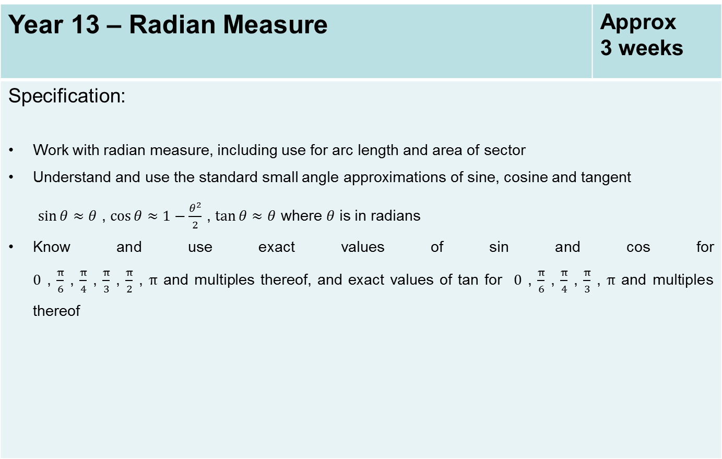
Year 13 – Radian Measure | Approx 3 weeks
Specification: Work with radian measure, including use for arc length and area of sector Understand and use the standard small angle approximations of sine, cosine and tangent $\sin{θ}≈θ$ , $\cos{θ≈1−\frac{θ^{2}}{2}}$ , $\tan{θ≈θ}$ where $θ$ is in radians Know and use exact values of sin and cos for $0$ , $\frac{π}{6}$ , $\frac{π}{4}$ , $\frac{π}{3}$ , $\frac{π}{2}$ , $π$ and multiples thereof, and exact values of tan for $0$ , $\frac{π}{6}$ , $\frac{π}{4}$ , $\frac{π}{3}$ , $π$ and multiples thereof

Slide 26
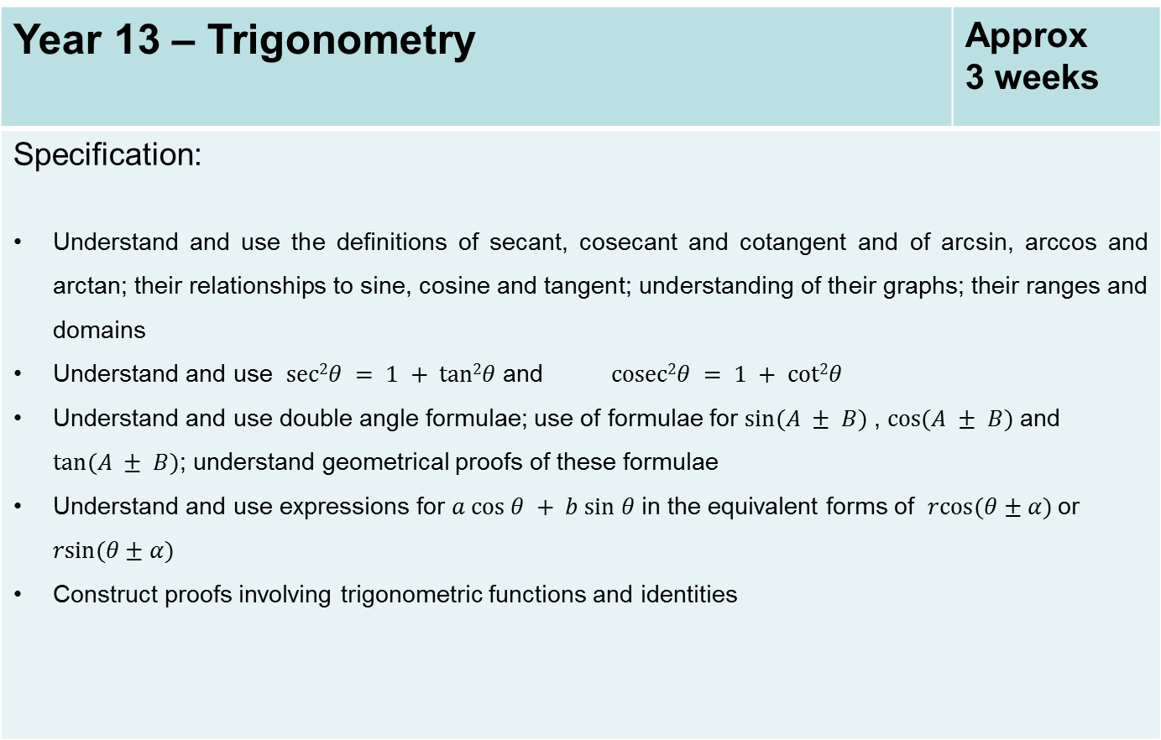
Year 13 – Trigonometry | Approx 3 weeks
Specification: Understand and use the definitions of secant, cosecant and cotangent and of arcsin, arccos and arctan; their relationships to sine, cosine and tangent; understanding of their graphs; their ranges and domains Understand and use $sec2θ = 1 + tan2θ$and $cosec2θ = 1 + cot2θ$ Understand and use double angle formulae; use of formulae for $sin⁡(A ± B)$, $cos⁡(A ± B)$and $tan⁡(A ± B)$; understand geometrical proofs of these formulae Understand and use expressions for $a cos θ + b sin θ$in the equivalent forms of $rcos(θ±α)$or $rsin(θ±α)$ Construct proofs involving trigonometric functions and identities

Slide 27
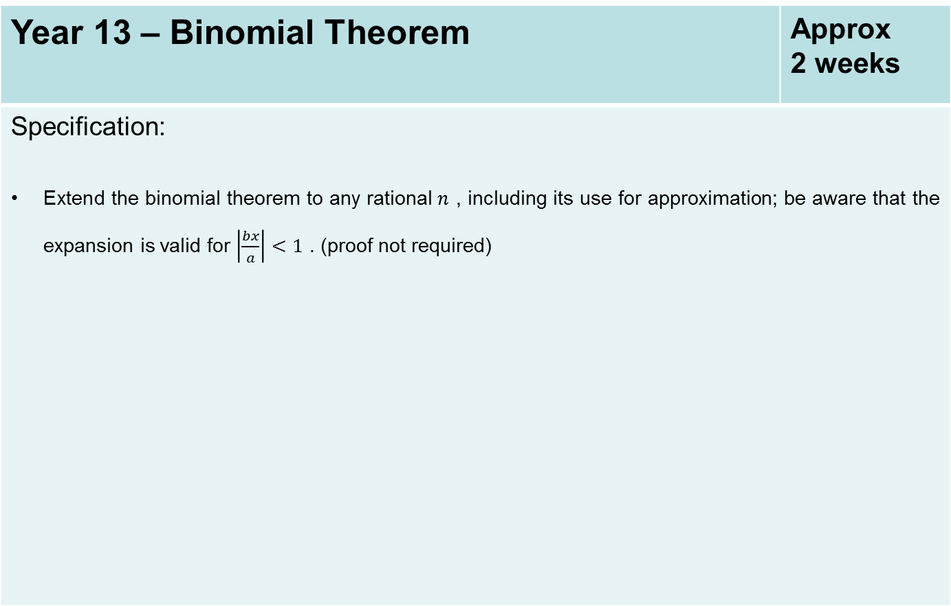
Year 13 – Binomial Theorem | Approx 2 weeks
Specification: Extend the binomial theorem to any rational$n$ , including its use for approximation; be aware that the expansion is valid for $\left|\frac{bx}{a}\right|<1$ . (proof not required)

Slide 28
Year 13 – Calculus of Exponential and Trigonometric Functions | Approx 2 weeks
Specification: Differentiate and integrate x^{n} , for rational values of n , and related constant multiples, sums and differences. Differentiate and integrate e^{kx} and a^{kx} Understand and use the derivative of ln x Apply differentiation to find gradients, tangents and normals, maxima and minima and stationary points, points of inflection. Evaluate definite integrals; use a definite integral to find the area under a curve and the area between two curves.

Slide 29
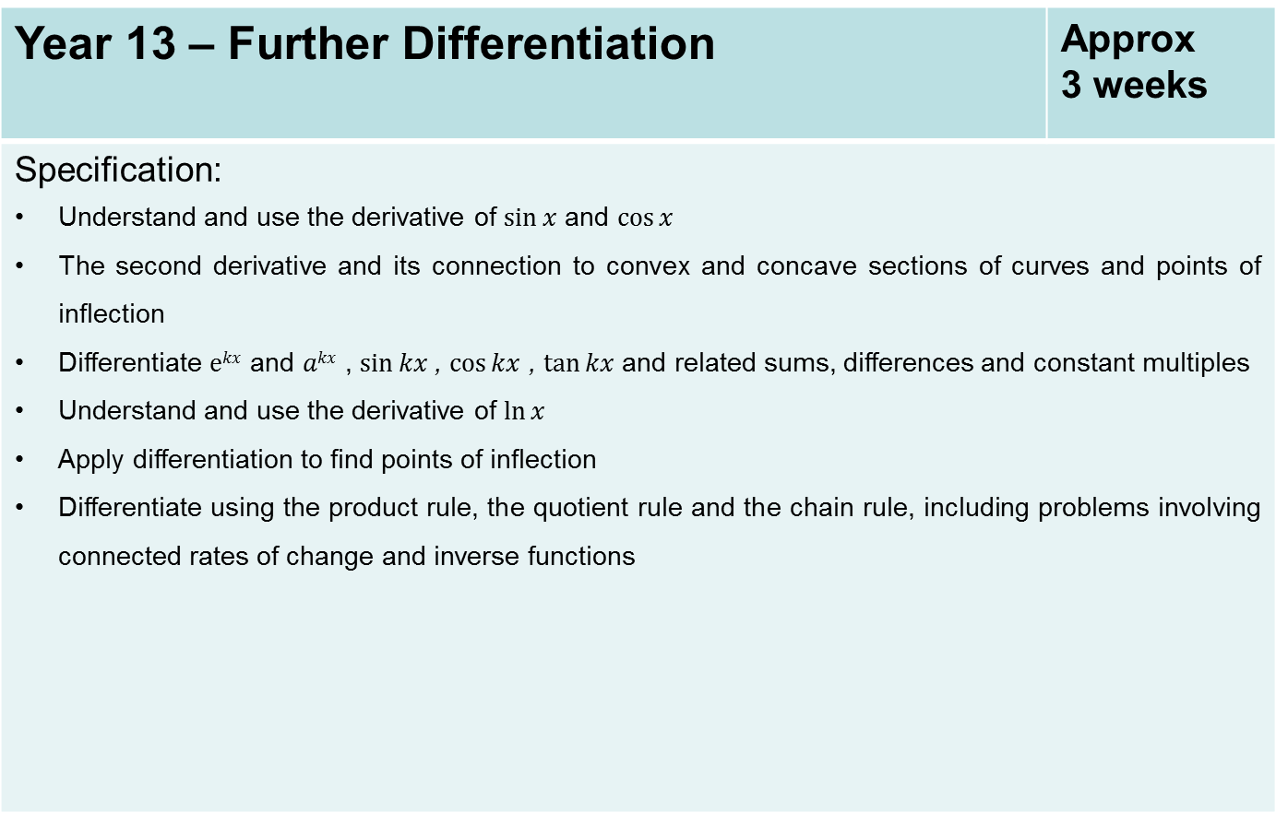
Year 13 – Further Differentiation | Approx 3 weeks
Specification: Understand and use the derivative of $sin⁡x$ and $cos⁡x$ The second derivative and its connection to convex and concave sections of curves and points of inflection Differentiate $ekx$ and $akx$ , $sin⁡kx$, $cos⁡kx$ , $tan⁡kx$and related sums, differences and constant multiples Understand and use the derivative of $ln⁡x$ Apply differentiation to find points of inflection Differentiate using the product rule, the quotient rule and the chain rule, including problems involving connected rates of change and inverse functions

Slide 30
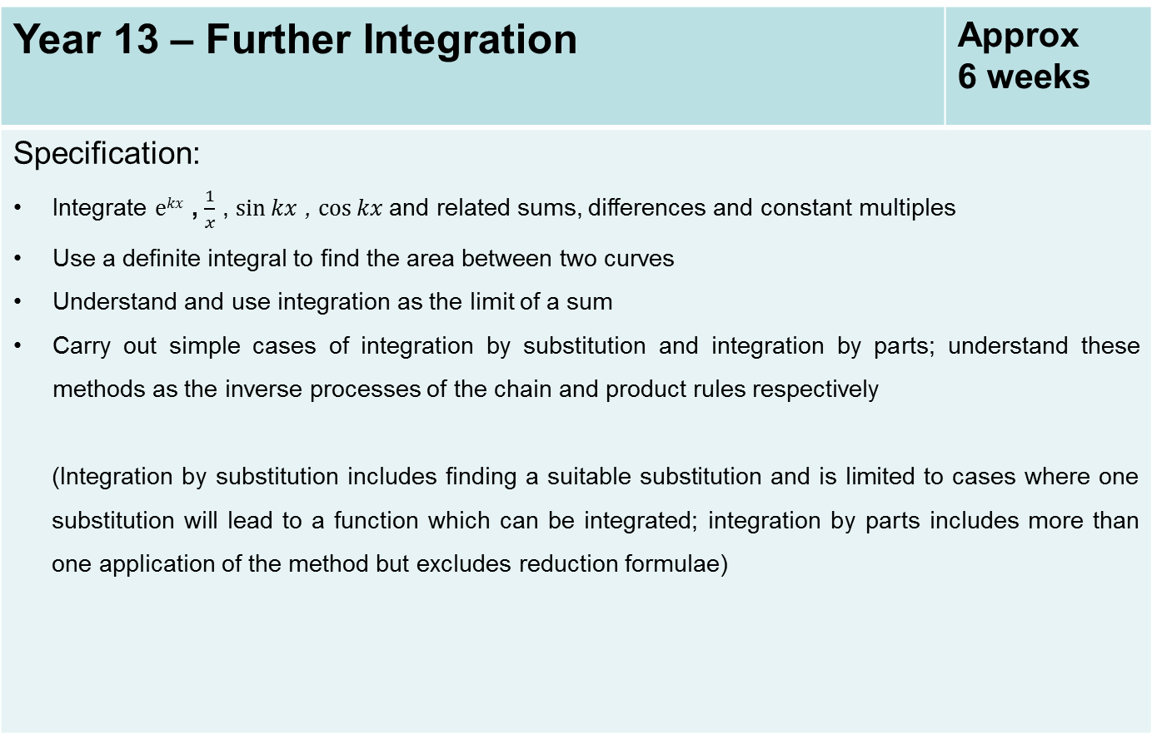
Year 13 – Further Integration | Approx 6 weeks
Specification: Integrate $ekx$ , $\frac{1}{x}$ , $sin⁡kx$ , $cos⁡kx$and related sums, differences and constant multiples Use a definite integral to find the area between two curves Understand and use integration as the limit of a sum Carry out simple cases of integration by substitution and integration by parts; understand these methods as the inverse processes of the chain and product rules respectively (Integration by substitution includes finding a suitable substitution and is limited to cases where one substitution will lead to a function which can be integrated; integration by parts includes more than one application of the method but excludes reduction formulae)

Slide 31
Year 13 – Further Applications of Calculus | Approx 3 weeks
Specification: Understand and use the parametric equations of curves and conversion between Cartesian and parametric forms Use parametric equations in modelling in a variety of contexts Differentiate simple functions and relations defined implicitly or parametrically, for first derivative only

Slide 32
Year 13 – Differential Equations | Approx 5 weeks
Specification: Use of functions in modelling, including consideration of limitations and refinements of the models Differentiate simple functions and relations defined implicitly, for first derivative only Construct simple differential equations in pure mathematics and in context, (contexts may include kinematics, population growth and modelling the relationship between price and demand) Evaluate the analytical solution of simple first order differential equations with separable variables, including finding particular solutions (Separation of variables may require factorisation involving a common factor) Interpret the solution of a differential equation in the context of solving a problem, including identifying limitations of the solution; includes links to kinematics

Slide 33
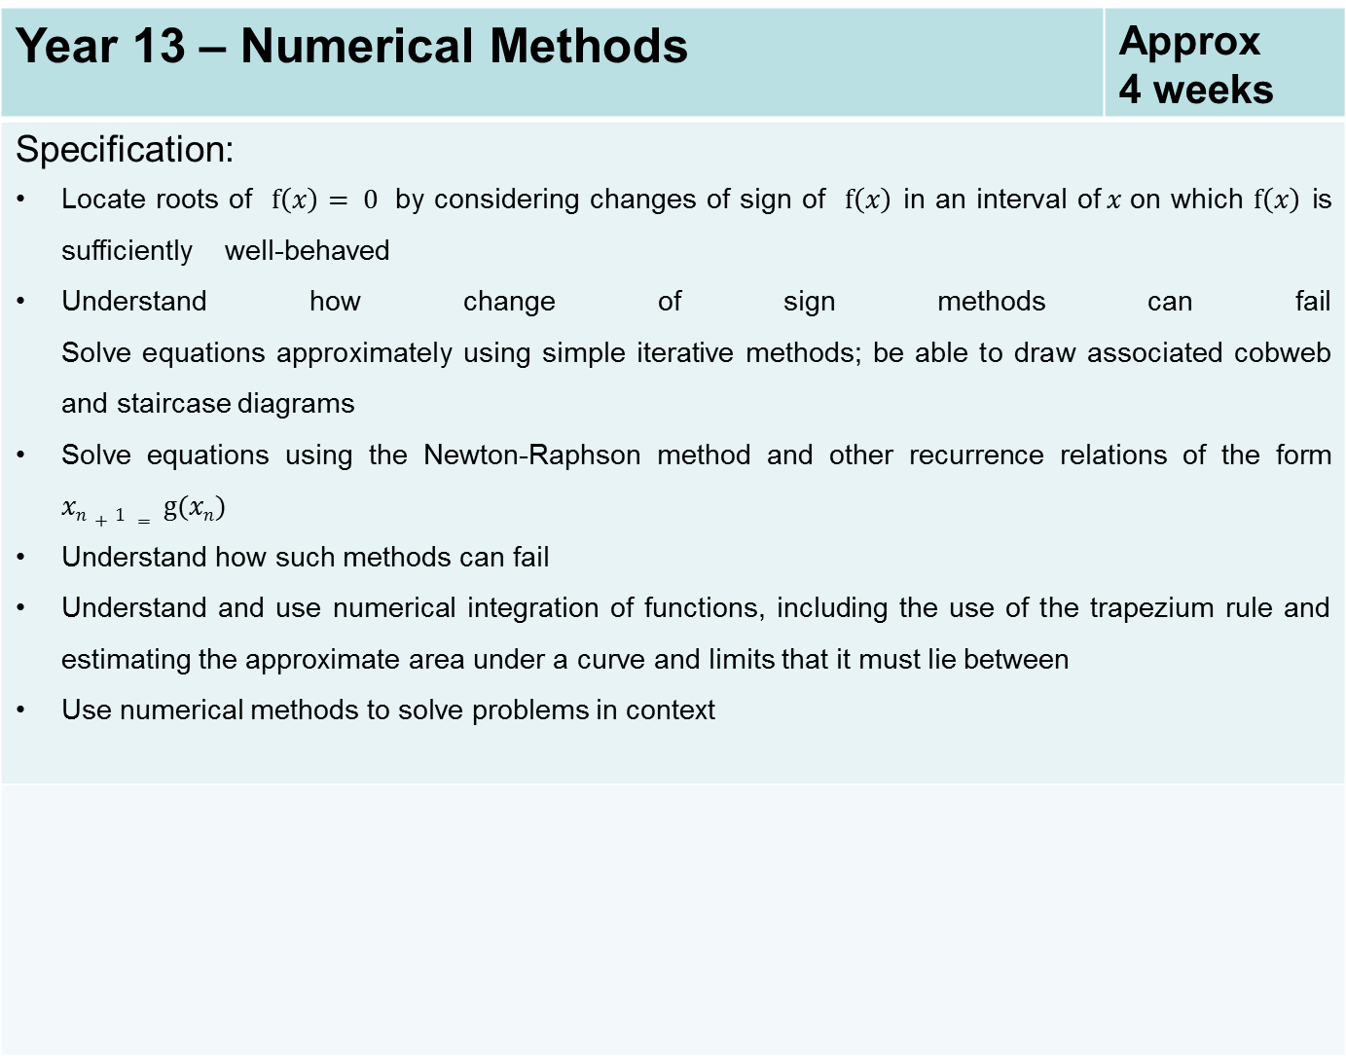
Year 13 – Numerical Methods | Approx 4 weeks
Specification: Locate roots of $f\left(x\right)= 0$ by considering changes of sign of $f\left(x\right)$ in an interval of$x$on which $f\left(x\right)$ is sufficiently well-behaved Understand how change of sign methods can fail Solve equations approximately using simple iterative methods; be able to draw associated cobweb and staircase diagrams Solve equations using the Newton-Raphson method and other recurrence relations of the form $xn+1 = g(xn)$ Understand how such methods can fail Understand and use numerical integration of functions, including the use of the trapezium rule and estimating the approximate area under a curve and limits that it must lie between Use numerical methods to solve problems in context

Slide 34
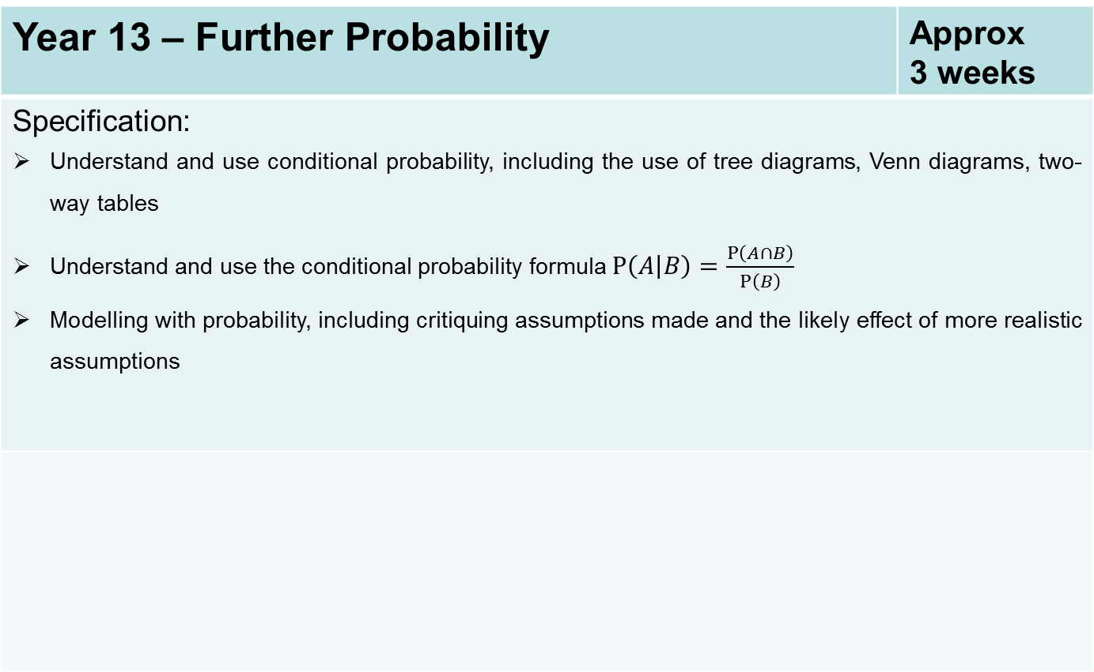
Year 13 – Further Probability | Approx 3 weeks
Specification: Understand and use conditional probability, including the use of tree diagrams, Venn diagrams, two-way tables Understand and use the conditional probability formula $P\left(A | B\right)=\frac{P\left(A∩B\right)}{P\left(B\right)}$ Modelling with probability, including critiquing assumptions made and the likely effect of more realistic assumptions

Slide 35
Year 13 – Statistical Distributions | Approx 3 weeks
Specification: Understand and use the Normal distribution as a model; find probabilities using the Normal distribution Link to histograms, mean, standard deviation, points of inflection and the binomial distribution Select an appropriate probability distribution for a context, with appropriate reasoning, including recognising when the binomial or Normal model may not be appropriate

Slide 36
Year 13 – Statistical Hypothesis Testing | Approx 3 weeks
Specification: Understand and apply correlation coefficients as measures of how close data points lie to a straight line and be able to interpret a given correlation coefficient using a given p-value or critical value (calculation of correlation coefficients is excluded) Conduct a statistical hypothesis test for the mean of a Normal distribution with known, given or assumed variance and interpret the results in context

Slide 37
Year 13 – Application of Vectors | Approx 3 weeks
Specification: Use vectors in three dimensions Use vectors to solve problems in kinematics Use trigonometric functions to solve problems in context, including problems involving vectors, kinematics and forces Understand, use and derive the formulae for constant acceleration for motion in 2 dimensions using vectors Use calculus in kinematics for motion in 2 dimensions using vectors

Slide 38
Year 13 – Projectiles | Approx 3 weeks
Specification: Model motion under gravity in a vertical plane using vectors; projectiles

Slide 39
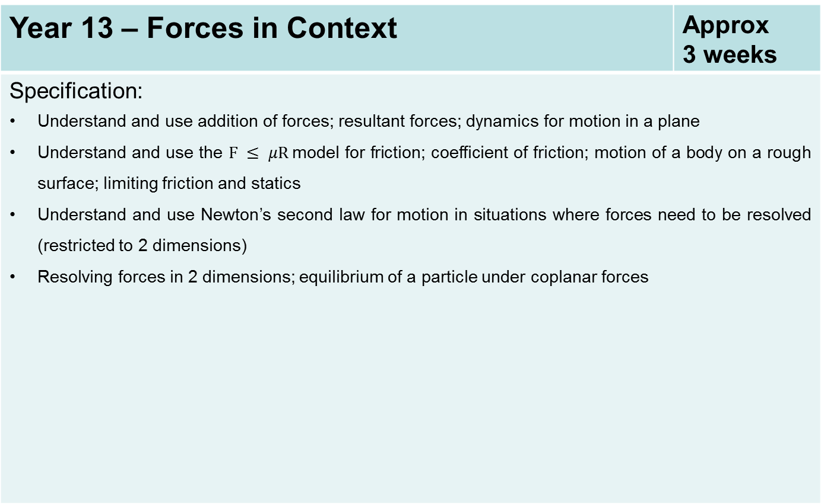
Year 13 – Forces in Context | Approx 3 weeks
Specification: Understand and use addition of forces; resultant forces; dynamics for motion in a plane Understand and use the $F ≤ μR$model for friction; coefficient of friction; motion of a body on a rough surface; limiting friction and statics Understand and use Newton’s second law for motion in situations where forces need to be resolved (restricted to 2 dimensions) Resolving forces in 2 dimensions; equilibrium of a particle under coplanar forces

Slide 40
Year 13 – Moments | Approx 3 weeks
Specification: Understand and use derived quantities and units: moment Understand and use moments in simple static contexts

