Slide 1



Simplifying Expressions:
Discuss:
Which of these expressions contain a pair of like terms? How do you know?
$$2β+2α$$
$${5y}^{2}+2y^{2}$$
$$5\sqrt{3}+3\sqrt{5}$$

Slide 2









In pairs:
Decide which expressions contain ONLY like terms
$$3p+3p$$
Like / Unlike
$$3p−3p$$
Like / Unlike
$$3p−2p$$
Like / Unlike
$$3p−2y$$
Like / Unlike
$$5y−2y$$
Like / Unlike
$${5y}^{2}−2y$$
Like / Unlike
$${5y}^{2}−2y^{2}$$
Like / Unlike
$${5y}^{2}+2y^{2}$$
Like / Unlike
$${−5y}^{2}+2y^{2}$$
Like / Unlike
Notes:
Print out sides 2, 3, 4

Slide 3

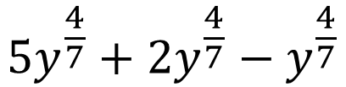






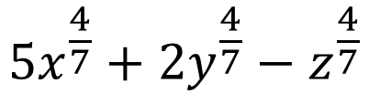
$${5y}^{−2}+2y^{2}$$
Like / Unlike
$${5y}^{−2}+2y^{−2}$$
Like / Unlike
$${5y}^{−2}+2z^{−2}$$
Like / Unlike
$${5y}^{−2}+2y^{−3}$$
Like / Unlike
$${5y}^{−2}+2y^{−3}−y$$
Like / Unlike
$${5y}^{−4}+2y^{−4}−y^{−4}$$
Like / Unlike
$${5y}^{−4.7}+2y^{−4.7}−y^{−4.7}$$
Like / Unlike
$${5y}^{\frac{4}{7}}+2y^{\frac{4}{7}}−y^{\frac{4}{7}}$$
Like / Unlike
$${5x}^{\frac{4}{7}}+2y^{\frac{4}{7}}−z^{\frac{4}{7}}$$
Like / Unlike

Slide 4




$$5\sqrt{x}+2\sqrt{y}−\sqrt{z}$$
Like / Unlike
$$5\sqrt{x}+2\sqrt{x}−\sqrt{x}$$
Like / Unlike
$$5x+2\sqrt{x}−\sqrt{x}$$
Like / Unlike
$$5x+2\sqrt{x}−x^{2}$$
Like / Unlike

Slide 5
$$3p+3p$$
Like / Unlike
$$3p−3p$$
Like / Unlike
$$3p−2p$$
Like / Unlike
$$3p−2y$$
Like / Unlike
$$5y−2y$$
Like / Unlike
$${5y}^{2}−2y$$
Like / Unlike
$${5y}^{2}−2y^{2}$$
Like / Unlike
$${5y}^{2}+2y^{2}$$
Like / Unlike
$${−5y}^{2}+2y^{2}$$
Like / Unlike

Slide 6
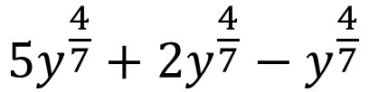





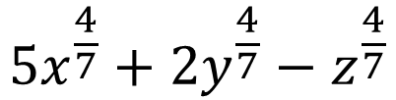
$${5y}^{−2}+2y^{2}$$
Like / Unlike
$${5y}^{−2}+2y^{−2}$$
Like / Unlike
$${5y}^{−2}+2z^{−2}$$
Like / Unlike
$${5y}^{−2}+2y^{−3}$$
Like / Unlike
$${5y}^{−2}+2y^{−3}−y$$
Like / Unlike
$${5y}^{−4}+2y^{−4}−y^{−4}$$
Like / Unlike
$${5y}^{−4.7}+2y^{−4.7}−y^{−4.7}$$
Like / Unlike
$${5y}^{\frac{4}{7}}+2y^{\frac{4}{7}}−y^{\frac{4}{7}}$$
Like / Unlike
$${5x}^{\frac{4}{7}}+2y^{\frac{4}{7}}−z^{\frac{4}{7}}$$
Like / Unlike

Slide 7
$$5\sqrt{x}+2\sqrt{y}−\sqrt{z}$$
Like / Unlike
$$5\sqrt{x}+2\sqrt{x}−\sqrt{x}$$
Like / Unlike
$$5x+2\sqrt{x}−\sqrt{x}$$
Like / Unlike
$$5x+2\sqrt{x}−x^{2}$$
Like / Unlike

Slide 8






Your Turn: In your books copy and complete the following:
$$6a+6b$$
Like / Unlike
$$13a−27a$$
Like / Unlike
$$13a^{2}−27a$$
Like / Unlike
$$13a^{2}−27a^{−2}$$
Like / Unlike
$$13\sqrt{a}−27\sqrt{a}$$
Like / Unlike

Slide 9
Mark your work
$$6a+6b$$
Like / Unlike
$$13a−27a$$
Like / Unlike
$$13a^{2}−27a$$
Like / Unlike
$$13a^{2}−27a^{−2}$$
Like / Unlike
$$13\sqrt{a}−27\sqrt{a}$$
Like / Unlike

Slide 10
Collecting ‘like’ terms
"Like terms" are terms whose variables
(and their powers such as the 2 in x²) are the same.
The coefficients may be different.
Algebraic expressions can be simplified by collecting like terms

Slide 11
Simplify
a + a + a + a + a =
5a
a
a
a
a
a
5a
Notes:
Example

Slide 12
And another…
3c + 2c + c =
6c
3c
2c
c
6c

Slide 13
And another…
4d + d + d – d =
5d
4d
d
d
-d
5c

Slide 14
And another…
e² + 2e² =
3e²
2e²
e²
3e²

Slide 15
And another…
2a + 3b + 4a + b =
6a + 4b
2a
3b
4a
b
2a
4a
3b
b
3b
b
2a
4a
6a + 4b

Slide 16
And another…
-2a - 3b + 4a + b =
2a – 2b
4a
b
-2a
-3b

Slide 17
On your whiteboards…
Simplify the following expressions by collecting like terms.

Slide 18
4d + d + 3d
8d

Slide 19
5d -2d + 3d
6d

Slide 20
5p + 4q – 2p + q
3p + 5q

Slide 21
5s - t +s + t
6s

Slide 22
2p² +3p² – 4p²
p²

Slide 23
3pq - 4 + 5pq
8pq - 4

Slide 24

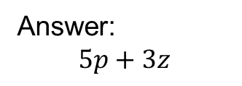
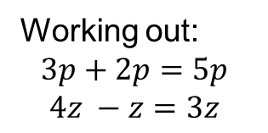


Worked Example
TITLE: Collecting Like Terms
Your Turn
$Simplify$ $3p+4z+2p −z$
3p
$$4z$$
2p
$$−z$$
Working out:
$$3p+2p=5p$$
$$4z −z=3z$$
Answer:
$$5p+3z$$
Notes:
Explicit Instruction
Try modelling the worked example in silence, without talking it through. This reduces “cognitive overload”.
Then ask students to describe each step or explain each step yourself after your silent demonstration
Students can use whiteboards to attempt “their turn” first, ask students to model their working out as you have.
Students to then record at least one of the examples in their Maths books.

Slide 25
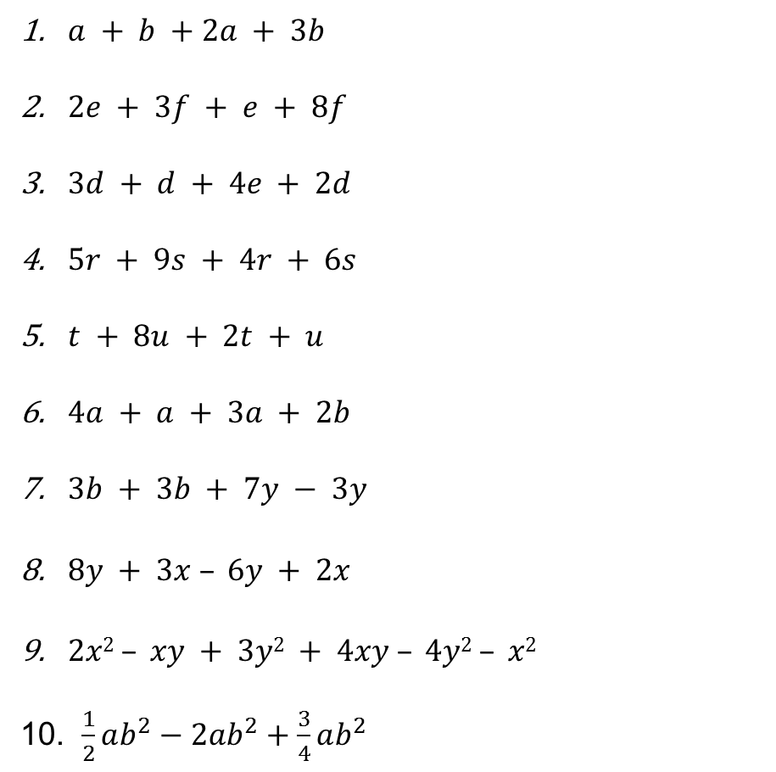
In your books, fully simplify each expression
$a + b +2a + 3b$
$2e + 3f + e + 8f$
$3d + d + 4e + 2d$
$5r + 9s + 4r + 6s$
$t + 8u + 2t + u$
$4a + a + 3a + 2b$
$3b + 3b + 7y − 3y$
$8y + 3x – 6y + 2x$
$2x2 – xy + 3y2 + 4xy – 4y2 – x2$
10. $\frac{1}{2}ab^{2}−2ab^{2}+\frac{3}{4}ab^{2}$

Slide 26
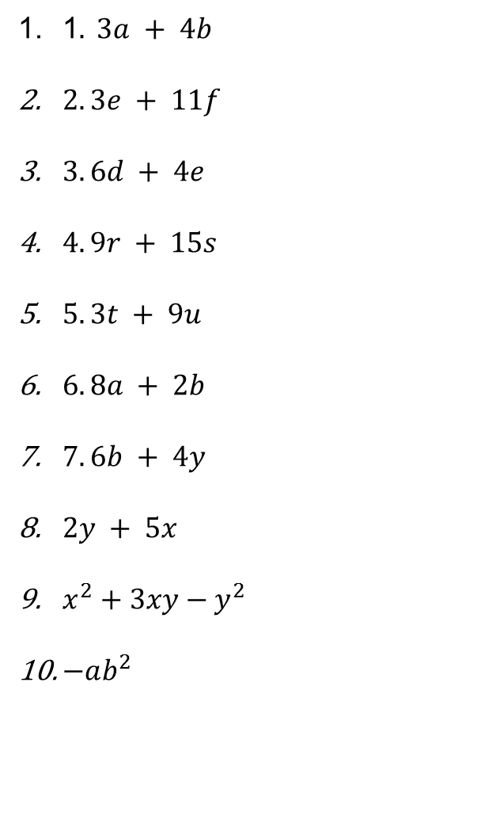
Mark your work
1$. 3a + 4b$
$2. 3e + 11f$
$3. 6d + 4e$
$4. 9r + 15s$
$5. 3t + 9u$
$6. 8a + 2b$
$7. 6b + 4y$
$2y + 5x$
$x^{2}+3xy−y^{2}$
$−ab^{2}$

Slide 27
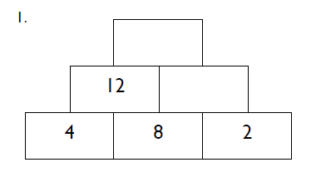
Algebra Pyramids
Notes:
Print out sheets for students
Acknowledgements: Craig Barton www.variationtheory.com, East Midlands East Maths hub and NES Maths Department

