Slide 1
Short term Retrieval
Recap – On your whiteboards, work out:
15 + -22
-13 + -8
20 + -1.5
2.7 + -3.5

Slide 2
Mark it
15 + -22 = -7
-13 + -8= -21
20 + -1.5 = 18.5
2.7 + -3.5 = -8

Slide 3
On your whiteboards, calculate:
Build
12 + -38 + -12
15 + -4 + -3 + 5
8 + 5 + -5 + -16 + -4
2.5 + -0.2 + -4.8 + 3.5
Notes:
Ensure “smart” methods are shared with everyone in the class.

Slide 4
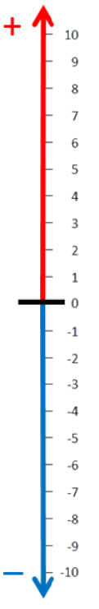
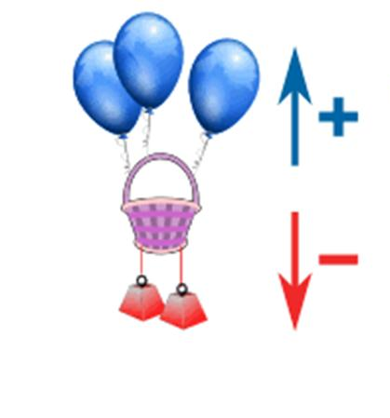
Build
On your whiteboard…
On a vertical number line:
My basket has 3 positives (balloons) and 2 negatives (weights)
What number would my basket be on?
3

Slide 5
Build
On your whiteboard..
My basket starts at number 3.
I subtract 3 balloons.
What happens to my basket?
Write a number sentence to describe this.

Slide 6
Build
On your whiteboard…
My basket starts at number 4.
I subtract 2 weights
What happens to my basket?
Write a number sentence to describe this.

Slide 7
Build
On your whiteboard..
My basket starts at number -5.
I subtract 4 balloons
What happens to my basket?
Write a number sentence to describe this.

Slide 8
Build
On your whiteboards..
My basket starts at number -7.
I subtract 3 weights
What happens to my basket?
Write a number sentence to describe this.

Slide 9
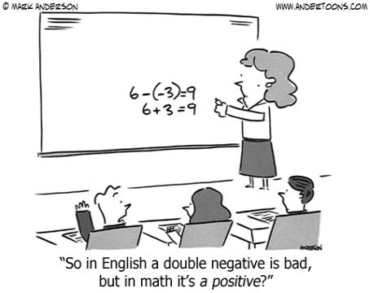
Build
Subtracting Negative Numbers

Slide 10
Develop Understanding
On your whiteboard, work out
0 - -3
8 － -8
-3 - -5
-6 - -6

Slide 11
Mark it
0 - -3 = 3
8 － -8 = 16
-3 - -5 = 2
-6 - -6 = 0

Slide 12
On your whiteboard, fill in the blanks:
Develop Understanding
13 – 5 = 13 + -5
35 – -7 = 35 +
12 4 = 12 + -4
C – D = C + - D

Slide 13
Fill in the blanks
Mark it
13 – 5 = 13 + -5
35 – -7 = 35 + 7
12 - 4 = 12 + -4
C – D = C + -D

Slide 14
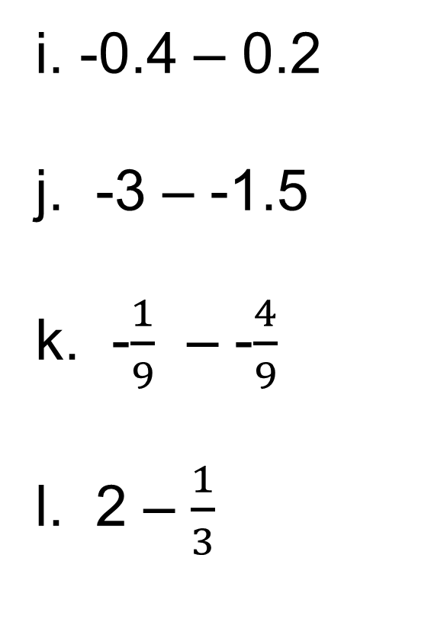
Develop Understanding
In your book, work out:
-6 – -2
-3 – +5
-5 – -5
0 – -8
-14 – -9
33 – 5
-105 – -31
42 – -8
i. -0.4 – 0.2
j. -3 – -1.5
k. -$\frac{1}{9}$ – -$\frac{4}{9}$
l. 2 – $\frac{1}{3}$

Slide 15
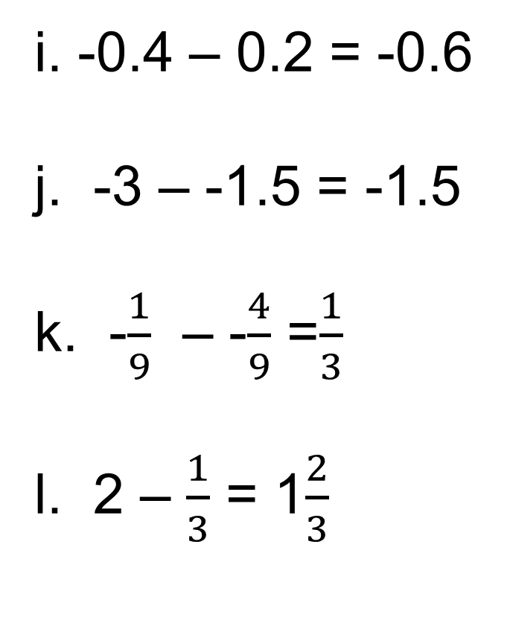
Mark it
-6 – -2 = -4
-3 – 5 = -8
-5 – -5 = 0
0 – -8 = 8
-14 – -9 = -5
33 – 5 = 28
-105 – -31 = -74
42 – -8 = 50
i. -0.4 – 0.2 = -0.6
j. -3 – -1.5 = -1.5
k. -$\frac{1}{9}$ – -$\frac{4}{9}$ =$\frac{1}{3}$
l. 2 – $\frac{1}{3}$ = 1$\frac{2}{3}$

Slide 16
Challenge
Develop Understanding
-17 – -25 + 5 + -14
= -17 + 25 + 5 + -14
= 25 + 5 – 17 – 14
= 30 – 31
= -1

Slide 17
In your books, work out:
Transfer
9 + -3 – -5
12 – 18 – -21 – 11
-11 – -28 - 19 + -3
-1 – -1 + -2 – -2 + … + -100 – -100

Slide 18
Mark it
9 + -3 – -5 = 11
12 – 18 – -21 – 11= 4
-11 – -28 - 19 + -3 = 1
-1 – -1 + -2 – -2 + … + -100 – -100 = 0
Notes:
Acknowledgements:
East Midlands East Maths Hub
NES Maths Team

