Slide 1

Identifying the Hypotenuse, Opposite and Adjacent sides
The hypotenuse is the longest side, always opposite the right-angle
hypotenuse
The opposite is always across from the angle θ
opposite
adjacent
The adjacent is the remaining side, next to the angle θ
adjacent
hypotenuse
opposite
Notes:
Need mini whiteboards, individual prints of slide 19 and card sort for pairs of students (slide 25)

Slide 2
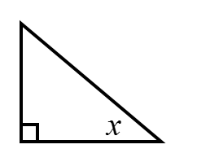



Which side is the OPPOSITE side?
$$α$$
$$β$$
$$γ$$

Slide 3
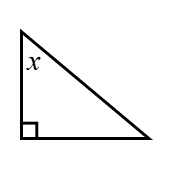



Which side is the OPPOSITE side?
$$α$$
$$β$$
$$γ$$

Slide 4
Which side is the HYPOTENUSE?
$$α$$
$$β$$
$$γ$$

Slide 5
Which side is the HYPOTENUSE?
$$α$$
$$β$$
$$γ$$

Slide 6
Which side is the ADJACENT side?
$$α$$
$$β$$
$$γ$$

Slide 7
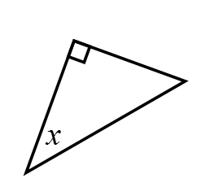



Which side is the ADJACENT side?
$$α$$
$$β$$
$$γ$$

Slide 8



Which side is the ADJACENT side?
$$β$$
$$α$$
$$γ$$
Notes:
What it is not example.

Slide 9




Title: Identifying Hypotenuse, Opposite and Adjacent sides
H = hypotenuse
O = opposite
A = adjacent
In your book copy the triangles and label the sides as H, O and A
1. | 2. | 3.
4. | 5. | 6.

Slide 10
Mark your work…
1. | 2. | 3.
4. | 5. | 6.

Slide 11
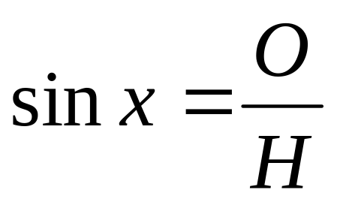
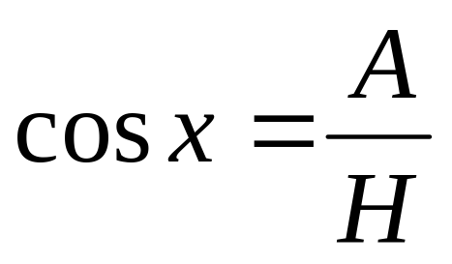
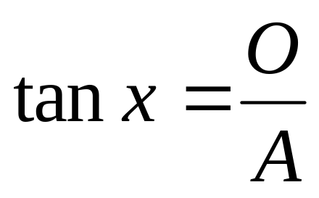
H = hypotenuse
O = opposite
A = adjacent
We have learnt that:
The ratio of the opposite to the hypotenuse is called Sine
The ratio of the adjacent to the hypotenuse is called Cosine
The ratio of the opposite to the adjacent is called Tangent
These are abbreviated as sin, cos and tan

Slide 12
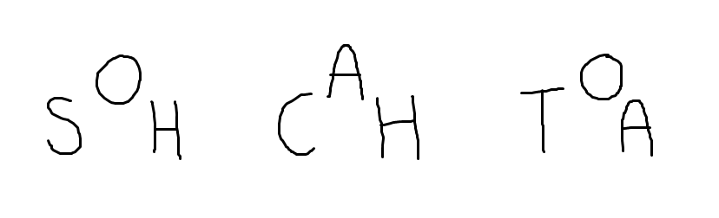
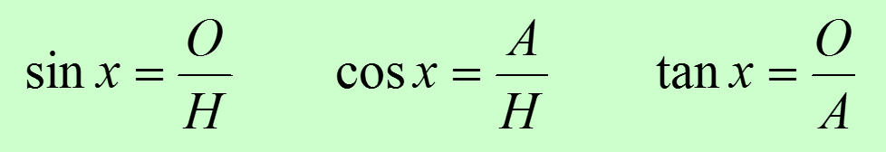
The branch of mathematics dealing with the relations of the sides and angles of triangles is called TRIGONOMETERY
To help remember the three ratio functions some people use this abbreviation:

Slide 13
Write down the value of sinx
5
3
x
4

Slide 14
Write down the value of cos x
5
3
x
4

Slide 15
Write down the value of tan x
5
3
x
4

Slide 16
Write down the value of cos x
x
13
5
12

Slide 17
Write down the value of tanx
x
13
5
12

Slide 18
Write down the value of sin x
x
13
5
12

Slide 19
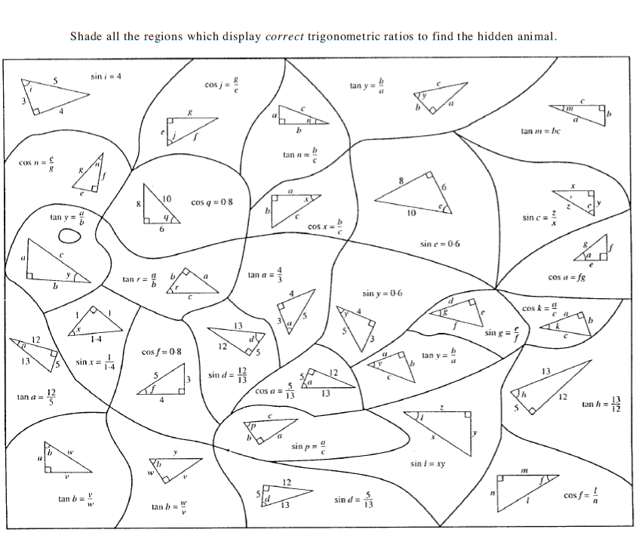

Slide 20
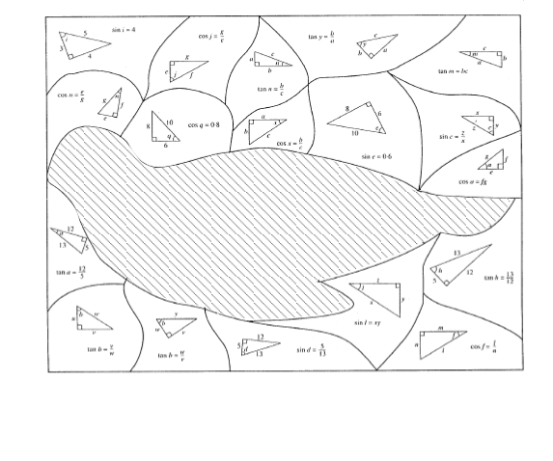
Solution… bird/seal

Slide 21
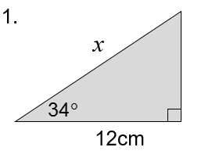
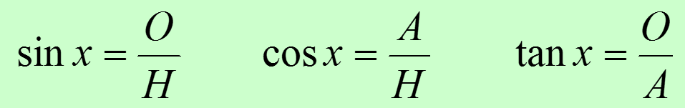
Which ratio would we use to find the missing length?
Notes:
Whiteboards again…

Slide 22
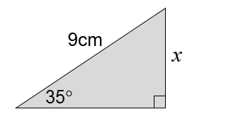
Which ratio would we use to find the missing length?
Notes:
Whiteboards again…

Slide 23
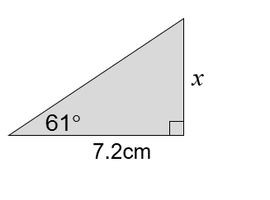
Which ratio would we use to find the missing length?
Notes:
Whiteboards again…

Slide 24
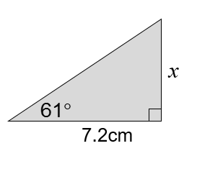
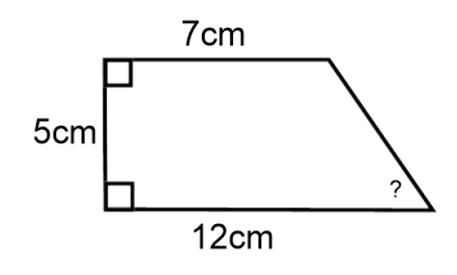
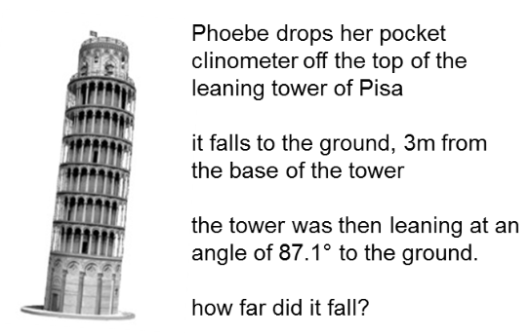
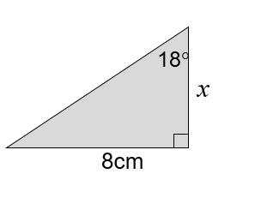
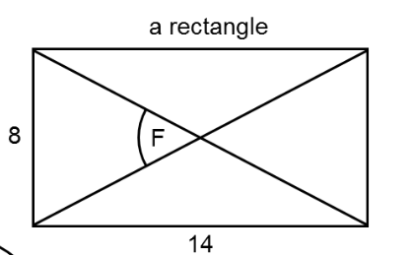
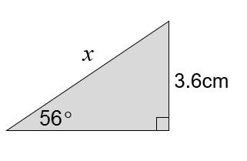
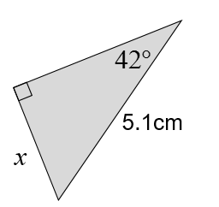
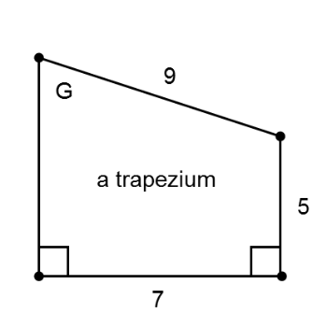
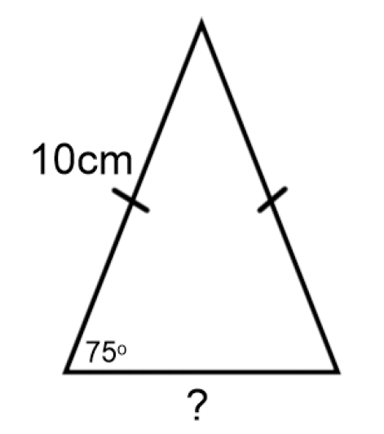
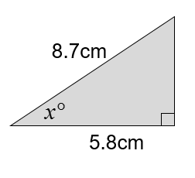
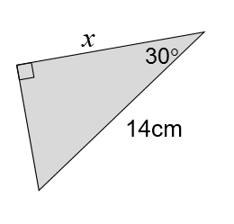
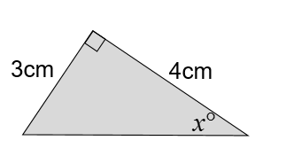
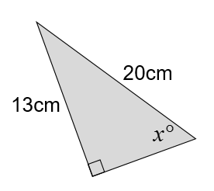
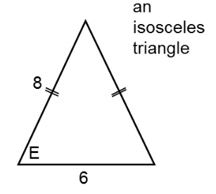
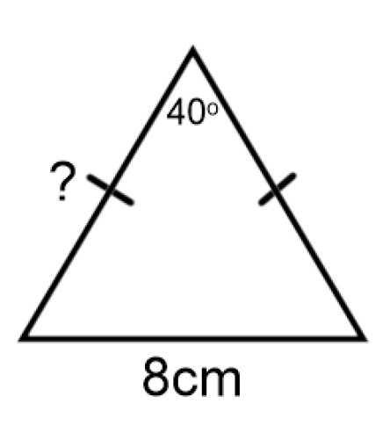
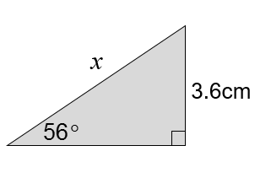
1.
2.
3.
4.
5.
6.
7.
8.
9.
10.
11.
12.
13.
14.
15.
16.
Which ratio would help find the missing length or angle?
Sine, Cosine or Tangent?
Sort the cards into three groups.
Notes:
Card Sort. Sort the following problems into three groups. Sin/Cos or Tan?

Slide 25
1.
2.
3.
TAN
4.
TAN
TAN
TAN
5.
6.
7.
8.
TAN
SIN
SIN
ALL
9.
10.
11.
12.
TAN
COS
COS
COS
13.
14.
15.
16.
sin
COS
SIN
SIN
These aren’t the only answers..
Did you choose a different ratio? Why?
Notes:
Acknowledgements: Don Steward, Dan Walker and CMIT

