Slide 1









$$1$$
$$2$$
$$2.5$$
$$45°$$
$$1$$
$$45°$$
$$2$$
$$45°$$
$$2.5$$
Discuss: What is the same? What is different?
Try to include these key words in your discussion:
Angle
Similar
Ratio
Hypotenuse
Adjacent
Opposite
Notes:
Need: Mini whiteboards. Print Slide 23 for those students need more practise finding a missing side.

Slide 2

Geogebra Demo
The ratio of the opposite side to the adjacent side in any right-angled with an angle of 45 degrees is 1:1
$$45°$$
adjacent
opposite
Notes:
https://www.geogebra.org/m/QgTmeaA8#material/ET5MMAVn – select tan, alter angle to 45 degrees.

Slide 3
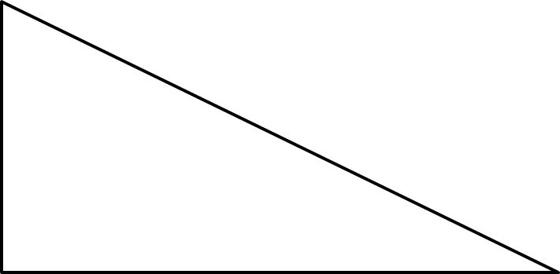
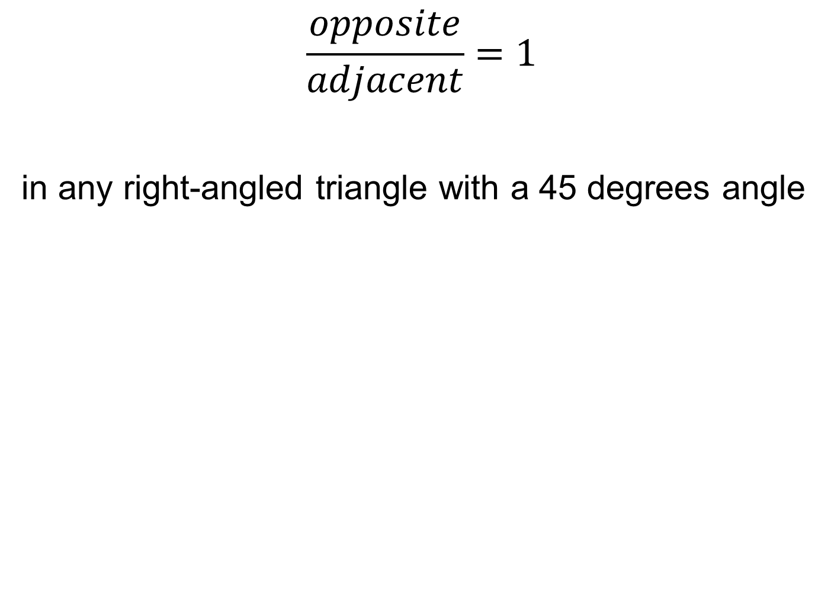


$$\frac{opposite}{adjacent}=1$$
in any right-angled triangle with a 45 degrees angle
adjacent
$$45°$$
adjacent
opposite
$$45°$$
opposite

Slide 4
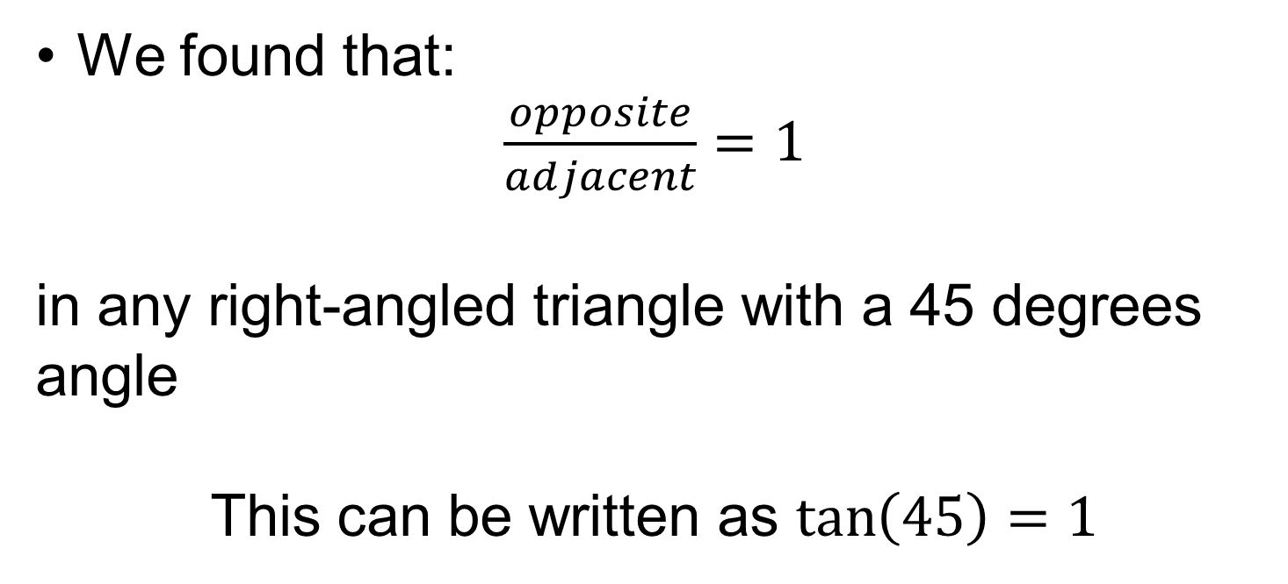
The ratio of the adjacent side to the opposite in any right-angled triangle is called the TANGENT ratio.
We found that:
$\frac{opposite}{adjacent}=1$
in any right-angled triangle with a 45 degrees angle
This can be written as $\tan\left(45\right)=1$

Slide 5
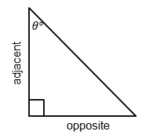
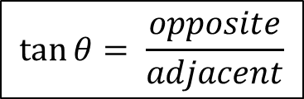
In your book…
Title: The TANGENT Ratio
The ratio of the adjacent side to the opposite side in any right-angled triangle is called the TANGENT ratio.
$$\tan{θ= \frac{opposite}{adjacent}}$$

Slide 6



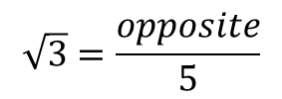







Worked Example
SUBTITLE: Using the Tangent ratio to find the opposite length
Your Turn
$$?$$
$$5 cm$$
$$?$$
$$60°$$
$$50°$$
$$14cm$$
$$\tan\left(60\right)=\sqrt{3}$$
$$\sqrt{3}=\frac{opposite}{5}$$
$$opposite=\sqrt{3}×5$$
$The opposite side is 16.7 cm$ (1dp)
$The opposite side is 8.7 cm$ (1dp)
Notes:
Explicit Instruction

Slide 7
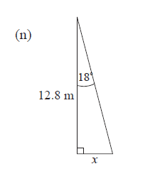
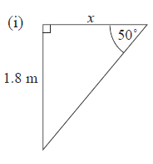
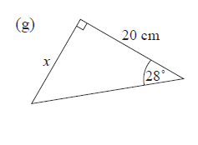
In your book…
Calculate the missing lengths to 1 decimal place.
c
b
a
Notes:
Questions a,b – finding the opposite
Question x – finding the adjacent. Some students may already know how to do this following the other lessons at this point.

Slide 8
Mark your work:
Calculate the missing lengths to 1 decimal place.
c
b
b = 10.6 cm
c = 1.5 m
a =4.2 m
Notes:
Questions a,b – finding the opposite
Question x – finding the adjacent. Some students may already know how to do this following the other lessons at this point.

Slide 9

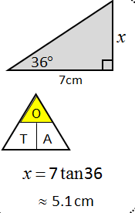
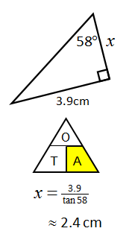
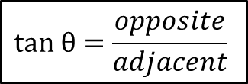
Some people find calculation triangles, like those used in Science, useful to know whether to multiply or divide
$$tan θ=\frac{opposite}{adjacent}$$
Finding the opposite
Finding the adjacent

Slide 10
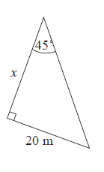
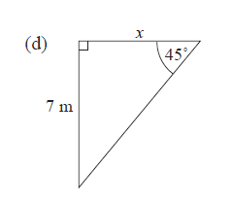
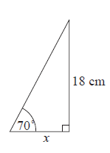
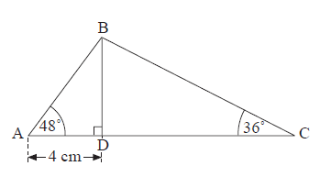








In your book…
Copy the questions and calculate the missing lengths to 1 decimal place.
$$a$$
d)
$$c$$
$$c$$
$$d) Find the length of AC$$
$$b$$
Notes:
a, b – Finding the adjacent
c – opposite and repeating tan (45) = 1
d – finding both!

Slide 11
Mark your work..
a) 7 m
b) 6.6 cm
c) 20 m
d) BD = 4.4 cm, DC = 6.1 cm, AC = 10.1 cm

Slide 12
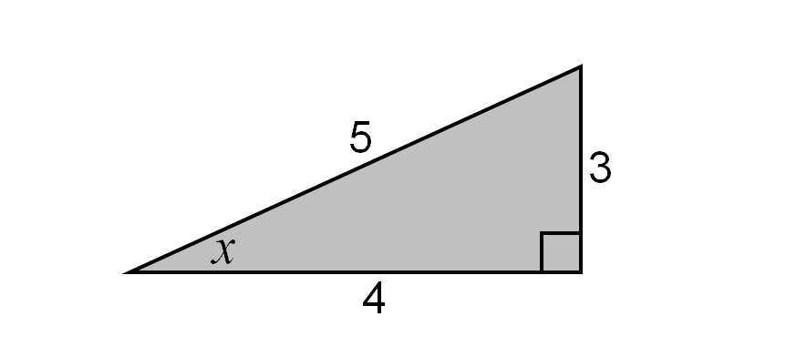
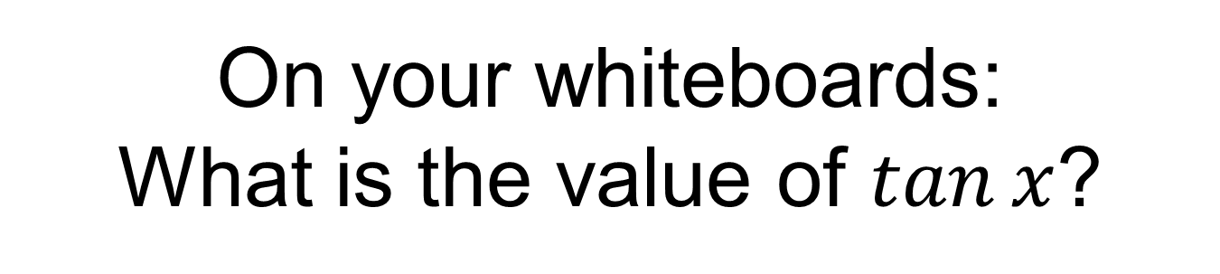
On your whiteboards:
What is the value of $tan⁡x$?

Slide 13
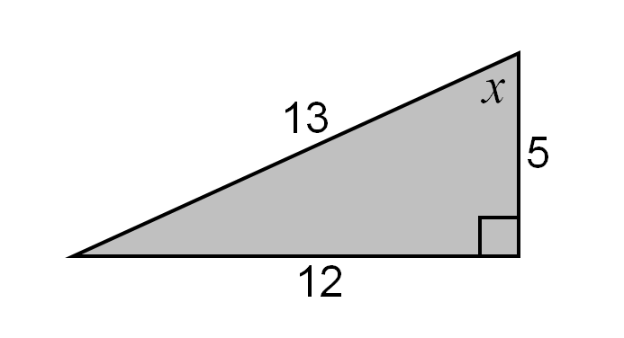
On your whiteboards:
What is the value of $tan⁡x$?

Slide 14
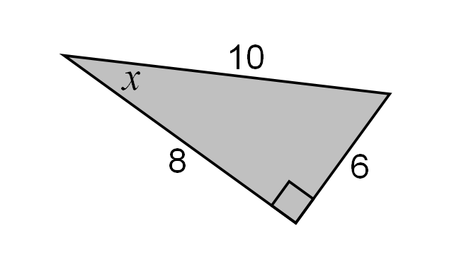
On your whiteboards:
What is the value of $tan⁡x$?

Slide 15

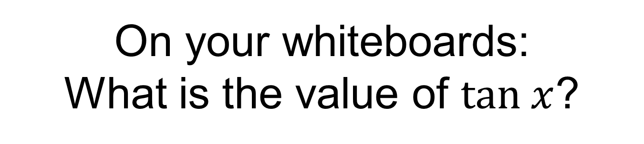

On your whiteboards:
What is the value of $tan x$?
5
5
$$x$$
$$5\sqrt{2}$$

Slide 16

On your whiteboards:
What is the value of $x$?
5
5
$$x$$
$$5\sqrt{2}$$

Slide 17
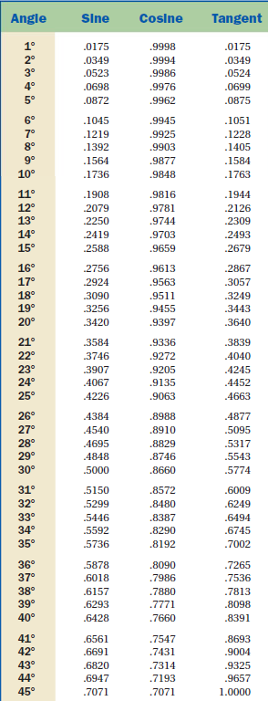
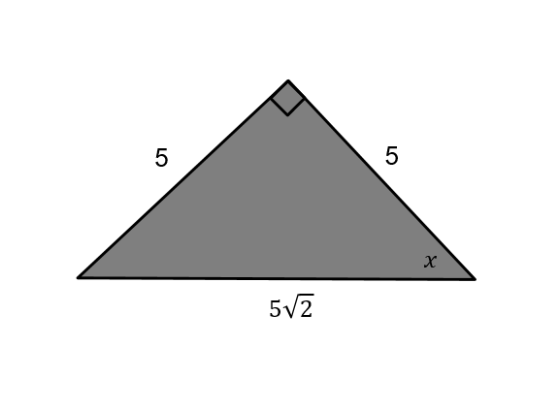

On your whiteboards:
What is the value of $x$?

Slide 18
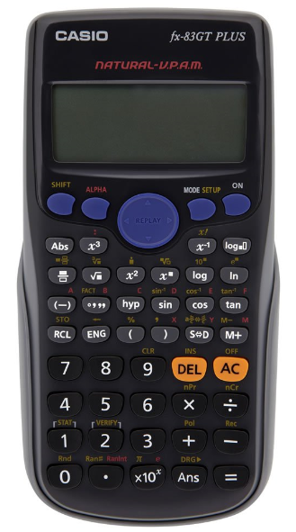



$$2\sqrt{3}$$
What is the value of $x$?
Press shift
Press tan
Enter $1$
Close the bracket
Press =
$$x=45°$$

Slide 19
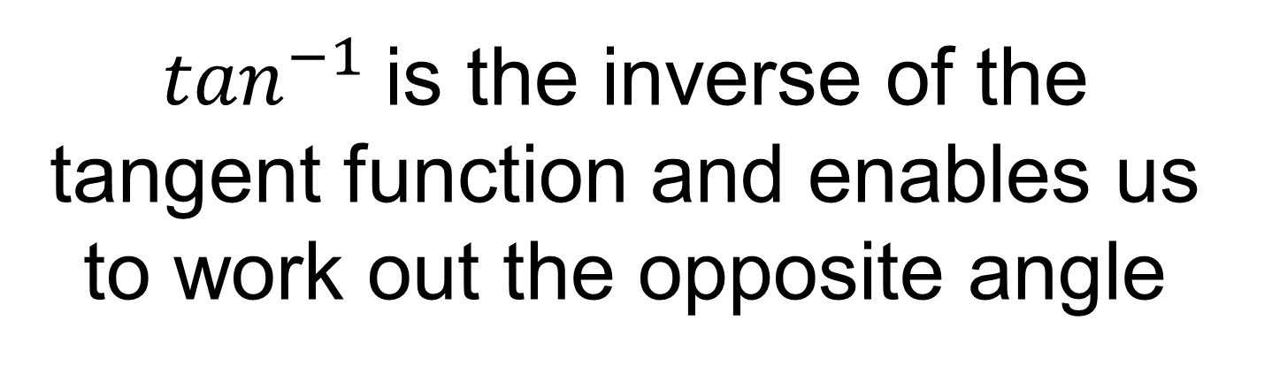
$\tan^{−1}$is the inverse of the tangent function and enables us to work out the opposite angle

Slide 20



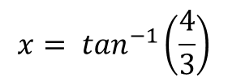

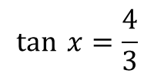





Worked Example
TITLE: Using inverse tangent to find the opposite angle
Your Turn
$$13 cm$$
$$x$$
$$4 cm$$
$$3 cm$$
$$x$$
$$5 cm$$
$$12 cm$$
$$5 cm$$
$$\tan{ x=\frac{4}{3}}$$
$$x= \tan^{−1}\left(\frac{4}{3}\right)$$
$$x=53.1 (1dp)$$
Notes:
Explicit Instruction
Your Turn x = 85.2

Slide 21
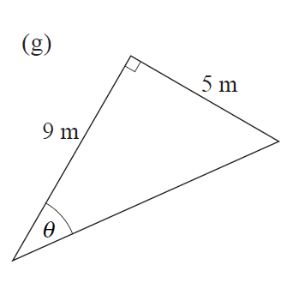
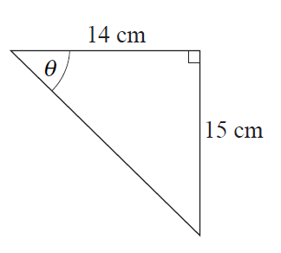
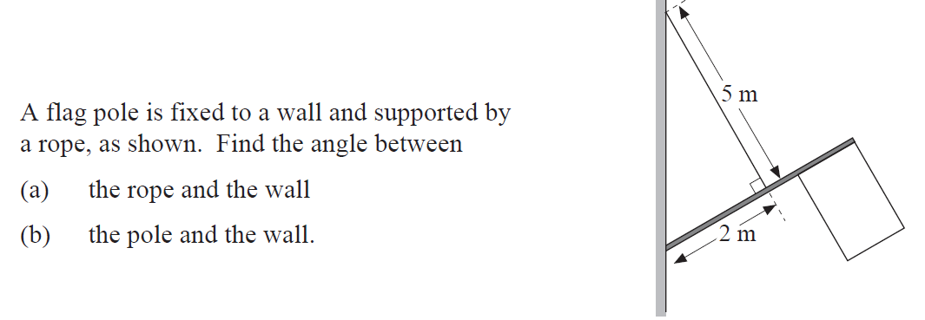




In your book…
Copy the questions and calculate the missing lengths to 2 decimal places.
$$c$$
$$b$$
$$a$$
$$c$$

Slide 22
Mark your work…
46.97
b) 29.05
c) Part a - 21.80
c) Part b - 68.20

Slide 23
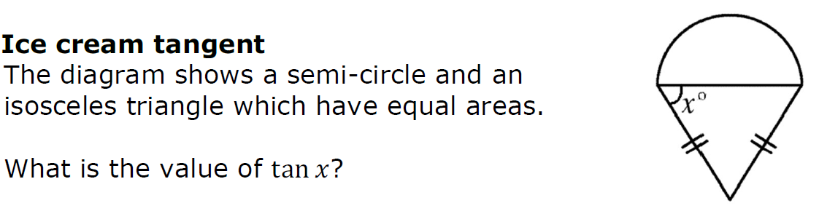
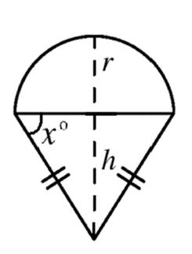
Challenge
Notes:
Show second diagrams with variables marked for hint…

Slide 24
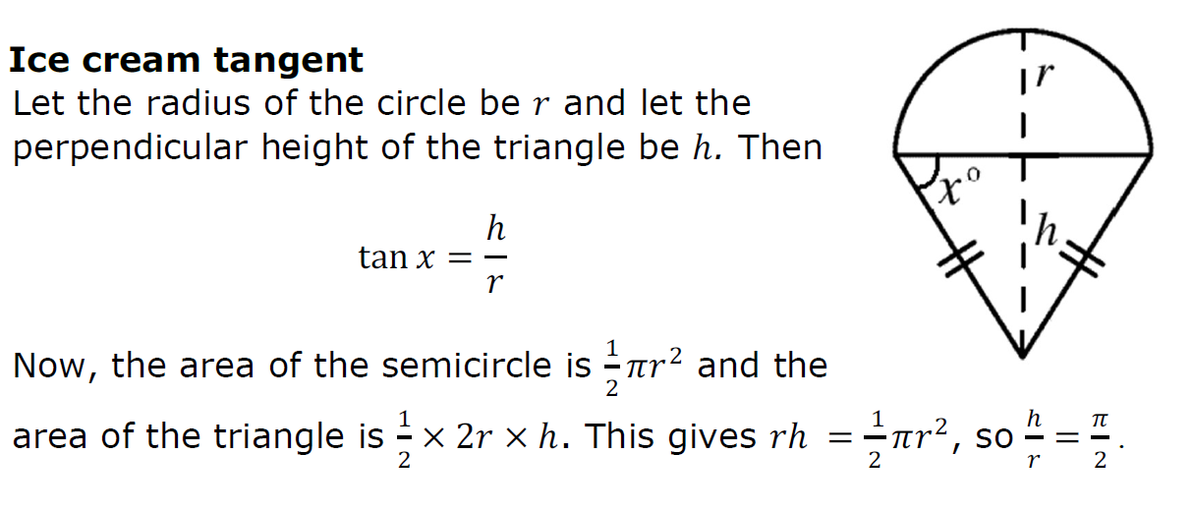
Challenge Solution

Slide 25
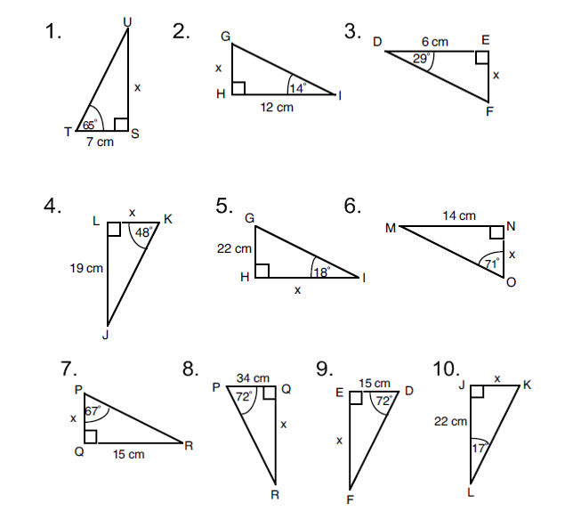
More consolidation…
Notes:
Acknowledgments: Dan Walker, CMIT and Nrich

Slide 26
More consolidation…
3.3cm
3cm
15cm
4.8cm
17cm
67.7cm
6.7cm
6.4cm
104.6cm
46.2cm
Notes:
Acknowledgments: Dan Walker, CMIT and Nrich

